Slide 1



Breathe freely
Airway Dilation Catheter

Slide 2
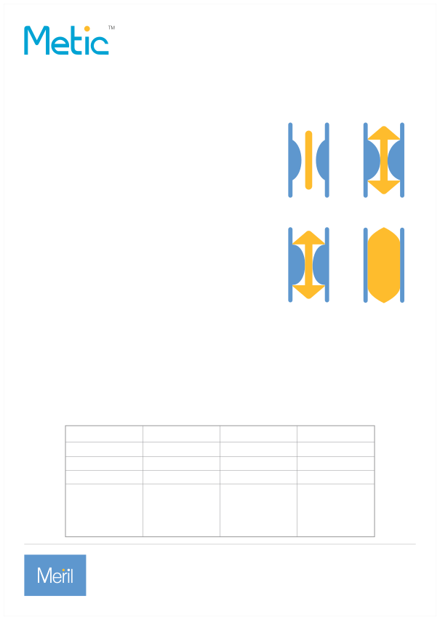
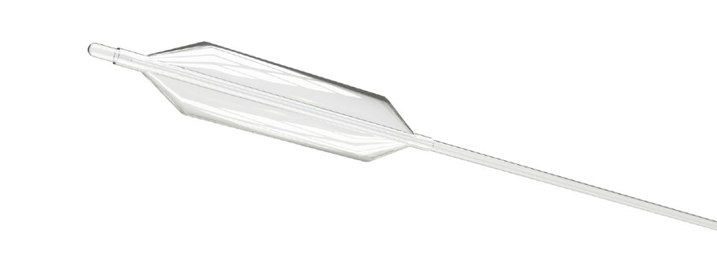
Airway Dilation Catheter
The Metic™ Balloon Dilation System is designed to safely dilate airway strictures with minimal mucosal trauma. Developed in partnership with ENT Surgeons, the Metic™ offers an safe, elegant, minimally invasive solution for airway management.
Patient safety is our commitment. The Metic™ delivers:
A product specically designed for the airway
Airway Balloon Dilation
• Custom balloon catheter and stylet optimized for airway anatomy
Atraumatic access
• Low-prole system crosses narrow stenoses
Atraumatic access
Safe, accure placement
• Soft seeker tip guides device through delicate anatomy
Precise placement under direct visualization
• Integrated stylet provides enhanced support and maneuverability
• Malleable shaft can be custom-shaped for easy access
Controlled radial dilation
• Durable high pressure balloon engineered for resistant lesions
• Non-compliant design maintains consistent diameter through multiple dilations
• Precise ination and pressure regulation
controlled
Consistent
radial dilation
dilation of strictures
Catalog Number
Balloon Diameter (mm)
Balloon Length (mm)
Units (per box)
BC0524A BC0724A BC0924A BC1040A BC1240A BC1440A BC1640A
5 7 9 10 12 14 16
24 24 24 40 40 40 40
5 5 5 5 5 5 5
Meril Life Sciences India Pvt. Ltd. 512/513, Midas Tower, Sahar Plaza, Andheri (E), Mumbai - 400 059, Maharashtra, India T +91 22 4047 9797 F +91 22 4047 9717 W: www.merillife.com

