Slide 1
CQRS / Event Sourcing
Coging workshop in Java

Slide 2
CQRS/ES : A naive implementation
Eventstore
Repository
Event
Event
Aggregate
Command Handler
Command

Slide 3
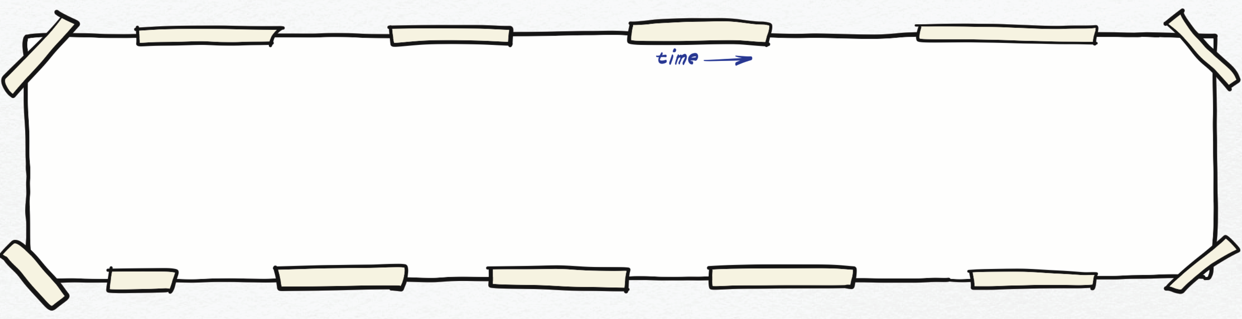
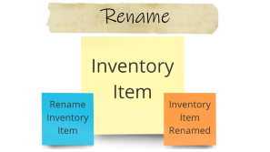
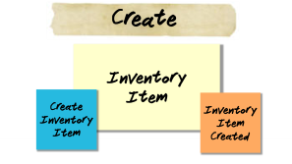


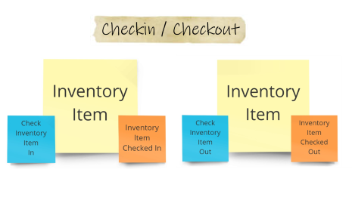
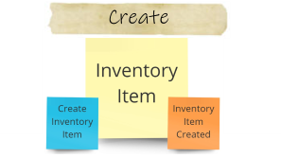
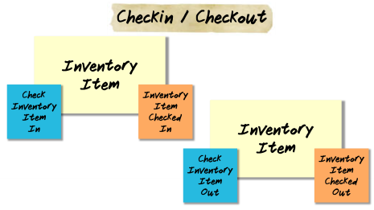
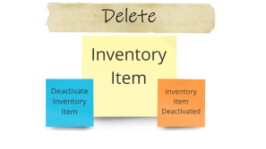
Let’s explore the domain with Event Storming

Slide 4

Create
Inventory
Item
Create
Inventory
Item
Inventory
Item Created

Slide 5
Rename
Inventory
Item
Rename
Inventory
Item
Inventory
Item Renamed

Slide 6
Checkin / Checkout
Inventory
Item
Check
Inventory
Item
In
Inventory
Item Checked In
Inventory
Item
Check
Inventory
Item
Out
Inventory
Item Checked Out

Slide 7
Deactivate
Inventory
Item
Deactivate
Inventory
Item
Inventory
Item Deactivated

Slide 8
Step 02

Slide 9
Step 03

Slide 11
Step 04

Slide 12
Step 05

Slide 13
CQRS/ES : Read side
Eventstore
Repository
Event Handler
Event
Event
Aggregate
Read Model
Command Handler
Query
Command
DTO

Slide 14
Step 06

Slide 15
CQRS/ES : Less naive
Eventstore
Event Handler
Event Handler
Read model
Pub/Sub topic
Repository
Event
Event
Aggregate
Command Handler
Query
Command
DTO

Slide 17

This Photo by Unknown Author is licensed under CC BY-SA

