Slide 1
CQRS / Event Sourcing
Coging workshop in Java

Slide 2
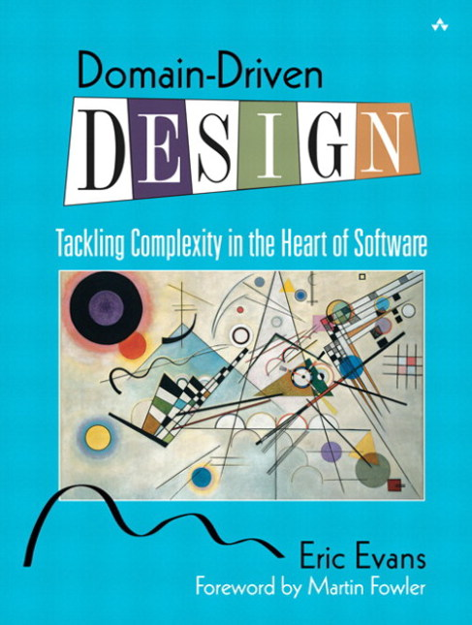
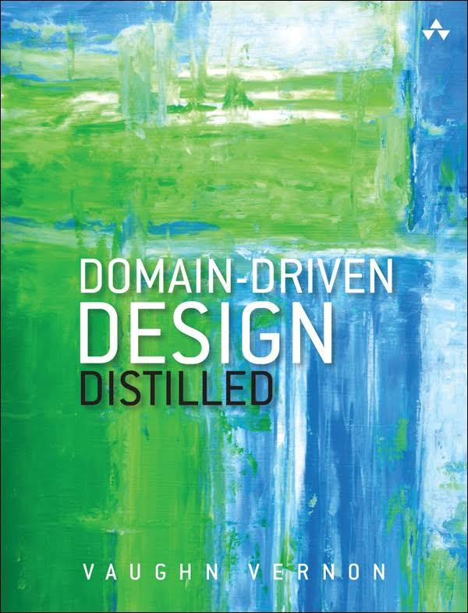
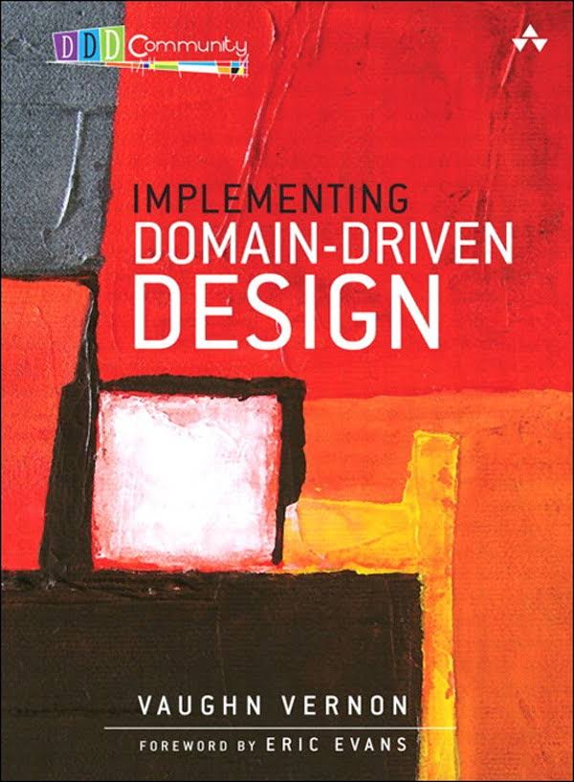
Domain-Driven Design

Slide 3
CQRS/ES : A naive implementation
Eventstore
Repository
Event
Event
Aggregate
Command Handler
Command

Slide 4
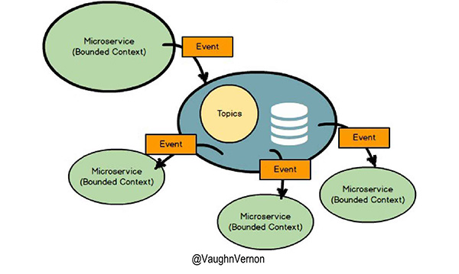
Reactive system

Slide 5
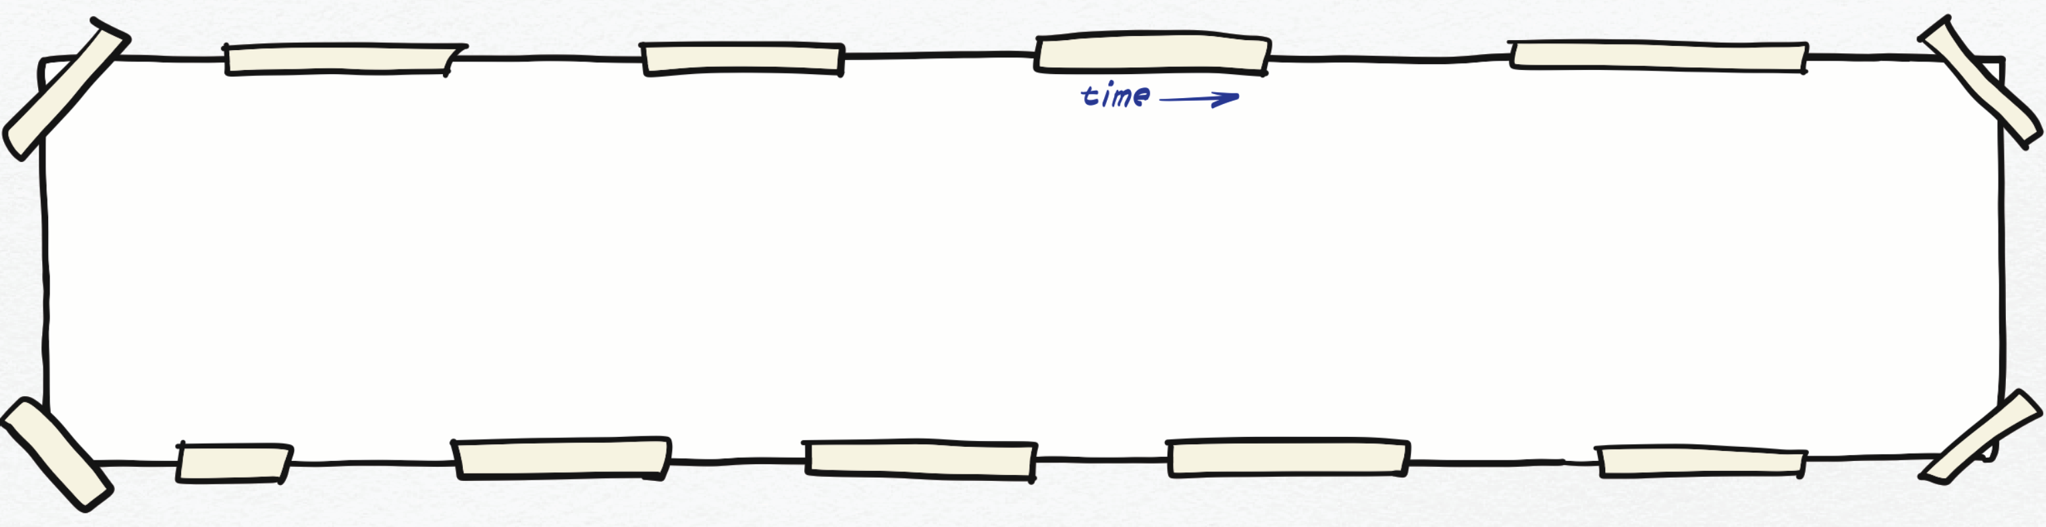
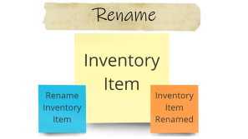
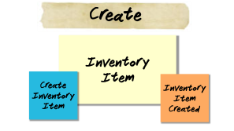

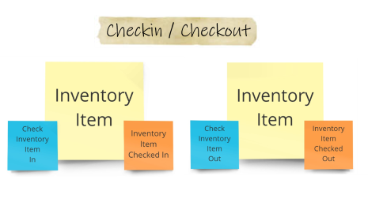

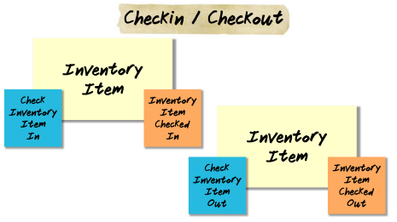
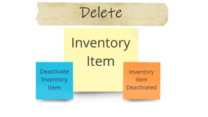
Let’s explore the domain with Event Storming

Slide 6

Create
Inventory
Item
Create
Inventory
Item
Inventory
Item Created

Slide 7
Rename
Inventory
Item
Rename
Inventory
Item
Inventory
Item Renamed

Slide 8
Checkin / Checkout
Inventory
Item
Check
Inventory
Item
In
Inventory
Item Checked In
Inventory
Item
Check
Inventory
Item
Out
Inventory
Item Checked Out

Slide 9
Deactivate
Inventory
Item
Deactivate
Inventory
Item
Inventory
Item Deactivated

Slide 10
Disclaimer
This implementation is not production ready
It’s a learning exercice
Object Oriented (no functional approach)
No framework and minimal dependencies
No black magic (vanilla Java)
The goal is to understand how a CQRS/ES system can be developed

Slide 11
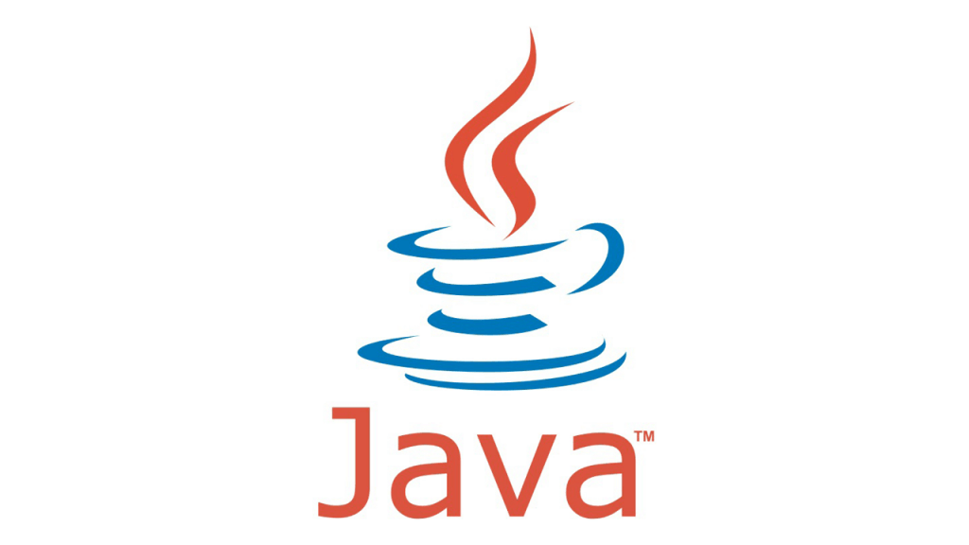


Step 01
https://github.com/agilepartner/cqrs-es-workshop-java
https://start.spring.io/
This Photo by Unknown Author is licensed under CC BY-NC-ND

Slide 12
Step 02

Slide 13
Step 03

Slide 15
Step 04

Slide 16
Step 05

Slide 17
CQRS/ES : Read side
Eventstore
Repository
Event Handler
Event
Event
Aggregate
Read Model
Command Handler
Query
Command
DTO

Slide 18
Step 06

Slide 19
CQRS/ES : Less naive
Eventstore
Event Handler
Event Handler
Read model
Pub/Sub topic
Repository
Event
Event
Aggregate
Command Handler
Query
Command
DTO

Slide 20
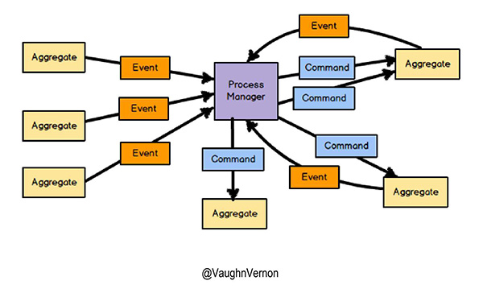
Process

Slide 22

This Photo by Unknown Author is licensed under CC BY-SA

