Slide 1

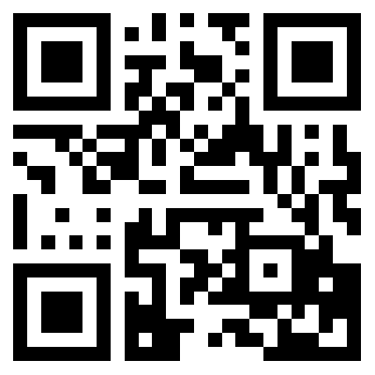
TREM READING
READ DIFFERENTLY &
CULTIVATE YOUR COLLECTIVE INTELLIGENCE

Slide 2

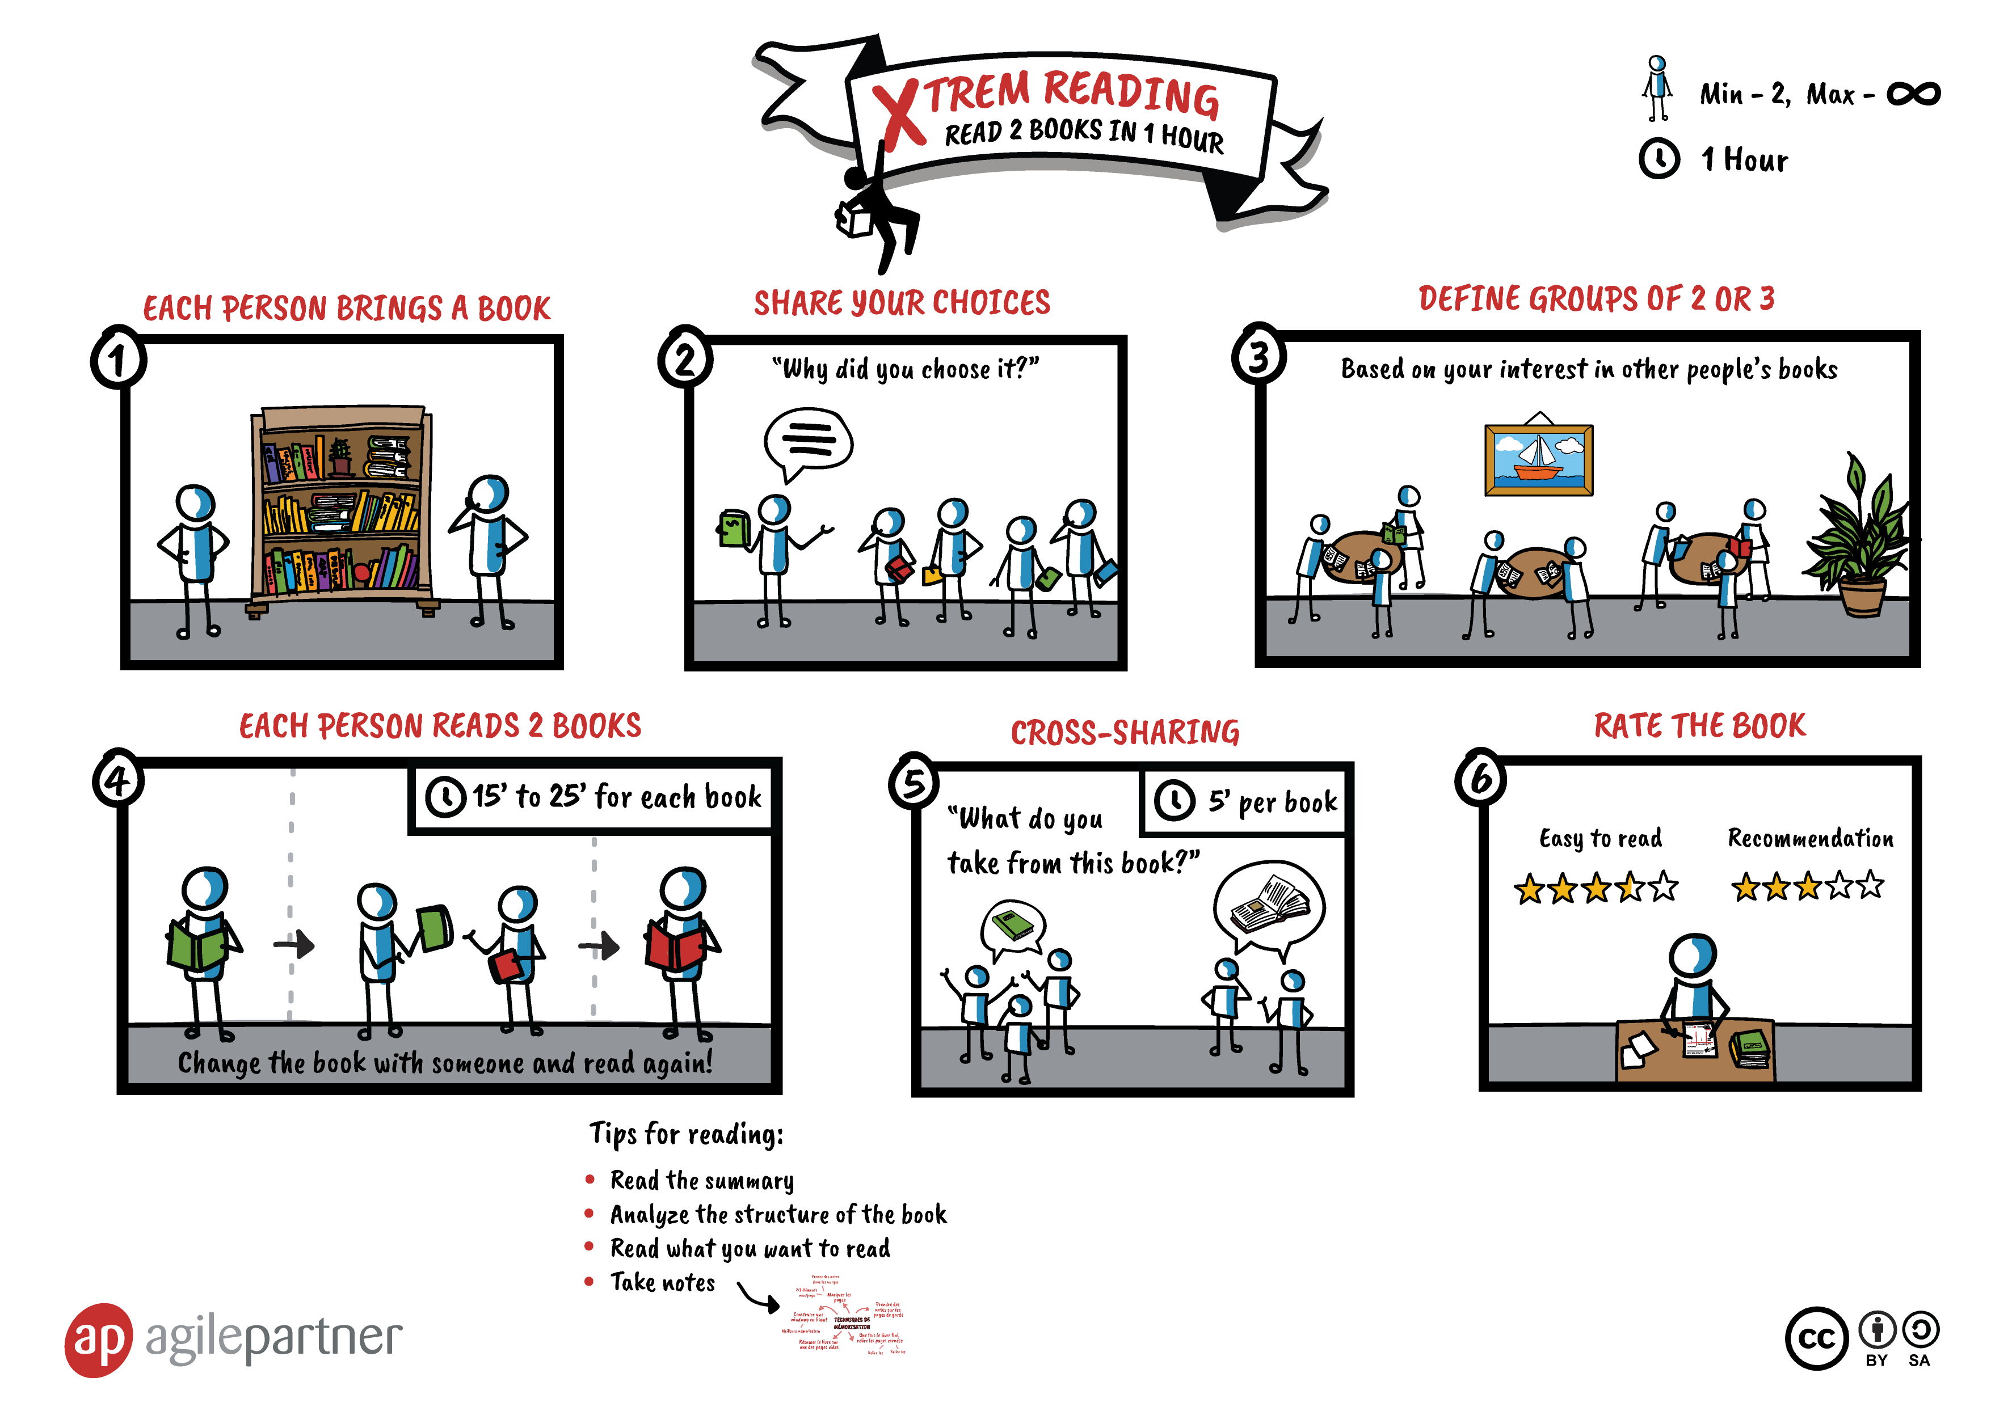
#XtremReading

Slide 3
CHOOSE A BOOK
#XtremReading
Notes:
YOAN

Slide 4
CREATE GROUP OF 3
2
#XtremReading
Notes:
YOAN

Slide 5
3
#XtremReading
Notes:
YOAN

Slide 6
Start with your book
#XtremReading
Notes:
YOAN
Read it in a way you can share stuff at the end
Analyser la structure
Trouver le chapitre clé
Prendre des notes

Slide 7
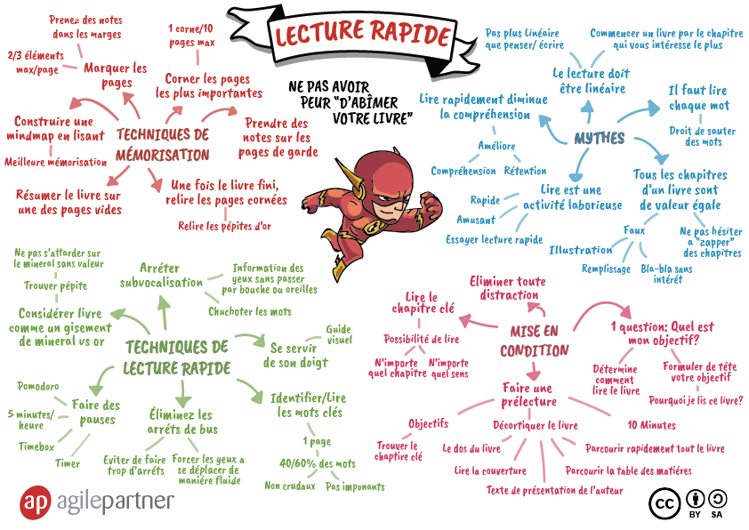
#XtremReading
Notes:
YOAN
Read it in a way you can share stuff at the end
Analyser la structure
Trouver le chapitre clé
Prendre des notes

Slide 8
5’
#XtremReading
Notes:
YOAN

Slide 9
#XtremReading

Slide 10
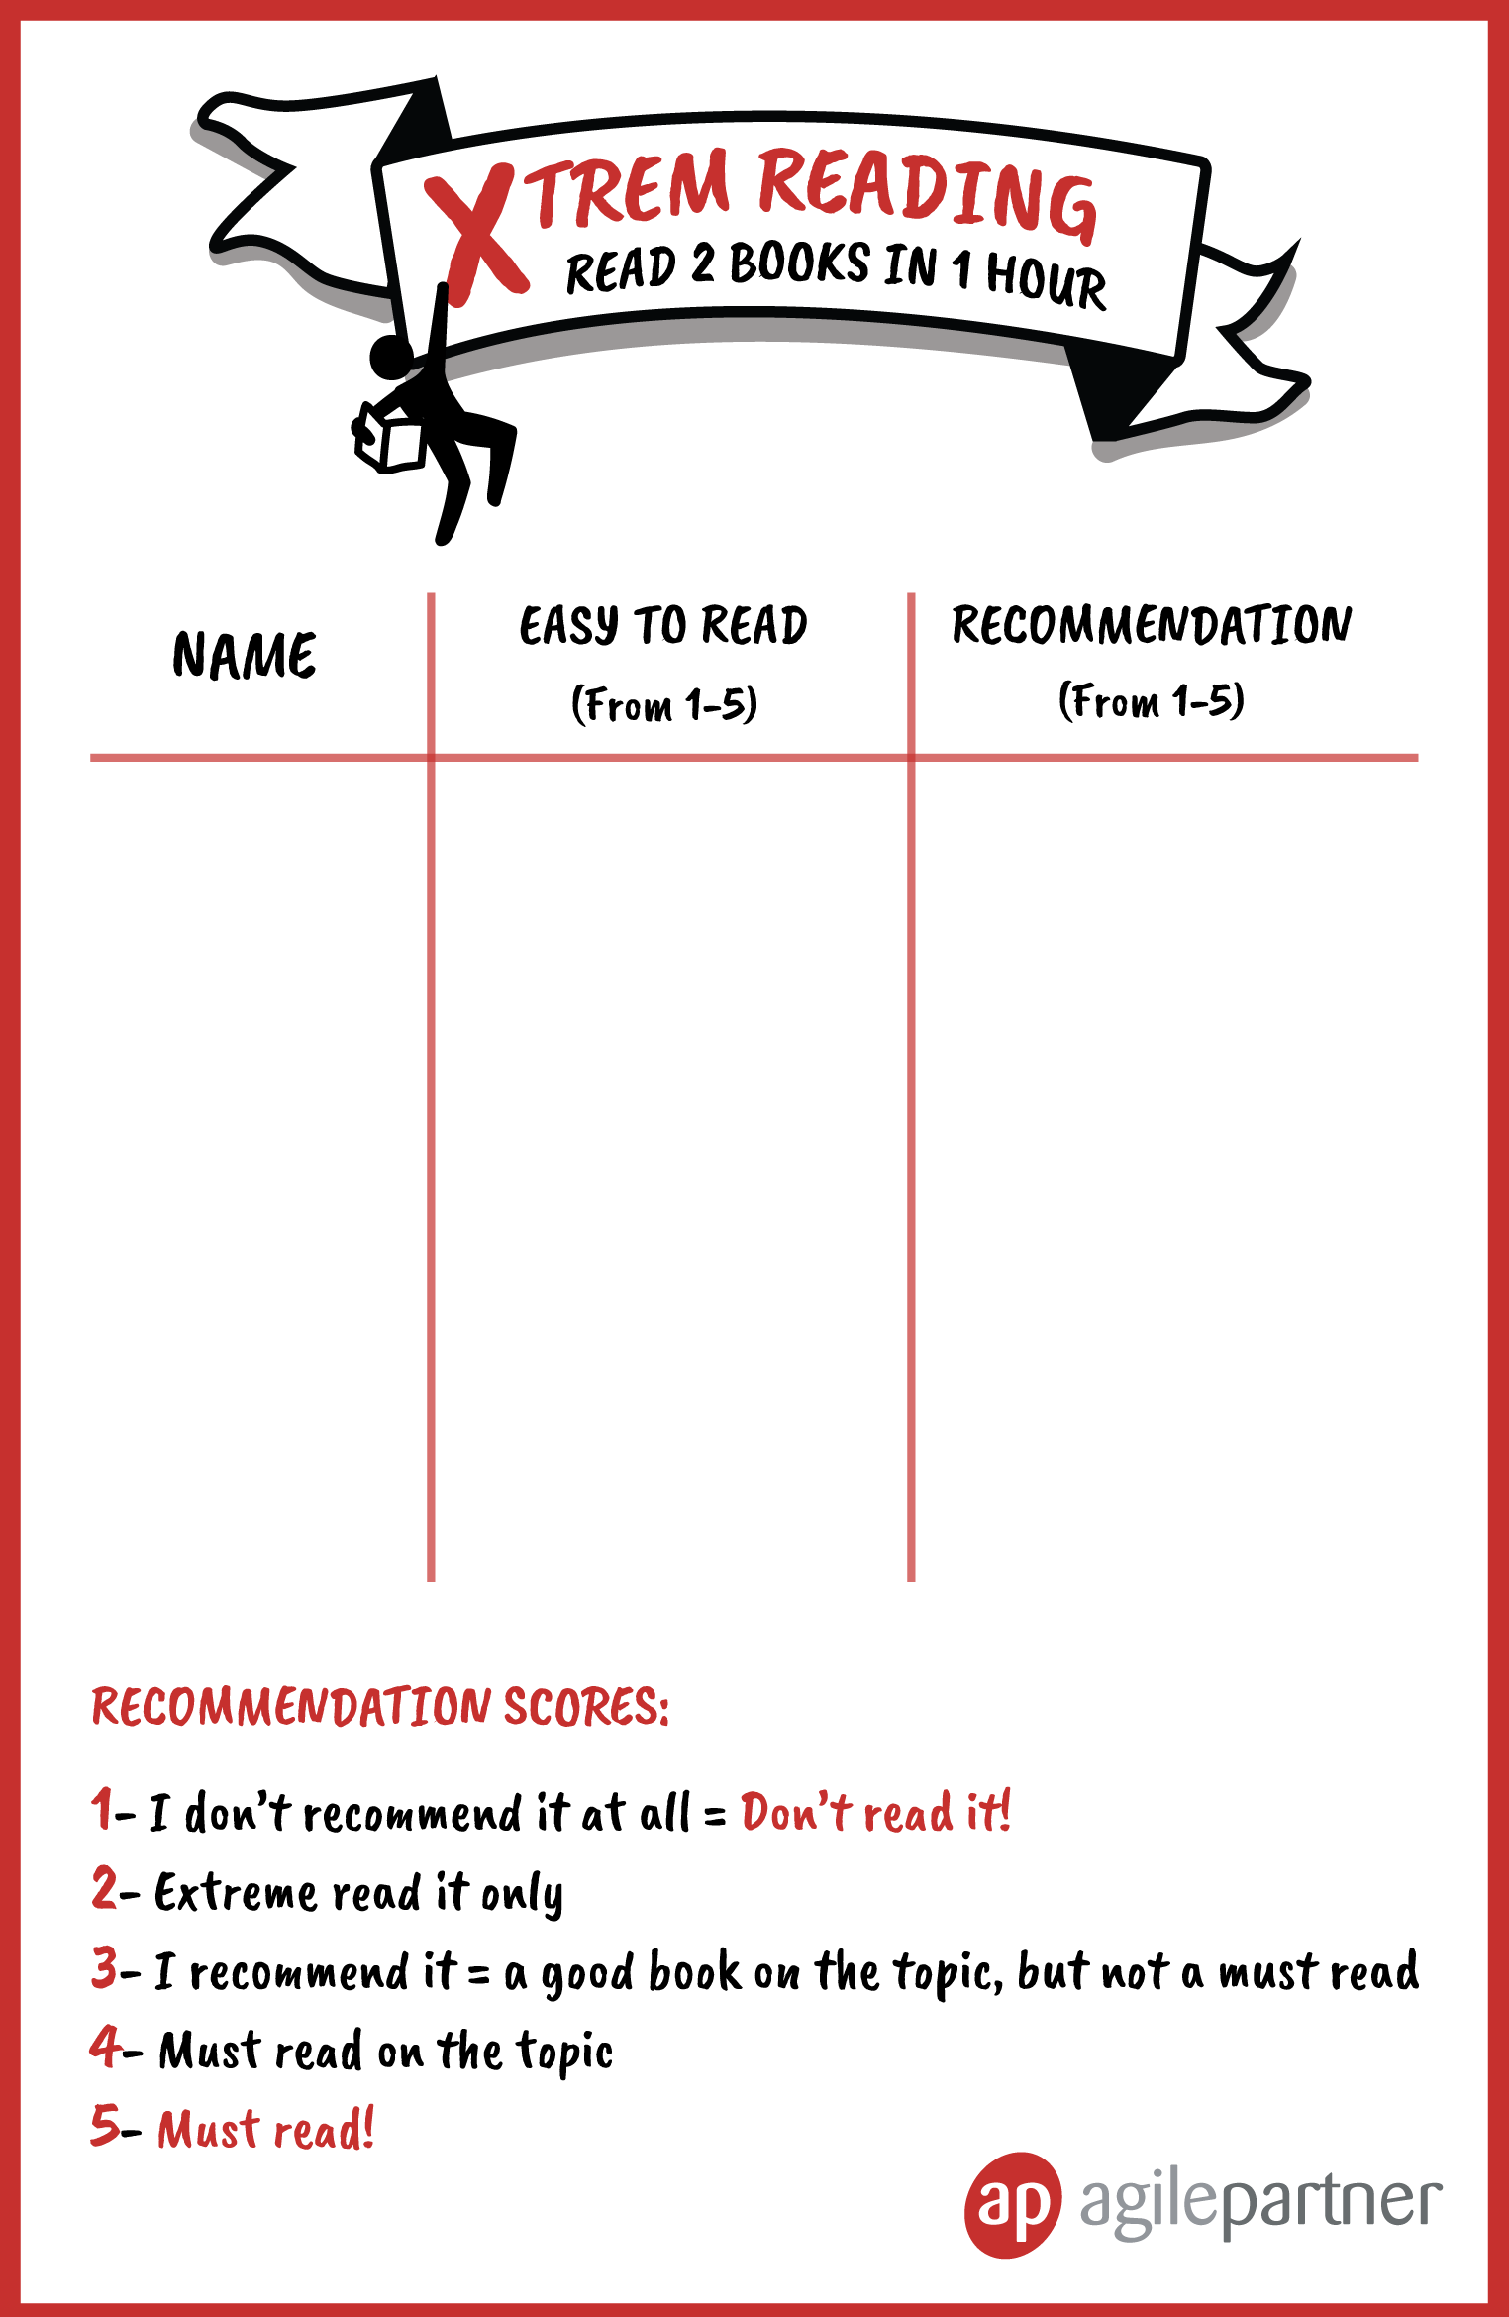
Your name
Your POV
Your POV
#XtremReading

Slide 11

http://bit.ly/2VnPx6g
Notes:
YOAN

