Slide 1
Cognoscenti
Introduction to
Document List
and
Document Folders

Slide 2
Cognoscenti Documents
A workspace can collect many documents
They are displayed with
  most recently changed document first,
  oldest last
Document title, description is displayed
Colored labels can be put on documents from a prepared list of labels

Slide 3
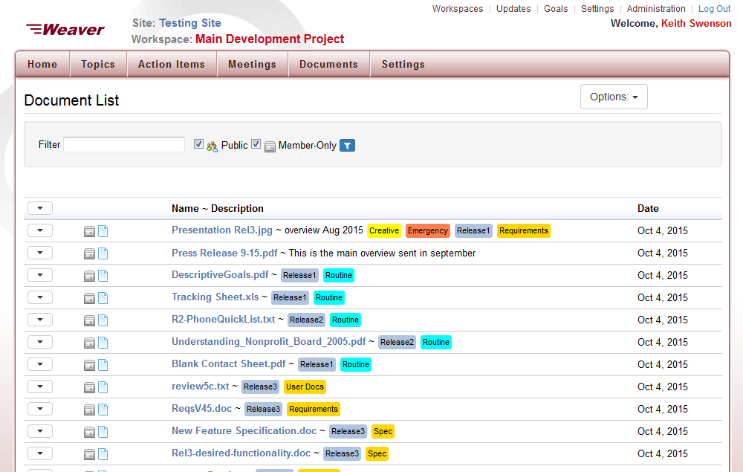

Slide 4
No alphabetical list is offered
But if you know the name of what you are looking for, type a few letters in the filter box
The word or phrase you type will be found in the
  Name
  Description
Filtering is displayed instantly as you type
When the list is short enough, you are done
  Usually only a couple of letters are needed

Slide 5
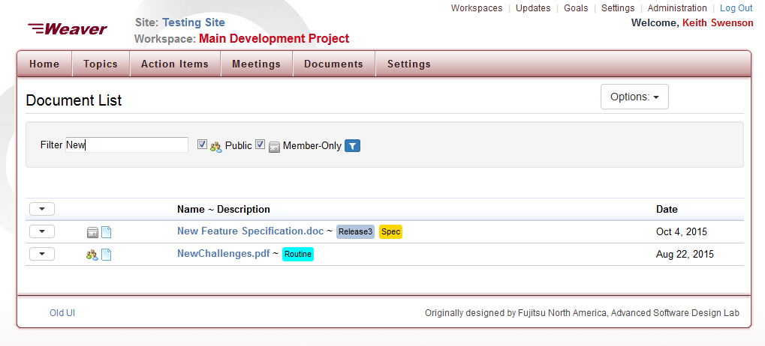
Typing “New” in the filter box

Slide 6
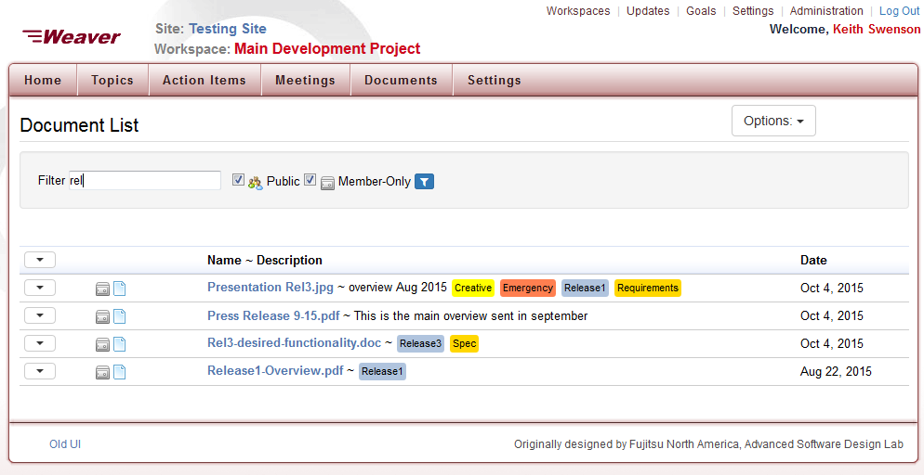
Typing “rel” into filter box

Slide 7
Filter by labels
  Pick from a list of all labels
  Click on a label on a document
Remove label filters
  Remove option in label filter list
  Click on a label on a document
Filtered documents appear instantly

Slide 8
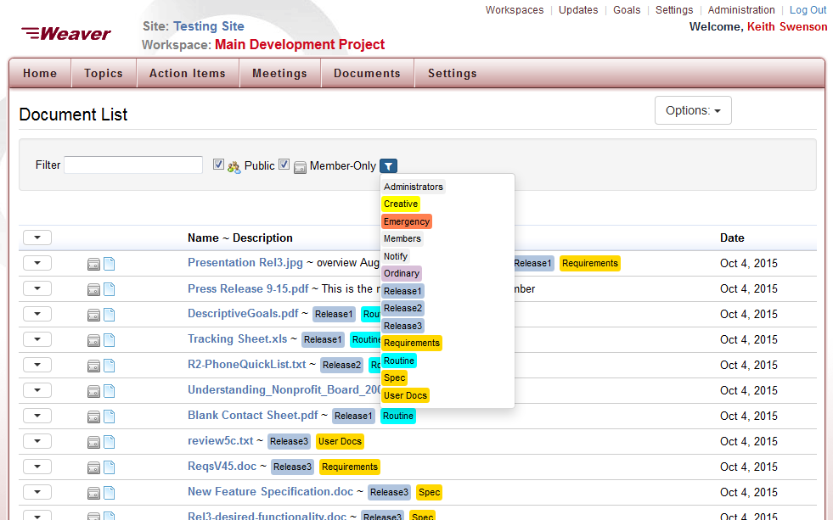
List of Labels to pick from

Slide 9
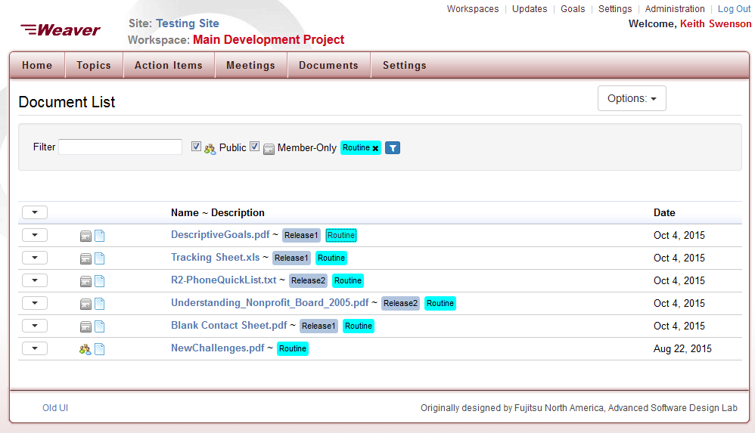
After clicking on “Routine” label

Slide 10
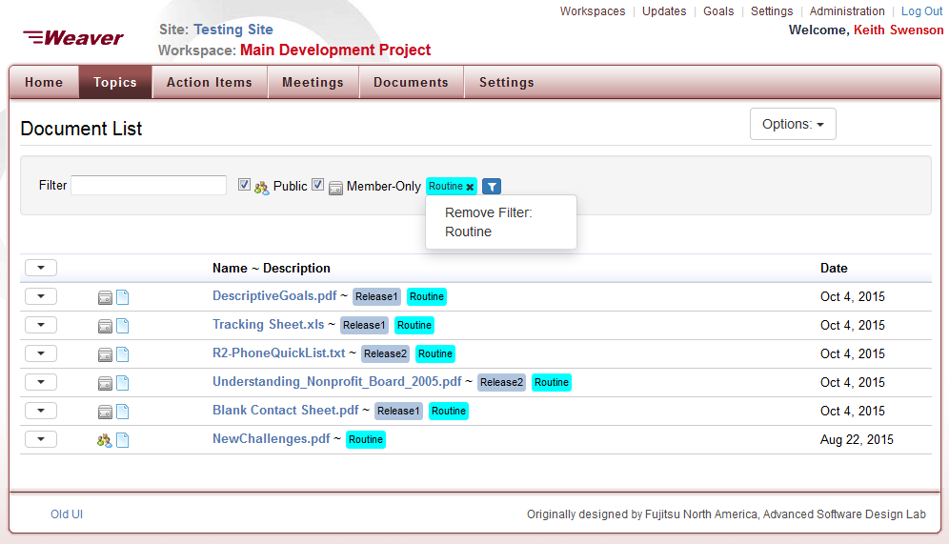
Removal of Label Filter

Slide 11
Document Folder Mode
  Shows documents with exactly same list of filters
  Shows all drill-down labels that are available
  Looks and acts like file folders
  Click on parent folders to move back up

Slide 12
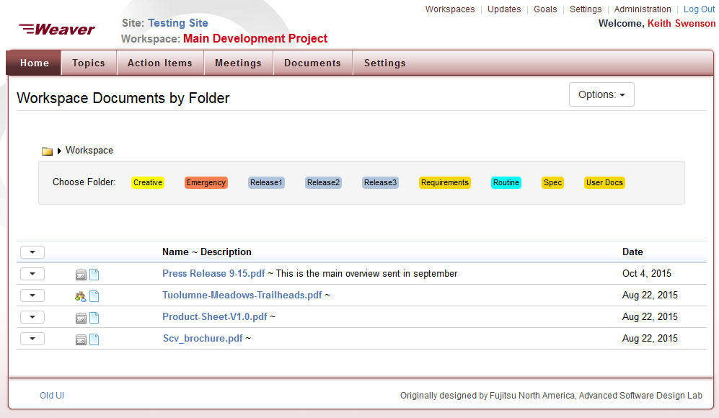
Show documents at “root level” (no labels)

Slide 13
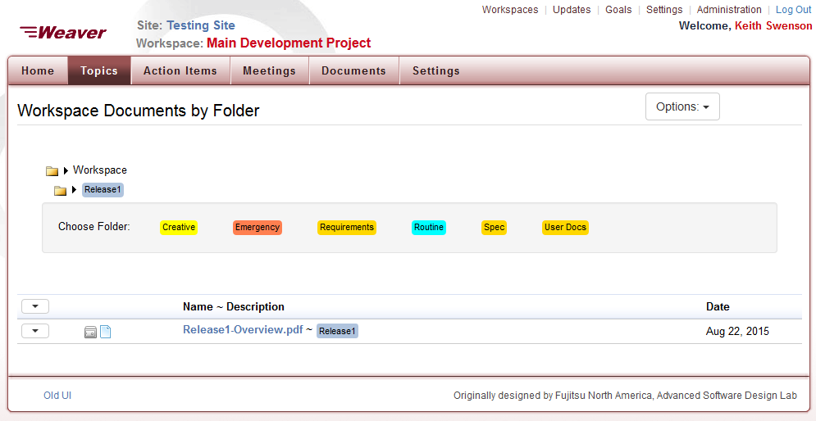
Drill down on “Release 1”

Slide 14
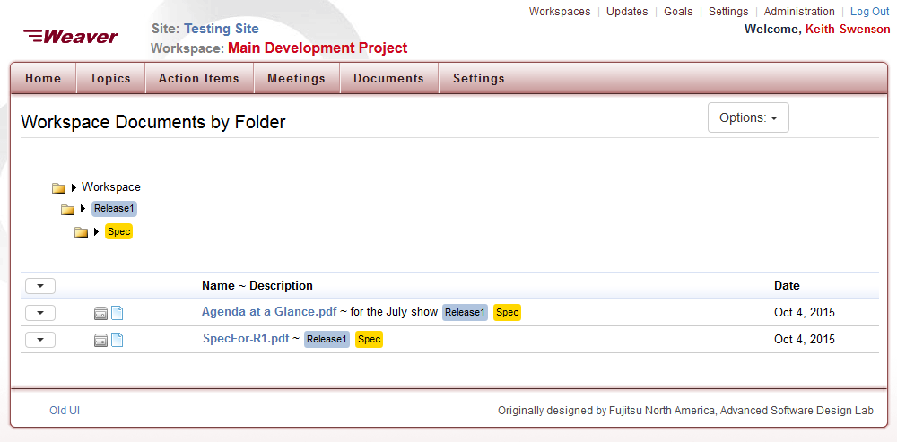
Drilling down on Specs within Release 1

Slide 15
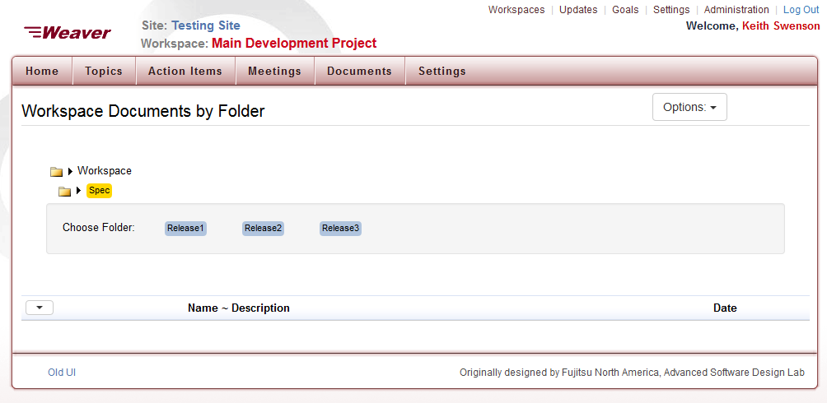
Start over, this time choosing “Spec” first

Slide 16
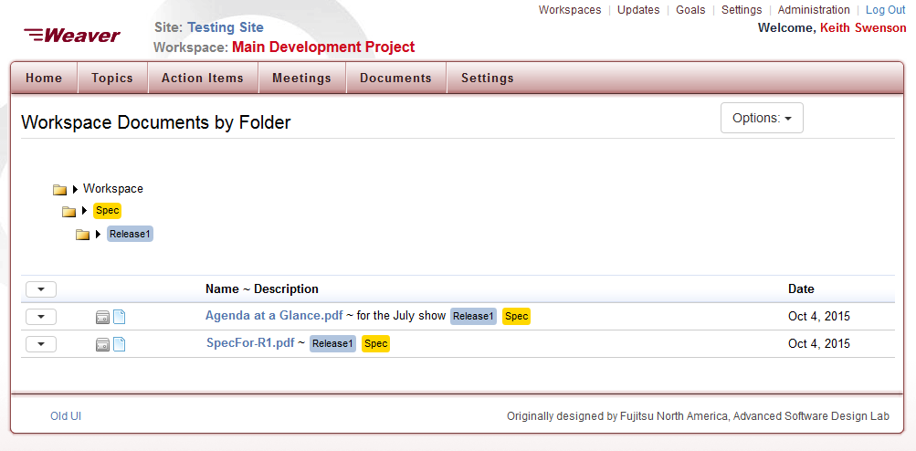
And then “Release 1” within “Spec” folder

Slide 17
Folder view allows you
  Group documents into collections
  deal with groups of documents as if in a folder
You can upload to a folder
  By setting labels at the time of upload

Slide 18
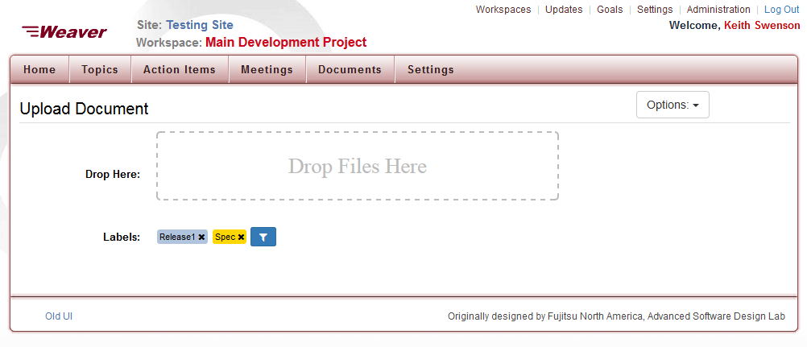
Files dropped and uploaded will have “Release1” and “Spec”

Slide 19
Labels are
  Set up for the entire workspace
Can be used for grouping and filtering
  Documents
  Topics
  Action Items

Slide 20
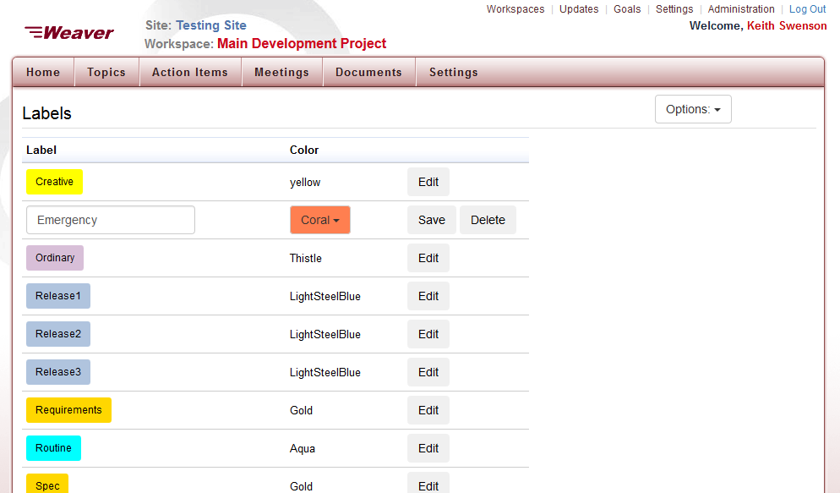
Add, Remove, Edit Labels on the Labels Page

Slide 21
Summary
Document lists are long, and ordered by date
Filter names by typing a few letters
Labels can be applied to documents
  When attaching
  Later when organizing
Filter by label by clicking on a label
Folder view makes labels group documents
  As if they were in a folder
  Keeps all the similar documents together

