Slide 1
User
Browser
Actual Login
Actual Session
~ 1 month
SSOFI Login
Authentication
Verify
Authentication
Weaver
Rapifly

Slide 2
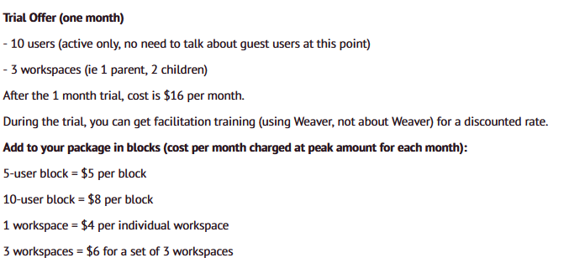

Slide 3
User
Browser
Login
Authentication
Weaver
Rapifly

Slide 4
Weaver
Document sharing
Discussion Topics
Commenting
Action Items
Email
Meetings
Rapifly
Task Brainstorming
Task Sorting Prioritization
Task Assignment
Review

