Slide 1
Fujitsu Middleware SSO Support
Keith Swenson
April 2012

Slide 2
Setting and purpose
Fujitsu sells multiple middleware product developed separately
Cloud deployments as well
Users was to log in once
There is an opportunity for Fujitsu to show leadership in allowing users to log in once, and access multiple cloud or non-cloud applications, without having to re-log in.
Fujitsu should leverage standards in this area

Slide 3
OLD – Unsafe – Way
Software
Application 1
1. Initial unauthenticated access
2. login form
3. submit NAME and PASSWORD
6. Serve Page
Dashboard user
5. Verify
The Problem is:
Application sees the PASSWORD!
This is unsafe for using many apps!
Every application needs separate login screen.
Every login is only for one application.
4. Request Verify
Separate
Directory -or-
Auth Module

Slide 4
SSO Backend Support UNSAFE
App 1
SSO
Send UserName
& Password
Auth Module
Send UserName
& Password
App 2
SSO
Dashboard user
Send UserName
& Password
App 3
SSO
Solution: Eliminate the login prompt from the application.

Slide 5
General OpenID Architecture
Software
Application
User’s
Browser
Browser
User
Trusted
Authentication
Module

Slide 6
General OpenID Architecture
Software
Application 1
1. Initial unauthenticated access
8. Serve Page
Browser
User
7. Verify
2. Redirect to
Login Form
6. Request Verify
3. login form
4. login with NAME and PASSWORD
Separate
Auth Module
5. redirect back
All interaction is
HTTP. No need for special protocol.
No Firewall Problem.

Slide 7
No Restriction on Physical Host
Software
Application 1
Host A
Software
Application 2
Many applications can share one authentication module.
Authentication module can be on any server, any address.
Authentication does not depend on the physical host that the application is run on.
Software
Application 3
Host B
Software
Application 4
Host C
Separate
Auth Module

Slide 8
Cloud based applications as well
Software
Application 1
Cloud A
Software
Application 2
Many applications can share one authentication module even when they are running in the cloud!
Authentication module can be on any server, any address.
Authentication does not depend on the physical host that the application is run on.
Software
Application 3
Host B
Software
Application 4
Cloud C
Separate
Auth Module

Slide 9
Federated ID – Multiple Pools of People
Separate
Auth Module
Software
Application 1
Cloud A
Users can be authenticated by multiple different authentication servers.
Each application can use any number of authentication servers
Users bring their own ID to the application.
Software
Application 2
Software
Application 3
Host B
Software
Application 4
Cloud C
Separate
Auth Module

Slide 10
True Cloud Model
S
S
S
Multitude of Application
Services
Auth
S
S
S
S
S
S
S
S
S
S
S
S
S
Auth
S
S
S
S
S
S
S
S
S
S
Auth
Multiple Authentication
Services.
Any ID works for any Application.
S
S
S

Slide 11
“Who Are You” Page
Most of application is the “page logic” that generates the normal pages.
Pages receive requests, either unauthenticated or authenticated based on application session.
When user clicks login, the browser is directed to the “Who Are You” page.
The WAY page is a standard form inside an application to ask for the user ID.
Then, depending upon the ID, the correct external authentication service is used for that ID using OpenID protocol.
WAY page is reusable in different apps.
Application 1
Page Logic
WAY
(Who Are You)

Slide 12
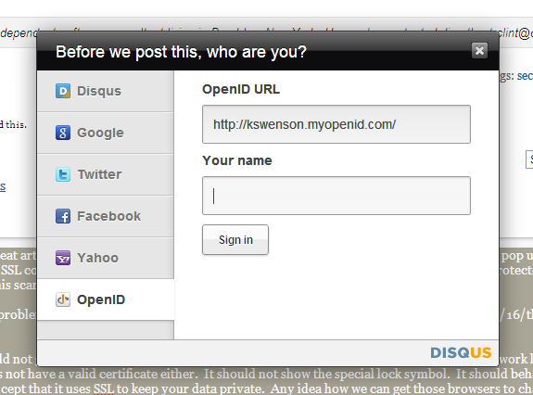
Example from DISQUS

Slide 13
Who Are You Page != Login Page
Application 1
1. Initial unauthenticated access
Page Logic
2
11. Serve Page
WAY
(Who Are You)
3. Who are You
10. Verify
4. Give ID
9. Request Verify
8
5
6. login form
LDAP
OpenID Provider
7. login
CA Site Minder
OpenID Provider
Other….
OpenID
OpenID Protocol

Slide 14
Who Are You Page != Login Page
Application 1
1. Initial unauthenticated access
Page Logic
2
11. Serve Page
WAY
(Who Are You)
3. Who are You
10. Verify
4. Give ID
9. Request Verify
8
5
6. login form
LDAP
OpenID Provider
7. login
CA Site Minder
OpenID Provider
Other….
OpenID
OpenID Protocol

Slide 15
Login → automatic & transparent
Application 1
1. Initial unauthenticated access
Page Logic
2
7. Serve Page
WAY
(Who Are You)
Cookie remembers who the user is, so
this is invisible.
6. Verify
5. Request Verify
4
3
OpenId Provider
User already logged into service so this is invisible.
OpenID Protocol

Slide 16
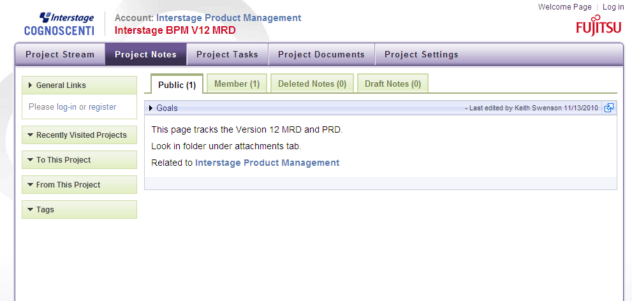
Ready to start, click “log in”
Sample Application for demo is “Cognoscenti”

Slide 17
Step 1: request login
Application 1
1. Initial unauthenticated access
Page Logic
2
WAY
(Who Are You)
3. Who are You
Auth Service 1

Slide 18
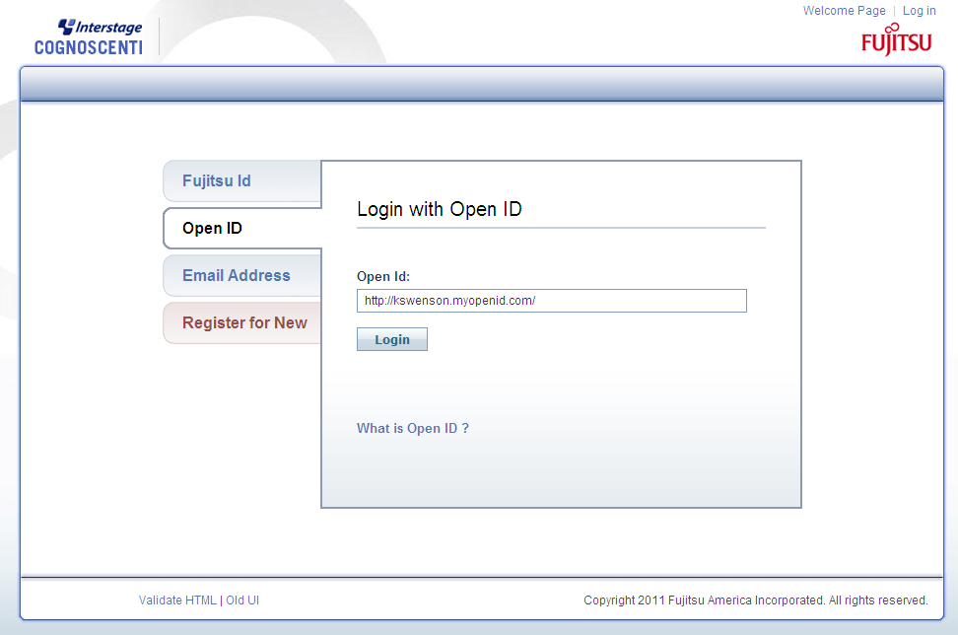
The “Who Are You” page

Slide 19
Step 2: Specify ID, get login form
Application 1
Page Logic
WAY
(Who Are You)
4. Give ID
8
5
6. login form
Auth Service 1

Slide 20
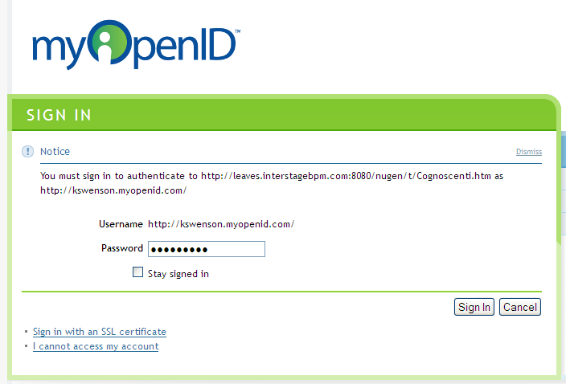
Log in to ID Provider (myopenid)

Slide 21
Step 3: submit password to provider
Application 1
Page Logic
11. Serve Page
WAY
(Who Are You)
10. Verify
9. Request Verify
8
Auth Service 1
7. login

Slide 22
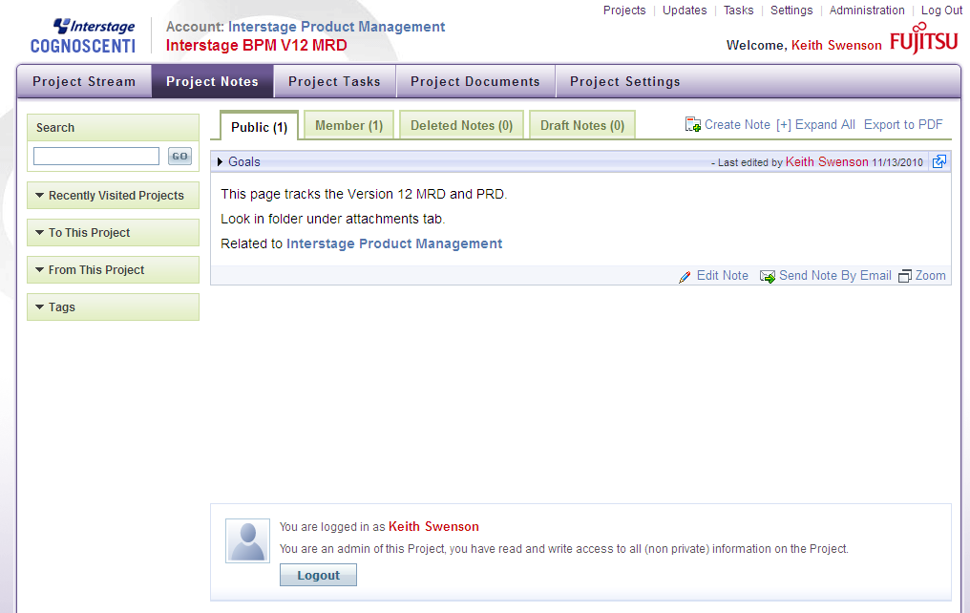
Now you are logged in

Slide 23
User Perception – No Skipping

Slide 24
User Perception – Auto 2

Slide 25
User Perception – Auto 1

Slide 26
User Perception – Full Auto

Slide 27
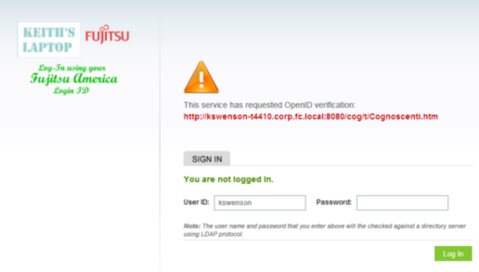
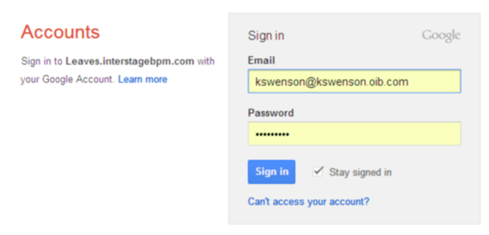
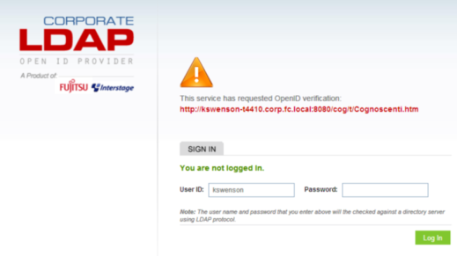
Demo Configuration
Reliers
Site-L
Site-D
Site-C
Providers
Keith’s Laptop
LDAP Provider
MyOpenID
Corporate
LDAP Provider
Google

Slide 28
Notes about Demo
Cognoscenti is designed to show off the capabilities of OpenID, and has many options to show different user.
A real application would probably just use one mode, simplifying the user interface
For example, an admin might configure a real application to only use one specific OpenID provider, and users would not see all the options.
In many real life cases the fact that OpenID protocol is being used will be completely hidden from the user. Think of “protocol” not “identity”
I demo both internal and external OpenID providers
Probably a company would never use both, just one or the other
I demo options to remember and not-remember ids
Probably a real application would always remember the ID for the user, but to show how it works I need the option to turn this off.
Some providers remember & not-remember login sessions
Again, I am showing all the options, but real user probably uses just one.

Slide 29
LDAP Auth Service
Application 1
1. Initial unauthenticated access
Page Logic
2
13. Serve Page
WAY
(Who Are You)
3. Who are You
12. Verify
4. Give ID
11. Request Verify
10
5
6. login form
Auth Service
For LDAP
7. login
8. LDAP
Authenticate
9. LDAP
Response
LDAP
Server
Application does not need
to know how the auth service works.

Slide 30
Auth Service for Active Directory
Application 1
1. Initial unauthenticated access
Page Logic
2
13. Serve Page
WAY
(Who Are You)
3. Who are You
12. Verify
4. Give ID
11. Request Verify
10
5
6. NTLM Requests
Auth Service
For AD
7. NTLM Responses
8. AD
Authenticate
9. AD
Response
Active
Directory
Application does not need
to know how the auth service works.

Slide 31
Auth Service for Active Directory
Application 1
1. Initial unauthenticated access
Page Logic
2
13. Serve Page
WAY
(Who Are You)
3. Who are You
12. Verify
4. Give ID
11. Request Verify
10
5
6. login form
Auth Service
DB Based
7. login
8. DB
Lookup
9. Verify
Data Base
Application does not need
to know how the auth service works.

Slide 32
Allows SSO for our Suite
BPM Console
Analytics Console
Custom App
Shared
Auth Service

Slide 33
Internal ID not same as Identity
Each app maintains
a profile for the user
mapping to ID
Internal
User ID
BPM Console
XYSSK001
http://kswenson.myopenid.com/
Analytics Console
AQNNNZS
http://kswenson.myopenid.com/
Custom App
U32-4RRT
http://kswenson.myopenid.com/

Slide 34
Internal ID may the same if desired
Each app maintains
a profile for the user
mapping to ID
Internal
User ID
BPM Console
kswenson
http://ldapserver/kswenson
Analytics Console
kswenson
http://ldapserver/kswenson
Custom App
kswenson
http://ldapserver/kswenson

Slide 35
tenant support
Each app maintains
a profile for the user
mapping to ID
Internal
User ID
BPM Console
tenant1/kswenson
http://ldapserver4tenant1/kswenson
Analytics Console
tenant1/kswenson
http://ldapserver4tenant1/kswenson
Custom App
tenant1/kswenson
http://ldapserver4tenant1/kswenson

Slide 36
Multi-tenant works the same way
Multi-Tenant Server
Log in once, and then access any tenant (that you have access to…)
Tenant 1
Tenant 2
Tenant 3
Who Are You?
Shared
Auth Service

Slide 37
Benefits of OpenID support
True cross-server & cross-domain SSO
Proven Secure – application never sees your password, do not have to worry whether application is trusted or not.
Integrate with other software supporting OpenID:
Oracle Identity Provider
IBM
CA SiteMinder
Open source capability
Cloud scalability – proven ability to support millions of users.
Gives us flexibility – separate the authentication from the application. App that uses OpenID does not need to be modified to support other authentication schemes. Custom OpenID providers can be plugged in without altering App.
Internal Protocol – users do not (necessarily) know.

Slide 38
Questions
How do you expect current customers to use it?
Just use the LDAP-OpenID provider. Users authenticate with their normal username and password. They don’t even know that the system is using OpenID.
How do they get LDAP-OpenID provider?
We ship this provider included in every product. It is a separate install, but shipped with both IBPM and IBPM-A. They only need to install one.
What if they have CA SiteMinder?
SiteMinder supports OpenID directly, so there would be no need to add an additional OpenID provider. Fully integrated no additional cost.
How do you keep anyone with Google ID from accessing system?
OpenID authenticates you, but it does not authorize you for anything. Someone must give you authority to access protected resources. Could be an administrator or another user.

Slide 39
Questions
Where did LDAP-OpenID provider come from
FAI developed this - ~2000 lines of Java code
Projects teams think they already do SSO
Only the unsecure form where each applications handles the password.
OpenID protocol is safe because no application ever sees a password.
Proprietary approached exist for this, but none at Fujitsu, and there is no need since OpenID is an open protocol to do the same thing.
What about groups?
OpenID only does authentication / SSO. It does not have anything to do with organizational structure or other directory capabilities.
Will a company every really use a Google OpenID?
They will if they decide to use Gmail for their employees. That would drive the decision. If they don’t need a google cloud service, they probably will not allow use of a Google OpenID for authentication.

Slide 40
Why OpenID, not SAML?
Cross-server & cross-domain SSO: both OpenID and SAML can provide this capability
User Interface vs. Server: SAML is for server to server authentication. OpenID is for browser to server authentication. OpenID works at the GUI level for authenticating users. SAML cannot do this. because SAML is focused on exchange of XML documents with assertions in it.
Proven Secure: SAML still requires the user to give a password to an application at the first time login and user must trust that application is secure. SAML is less secure in this sense because it is possible for an evil application to steal your password. OpenID works at the browser/GUI level, no application ever sees the user’s password. You can safely use an OpenID even with an application you don’t trust.
Integrate with other software:
OpenID: Oracle, IBM, CA, open source, Google, Yahoo, many cloud providers
SAML: at least CA. probably the same.
Cloud scalability: Both OpenID are protocols and both can scale to tremendous size. The architectural advantage to OpenID is that multiple authentication providers can be used without any need to configure the application. The OpenID itself tells the application everything it needs to know. With SAML the application might be configured to use multiple authentication providers, but this adds an extra layer of complexity to the application and to managing the application. The administrator would have to configure each provider, and the user would have to select each provider. OpenID automatically gives you a globally unique ID for the user, while SAML has no guarantee of a global ID.
Gives us flexibility: both OpenID and SAML provide a separation between authentication and authorization. But OpenID allows us to completely remove the “login prompt” from the applications. This allows different authentication providers to implement different login prompts. In the case of Active Directory the login prompt can be eliminated and replaces with NTLM exchange. Because the login can be customized at the UI level to each auth provider, we can offer many options that would be complicated if we try to replicate across all applications.
They are different: even if choose OpenID for GUI level user authentication, SAML is still needed for server to server authentication. There is no either/or choice – they are different things.

Slide 41
SAML vs. OpenID
App 1
Send UserName
& Password
no login GUI
LOGIN
SAML
protocol
Auth
Provider
App 2
LOGIN
Send UserName
& Password
Applications:
1. never see the user’s
password
2. do not need a
login prompt
3. do not need config
App 1
OpenID
protocol
App 2
login GUI can
be specific to
auth technology.
True SSO.
UserName
& Password
ONLY HERE
Auth
Provider
LOGIN

Slide 42
Clarification
Do not get confused:
ID – a universal, global identification of a user
Authentication – proof that the user is who they say they are
Authorization – what they are allowed to do
Profile – settings that are associated with the user
User Groups – collections of users
These are all SEPARATE concepts
OLD SYSTEM often required these to be from one place
New design allows different servers to be responsible for different parts

Slide 43
Clarification
ID – a universal, global identification of a user
Same ID can be used in many applications, many hosts
Looks like a URL
Authentication – proof that the user is who they say they are
OpenID provider takes care of proving who user is
ONLY the OpenID provider takes/handles a password
Authorization – what they are allowed to do
Each application controls what user is able to do
Nothing to do with OpenID provider
Profile – settings that are associated with the user
Each application keeps settings for each user
Groups – still need LDAP for this
centralized management of user groups requires a directory server

Slide 44
Application Requirements
Each application has an “internal id” to track each user
User may have multiple global ID
They can log in with more than one OpenID, for example
First time they log in,
the application generates and assigns the internal ID
Sets up a profile for them
Asks for and remembers their display name
Later they are allowed to
add and remove OpenIDs
add and remove email addresses
change their name

Slide 45
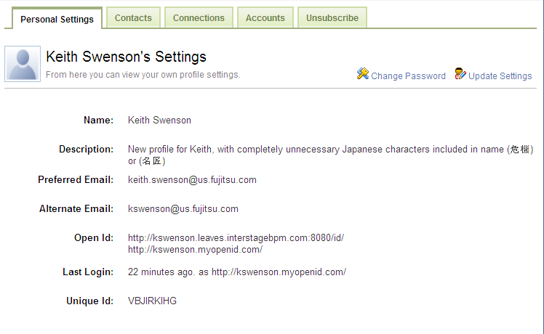
For example
Display Name
Multiple
Email
Multiple
OpenIDs
Internal ID

Slide 46
Code Modules Available for Reuse
“Who Are You” Module
Standard Java Servlet for inclusion in application
Uses J2EE session to communicate with application
Configure for simple UI for special services
Auth Service for LDAP
Separately installed TomCat Application
Configure to talk to an LDAP server
Auth Service for Active Directory
Separately installed TomCat Application
Uses NTLM to authenticate user transparently
Auth Service for Database
Separately installed TomCat Application
Stores user info in DB, has UI for changing/resetting password

Slide 47
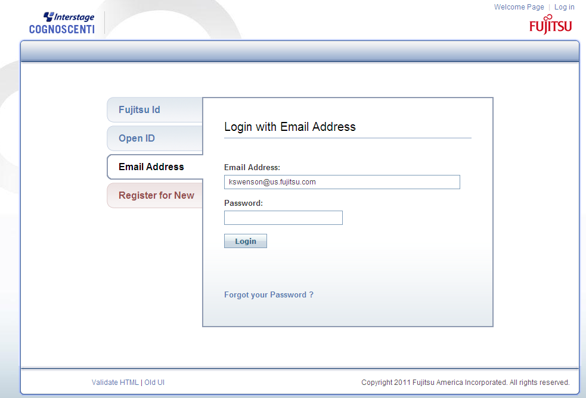
Who Are You (Email)

Slide 48
Who Are You (OpenID)

Slide 49
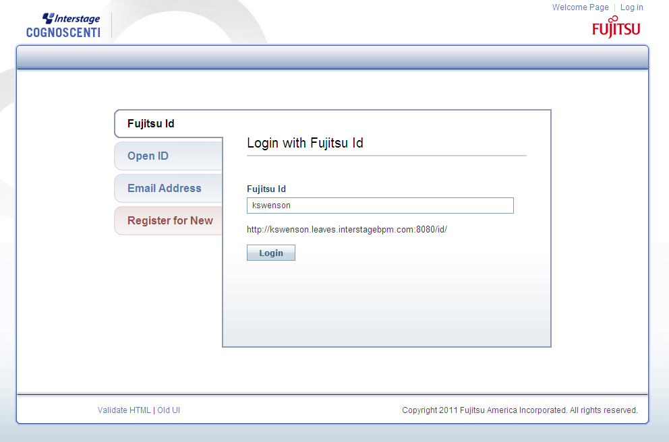
Who Are You (Specially Configured)

Slide 50
References
Some recent links about Cloud and Identity
http://social-biz.org/2012/05/26/sso-much-fun-identity-update/
Cloud Software and Identity
http://social-biz.org/?p=1197&preview=true
Cloud User’s Bill of Rights (what users expect)
http://social-biz.org/2012/03/14/cloud-users-bill-of-rights/
How OAuth Fits In
http://social-biz.org/2008/12/11/rest-assured-oauth-security/
Bigger view of longer term effects of SSO on the cloud
http://social-biz.org/2008/06/15/web-21-how-openid-will-rescue-web-20/

Slide 51
Module Options
Application
User’s
Browser
OpenID Client
Servlet
LDAP
OpenID Provider
Active Directory
OpenID Provider
Standalone
OpenID Provider

Slide 52
Module Internals
Application
User
State &
Access
Rights
User’s
Browser
SSOFI Client
init params
servlet
session
login state
(3rd Party)
(External)
(LDAP)
Auth
Provider
SSOFI OpenID Provider
config params
Connector
servlet
user sessions

Slide 53
Application
User List
Login State
Access
Rights
return
UserManager
error
UserProfile
SSOFI Client
ID
init params
login
Initialize-
Params
servlet
(“who are
you” page)
session
return
Auth-
Attempt
login state
Files

Slide 54
User’s
Browser
Host
Application
SSOFI
ID Selection
Open ID
Provider
Page displayed for unauthenticated user.
prepare attempt
User enters an ID into the form & clicks LOGlN
discover provider
User enters password & actually logs in
verify
set logged in
Page displayed for authenticated user.

Slide 55
Server
Process
Execution
Pop Email
Listener
Choice
Decoding

Slide 56
Server
Process
Execution
Pop Email
Listener
Choice
Decoding
IMAP Email
Listener

