Slide 1

Stock Market Trader (Swing trading Use-Case)
Following real-time Stock Prices
Understanding/interpreting international Economic & Political Trends
Buys or sells based on Experiences and Forecasts
Holding positions for Days or Weeks, looking to profit from Price swings
Notes:
Types of Traders:
Institutional Traders:
These traders work for large institutions like hedge funds, pension funds, and investment companies, often trading on a large scale.
Retail Traders:
These are individual investors who trade for themselves, often using online brokerage platforms.
Day Traders:
These traders focus on short-term trading, often buying and selling stocks within the same day.
Swing Traders:
These traders hold positions for a few days or weeks, looking to profit from price swings.
Position Traders:
These traders hold positions for longer periods, often years, hoping to capitalize on long-term growth.

Slide 2

Welcome AI Trader
Continuously monitors actual Stock market Prices.
Analyses News, economic Data, company Performance, and other Factors that can influence stock Prices.
Decides which Stocks to buy or sell based on its Analysis and Reasoning.
Monitors round the Clock, 24/7, 365 Days.
AI Trader

Slide 3
Agentic AI and AI Agents (AI Trader)
AI Agents act Autonomously without Human Intervention
AI Agents reason based on the AI Model they were provided (however)
AI Models Knowledge is limited to the Content they were trained on
AI Models not aware of real-time Data
AI Agents are provided Tools… (the solution)
Tools: Fetch real-time Data to Augment the AI Model’s Knowledge
Tools: Act…
Send Notifications (mail, WhatsApp, Teams,…)
Change DB content, add Orders, update Records …
Generate Statistics
More and More…
Notes:
A REST API content provider for stock market traders following economic and political trends typically aggregates and delivers real-time or near-real-time data from news, government sources, market events, and geopolitical developments. These APIs help traders make data-driven decisions based on macroeconomic and political signals.
Here are some of the best REST API providers for this purpose:
🔹 1. News API
Website: https://newsapi.org
Use: Provides access to breaking news headlines and articles from news sources worldwide.
Best For: General political, economic, and financial news monitoring.
Data Sources: Bloomberg, Reuters, CNBC, etc.
🔹 2. Finnhub API
Website: https://finnhub.io
Use: Offers financial data, economic indicators, news, and sentiment analysis.
Best For: Real-time stock market data + economic news + sentiment.
Economic Data: GDP, CPI, interest rates.
News: From major financial outlets with sentiment scoring.
🔹 3. Trading Economics API
Website: https://tradingeconomics.com
Use: Access to 20 million economic indicators, forecasts, and news.
Best For: Macro-economic trend tracking.
Coverage: GDP, inflation, employment, interest rates, and more — for 196 countries.

Slide 4
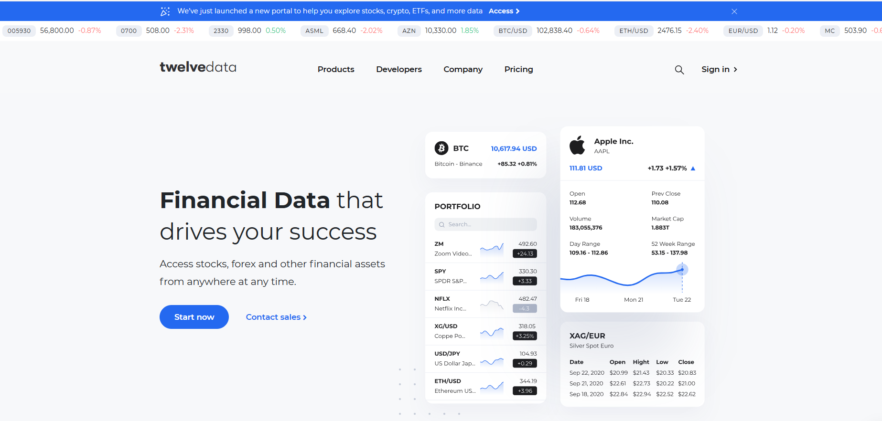



Welcome AI Trader
For every record on your Stock Wallet…
Fetch real-time stock prices from www.twelvedata.com
Fetch economic trends from www.tradingeconomics.com
Reasoning…
Update the stock records on cloud Database
Send out WhatsApp notifications on unexpected price Rise or Fall
Twelvedata.com Financial Assets
2
4
AI MODEL
6
Prompt
For each stock record incrementally buy or sell stocks on my wallet given actual prices and economic trends and notify when price deviates thresholds….
AI Agent
I work ….
- 24/7
- 365 days a year
- each minute
- configurable scheduling interval
tradingeconomics.com Economic Trends
1
5
3
Stock Wallet Database

Slide 5
Why AI Trader
Works round the clock, 24/7, 365 days
Access to most actual real-time Stock prices and other Financial Assets
Access to world-wide economic Trends that impact Stock Markets
Forecasts on Historical and Real-Time Financial and Economic Trends
Buys & Sells stocks based on its Reasoning considering Real-Time Facts.
Notifies when Prices fall below Predefined and Configured Thresholds
Generates periodical Statistics and Charts on Stock Inventory history

Slide 6
Why this Use Case
No intention to bring a new Product
Focus on showcasing Technologies…
Spring AI
MS Azure AI Foundry
Azure DevOps
Terraform
Gradle
HELM
…

