Slide 1

Stock Market Trader
Following real-time Stock Prices
Understanding International Economic & Political Trends
Buyes or Sells based on Justifications and Predictions

Slide 2

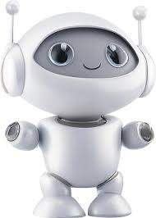
Farewell Trader, Welcome AI Trader
AI Trader

Slide 3
Agentic AI?
Agents act Autonomously without Human intervention
Agents reason based on the AI Model they were given
Knowledge cut-off constraints what they can reason about
Agents are given Tools…
Tools: to Fetch real-time data to Augment their Knowlegde
Tools: to Act
Send notification
Change DB content, add order, add records …

Slide 4
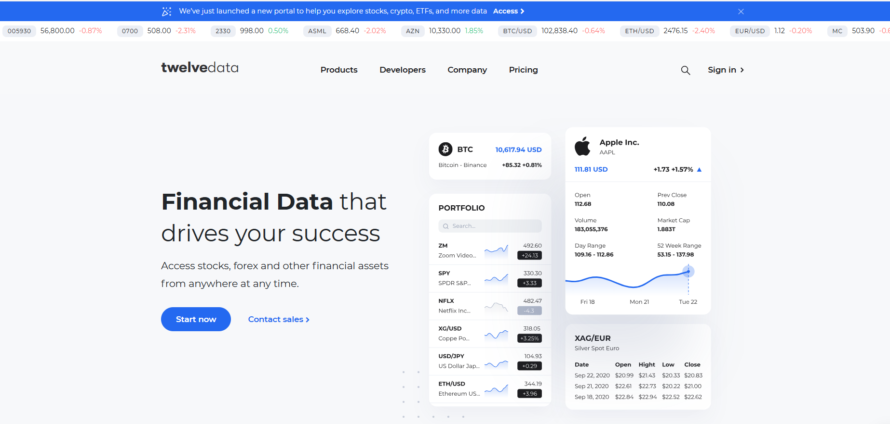

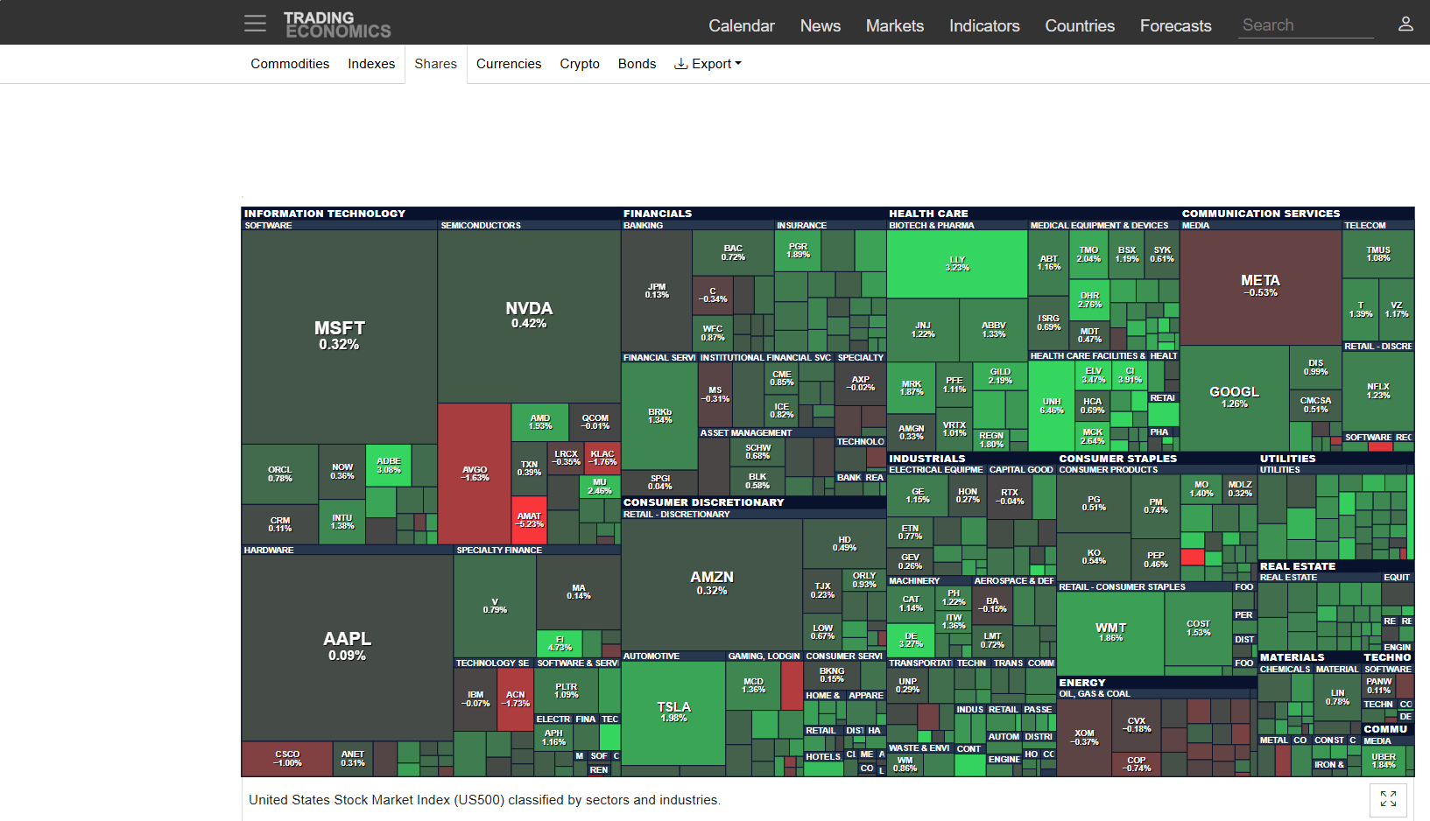

Welcome AI Trader
Fetch real-time stock prices from www.twelvedata.com
Fetch economic trends from www.tradingeconomics.com
Fetch and Update the stocks you have outstanding cloud DB
Send out WhatsUp notifications on big price range Rise or Fall
Twelvedata.com Financial Assets
1
AI MODEL
4
Twelvedata.com Financial Assets
2
AI Agent
3
I work ….
- 24/7
- 365 days a year
- each minute
- configurable scheduling interval
Stock Wallet Database

Slide 5
Why AI Trader
Works round the clock, 24/7, 365 days

Slide 6
Why this Use Case
No intention to bring a new product
To demonstrate the technology underneath
Demonstrating End-to-End software development process
From Java /Spring development
Gradle build and SpringBoot jar package
DevOps pipeline Test

