Slide 1

Stock Market Trader
Following real-time Stock Prices
Understanding/interpreting international Economic & Political Trends
Buys or sells based on Experiences and Forecasts

Slide 2

Welcome AI Trader
Continuously monitors actual Stock market Prices.
Analyses News, economic Data, company Performance, and other Factors that can influence stock Prices.
Decides which Stocks to buy or sell based on its Analysis and Reasoning.
Monitors round the Clock, 24/7, 365 Days.
AI Trader

Slide 3
Agentic AI and AI Agents (AI Trader)
AI Agents act Autonomously without Human Intervention
AI Agents reason based on the AI Model they were provided (however)
AI Models Knowledge is limited to the Content they were trained on
AI Models not aware of real-time Data
AI Agents are provided Tools… (the solution)
Tools: Fetch real-time Data to Augment the AI Model’s Knowledge
Tools: Act…
Send Notifications (mail, WhatsApp, Teams,…)
Change DB content, add Orders, update Records …
Generate Statistics
More and More…

Slide 4
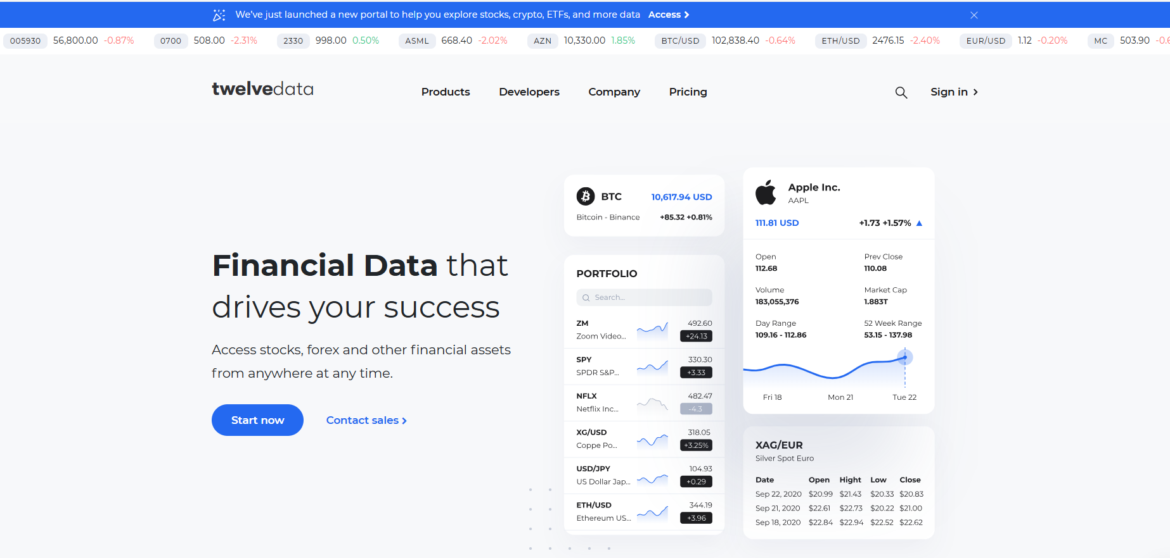



Welcome AI Trader
For every record on your Stock Wallet…
Fetch real-time stock prices from www.twelvedata.com
Fetch economic trends from www.tradingeconomics.com
Reasoning…
Update the stock records on cloud Database
Send out WhatsApp notifications on unexpected price Rise or Fall
Twelvedata.com Financial Assets
2
4
AI MODEL
6
Prompt
For each stock record incrementally buy or sell stocks on my wallet given actual prices and economic trends and notify when price deviates thresholds….
AI Agent
I work ….
- 24/7
- 365 days a year
- each minute
- configurable scheduling interval
tradingeconomics.com Economic Trends
1
5
3
Stock Wallet Database

Slide 5
Why AI Trader
Works round the clock, 24/7, 365 days
Access to most actual real-time Stock prices and other Financial Assets
Access to world-wide economic Trends that impact Stock Markets
Forecasts on Historical and Real-Time Financial and Economic Trends
Buys & Sells stocks based on its Reasoning considering Real-Time Facts.
Notifies when Prices fall below Predefined and Configured Thresholds
Generates periodical Statistics and Charts on Stock Inventory history

Slide 6
Why this Use Case
No intention to bring a new Product
Focus on showcasing Technologies…
Spring AI
MS Azure AI Foundry
Azure DevOps
Terraform
Gradle
HELM
…

