Slide 1

Stock Market Trader
Following real-time Stock Prices
Understanding International Economic & Political Trends
Buys or Sells based on Justifications and Predictions

Slide 2


Farewell Trader, Welcome AI Trader
AI Trader

Slide 3
Agentic AI?
Agents act Autonomously without Human intervention
Agents reason based on the AI Model they were given
Knowledge cut-off constraints what they can reason about
Agents are given Tools…
Tools: to Fetch real-time data to Augment their Knowlegde
Tools: to Act
Send notification
Change DB content, add order, add records …

Slide 4
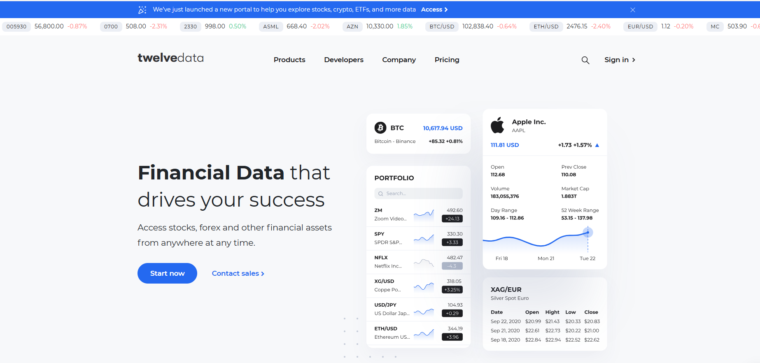



Welcome AI Trader
For every record on your Stock Wallet…
Fetch real-time stock prices from www.twelvedata.com
Fetch economic trends from www.tradingeconomics.com
Reasoning…
Update the stock records on cloud Database
Send out WhatsUp notifications on unexpected price Rise or Fall
Twelvedata.com Financial Assets
2
4
AI MODEL
6
Prompt
For each stock record incrementally buy or sell stocks on my wallet given actual prices and economic trends and notify when price deviates thresholds….
AI Agent
I work ….
- 24/7
- 365 days a year
- each minute
- configurable scheduling interval
tradingeconomics.com Economic Trends
1
5
3
Stock Wallet Database

Slide 5
Why AI Trader
Works round the clock, 24/7, 365 days
Access to most actual real-time Stock prices and other Financial Assets
Access to World Economic Trends that potentially influence prices
Forecasts based on Historical and Real-Time Financial and Economic Trends
Buys & Sells based on its Reasoning based on Real-Time Facts.
Notifies when Prices fall below Predefined and Configured Thresholds

Slide 6
Why this Use Case
No intention to bring a new product
Focus on showcasing technologies
Spring AI
MS Azure AI Foundry
Azure DevOps
Terraform
Gradle
HELM
…

