Slide 1



11010
compiler
C Program
compiler
1101
compiler
10011

Slide 2

runs on
Model
compiles to
runs on
runs on

Slide 3

runs on
compiles to bytecode
runs on
runs on

Slide 4
runs on
compiles to bytecode
runs on
runs on

Slide 5

runs on
compiles to bytecode
runs on
runs on

Slide 6











Slide 7
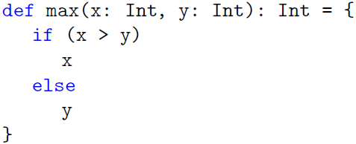
“def” starts a function definition
parameter list in parentheses
function name
function’s result type
equals sign
function body
in curly braces

Slide 8
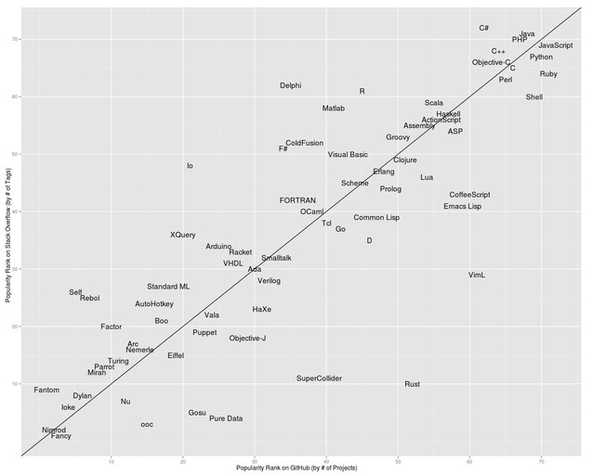
Tier 1
Tier 2

Slide 9
Copy
char
char
Keyboard
Printer

Slide 10
Copy
char
char
char
Keyboard
Printer
char
PT Reader
PT Punch

Slide 11
Copy
char
char
getchar
putchar
?
?
Keyboard
Printer

Slide 12
Copy
getchar
putchar
File
Keyboard
Printer

Slide 13
Flow of Control
Sender
message
Recipient
Opposed Dependency

Slide 14

function parameters is parentheses
function body
right arrow

