Slide 1



11010
compiler
C Program
compiler
1101
compiler
10011

Slide 2

runs on
Model
compiles to
runs on
runs on

Slide 3

runs on
compiles to bytecode
runs on
runs on

Slide 4
runs on
compiles to bytecode
runs on
runs on

Slide 5

runs on
compiles to bytecode
runs on
runs on

Slide 6











Slide 7
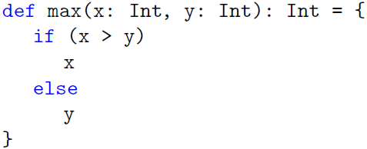
“def” starts a function definition
parameter list in parentheses
function name
function’s result type
equals sign
function body
in curly braces

Slide 8
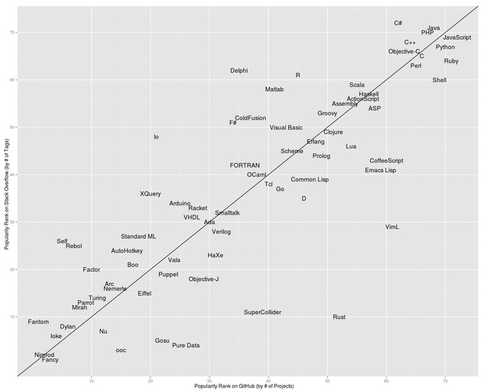
Tier 1
Tier 2

Slide 9
Copy
char
char
Keyboard
Printer

Slide 10
Copy
char
char
char
Keyboard
Printer
char
PT Reader
PT Punch

Slide 11
Copy
char
char
getchar
putchar
?
?
Keyboard
Printer

Slide 12
Copy
getchar
putchar
File
Keyboard
Printer

Slide 13
Flow of Control
Sender
message
Recipient
Opposed Dependency

Slide 14

function parameters is parentheses
function body
right arrow

Slide 15
abstract class or trait
Base
Core
Stackable
class(es)
traits

Slide 27
PC 1
PC 2

Slide 28
Actor
Behavior
State

Slide 29
Event-Based Thread
Actor
Behavior
State

