Slide 1
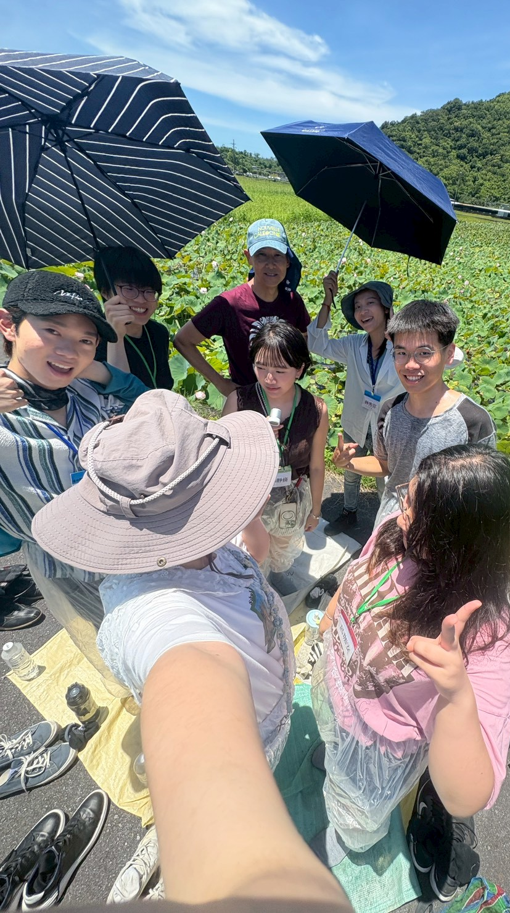

AQUA TEAM
From Crop to Brand
A Toolkit for Small Farmers to Start From Zero and Build a Pastoral Life
From Crop to Brand · Multi-Use Crops × Brand Loyalty × Stable Income Model
5 Days, 4 Nights of Rural Field Study · A Practical Proposal for the Pastoral Dream

Slide 2



Opening · THE CHALLENGE
Many People Dream of a Pastoral Life, but Reality Gets in the Way
We found that the biggest challenge in rural experiences and small-farm entrepreneurship isn’t passion — it’s whether the economics can hold up. This toolkit was built to answer that question.
01
02
03
Multi-Use Crops
Brand & Word of Mouth
Stable Income Model
Squeeze every bit of value from the crop through the most effective use
From a one-time visitor to a long-term relationship — and referrals to friends
The most important step: making income predictable and repeatable
AQUA TEAM
02

Slide 3
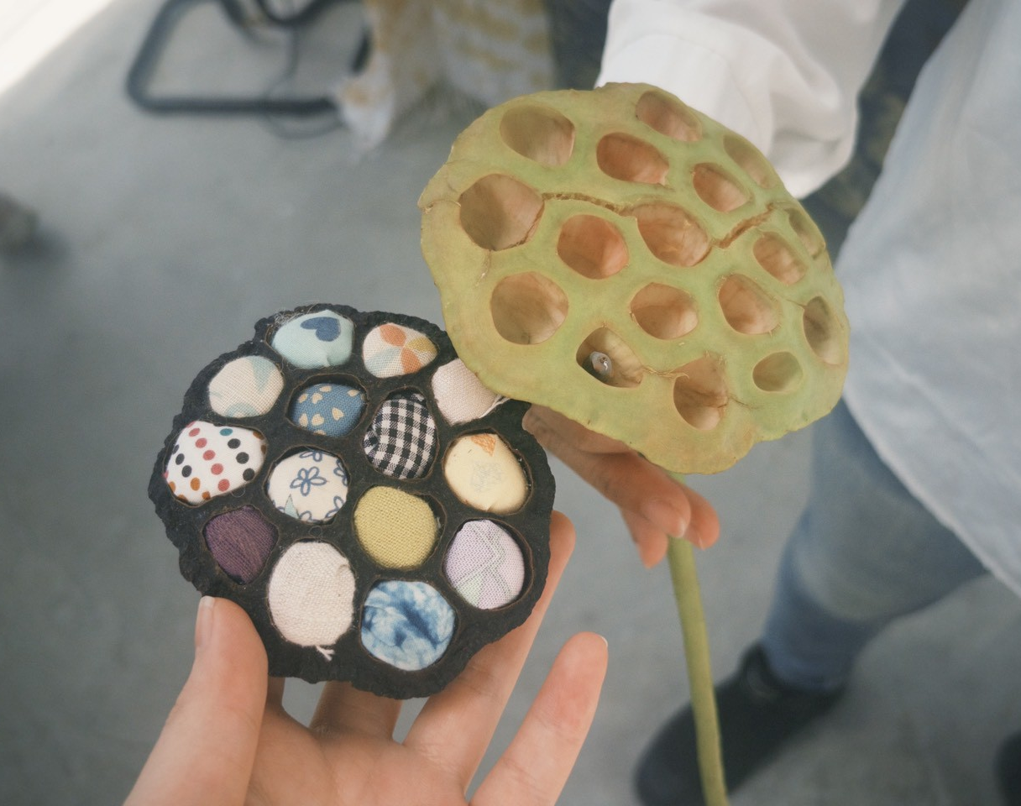

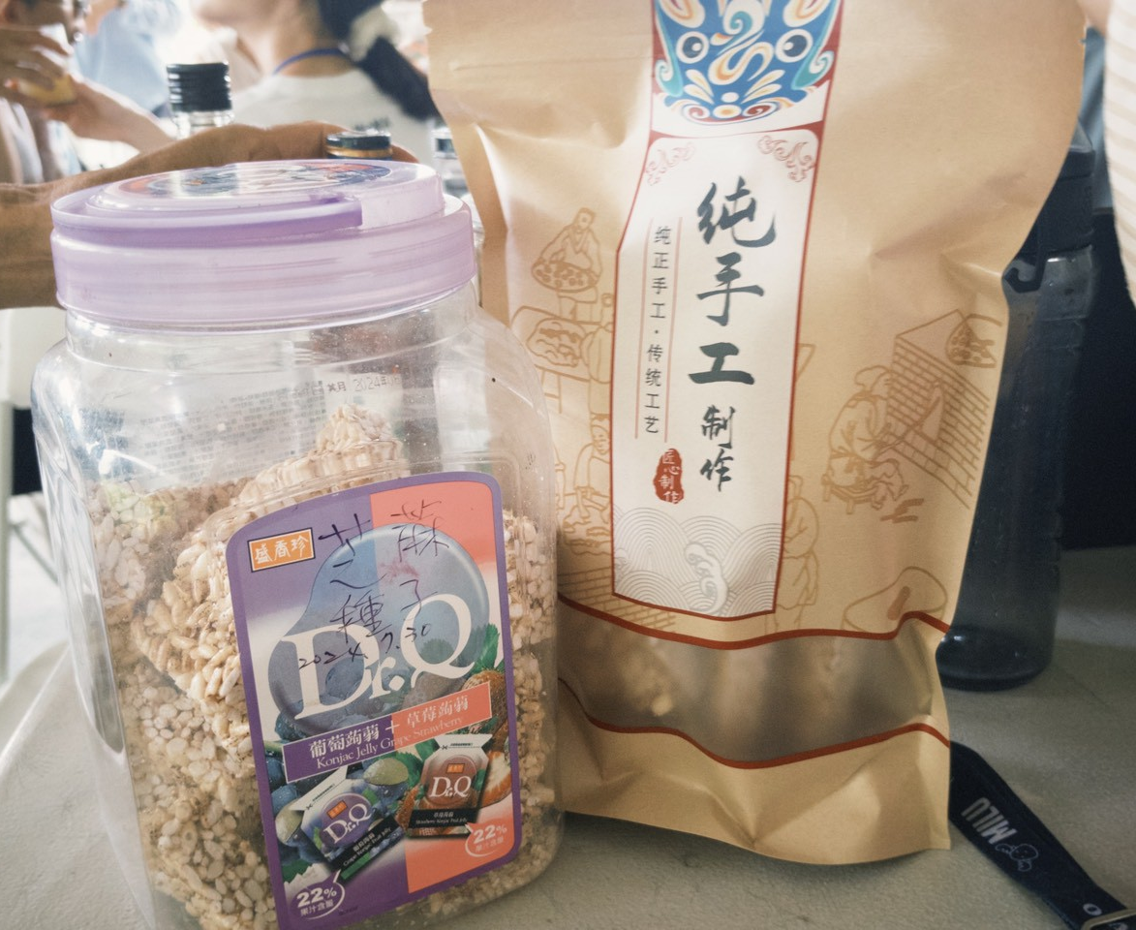
PART 01
How to Get Multiple Uses from One Crop
From Crop to Brand — A Seven-Step Workflow from Agricultural Product to Brand
AQUA TEAM
03

Slide 4







TOOLKIT OVERVIEW
Agri-Processing Brand Toolkit | Seven Steps
STEP 1
STEP 2
STEP 3
STEP 4
Crop Resource Inventory
Customer Needs Map
Processing Possibilities
Case Studies & Inspiration Library
Identify crop characteristics, surplus resources, and local advantages
Clearly define the target audience and market demand
One crop, many possible processing directions
Domestic and international success stories and cross-sector collaboration
STEP 5
STEP 6
STEP 7
Local Collaboration Network
Brand Story Template
MVP Validation
Connecting small farmers, processors, designers, and researchers
Establish the brand’s philosophy, character, and local value
Small-batch trials, market testing, and continuous refinement
DEMO：https://tjimmy0113.github.io/tu-lu-toolkit/
AQUA TEAM
04

Slide 5
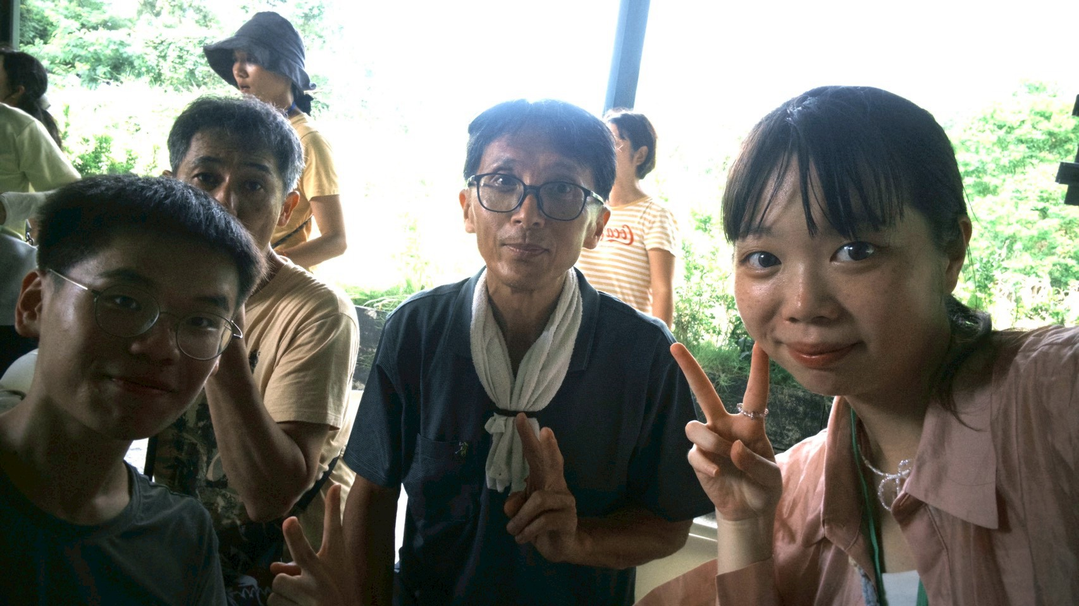

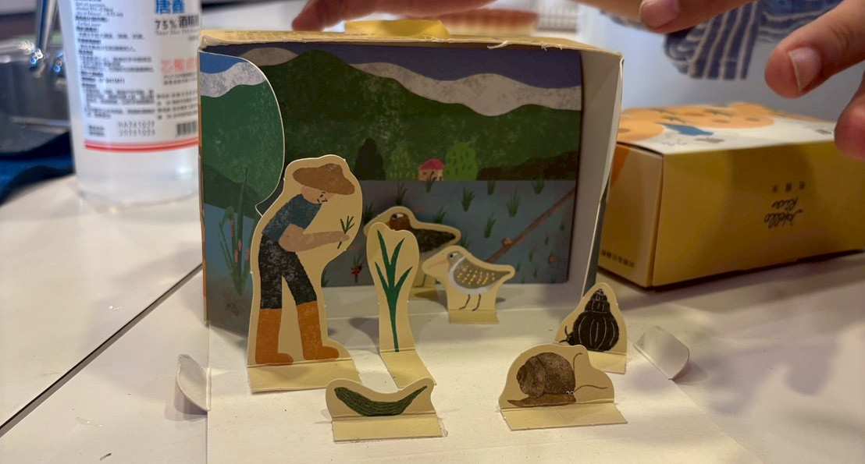
From “Growing Agricultural Products,”
Toward
“Creating Brand Value.”
By rediscovering crops, exploring processing possibilities, and connecting local resources with market demand, every small farmer can use a systematic process to turn agricultural products into a brand with a story, character, and competitive edge.
AQUA TEAM
08

Slide 6
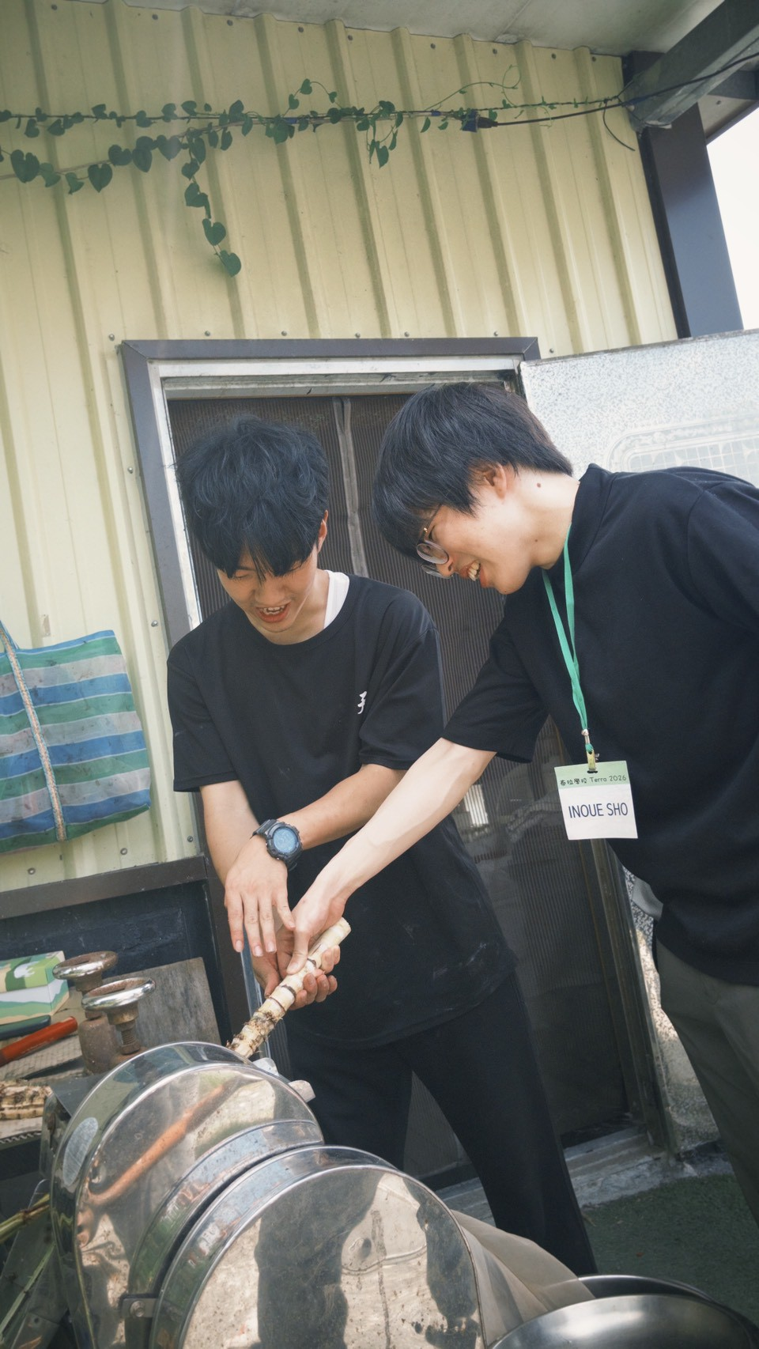

PART 02
Brand Loyalty & Word of Mouth
Trust → Emotion → Repurchase: Turning a Single Purchase into a Long-Term Relationship
AQUA TEAM
09

Slide 7
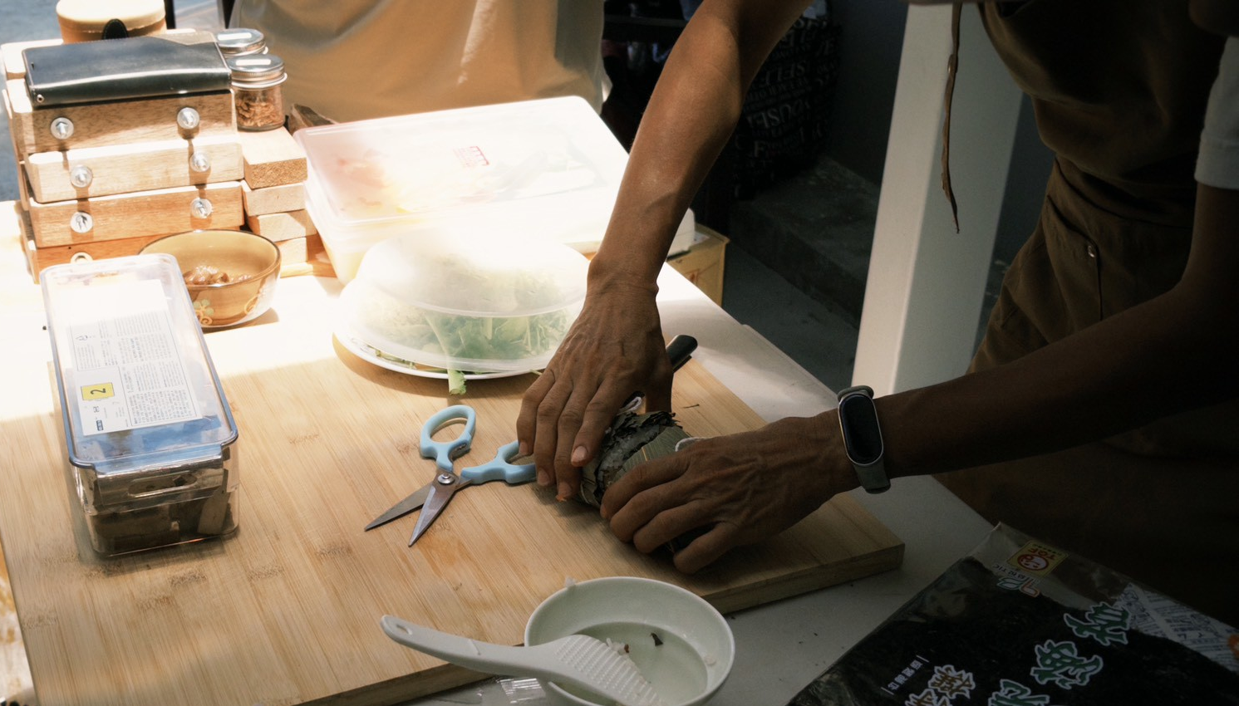



Three Brand Steps · THE MODEL
Word of mouth is really built up over three stages
TRUST
EMOTION
REPURCHASE
Trust
Emotion
Repurchase
Get consumers to dare to buy for the first time
Get consumers to want to stay
Turn a single purchase into a habit
Trust gets people to buy for the first time; emotion makes them want to stay; repurchase turns the relationship into a long-term habit.
AQUA TEAM
10

Slide 8
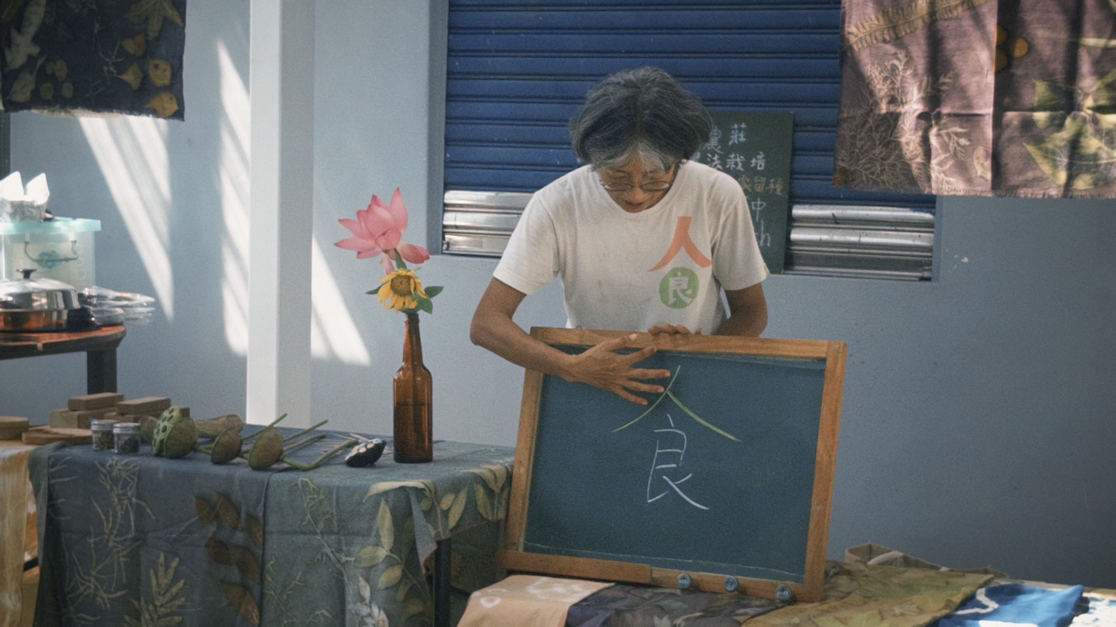



1
STEP 1 · TRUST
Building Trust: Getting People to Buy for the First Time
The biggest problem with agricultural products is uncertainty — is it natural, is it safe, why is it more expensive.
Reducing Information Asymmetry
Knowledge Education
Authentic Stories
Farm/factory visits, QR-code origin tracing, and production videos let consumers see how the product is actually made.
Regularly sharing the value of health and natural farming methods helps consumers understand the meaning beneath the surface.
People trust “real people” more than corporate packaging — a farmer’s daily life, founding story, land, and culture.
What consumers trust isn’t the product itself, but the people and the entire production process.
AQUA TEAM
11

Slide 9
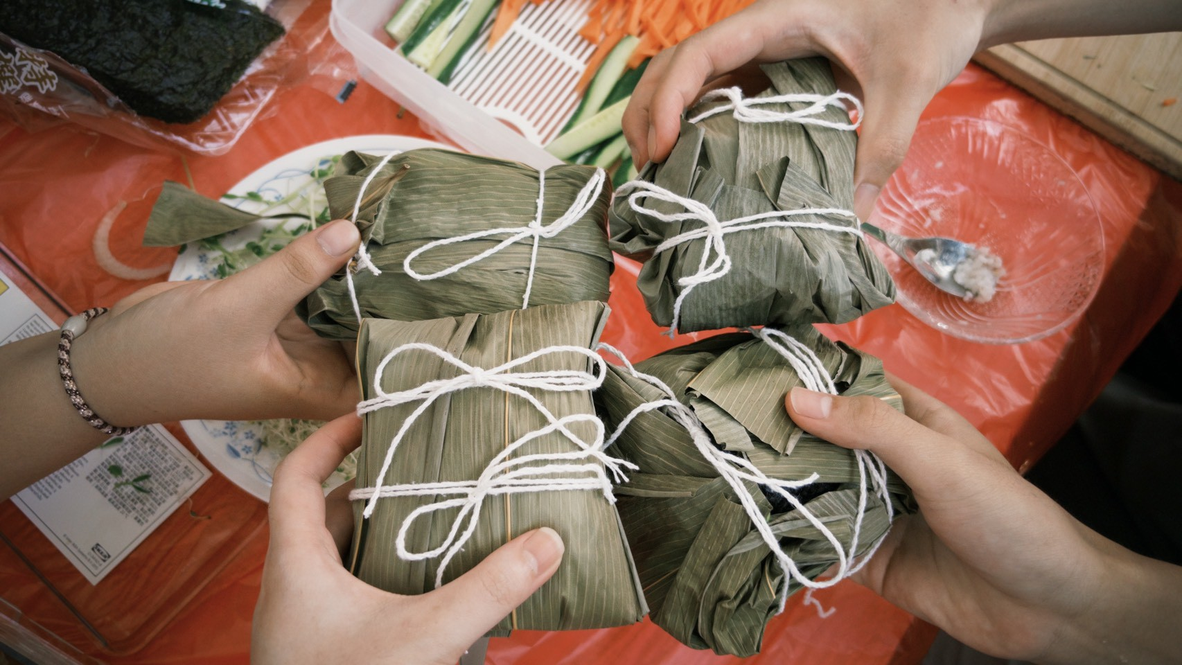



2
STEP 2 · EMOTION
Building Emotion: Getting People to Want to Stay
Once trust is established, the next step isn’t selling — it’s inviting consumers into the brand’s world.
Immersive Experiences
Human Connection
Everyday Integration
Harvesting, DIY processing, and farm activities let customers form memories through hands-on participation.
Farmers personally lead tours, building genuinely warm, personal interactions.
Running social media accounts, sharing recipes, and authentic KOL shares bring the brand into everyday life.
Emotional connection turns the brand from a one-time transaction into an ongoing relationship.
AQUA TEAM
12

Slide 10
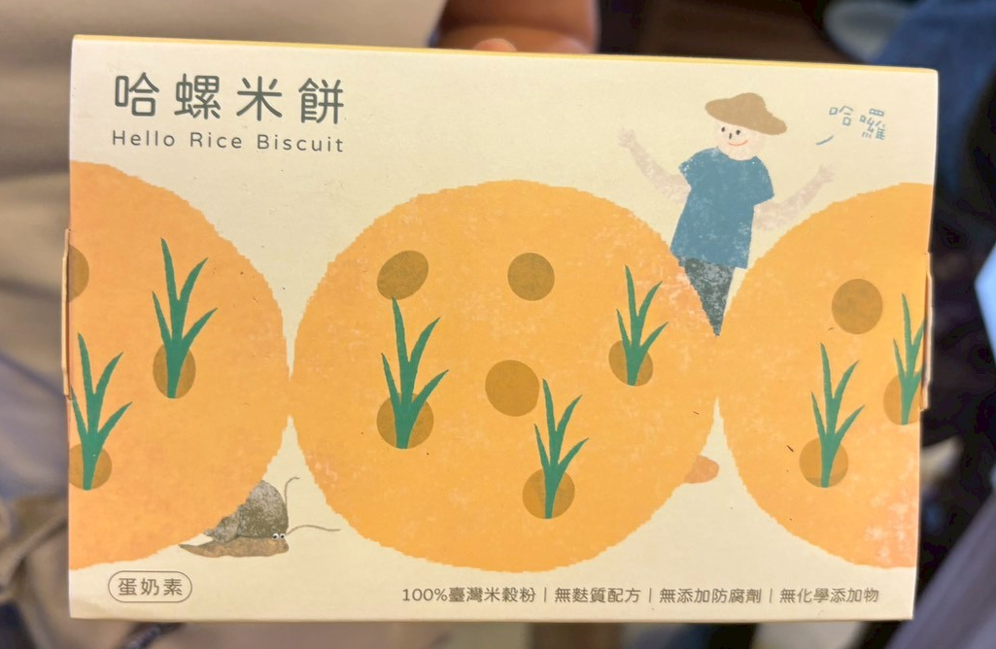



3
STEP 3 · REPURCHASE
Building Repurchase: Letting Habits Form Naturally
The key question: how to turn a single purchase into a long-term consumption habit.
Repurchase Mechanisms
Subscription Model
Community Spread
Membership systems, points, and discounts make repurchasing easier and more appealing.
Regular produce boxes and seasonal deliveries mean customers don’t have to think each time — they just receive them automatically.
Referral rewards and bring-a-friend events turn loyal customers into brand promoters.
Repurchase comes from convenience, habit, and the brand’s ongoing presence.
AQUA TEAM
13

Slide 11

PART 03
Revenue Model
The most important step: turning passion into predictable, sustainable cash flow
AQUA TEAM
14

Slide 12






REVENUE STREAMS
Seven Major Revenue Streams
Processed Product Sales
Membership System
Experience Events
School Partnerships
Dried fruit, jam, tea bags, rice products, gift boxes
Regular / Frequent / VIP tiers, based on spending or annual fee
Tastings, hands-on workshops, farm tours, family fruit-picking
Field trips, food & farming education, course packages, teaching aids
Primary cash flow
Increases repurchase rate
Creates return-visit value
Stable partnership income
Crop Subscriptions
Referrals & Group Buys
Teaching Kits & Materials
Pre-order next season’s crops or processed goods
Corporate gift boxes, community group purchases
Food & farming education kits, planting kits, worksheets
Secures funding in advance
Expands the customer base
Extends educational value
AQUA TEAM
15

Slide 13


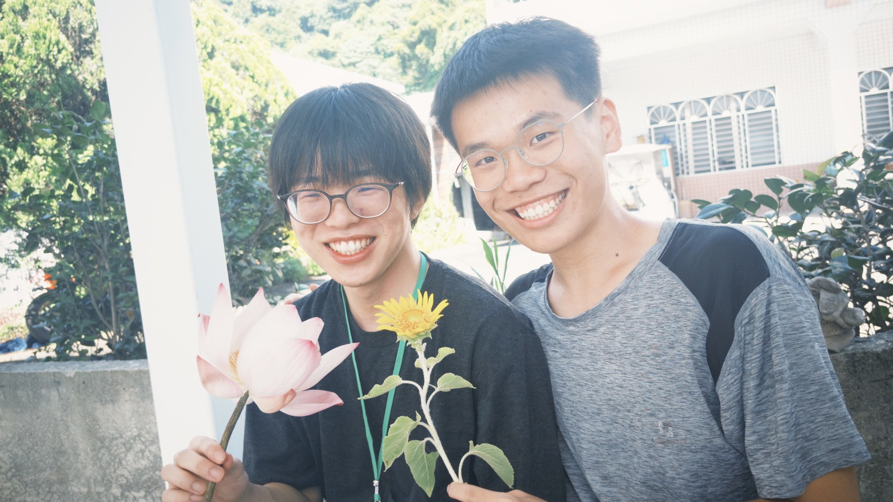
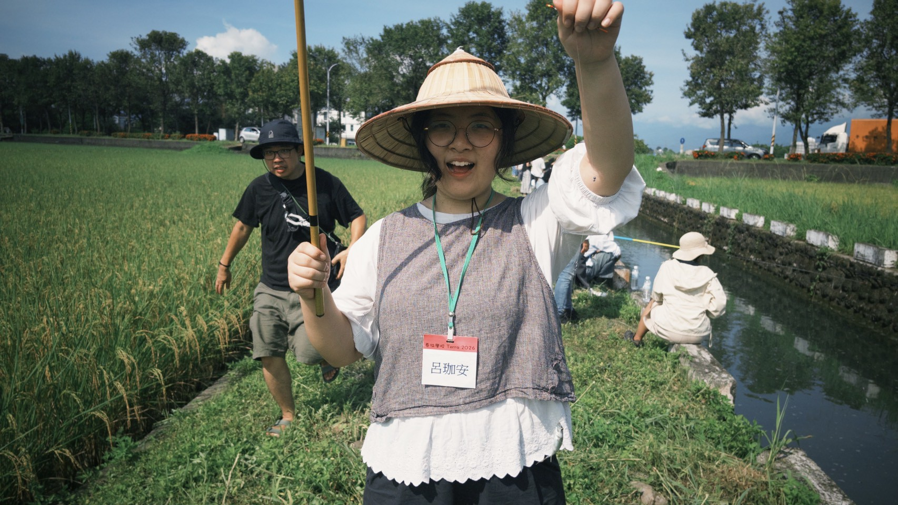
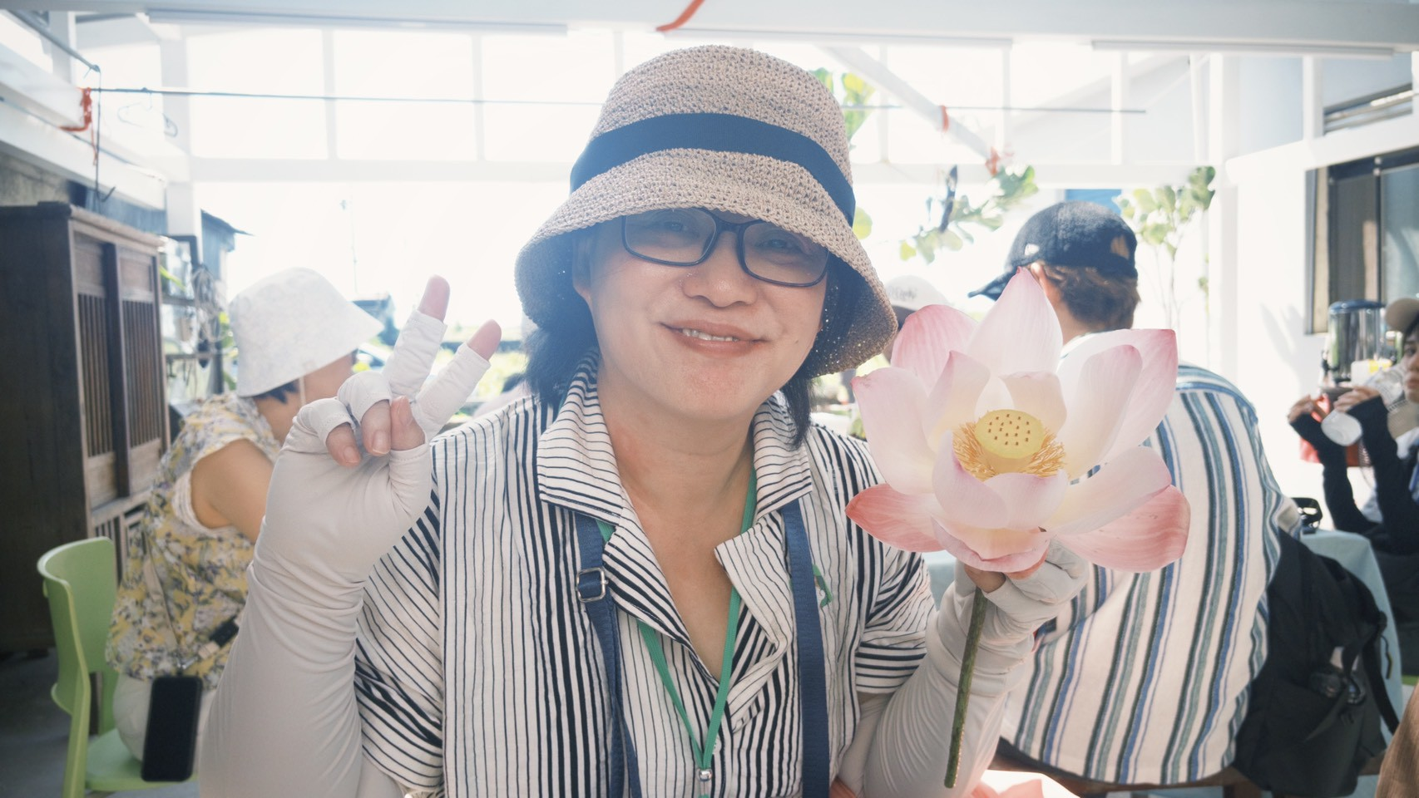

KEY METRICS
QuantitativeMetrics
Event-to-Purchase Conversion Rate
Membership Conversion Rate
Repurchase Rate
How many people place an order after attending an event
How many customers are willing to become members
Whether the brand makes customers willing to buy again
AQUA TEAM
18

Slide 14
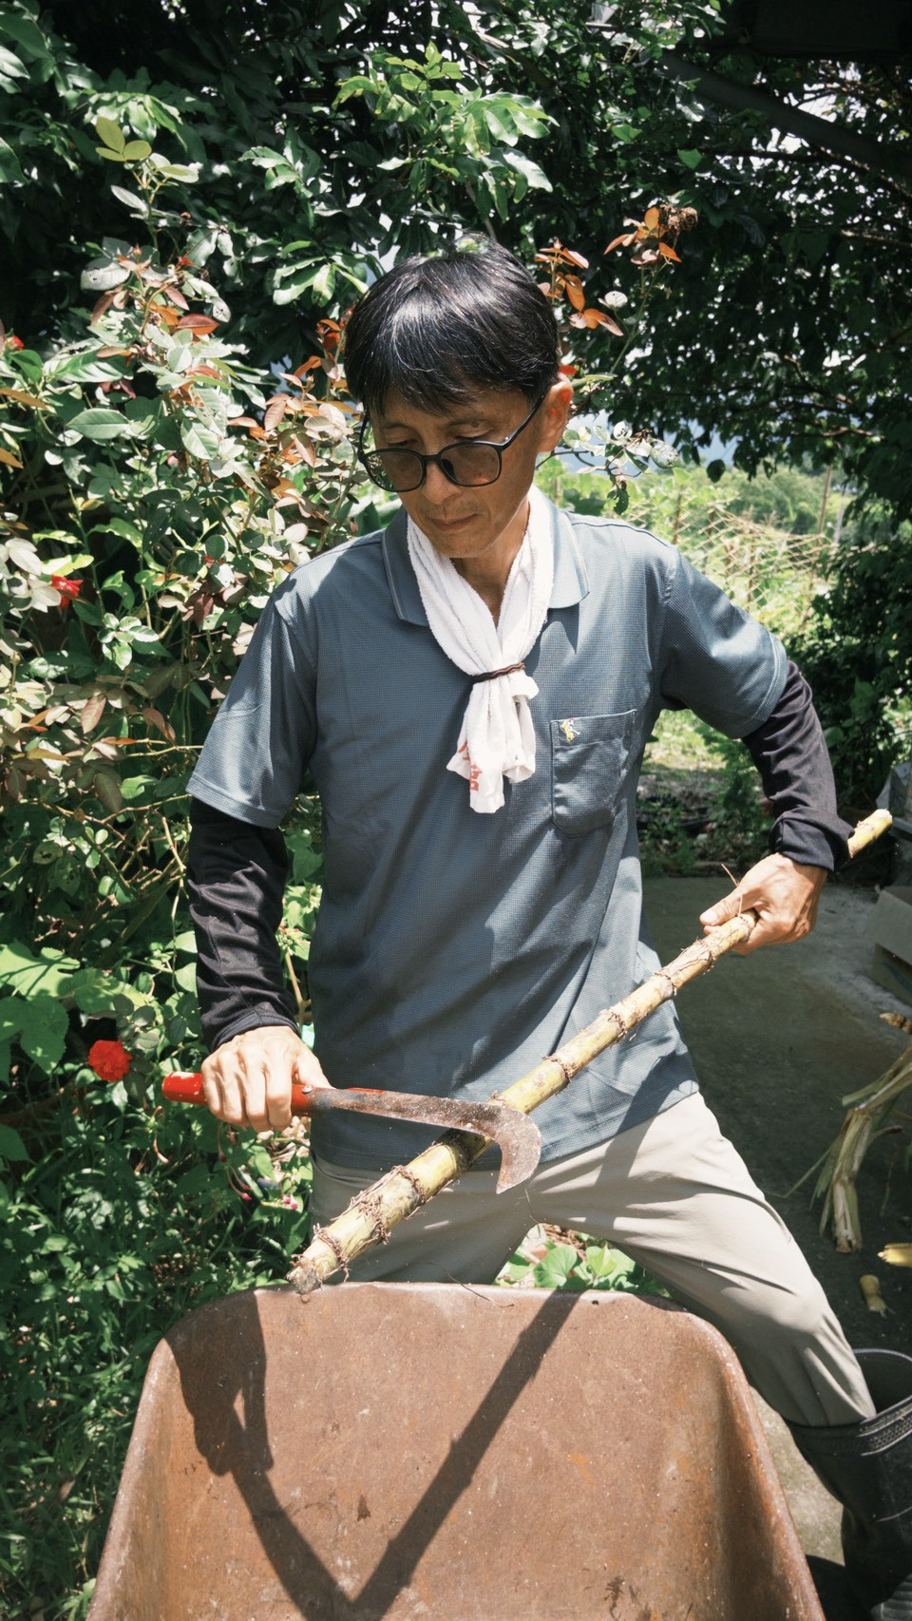
Let Every Stalk of Sugarcane Be Squeezed for All It's Worth.
Multi-Use Crops Maximize Value;
Brand Word of Mouth Makes Relationships Last Longer;
Diverse Income Sustains the Dream.
From “Growing Agricultural Products” to “Creating Brand Value.”
AQUA TEAM - aquaguy、aquagod、aquaman、aquawoman、kkbox、aquawarrior
Thank You for Listening · Let’s Turn the Pastoral Dream into an Everyday Life

Slide 15
STEP 1–2
First Understand the Crop, Then Understand the Market
1
CROP DISCOVERY
2
CUSTOMER DISCOVERY
Rediscover Your Crop
Re-Examine Market Demand
What resources do I actually have?
Many processed products fail not because they’re bad, but because no one needs them.
What are the main crops? When is yield highest?
Which items are often left over or hard to sell because of appearance?
Which have the best quality and the most local character?
Output: a crop resource inventory (e.g., sugarcane — high sweetness, weather-resistant, lots of surplus material)
Who will buy? Tourists, families, campers, gift-givers, corporate gift boxes
What they really want is convenience, health, experience, and a story
Output: a customer needs map (tourists → want to bring home Yilan specialties → souvenirs)
Core:Treat the crop as a “resource,” not just an agricultural product.
Core:Don’t sell the crop — sell the need.
AQUA TEAM
05

Slide 16
STEP 3–4
First Brainstorm Possibilities, Then Borrow Inspiration from the World
3
VALUE EXPANSION
4
INSPIRATION SEARCH
Expand Processing Possibilities
Search for Outside Inspiration
For each agricultural product, brainstorm at least 10 ways to process it.
No need to reinvent the wheel — learn from examples around the world.
Rice → rice wine, rice crackers, rice puffs, rice ice cream, rice milk, rice snacks...
Sugarcane → brown sugar, syrup, popsicles, fermented drinks, DIY materials
Categories: food / beverages / desserts / skincare / creative goods / experiences
Research cases from Japan, Korea, Europe, and counties across Taiwan
How do local revitalization projects, farmers’ associations, and creative brands do it?
Cross-disciplinary collaboration: food science, design, agricultural research stations, research institutions
Core:Don’t settle for one answer — brainstorm broadly first.
Core:Don’t just look at competitors — look for inspiration across different industries.
AQUA TEAM
06

Slide 17
STEP 5–6
Connect Local Partners, Tell a Great Brand Story
5
LOCAL COLLABORATION
6
BRAND STORY
Build a Local Co-Creation Model
Brand Story Design
It’s hard for a single small farmer to do everything, so build a collaboration network.
A brand isn’t a logo — a brand is a story.
Inventory: nearby small farmers, processing plants, packaging designers, farmers’ associations, restaurants, schools
Connect with government resources and local revitalization teams
Example: your own strawberries + nearby honey + tea = a signature Yilan gift box
Who are we? What do we grow? Why do we grow it this way?
What’s special about this land? What problem are we trying to solve?
Example: Yilan’s heavy rain → choose weather-resistant sugarcane → make use of surplus material → reduce waste and create value
Core:It’s not about doing everything alone — it’s about creating value together.
Core:Use a story to make customers remember you — don’t compete on price.
AQUA TEAM
07

Slide 18
STEP 7 · Core Concept
Validate at Small Scale, Build a Repeatable Model
7
PROTOTYPE & TEST
Validation & Optimization
Don’t do it all at once — start with small-scale testing.
The whole toolkit, in one sentence:
From “Growing Agricultural Products,”
Toward
“Creating Brand Value.”
Tastings, market sales, surveys, interviews
Observe purchase rates and community feedback, then refine again
Document the processing / branding / packaging / sales workflow
Form a repeatable model
By rediscovering crops, exploring processing possibilities, and connecting local resources with market demand, every small farmer can use a systematic process to turn agricultural products into a brand with a story, character, and competitive edge.
Core:Validate in small steps first, then scale up.
AQUA TEAM
08

