Slide 1
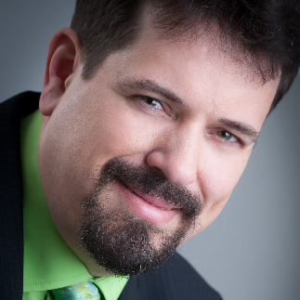
A VOYAGE THROUGH BDD IN THE FINANCIAL SECTOR
Dirk Rombauts
BDD Coach at Pickles Pro
Maintainer of Pickles
Accredited SpecFlow Trainer

Slide 2
Introduction

Slide 3
Your Take-Away from this Talk
BDD can improve your productivity
Fewer misunderstandings
Less rework
Learn from what we did
… from our successes
… from our mistakes
Notes:
I like to introduce Behaviour Driven Development as a technique for capturing requirements in software projects, in such a way that both the technical roles in the team (like developers and testers) and the non-technical roles in the team (like product owners and business analysts) understand the requirements in the same way. Most failures in software projects are caused by bad communication and misunderstood requirements. BDD can reduce those misunderstanding and thus boost the chances of success of your project.

Slide 4
Corporate Actions
Companies announce things like
Dividend Payout
Tender Offer
Stock Split

Slide 5

AIM GAIN Corporate Actions DM
Developed by AIM Software, Vienna-based
Improve the quality of data in the financial sector
Their chief customers are private banks

Slide 6
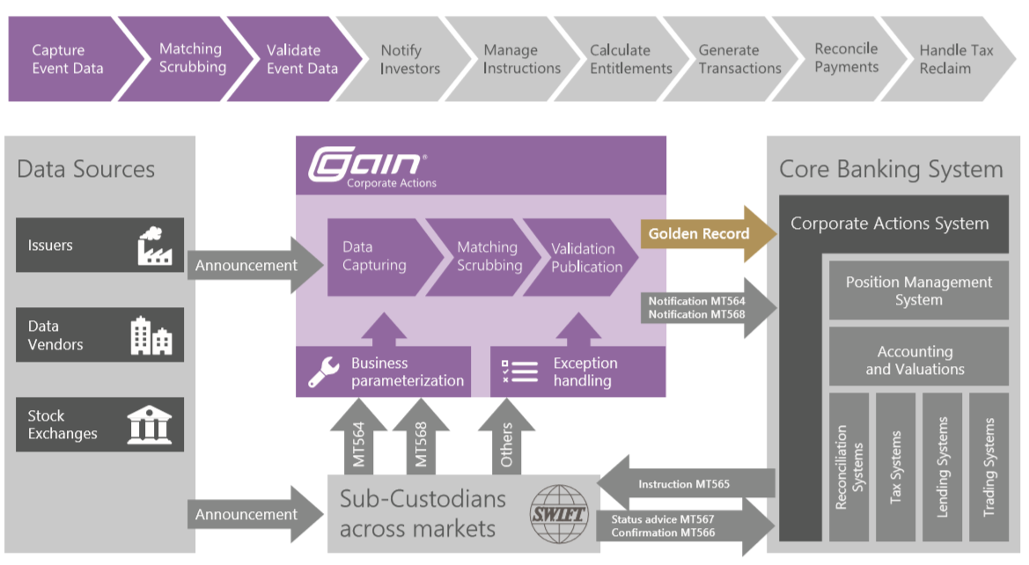
AIM GAIN Corporate Actions DM
http://www.aimsoftware.com/products/gain-corporate-actions

Slide 7
The Team
Product Owner
Domain Expert
(who became Product Owner)
Scrum Master + Developer
4 developers
2 experienced
2 less experienced
1 Functional Tester
(who became a full-blown developer)

Slide 8
The Technical Situation
Two solutions
One “static” with the shell application
One “dynamic” with the product-specific code
Very few unit tests
Impossible to load the “dynamic” code in isolation
Reasonable amount of functional tests
All end-to-end

Slide 9
Our Challenges
Communication Problems
Between Product Owner and Domain Expert
Between Product Owner and Developers
Requirements in French
No contact with actual customer

Slide 10
First Steps

Slide 11


An Idea whose Time has Come
I used to work at TechTalk …
… but I never used SpecFlow
… and did only a bit of BDD
That Changed ☺
Bridging the Communication Gap
Specification By Example

Slide 12
The First Features
Talking with PO
Writing Gherkin scenarios
Reviewing them with PO

Slide 13
My Impression
“Finally, I was able to pin the Product Owner down on a clear, unambiguous statement”

Slide 14
The Product Owner’s Impression
“Finally, I had the feeling that the developers understood what I was saying”

Slide 15
No Automation?!
I did not manage to create an Automation Layer at first
Gherkin Scenarios became inspiration for functional tests
This was NOT a failure!

Slide 16
BDD is about Collaboration and Communication
We obtained lots of value through the improved communication and reduced misunderstandings

Slide 17
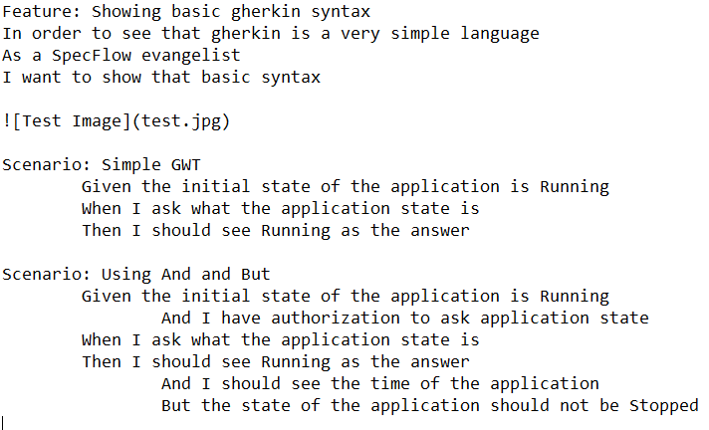
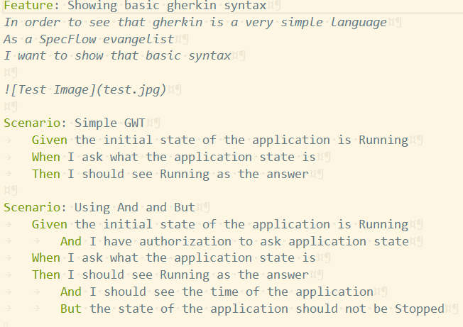
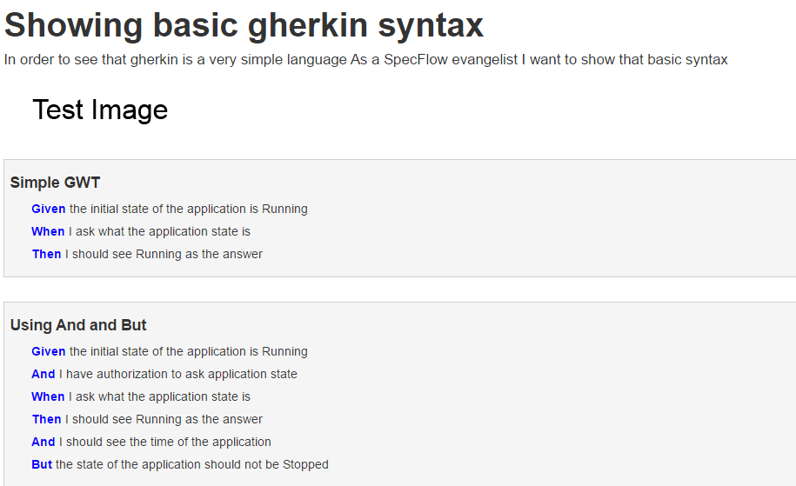
“I can’t show this to a customer”
Notes:
Product owner complain

Slide 18
Living Documentation
A documentation that describes how the system works, and is always up-to-date
The scenarios describe how the system work, and they are updated whenever the expected behavior changes
The scenarios can be the documentation of the system

Slide 19
Living Documentation Generators
Relish
Written in Ruby
Closed source
Documentation hosted in the cloud
http://www.relishapp.com/
Pickles
Written in .NET
Open source
Documentation hosted on premise
http://www.picklesdoc.com/

Slide 20
Fast Forward a few Months
Good routine
Gherkin scenarios
Inspiration for functional tests
Increased
Quality of communication
Productivity
Velocity
Less rework

Slide 21
Automation
The next attempt at an Automation Layer succeeded!
Two scenarios automated at the end of the sprint
I was so proud ☺
Over time, we migrated all functional tests to SpecFlow

Slide 22
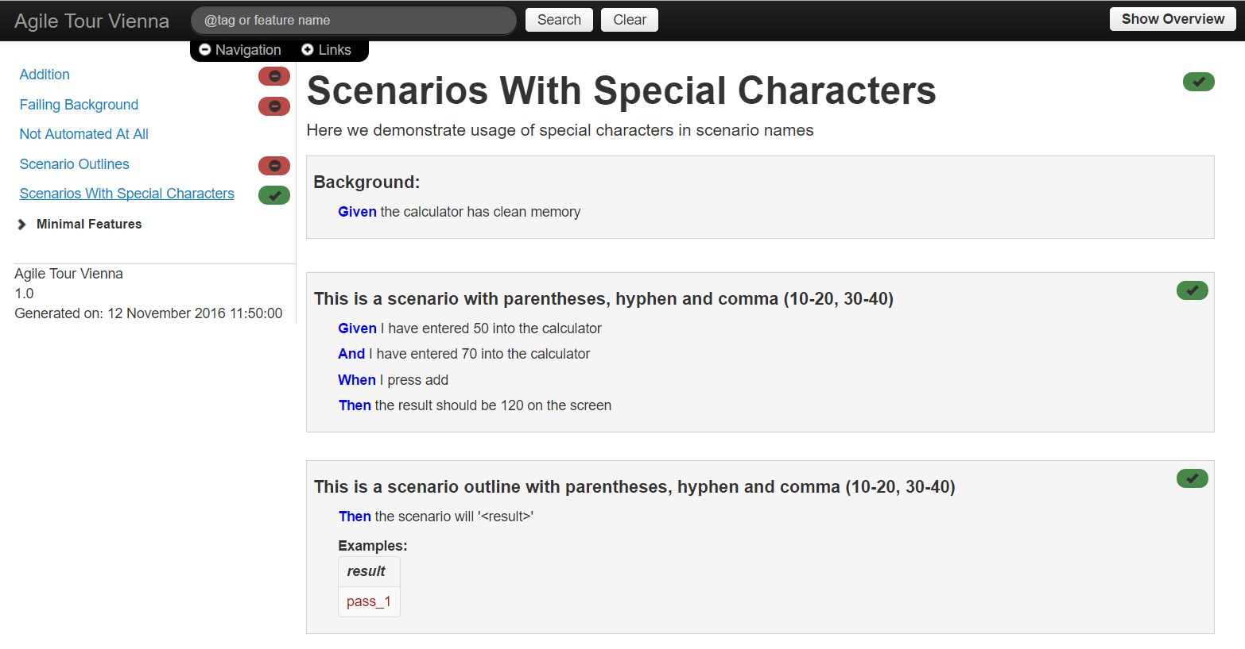
Living Documentation with Test Results

Slide 23
Rise to Glory

Slide 24
Meetings
Pre-Grooming
1 representative from each role
Outcome: sketches of scenarios
Grooming
Entire team
With fully formalized gherkin scenarios
Outcome: estimation
Sprint Planning
Entire team
Short meeting
Outcome: scope for the sprint

Slide 25
Meetings
Pre-Review
Developer, Product Owner
Go through acceptance criteria of user story
Outcome: approval by Product Owner
Sprint Review
All (and only) pre-reviewed stories
“outsiders” may be present
And of course …
Sprint Retrospective
Daily Scrum

Slide 26
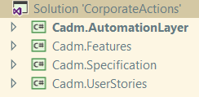
Three Stages in the Life of a Scenario
Under Specification
In its own project “Specification”
Need not be valid gherkin
Not automated
Under Development
Moved to project “UserStories” at start of the Sprint
Must be valid gherkin
Not necessarily automated
May be red during sprint
Must be green at the end of the sprint
Done
Must be green at all times
Organized by feature in project “Features”

Slide 27
Three Stages in the Life of a Scenario
High segregation of scenarios
Build does not break when BA checks in invalid gherkin
Automation Layer in a different project
High maintenance effort
when moving feature files
when reorganizing scenarios into features
Potential loss of history in source control
In a different team, we used @tags instead of projects
Notes:
The automation is in a different project so that all three projects can refer to it for IntelliSense

Slide 28
SpecLog
Backlog in TFS did not suit us
Prioritized list is good for telling you what to do
Not for telling you why to do it
Product Owner did not have TFS access at all times
He would use an Excel file and synchronize that
Lots of additional info in the Excel file
Two sources of the truth

Slide 29
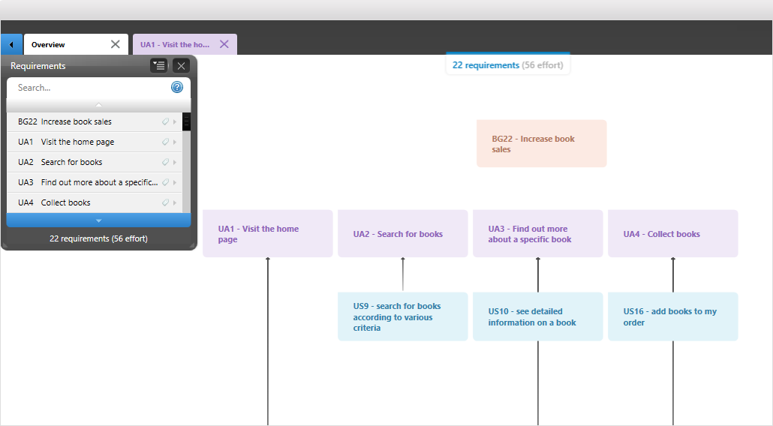
SpecLog
http://www.speclog.net/features/

Slide 30
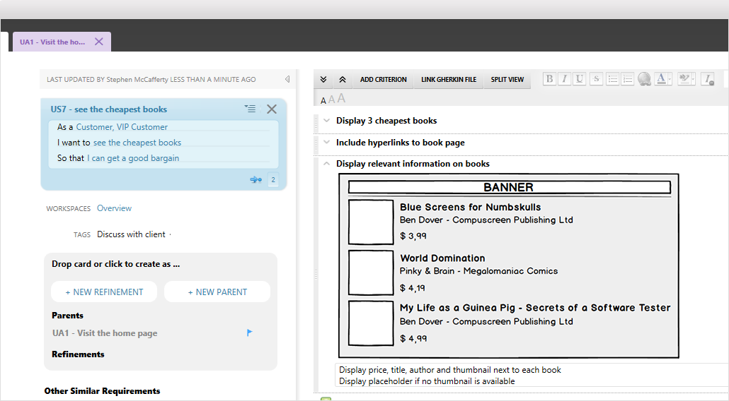
SpecLog
http://www.speclog.net/features/

Slide 31
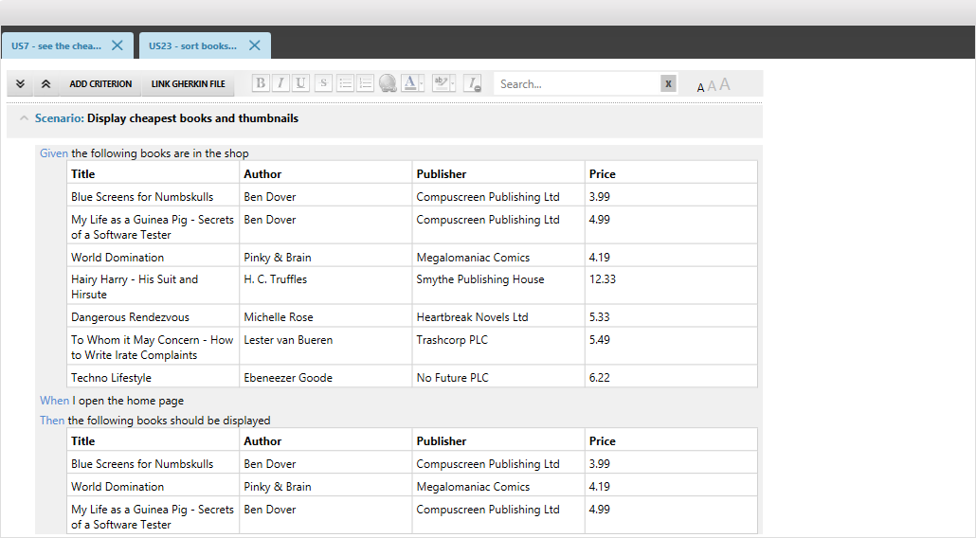
SpecLog
http://www.speclog.net/features/

Slide 32
SpecFlow+ Runner
We were unhappy with MSTest as a test runner
Not convenient to use from command line or build server
Reports were not convenient to use
Download from server
Open in Visual Studio
SpecFlow+ Runner to the rescue
Straightforward to use from command line
Outputs an HTML report
Good balance between
business readability
Technical information
We would use both MSTest and SpecFlow+ Runner
MSTest in Visual Studio
SpecFlow+ Runner for command line and build server
Notes:
We extended Pickles so it could parse SpecFlow+ Runner output files and donated that code to Pickles

Slide 33
Several Nightly Runs
Stories under development (current iteration)
Features that were done (regression)
Customer-specific functionality (per customer)
The results were aggregated on a webserver for a “single glance” status

Slide 34
Roles
Product Owner
customer wrangling
Business Analyst
Participate in customer discussions
Turn discussions into gherkin scenarios
Developers
Implement user stories
Automation Layer person
Maintain Automation Layer
Create bindings for user stories under development

Slide 35
Results
This setup worked really well
We achieved an all-time high in productivity
Iteration cycles became shorter
Our approach to “agile” changed
Away from a strict sprint-based Scrum setup
Towards a more flow-based Kanban-like setup

Slide 36
The Cracks

Slide 37
Problems in the Team
Information silos
Automation Layer person became a bottleneck
Business Analyst: developers became disconnected from requirements
Problems between team members
1 person left and had to be replaced
Notes:
The problem with that person leaving would have happened with or without BDD. I included it to show that no technique or methodology can protect you from that kind of problems.

Slide 38
Long Running Test Suites
Situation:
The architecture precluded testing functionality in isolation
All tests had to be run end-to-end
Lots of scenarios
Consequence:
Long running times
Verification was done infrequently
No benefit from outside-in development

Slide 39
Too Many Scenarios
Situation:
Scenarios were written like functional tests
“Now we can test everything”
Consequence:
Scenarios lost ability to explain the system
No benefit from Living Documentation

Slide 40
Flickering Tests
Situation:
A couple of hundred scenarios
Random failures, mostly because of timeouts
Consequence
Most nights the tests were red
People stopped trusting the tests
People stopped caring about the tests

Slide 41
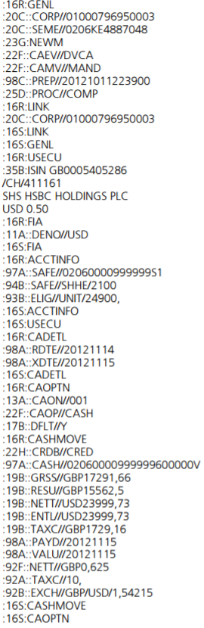
Too Much of the Wrong Kind of Detail
Situation:
Swift: text-based format with delimiters
Scenarios would specify entire messages
Pro: all information in one place
Contra: 50 lines of swift plumbing for 3 relevant fields
Consequence:
Difficult to grasp the point of the scenario
https://www.ubs.com/content/dam/static/global/bank_for_banks/bank_global_custody/ex_hosting/b4b_four/globalcustody/documents/SWIFT/technical/UBS_SWIFT_UG_CAM.pdf

Slide 42
Issues with Customer Collaboration
Customers were willing/able to change only up to a point
Were restricted by their own structures
Controlling vs. Collaboration
Notes:
Example: one customer did not have a way of dealing with a story not being finished in the sprint. They treated it as missing a milestone – which is of a different order.

Slide 43
Gherkin Abuse
Customers treated gherkin scenarios as
“A functional test that can be written by a business analyst and that will be executed automatically”
And arrived at the conclusion
“Now we can specify every possible combination and it will be tested automatically”
We missed the point of the explanatory power of scenarios!

Slide 44
Gherkin Abuse
“The customer has to sign off on the gherkin scenarios”
The gherkin scenarios were used
more like a controlling tool
less like a collaboration tool
Your toolset cannot replace a productive relation with your customer

Slide 45
Conclusions

Slide 46
The Point of BDD …
… is to improve
communication
common understanding
Functional testing is only a side effect

Slide 47
Benefits
Improved communication
Less rework
Increased velocity
Flow-like delivery, beyond Scrum stop-and-go
We reaped those benefits as long as the number of scenarios was relatively small

Slide 48
Opportunities for Growth
Once the number of scenarios reached a certain size, we bogged down. Possible improvements:
Retooling the software to support testability
Less end-to-end testing
Spread the test suites over multiple machines
Faster turnaround time
Remove Swift from the scenarios
Better readability
Focus on the collaboration instead of functional testing
Better understanding
Focus on quality, not quantity of scenarios

Slide 49
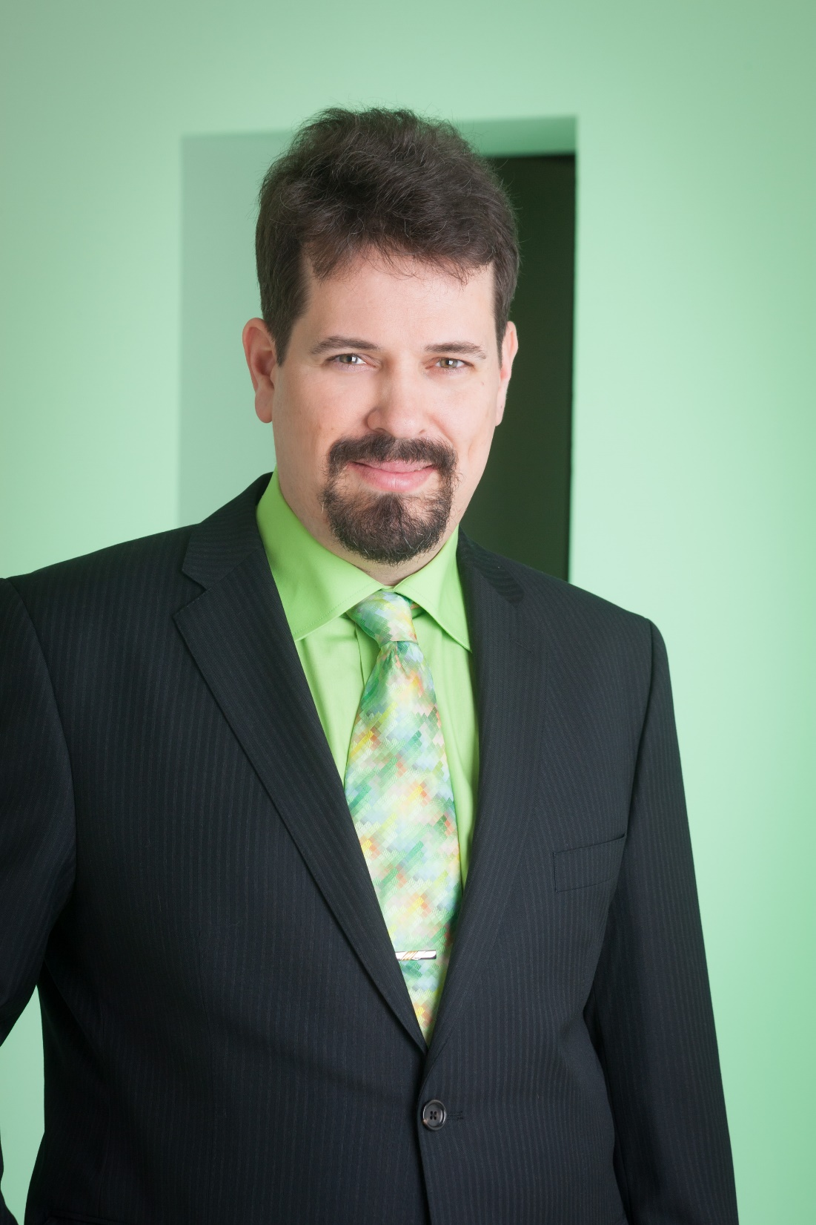
Dirk Rombauts
Thank you for listening!
BDD Coach at Pickles Pro
Maintainer of Pickles
Accredited SpecFlow Trainer
@picklesprobdd

Slide 50

Developing with SpecFlow

