Slide 1
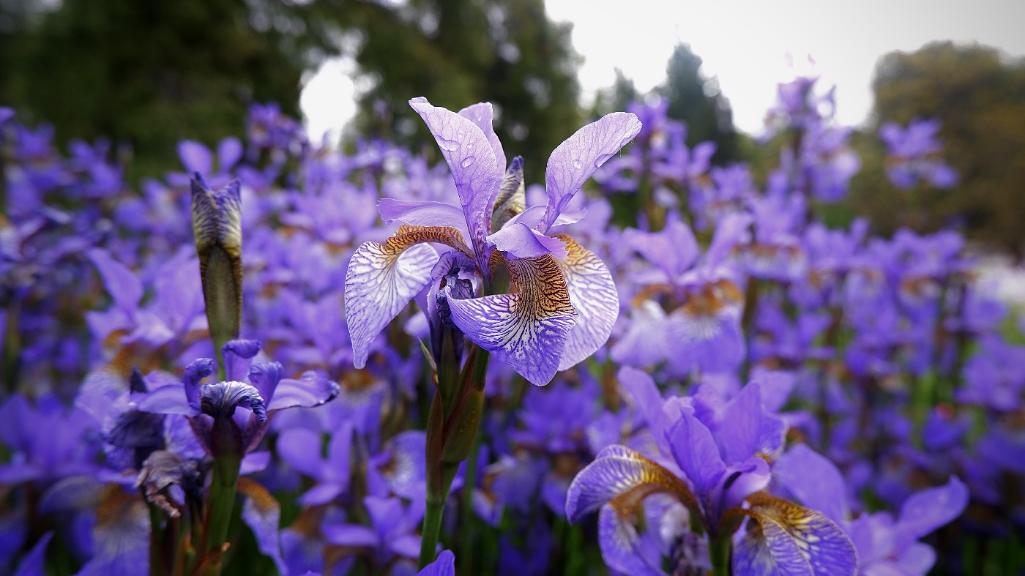
Analysing Decision Tree and K-means Clustering using Iris dataset
Submitted by:
Guruprasad K(1NT19CS407)
Agil Srinivasan(1NT19CS400)

Slide 2
Introduction
Basically, machine learning is to let a computer develop learning skills by itself with given knowledge. Pattern recognition can be treated like computer being able to recognize different species of objects.
In this project, the object is the Iris flower. The data set of Iris contains three different classes: Setosa, Versicolour, and Virginica.
The designed recognition system will distinguish these three different classes of Iris.

Slide 3
Aim
The aim of the case study is to design and implement a system of pattern recognition for the Iris flower based on Machine Learning.
This project shows the workflow of pattern recognition and how to use machine learning approach to achieve this goal.
After the project has been settled, the computer should have the ability to aggregate three different classifications of Iris flower to three categories.
The whole workflow of machine learning should work smoothly.
The users do not need to tell the computer which class the Iris belongs to, the computer can recognize them all by itself.

Slide 4
Data source and Data quality
We will use the dataset from the Kaggle. The dataset is obtained from the following link – https://www.kaggle.com/uciml/iris
The data set contains 3 classes with 50 instances each, and 150 instances in total, where each class refers to a type of iris plant.
Class : Iris Setosa,Iris Versicolour, Iris Virginica
The format for the data: (sepal length, sepal width, petal length, petal width).
We will be training our models based on these parameters and further use them to predict the flower classes.

Slide 5
Machine Learning Methods
Supervised Learning:
Supervised machine learning algorithms are trained to find patterns using a dataset. The process is simple, It takes what has been learned in the past and then applies that to the new data.
Supervised learning is further divided into:
Classification
Regression

Slide 6
Machine Learning Methods
● Classification:
Classification predicts the categorical class labels, which are discrete and unordered. It is a two-step process, consisting of a learning step and a classification step. There are various classification algorithms like – “Decision Tree Classifier”, “Random Forest”, “Naive Bayes classifier” etc
● Regression:
Regression is usually described as determining a relationship between two or more variables, like predicting the job of a person based on input data X. Some of the regression algorithms are: “Logistic Regression”, “Lasso Regression”, “Ridge Regression” etc.

Slide 7
Machine Learning Methods
Decision Tree Classifier:
The general motive of using a Decision Tree is to create a training model which can be used to predict the class or value.
It tries to solve the problem, by using tree representation.
Each internal node of the tree corresponds to an attribute, and each leaf node corresponds to a class label.

Slide 8
Machine Learning Methods
Unsupervised Learning:
Unsupervised learning is used against data without any historical labels. The system is not subjected to a pre-determined set of outputs, correlations between inputs and outputs or a “correct answer.”
The goal is to explore the data and find some sort of patterns or structures.
Unsupervised learning can be classified into:
Clustering
Association

Slide 9
Machine Learning Methods
● Clustering:
Clustering is the task of dividing the population or data points into several groups, such that data points in a group are homogenous to each other than those in different groups.
● Association:
An association rule is an unsupervised learning method that is used for finding the relationships between variables in a large database. It determines the set of items that occurs together in the dataset

Slide 10
Machine Learning Methods
K-means Clustering:
The goal of the K-means clustering algorithm is to find groups in the data, with the number of groups represented by the variable K.
The algorithm works iteratively to assign each data point to one of the K groups based on the features that are provided.
The outputs of executing a K-means on a dataset are:
● K centroids: Centroids for each of the K clusters identified from the dataset.
● Labels for the training data: Complete dataset labelled to ensure each data point is assigned to one of the clusters.

Slide 11
Conclusion
This project describes the work principle of machine learning, two different learning forms of machine learning and an application of machine learning. In addition, a case study of Iris flower recognition to introduce the workflow of machine learning in pattern recognition is shown.
The meaning of pattern recognition and how the machine learning works in pattern recognition has been described.
The K-means algorithm, which is a very simple machine learning algorithm from the unsupervised learning method is used.
The Iris recognition case study above shows that the Machine Learning algorithm works well in this pattern recognition.

