Slide 1
Collective Phenomena in Social Dynamics
ALEX GIMÉNEZ ROMERO

Slide 2
OUTLINE
General results
  Voter model in regular networks
  Voter model in complex networks
Final project: Epidemic Spreading in Weighted Networks
  Introduction
  Models
  Results
  Conclusions

Slide 3
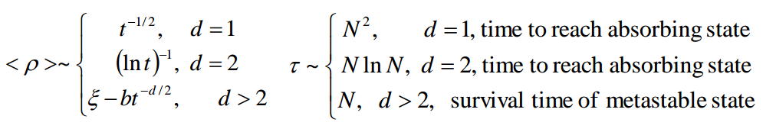
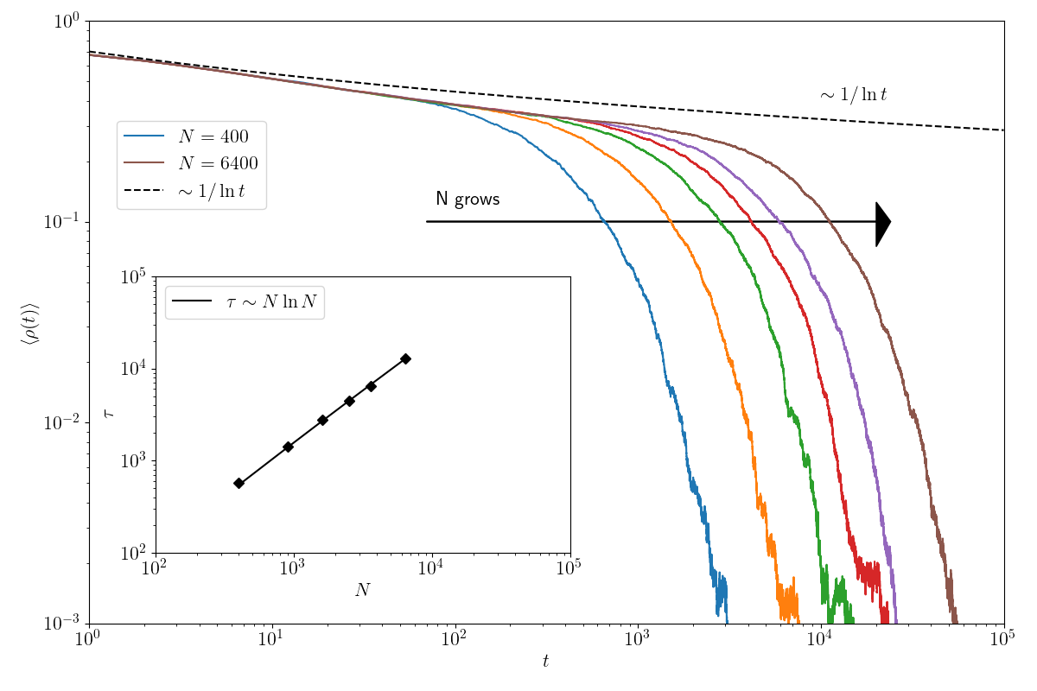
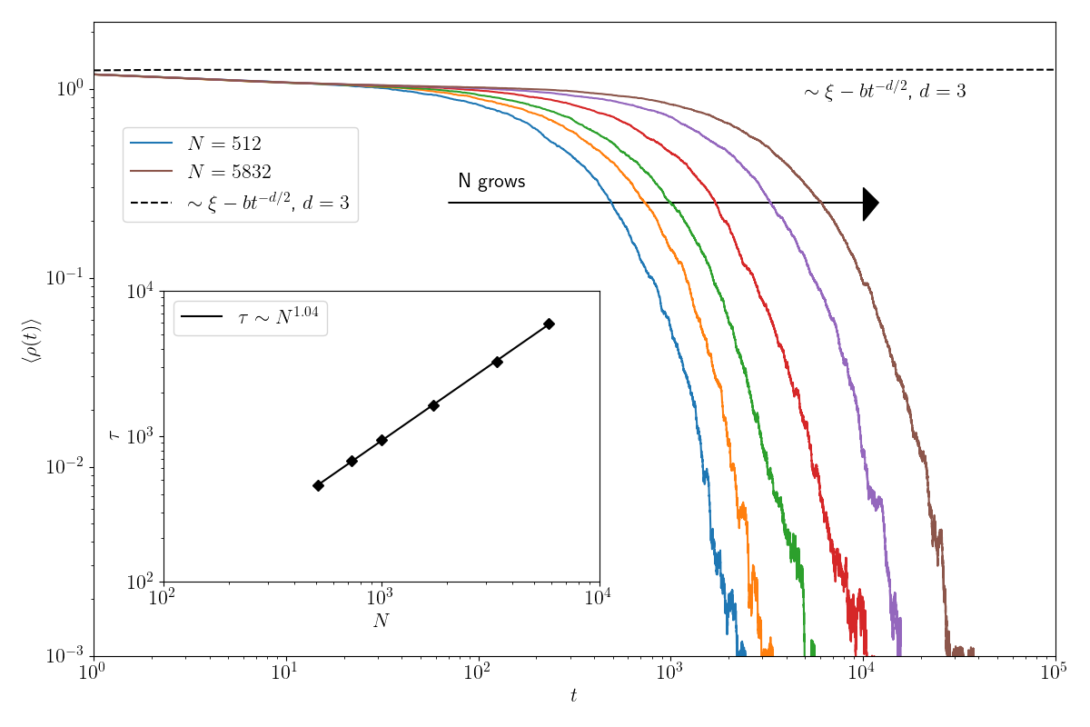
VOTER MODEL IN REGULAR NETWORKS
Two opinion Voter Model
Averages over 1000 realisations
d = 2, 3

Slide 4


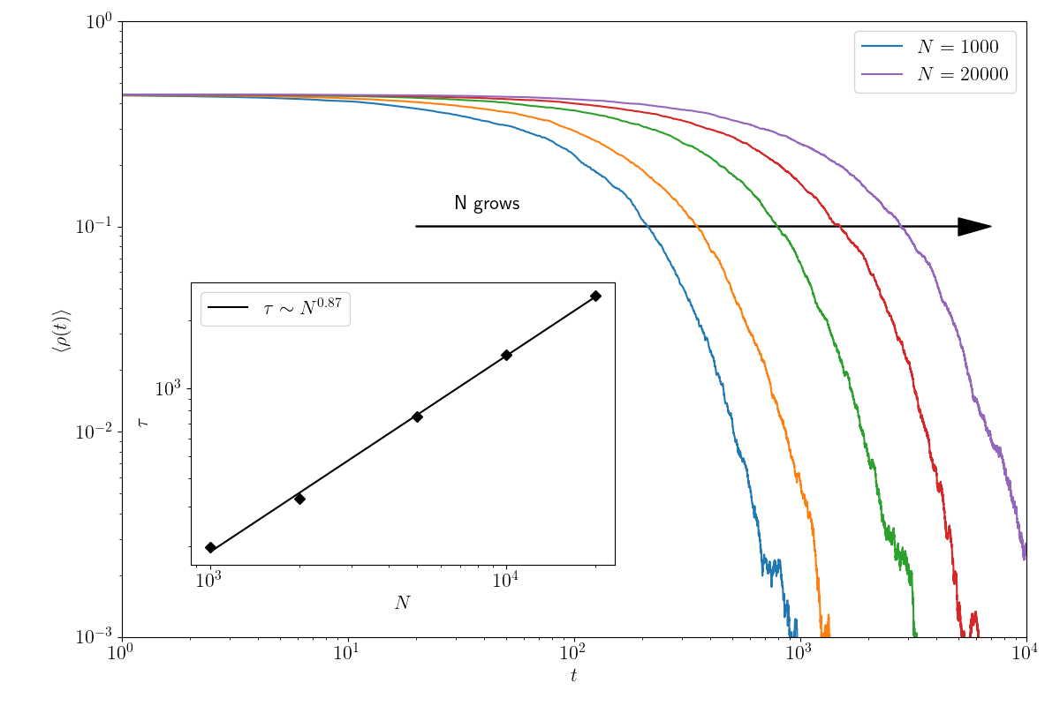
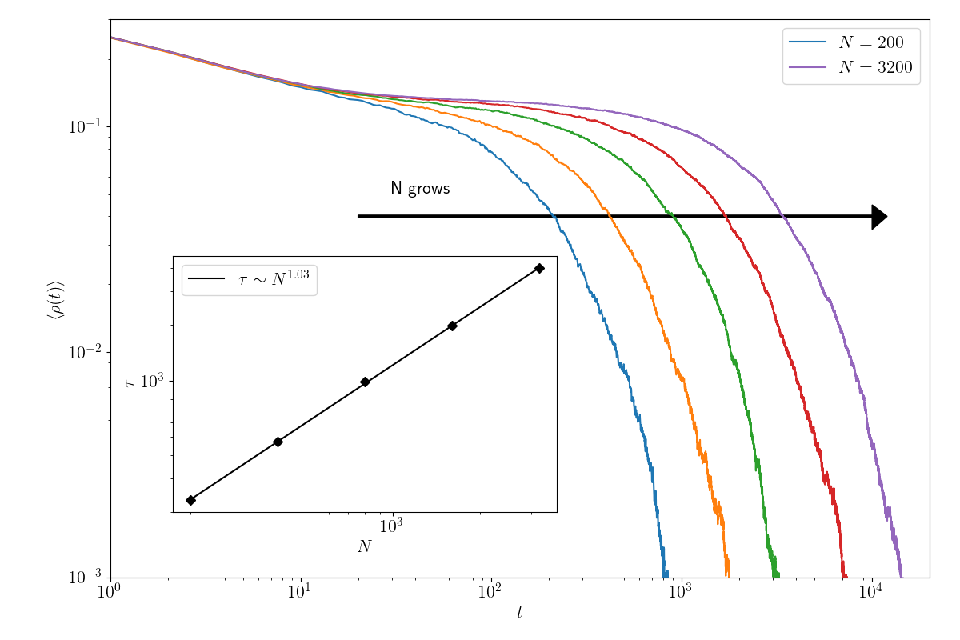
VOTER MODEL IN COMPLEX NETWORKS
Scale free networks (BA)
Small world networks (WS)
Suchecki et al, Eur. Phys. Lett. 69,228(2005)
Suchecki et al, Eur. Phys. Lett. 69,228(2005)

Slide 5
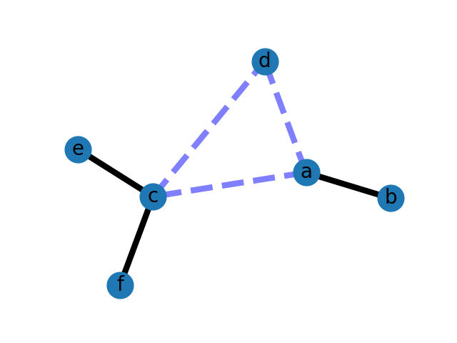
EPIDEMIC SPREADING IN WEIGHTED NETWORKS

Slide 6
INTRODUCTION
Two different models:
  Multiple step-contact epidemic
  Single step-contact epidemic
Different results for each of the models
  Weight distribution form does not affect prevalence in multiple step-contact epidemics but only its average.
  Homogeneity of weight distribution lead to a higher prevalence in single step-contact epidemics.

Slide 7
MULTIPLE STEP-CONTACT EPIDEMIC

Slide 8


SINGLE STEP-CONTACT EPIDEMIC
Infected nodes can only infect a single neighbour per time step.
Selection probability proportional to edge weights .
As usual are the infection and recovery probabilities.
,
I
Nothing happens
Neighbour selection
based on edge weights
S
Gets infected with
probability

Slide 9
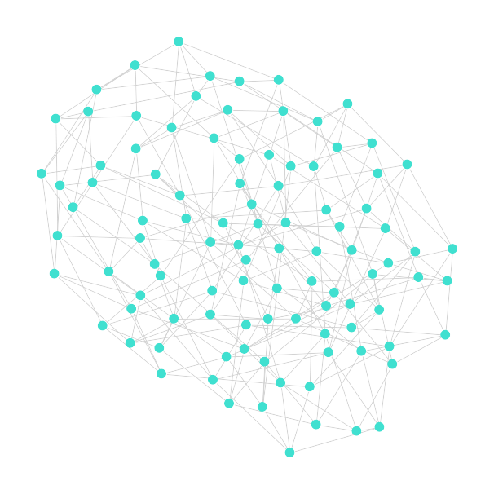




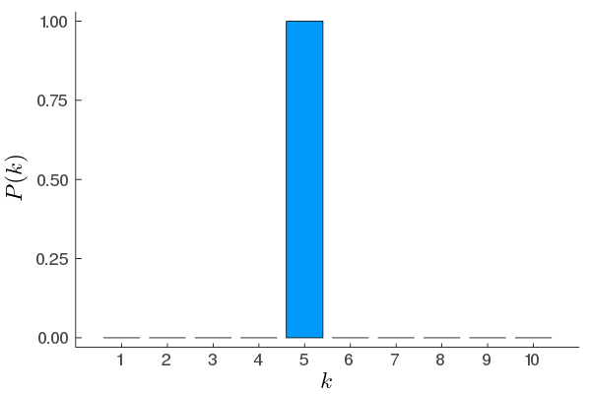

NETWORK PARAMETERS
Configurational model (RN) with fixed node degree.
SIS model.
nodes.
realisations.
initial infected nodes.
Example of network
Degree distribution

Slide 10
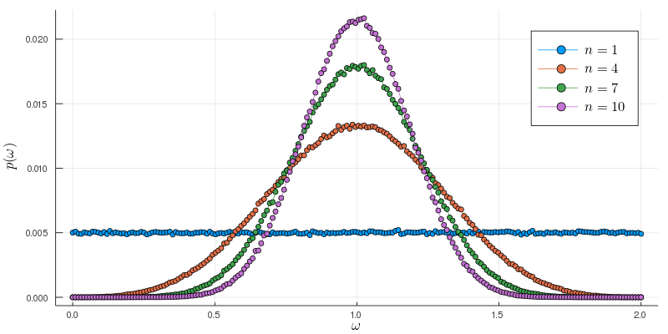
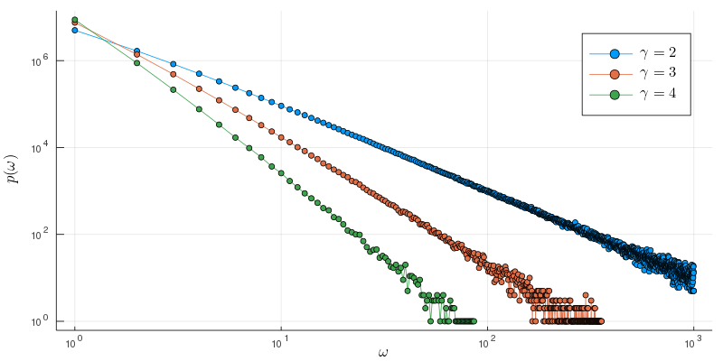
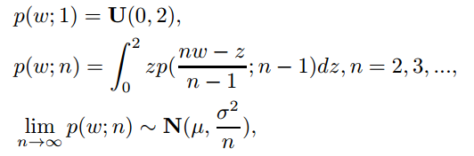

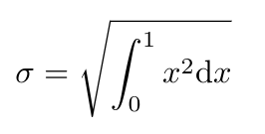
WEIGHT DISTRIBUTIONS
Uniform, Gaussian and Power-law weight distributions.

Slide 11
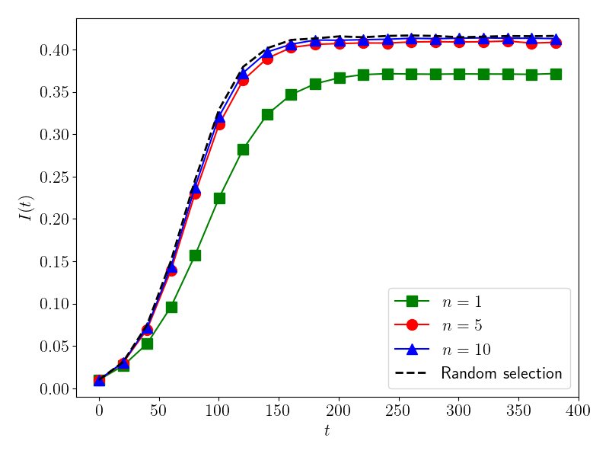
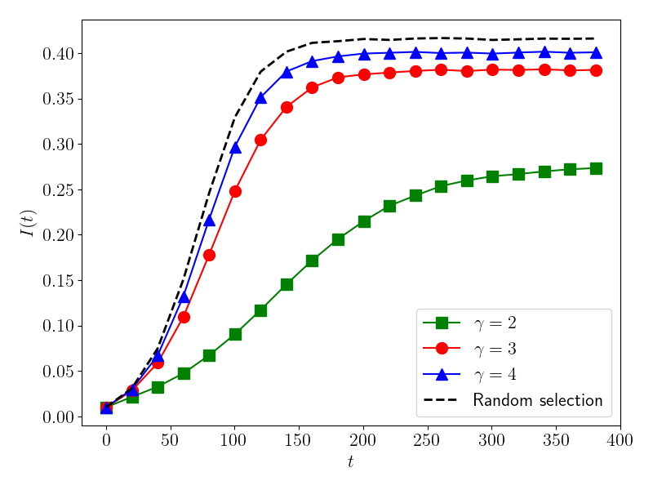
PREVALENCE
Uniform to Gaussian distribution
Power-law distribution

Slide 12
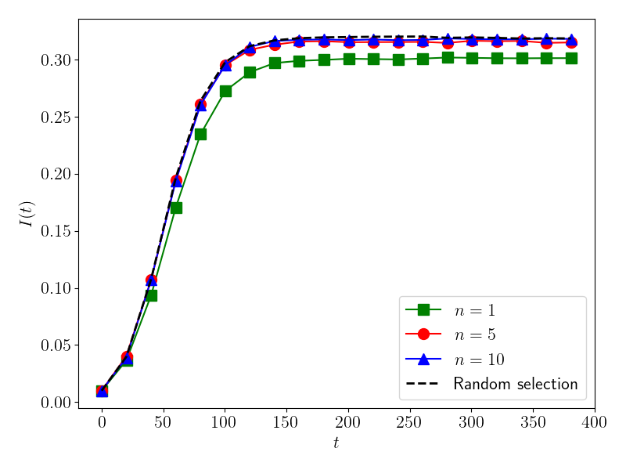
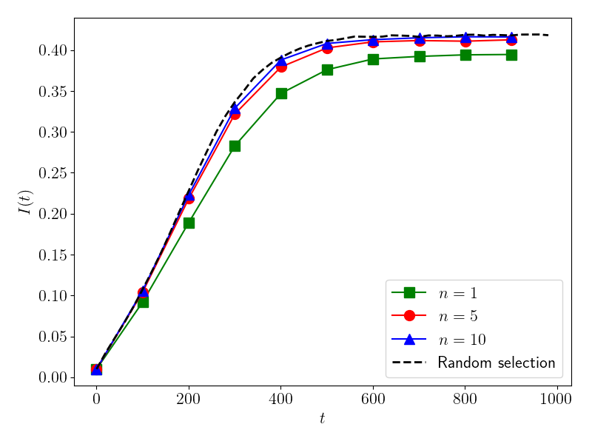
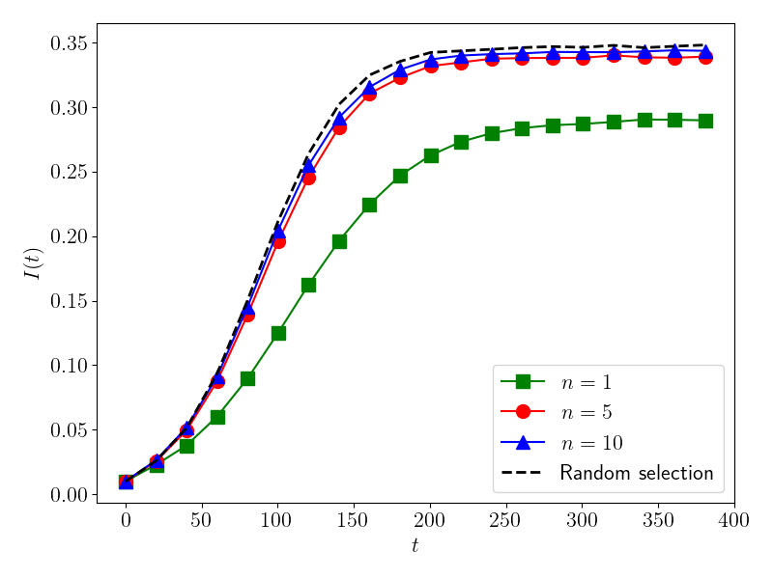
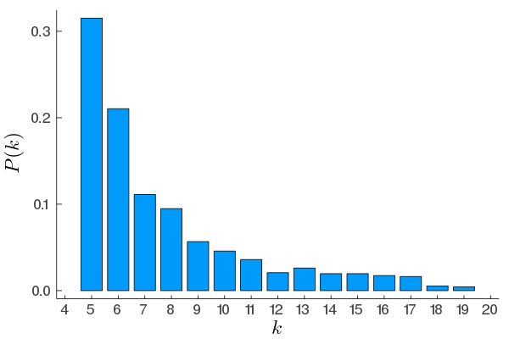
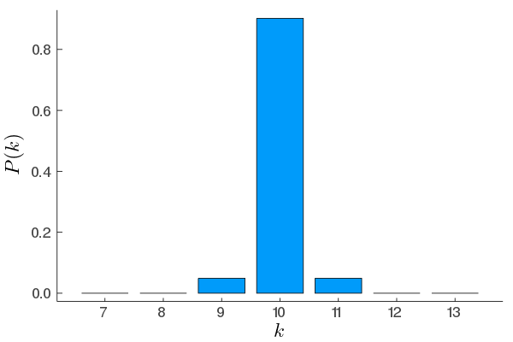
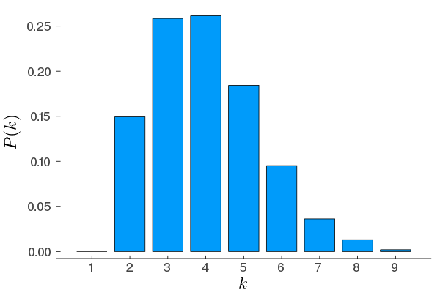

EFFECT OF DEGREE HETEROGENEITY
Scale Free (BA)
Small World (WS)
Random (WS p=1)

