Slide 1
Intro to Docker on Raspberry pi3
Adari Girish Kumar
21st September 2019
Chennai

Slide 2
Agenda
Docker Introduction
Use Cases
Basic Architecture and comparison to VM’s
More about Docker & Use cases
Docker on Raspberry pi 3

Slide 3
Introduction to docker

Slide 4
What is Docker?
Docker is an Open platform for developers and sysadmins to build, ship and run distributed applications.
It can run on most Linux distributions, Windows and Mac OS running Docker Engine (Toolbox).
It is supported by most of cloud providers and provide a popular Dev/Test, CI & DevOps platform for many use cases.

Slide 5
Docker Flow
Image
Run
Container
Operating System
Software
Application Code

Slide 6
Basic Architecture and comparison to VM’s

Slide 7
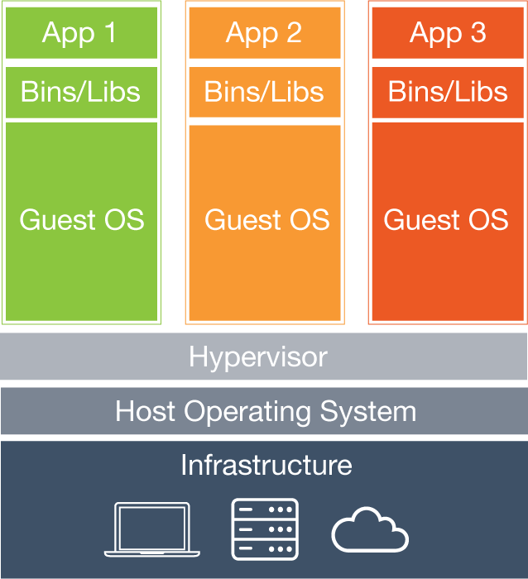
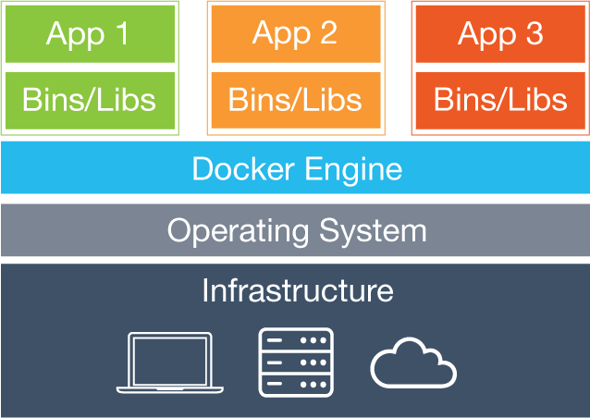
VM’s vs. Containers
VMs
container
Virtual Machines
Each virtual machine (VM) includes the app, the necessary binaries and libraries and an entire guest operating system
Containers
Containers include the app & all of its dependencies, but share the kernel with other containers.
Run as an isolated process in userspace on the host OS
Not tied to any specific infrastructure – containers run on any computer, infrastructure and cloud.

Slide 8
More about docker

Slide 9
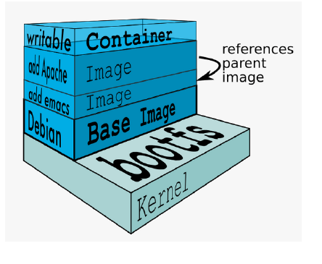
Docker Images
An image is a collection of files and some meta data
Images are comprised of multiple layers, multiple layers referencing/based on another image (Union File System)
Each image contains software you want to run
Every image contains a base layer
Layers are read only

Slide 10
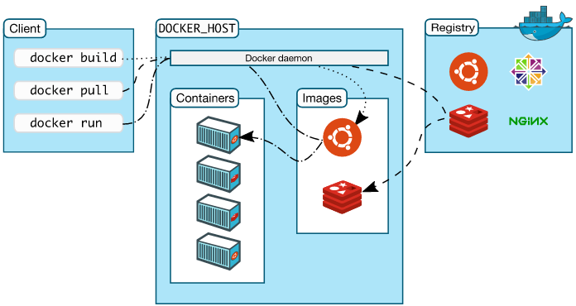
Docker Architecture
Docker client – Command Line Interface (CLI) for interfacing with the Docker
Dockerfile – Text file of Docker instructions used to assemble a Docker Image
Image – Hierarchies of files built from a Dockerfile, the file used as input to the docker build command
Container – Running instance of an Image using the docker run command
Registry – Image repository

Slide 11
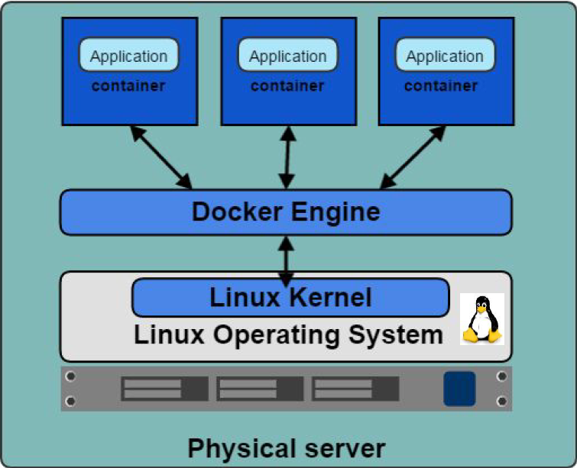
Docker Engine
Container execution and admin
Uses Linux Kernel namespaces and control groups
Namespaces provide for isolated workspace

Slide 12
Docker Features
Light-Weight
Minimal overhead (cpu/io/network)
Based on Linux containers
Decrease storage consumption
Uses layered filesystem to save space (AUFS/LVM)
Portable
Run it Everywhere! - Linux, Mac OS or Windows operating system that has Docker installed.
Raspberry pi support.
Move from one environment to another by using the same Docker technology.
Self-sufficient
A Docker container contains everything it needs to run
Minimal Base OS
Libraries and frameworks
Application code
A Docker container should be able to run anywhere that Docker can run.

Slide 13
Docker CLI – Common commands
docker build : build docker image from Dockerfile
docker run : run docker image
docker logs : show log data for a running or stopped container
docker ps : list running docker containers (analogous to ps)
docker ps –a : list all containers including not running
docker images : list all images on the local volume
docker rm : remove/delete a container | docker rmi : remove/delete an image
docker tag : name a docker image
docker login : login to registry
docker push/pull : push or pull volumes to/from Docker Registries
docker inspect : return container run time configuration parameter metadata

Slide 14
Advanced Functions
Orchestration, Monitoring, Operations, Service Discovery
Docker Environment Provisioning
Fragmented Market Solutions
Kubernetes
Swarm, Docker Data Center, Docker Cloud
ETCD, Docker Networking

Slide 15
Use Cases
Ready to Run Application Stacks
Excellent for Dev/Test setups
Deployment in Seconds, not Hours/Days
Start Up, Tear Down Quickly
Front-End App Servers
Highly horizontally scalable
Cattle Not Pets
Fast A/B, Rolling Deployments
Optimize CX
Traditional Technologies - MW/Backend
New App Dev & Microservices
Refactor all or part of legacy app
Containers are great for Microservices
Server Density
Containers can use dynamic ports
Run many of the same app on a server
instead of one per VM
One-Time Run Jobs and Analytics
Run the Job / Analysis and quit

Slide 16
Why Docker for IoT?
Why the IoT Needs Docker
Containers are well-positioned to address some of the main challenges that developers face when deploying software to IoT devices:
Minimal hardware resources. Many IoT devices lack powerful computing and memory resources. Their ability to process software updates is therefore limited. Containers can help on this front because installing a new container image does not require much computing power. An IoT device needs simply to download an image, put it wherever it’s going to live and remove the old image. Configuration processing is minimal.
Geographic distribution. In some use cases, IoT devices are spread across a large geographic area. Delivering software to them from a single central repository may not work well. With Docker, it’s easy to spin up image registries in multiple locations to serve the entire network well.
Limited or sporadic network access. They may have limited network bandwidth, or be online only occasionally. Docker can help to deliver software updates under these circumstances because when container images are updated, Docker downloads only the parts of the image that have changed.
Widely varying device environments. The software that runs on an IoT device could be almost anything. The diversity of software configurations on IoT devices would normally make application installation difficult, because applications would have to be configured for each type of environment if installed via traditional methods. With containers, however, the operating system version and other software variables are much less important. As long as the device runs some kind of Linux distribution and has a container runtime, you can install a containerized application on it without special configuration.

Slide 17
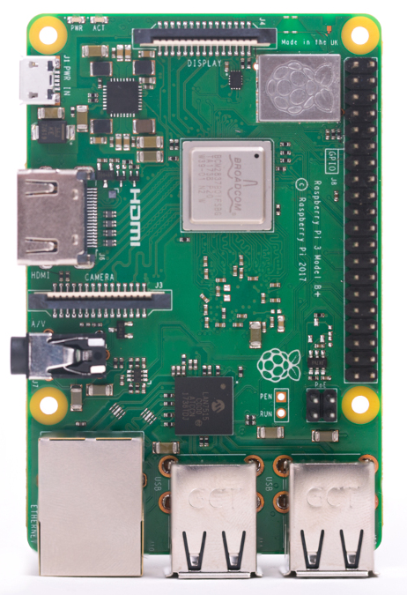
About Raspberry pi 3
The Raspberry Pi is a very cheap computer that runs Linux, but it also provides a set of GPIO (general purpose input/output) pins that allow you to control electronic components for physical computing and explore the Internet of Things (IoT).
All over the world, people use Raspberry Pis to learn programming skills, build hardware projects, do home automation, and even use them in industrial applications.
The Raspberry Pi operates in the open source ecosystem: it runs Linux (a variety of distributions), and its main supported operating system, Raspbian, is open source and runs a suite of open source software. The Raspberry Pi Foundation contributes to the Linux kernel and various other open source projects as well as releasing much of its own software as open source.

Slide 18
Setting up of raspberry & installing docker
https://github.com/agirishkumar/Docker_on_IoT
Step by Step process is mentioned with screenshots

Slide 19
Process
Download Raspbian OS (Buster/Stretch/jessie)
Set up your SD card
Install Putty
Install VNC Viewer
Install docker

Slide 20
Running Containers
Run Ngnix Container
Run a Container to Blink Led connected to Raspi

Slide 21
THANK YOU

