Slide 1



Artificial Intelligence
– state of affairs and perspective
Anton Kolonin
akolonin@aigents.com
Facebook: akolonin
AIGENTS
https://agirussia.org
https://aigents.com

Slide 2
AI – where are we now?
Programmable
Adaptive
Guided
Autonomous
194?
2020
20??
Weak
Strong
Big Data,
Machine Learning,
Experimental Statistics
Human-level
AI (HLAI)
Super-
human
AI
Narrow Artificial
Intelligence (AI)
Artificial General Intelligence (AGI)

Slide 3



General Intelligence:
Reaching complex goals in
different complex environments, using limited resources and minimizing risks
(Ben Goertzel + Pei Wang + Shane Legg + Marcus Hutter)
Intelligent
Being

Slide 4
Biological Intelligence:
Reaching food and parents for self-reproduction in natural environments using limited physical resources and minimizing existential risks
+
-
+
-

Slide 5

Personal Internet Assistant - Aigents®
Reaching information in online environments using limited CPU and RAM resources, minimizing risk
of being banned
AIGENTS®
https://aigents.com
509
Bandwidth
Limit
Exceeded
429
Too many
requests
404
Not found

Slide 6
What does come next?
Either - new “AI winter”, or – new breakthrough towards “technological singularity”?
AGI will appear in large companies which own really big data to train it and great capabilities to attract talents to create it?
Expected time of AGI arrival based on expert opinions – closest: 3-5 years, median: 80 years.
What is important for AGI:
  Work definition, “different environments”, “risk mitigation” (complex goals and environments and minimizing consumption of resources);
  “Definition of done” in terms of “Baby Turing Test” - including not criteria of passing the test oly, but ability to learn approaching the criteria satisfaction following the “learning curve” incrementally.

Slide 7
Current AI/AGI frontiers
Neuro-Symbolic integration
Explainable/Interpretable AI
Transfer learning
One shot (few-shot) learning
Strong generalization
Generative models
Structured prediction and learning
Fighting catastrophic forgetting
(and catastrophic remembering)
Incremental learning and life-long learning
Multi-modal learning
New “Turing Test” (e.g., “Baby Turing Test”)
Solving the “consciousness” problem

Slide 8
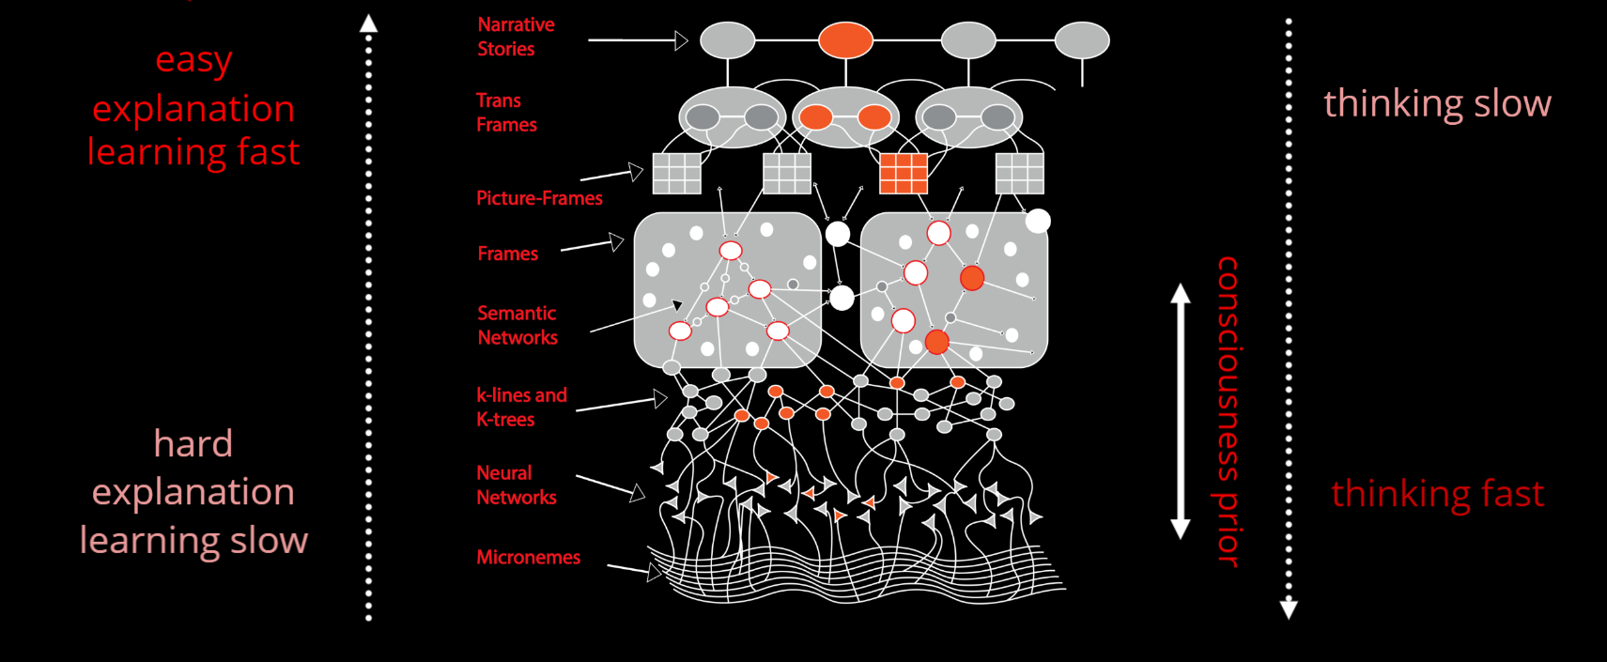
Hybrid Neuro-Symbolic Cognitive Architectures
Society of Mind – Marvin Minsky
Thinking, Fast and Slow – Daniel Kahneman
https://towardsdatascience.com/explainable-ai-vs-explaining-ai-part-1-d39ea5053347

Slide 9
Why do we need INLP in LLM/DL/GPT era?
Fighting Hallucinations with OAG/RAG at Palantir
Ontology
Augmented
Generation
Prompt
Query
Response
Ontology
Injection
Semantic
Filtering
LLM/GPT
Grounding Functions/Tools
Ontology / Semantic Graph / Knowledge Graph
https://blog.palantir.com/reducing-hallucinations-with-the-ontology-in-palantir-aip-288552477383

Slide 10
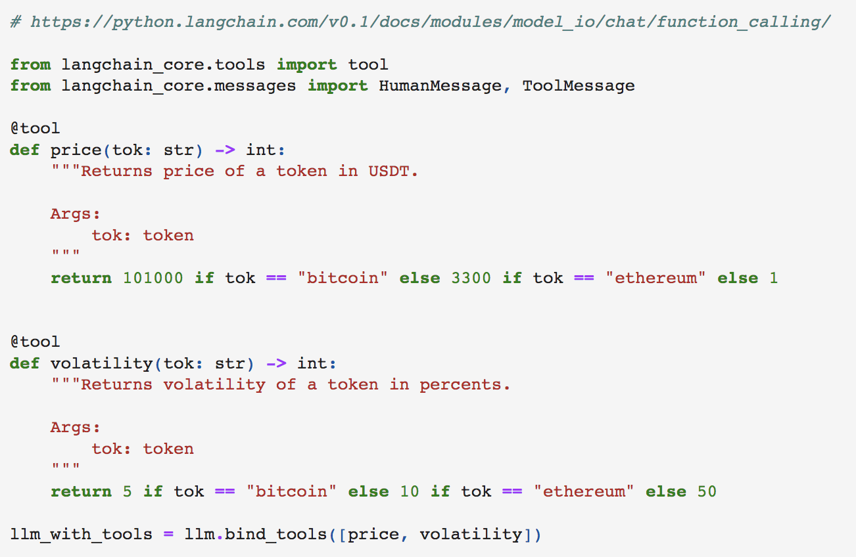
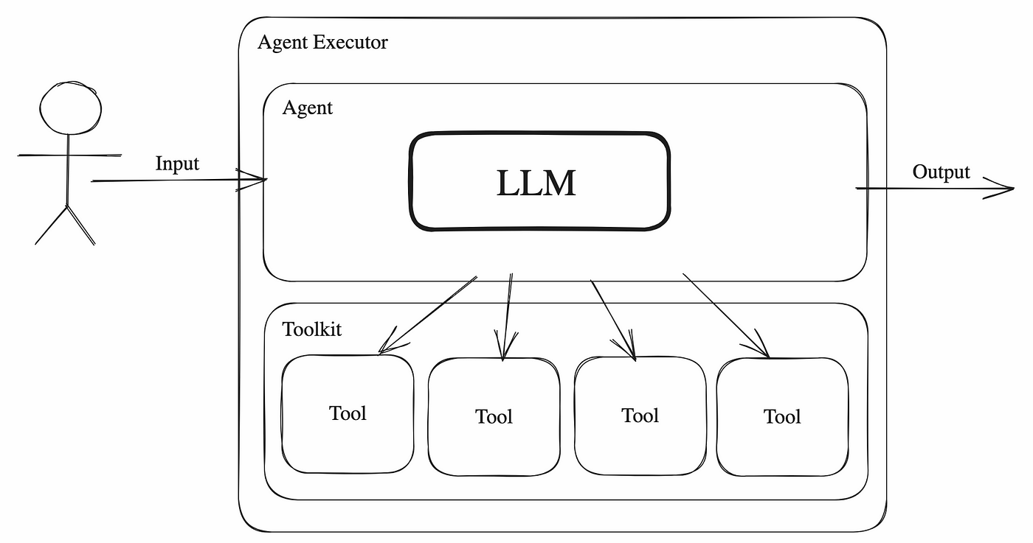
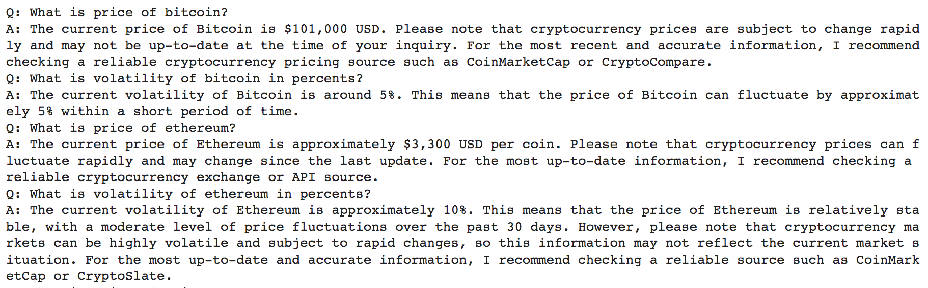
RAG/OAG/TAG + Tool Chains = is all you need?
https://blog.gopenai.com/how-to-supercharge-your-llm-with-langchain-agents-90afa7766188

Slide 11
Чего нам не хватает от БЯМ (LLM/GPT)?
Долгая дорога к AGI
2023
203?
Тьюринг тест пройден неформально
LLM ChatGPT
Сэм Альтман
Грег Брокман
Илья Суцкевер
LLM/GPT (или то, что придет за ними) научились инкрементальному обучению, до-обучению и переобучению на протяжении всего жизненного цикла, без катастрофического забывания/запоминания?
2014
202?
204?
Тьюринг тест пройден формально «инженерным методом»
Бот «Евгений Густман»
Владимир Веселов
Сергей Уласень
Евгений Демченко
LLM/GPT научились справляться с галлюцинациями - на основе онтологий, которые не нужно создавать вручную, а которые «как-то» строятся сами?
Мы можем тренировать AGI на смартфоне?
Мы можем доверить AGI энергоблок АЭС или ПВО отдельно взятой страны?

Slide 12



Bridging the Symbolic-Subsymbolic gap
for “explainable AI” and “transfer learning”
Labeled graph
Unlabeled graph
Hooves
Tail
White
Black
Brown
Red
0.5
0.5
0.5
0.5
1.0
AND
AND
Explain
Σ
Σ
Σ
1.0
1.0
1.0
OR
Transfer
Σ
Σ
0.5
0.5
AND
Σ
CNF
Soft-CNF
(Hooves AND Tail) AND
((White and Black) OR Brown)
=> Horse

Slide 13
Physiological Plausibility – different segments
of cortex responsible for different level of abstractions
actas a document (noun)
actas a deed (verb)
Abstract
act
Linguistic
акт
Conceptual
Social
a
а
Alo
Ahi
Visual
Auditory
Tactile
Olfactory

Slide 14
Multi-modal perception and action
Inputs
Seen color pixels
Read strokes
Heard pitches
Seen features
Read letters
Heard sounds
Seen objects
Read words
Heard words
Seen scenes
Read sentences
Heard sentences
Environmental Feedback
Expectations
Mutually Grounded Meanings and Cognitive Schemas
Imagined scenes
Imagined written sentences
Imagined spoken sentences
Internal Feedback
Imagined objects
Imagined written words
Imagined spoken words
Drawn features
Written letters
Pronounced sounds
Rendered color strokes
Rendered strokes
Generated pitches
Outputs

Slide 15
Multi-layer transformation of complexity
來吧寶貝
Inputs
16 X 16 = 256 pixels
Read strokes
來 吧 寶 貝
23K characters
Read letters
Compression
Read words
來 吧 寶貝
370K words
Read sentences
∞ sentences
來 吧 寶貝
Chinese
Meanings
Expectations
∞ sentences
Imagined written sentences
Come on baby
Imagined written words
Expansion
26 characters
Come on baby
Written letters
170K words
Rendered strokes
Come on baby
16 X 16 = 256 pixels
Outputs
Come on baby

Slide 16
Multi-modal perception + mutual grounding
Seen color pixels
Read strokes
Heard pitches
Separate odors
Tactile feelings
Seen features
Read letters
Heard sounds
Complex odors
Tactile complexes
ears paws tail
‘C’ ‘A’ ‘T’
[kæt] [mew]
cat’s smell
soft fur
Seen objects
Read words
Heard words
cat
“cat”
“cat”
Seen scenes
Read sentences
Heard sentences
walking cat
“a cat”
“it is a cat”
Mutually Grounded Meanings
This walking cat is mewing!

Slide 17
Graphs vs. Tensors
Sentences
Strokes, letters, words and phrases
Words
strokes , letters words and phrases
Letters
w o r d s
Strokes
\ /

Slide 18
Bridging the Symbolic-Subsymbolic gap in NLP
+--------Os-------+
| +-----Ds-----+
+Sp*i+ | +---A--+---Mg--+
| | | | | |
I.p saw.v the rusty.a saw.n sawing.v
Formal
Link Grammar
Deep
Language Model
I
saw
the
rusty
saw
sawing
I
saw
the
rusty
saw
sawing
0.5
0.5
Explain
0.5
0.5
0.5
0.5
0.5
0.5
0.5
0.5
Sp*I
Os
Ds
A
Mg
Σ
Σ
Σ
Σ
Transfer
“Link”
0.3
0.3
0.3
0.3
0.3
0.3
0.3
0.3
AND
AND
Σ
DNF
Soft-DNF
“Disjunct”
1.0
1.0
1.0
1.0
OR
Σ
Noun
Noun
https://link.springer.com/chapter/10.1007/978-3-319-97676-1_11
https://doi.org/10.1007/978-3-030-27005-6_11
https://github.com/singnet/language-learning/

Slide 19
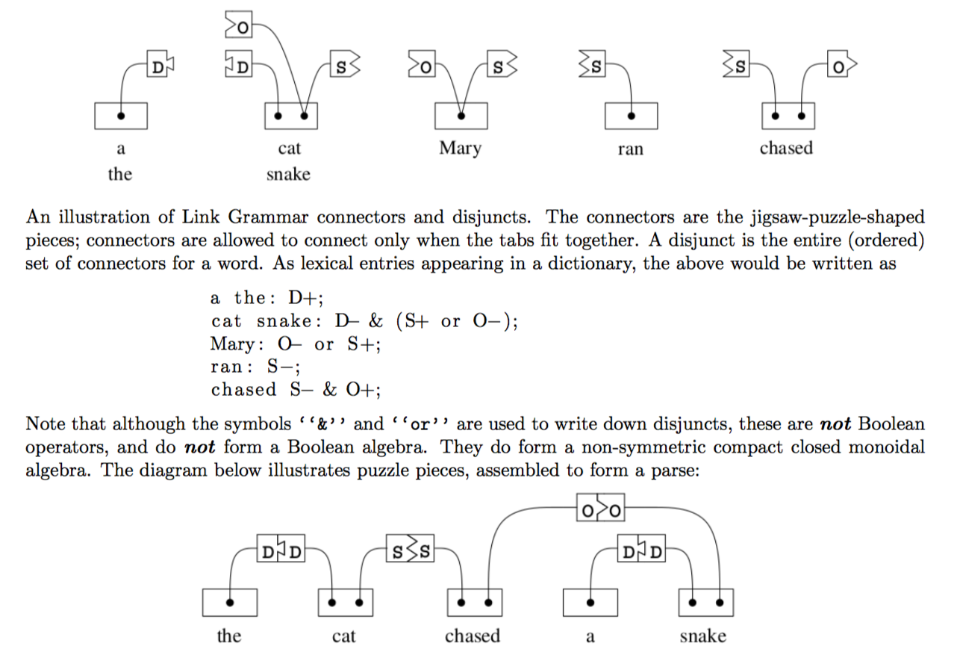
Link Grammar – Connectors/Costs, Disjuncts
1.0
0.5
Connectors & Costs
Disjuncts of Connectors
https://arxiv.org/abs/1401.3372
https://en.wikipedia.org/wiki/Link_grammar
https://github.com/opencog/link-grammar

Slide 20
NLP patterns (words, punctuation, phrases) for Interpretable Natural Language Processing (Aigents® “Deep Patterns”)
NOUN
VERB
SUBJECT PREDICATE OBJECT
OR
OR
0.35
0.65
0.29
0.71
“procedure”
“drug”
“negative effect”
“positive effect”
“disease”
OR
OR
OR
OR
AND
AND
0.83
0.78
0.90
0.10
cold
0.96
0.17
0.22
0.14
aspirin
treat
reduces
OR
0.33
head
tylenol
acetylsalicylic acid
treats
reduce
existential
0.67
frustration
acetaminophen
anxiety
acetaminophen may significantly reduce feelings of existential anxiety
https://ieeexplore.ieee.org/document/7361868
https://github.com/aigents/aigents-java

Slide 21
Knowledge as a graph with maintenance cost
Explicit “symbolic” knowledge
(System 2)
Educational
Grounding
Social knowledge
what
if
Self-consciousness
he
she
then
this
I
we
they
when
my
our
Concep-
tualization
where
Automation
Experiential
Grounding
(System 1)
Implicit “sub-symbolic” knowledge
https://www.amazon.com/Thinking-Fast-Slow-Daniel-Kahneman/dp/0374533555
https://amit02093.medium.com/atomspace-hyper-graph-information-retrieval-system-450cab9d751e

Slide 22
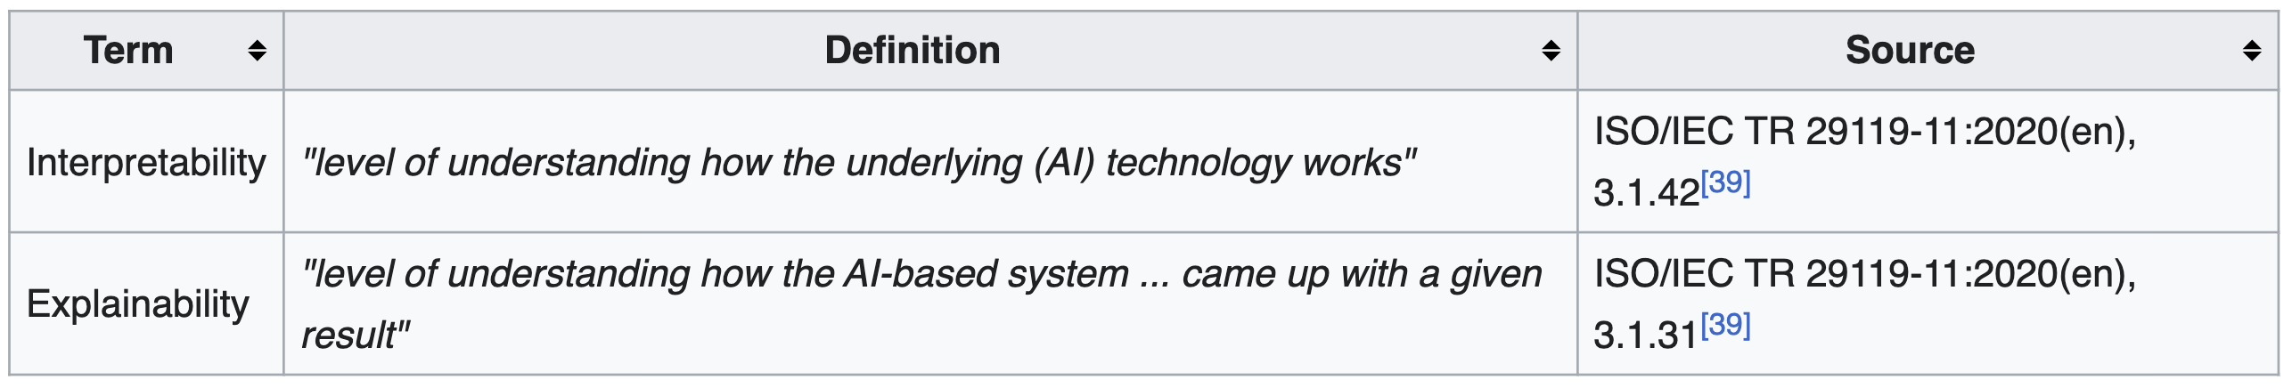
Explainability vs. Interpretability
https://arxiv.org/abs/2406.02981
Local vs. Global Interpretability: A Computational Complexity Perspective
https://en.wikipedia.org/wiki/Explainable_artificial_intelligence

