Slide 1
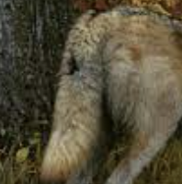


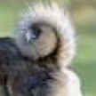
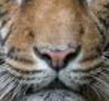
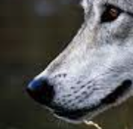

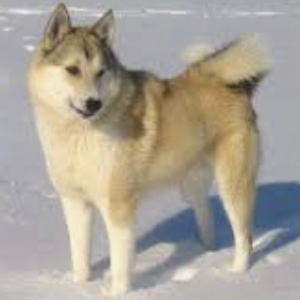
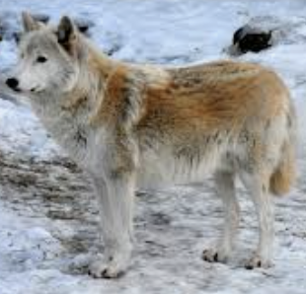
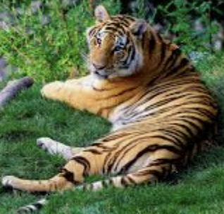
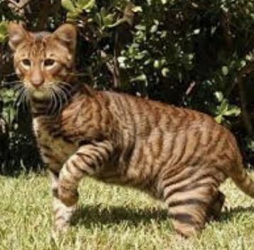
Meanings of Variables and their True Associations
small
large
tail down
wild
tail up
flat
muzzle
pointed
muzzle
pet
dog
wolf
tiger
cat

Slide 2
Obfuscated Variables and their True Associations
sm
la
td
wi
ta
fm
pm
pe
do
wo
ti
ca

Slide 3
Training and Testing Environments & Examples
sm
sm
sm
la
la
Testing:
fm, sm? => ca
fm, sm? => pe
fm, sm? => pe, ca
sm, fm, pe? => ca
sm, fm, wi? => N/A
la
Training:
fm, sm, ca
sm, fm, pe
pe, fm, sm, ca
td
td
td
wi
wi
wi
ta
ta
ta
fm
fm
fm
pm
pm
pm
Any combination of variables true at a time
Any combination of variables as a context
Any combination of variables fitting the context
pe
pe
pe
do
do
do
wo
wo
wo
ca
ca
ca
ti
ti
ti

