Slide 1
WEB UI Image Management
Professor: Dr. Paul Z. Wu
Project Owner:Toddy Mladenov
Team:
Kianoush moradian
Ksenia ivantsova
Avi herbstman

Slide 2
Main Technologies
Twitter API
Oauth.IO
AngularJS
Modules
Bootstrap
Other
JQuery / AJAX
Google API AJAX
Bootstrap
Angular Factory
HTML, CSS, JavaScript

Slide 3
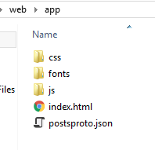
Main Files
Index.html
Results.html
App.js
Bootstrap.css
Upload.html
Update.html

Slide 4
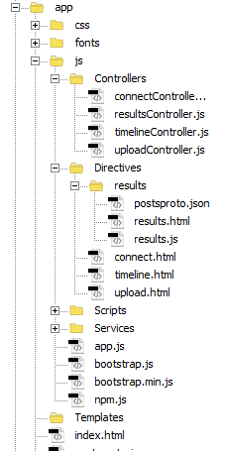
Modular directory structure

Slide 5
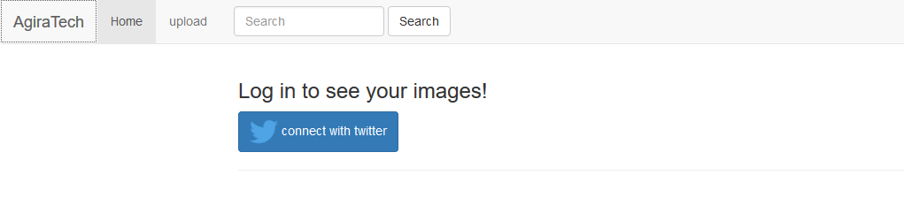
Twitter login
Features
Secure - Users are not required to share their passwords with 3rd party applications, increasing account security.
Standard - A wealth of client libraries and example code are compatible with Twitter’s OAuth implementation.

Slide 6
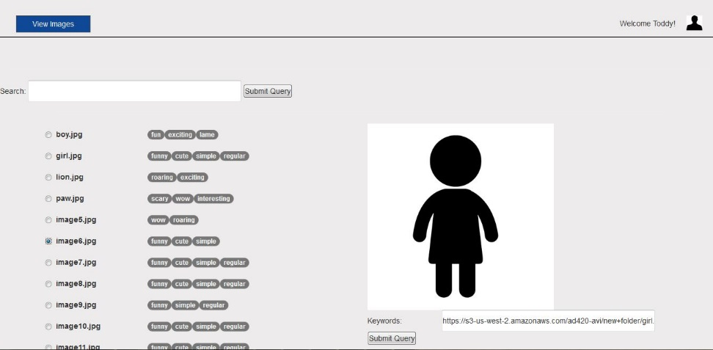
Display image page
Features:
1- Server real time connection
2- Display image list
3- Display image on select
4- Ability to Add/Remove Tags
5- Ability to Search

Slide 7
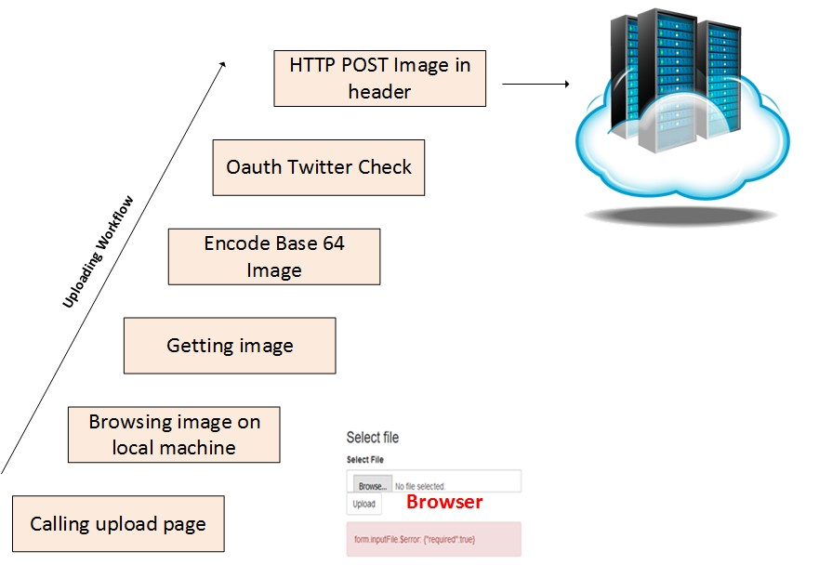
Upload

Slide 8
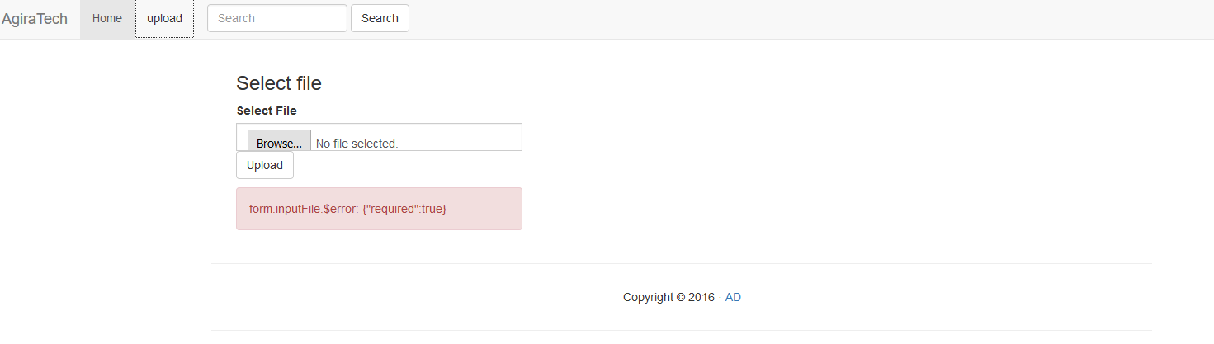
Upload image
Features:
1- Local Browsing
2- Uploading image

Slide 9
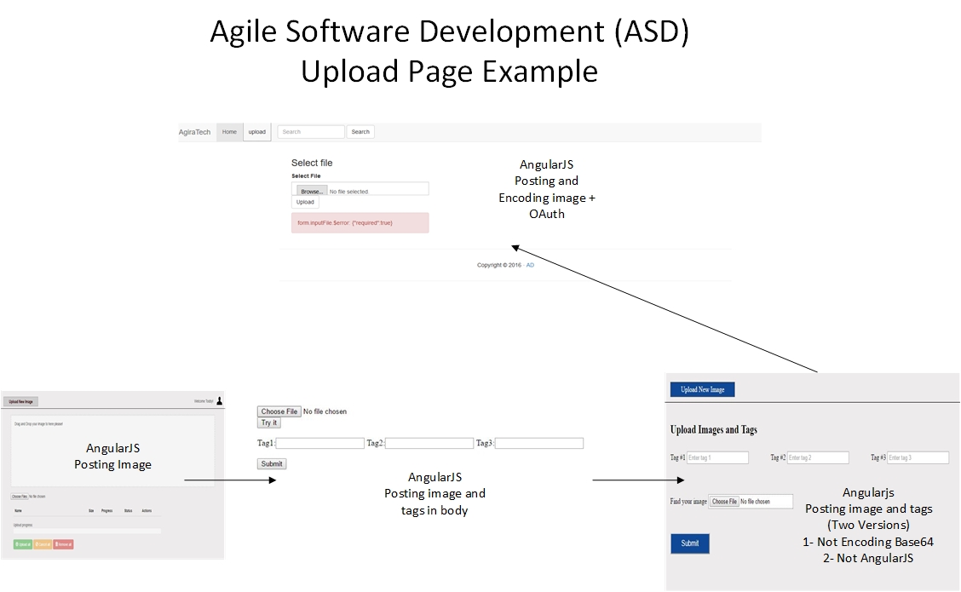

Slide 10
Thank You

