Slide 1
AI Acceptance Across the Scientific Community: A Review
Why so much skepticism toward AI?
What about precision medicine?
Find here my thoughts,
and the main reason I started this Instagram profile.
© 2025 A. Giuliano Mirabella

Slide 2
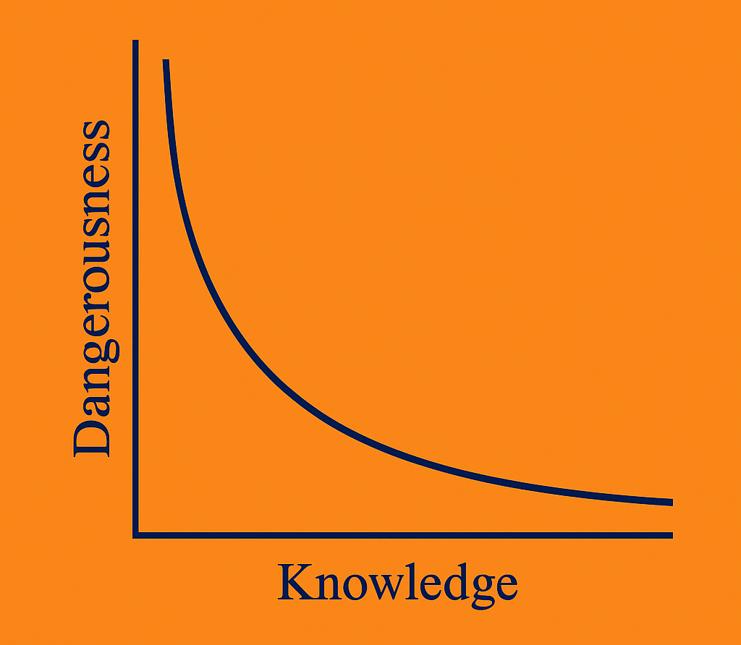
AI Acceptance Across the Scientific Community: A Review
The perceived and actual dangerousness of AI tools varies significantly with the user's level of knowledge.
At the lowest levels of understanding, danger is high—not because the tools are inherently malicious, but because users tend to trust them blindly.
© 2025 A. Giuliano Mirabella

Slide 3
AI Acceptance Across the Scientific Community: A Review
Only at higher levels of expertise does the danger diminish substantially.
Experts understand not just how AI works, but how and when to distrust it.
© 2025 A. Giuliano Mirabella

Slide 4
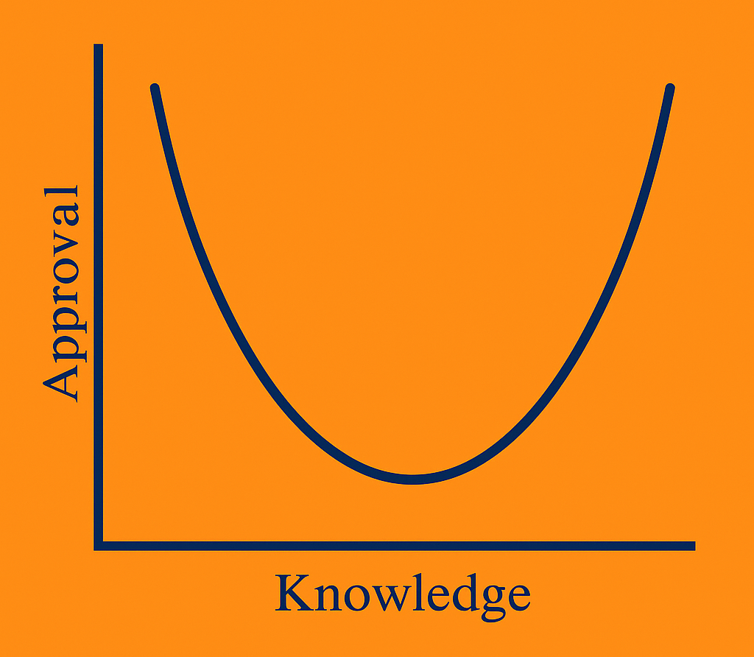
AI Acceptance Across the Scientific Community: A Review
The relationship between user approval of AI and their level of knowledge also follows a non-linear pattern.
At first, when users have little to no understanding of how AI works, approval is high, driven by the novelty and apparent intelligence of the tool.
© 2025 A. Giuliano Mirabella

Slide 5
AI Acceptance Across the Scientific Community: A Review
Approval tends to decline as users become aware of AI's limitations and potential pitfalls.
With further education and experience, approval rises again. This final rise is more mature: rooted in realistic expectations, effective usage, and awareness of both the strengths and weaknesses of AI systems.
© 2025 A. Giuliano Mirabella

Slide 6
AI Acceptance Across the Scientific Community: A Review
Uninformed regime
Left side of our graphs, exhibit high approval driven primarily by surprise and awe. They believe every output without scrutiny. Their use is risky, and benefits are highly uncertain.
Overconfidence Regime
Center of the graphs, decreased approval due to increased skepticism and a false sense of mastery. Users here incorrectly believe they've fully grasped AI’s capabilities.
Realistic Regime
Right side, this is the optimal region of AI knowledge. Users have developed a balanced and nuanced understanding of AI's strengths and limitations. The risk is substantially lower.
© 2025 A. Giuliano Mirabella

Slide 7
AI Acceptance Across the Scientific Community: A Review
Let’s improve our AI-related knowledge together!
Thank you!
© 2025 A. Giuliano Mirabella

