Slide 1
AI Acceptance Across the Scientific Community:
My Thoughts
Why so much skepticism toward AI?
What about precision medicine?
Find here my thoughts,
and the reason I started this Instagram profile.
© 2025 A. Giuliano Mirabella

Slide 2
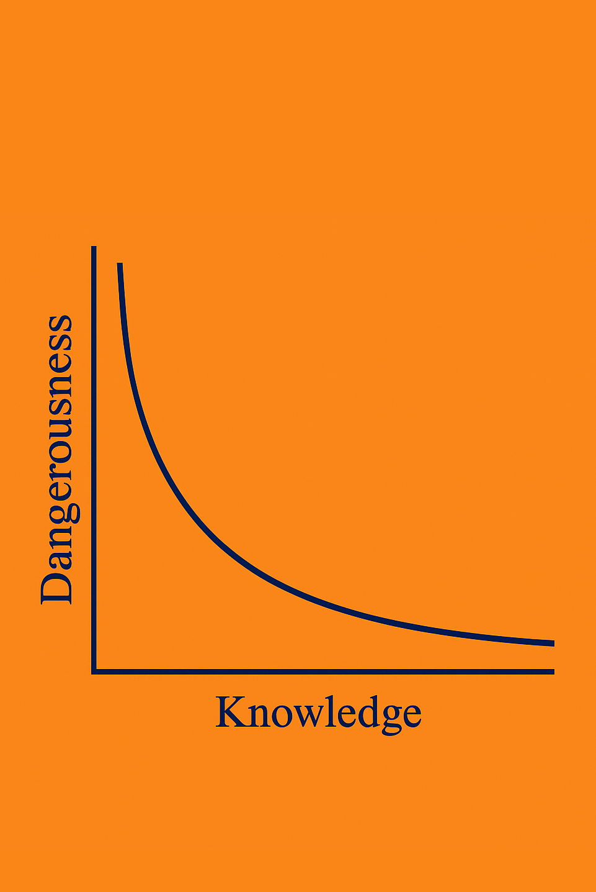
AI Acceptance Across the Scientific Community:
My Thoughts
The perceived and actual dangerousness of AI tools varies significantly with the user’s AI-related knowledge.
At the lowest levels of understanding, danger is high—not because the tools are inherently malicious, but because users tend to trust them blindly.
© 2025 A. Giuliano Mirabella

Slide 3
AI Acceptance Across the Scientific Community:
My Thoughts
Only at higher levels of expertise does the danger diminish substantially.
Experts understand not just how AI works, but how and when to distrust it.
© 2025 A. Giuliano Mirabella

Slide 4
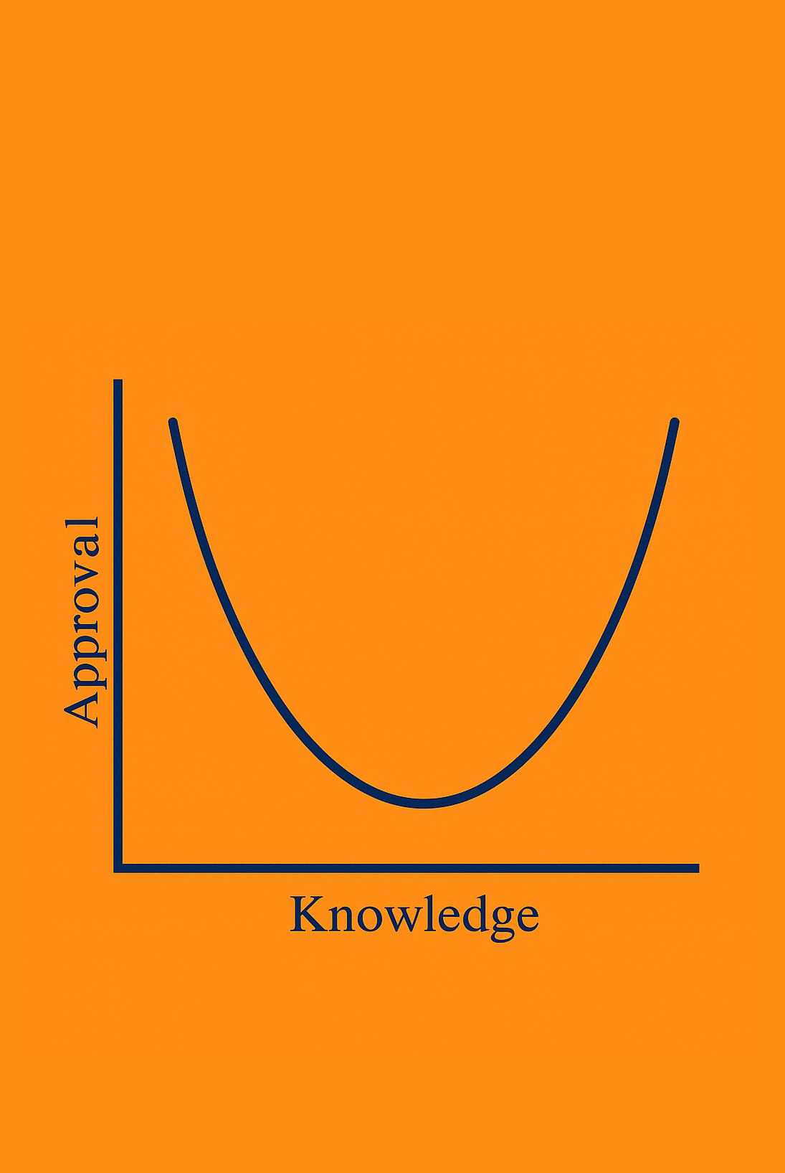
AI Acceptance Across the Scientific Community:
My Thoughts
The relationship between user approval of AI and their level of knowledge also follows a non-linear pattern.
At first, when users have little to no understanding of how AI works, approval is high, driven by the novelty and apparent intelligence of the tool.
© 2025 A. Giuliano Mirabella

Slide 5
AI Acceptance Across the Scientific Community:
My Thoughts
Approval tends to decline as users become aware of AI's limitations and potential pitfalls.
With further education and experience, approval rises again. This final rise is more mature: rooted in realistic expectations, effective usage, and awareness of both the strengths and weaknesses of AI systems.
© 2025 A. Giuliano Mirabella

Slide 6
AI Acceptance Across the Scientific Community:
My Thoughts
Uninformed regime:
Left side of our graphs, exhibit high approval driven primarily by surprise and awe. They believe every output without scrutiny. Their use is risky, benefits are highly uncertain.
Overconfidence regime:
Center of the graphs, decreased approval due to increased skepticism and a false sense of mastery. Users here incorrectly believe they've fully grasped AI’s capabilities.
Realistic
regime:
Right side, the optimal region. Users have developed a balanced understanding of AI's strengths and limitations. The risk is substantially lower.
© 2025 A. Giuliano Mirabella

Slide 7
AI Acceptance Across the Scientific Community:
My Thoughts
Solution:
Let’s improve our AI-related knowledge together!
© 2025 A. Giuliano Mirabella

