Slide 1

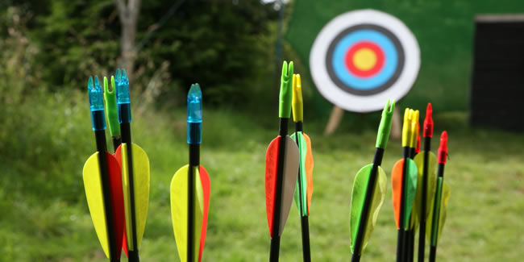



About
Membership
Calendar
Contact

Slide 2
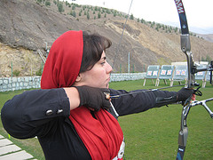
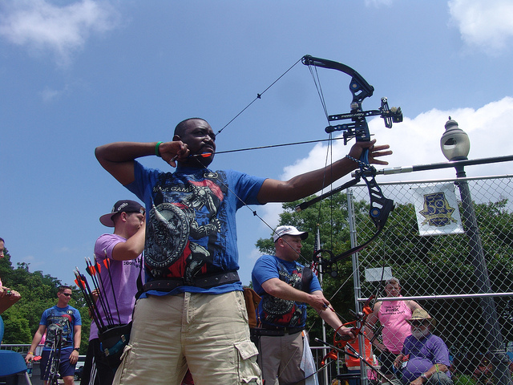
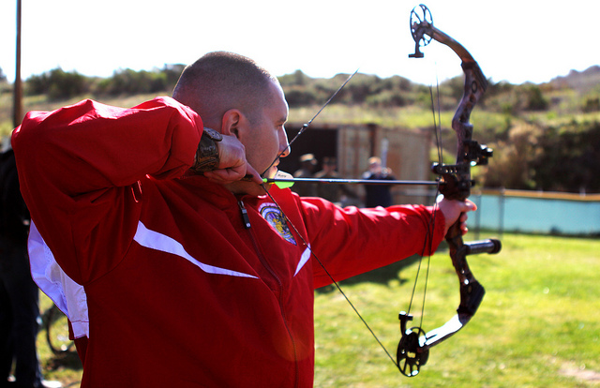
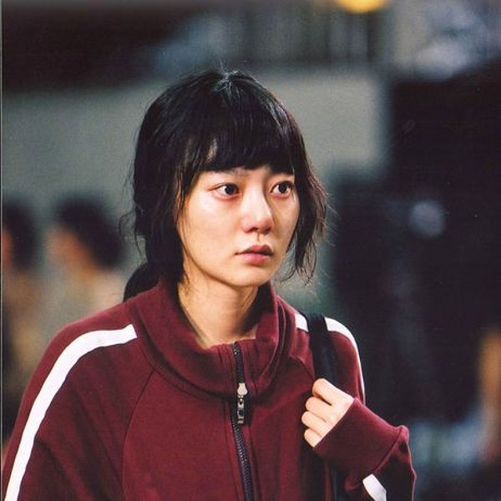
About
History: (something about archery or the studio)
Amy Smith
Derek Jenkins
Nathan Lee
Doona Bae

Slide 3
Membership
Class Description
Membership Fee
Frequently Asked Questions

Slide 4
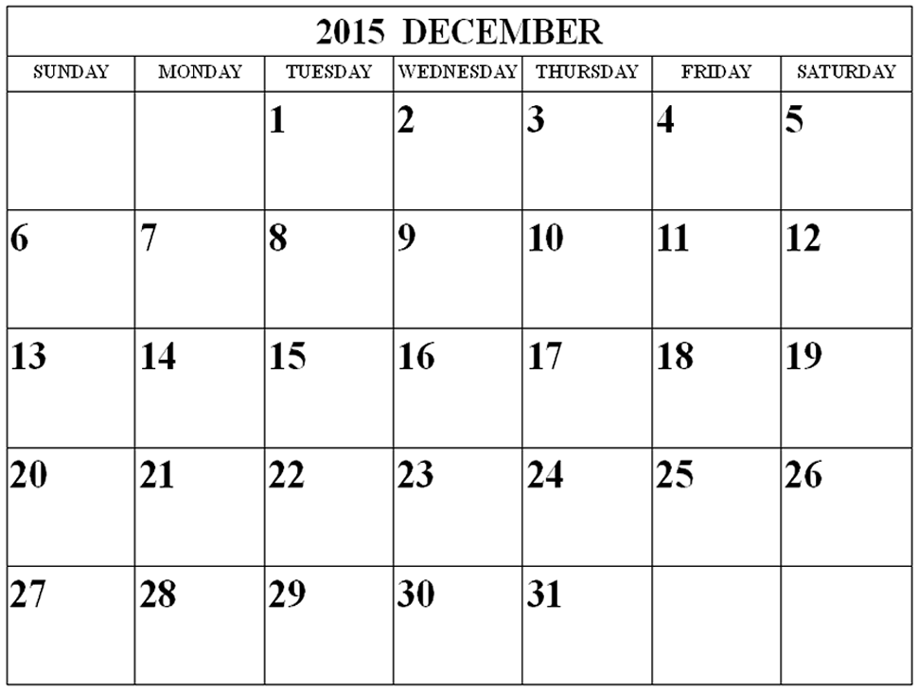
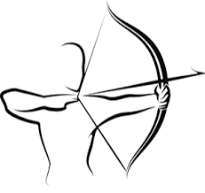
Calendar

Slide 5

Contact
Archery Madness
22313 70th Ave W, Suite U1A
Mountlake Terrace WA 98043
(425) 977-2770
Hours
Monday – Saturday: 9:00AM - 9:00PM
Sunday: 11:00AM - 6:00PM

