Slide 1
Install Software
ag

Slide 2
R from r-project.org
We need to install the latest version of R
Goto www.r-project.org
Select CRAN from menu at the left
Select Norway: uib from the list
Download for your platform (macos, windows or linux)
For mac select correct version
R-4.2.1.pkg for Intel processor (macs older than 1,5 years)
R-4.2.1-arm64.pkg for Apple Silicon processors (M1 or M2)
Install software as you normally would

Slide 3
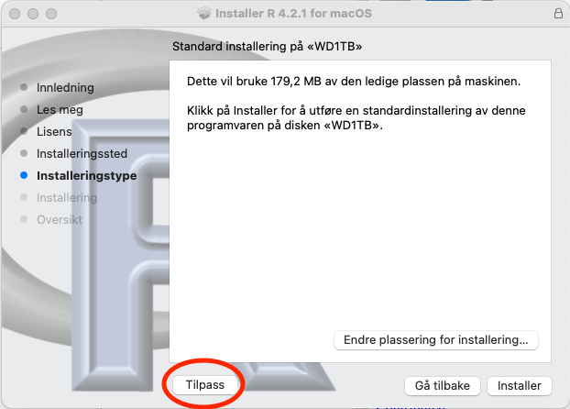
Mac installer
Select “Tilpass”
. . .
Tilpass

Slide 4
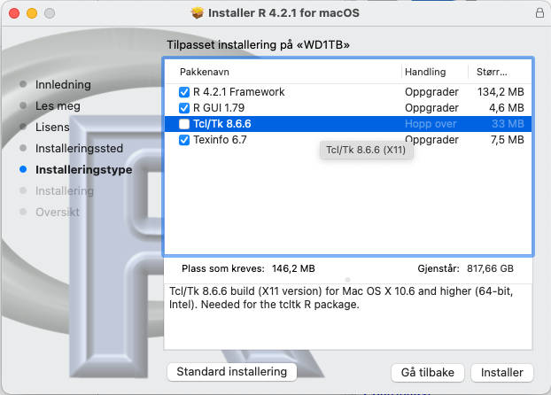
Mac installer cont.
deselect tcltk
. . .
Deselect tcl/pk

Slide 5
Install RStudio
We need to install latest version of RStudio
Goto https://www.rstudio.com/products/rstudio/download/
Download the free RStudio Desktop for your system
For mac drag the RStudio icon to the Applications folder alias next to the icon
For windows follow normal application installation procedure

Slide 6
Install Zotero
We need to install the latest version of Zotero
Goto https://www.zotero.org/download/
After Zotero is installed and running return to www.zotero.org with your favourite web borwser.
Install Zotero Connector
If you are using Safari on mac the connector is included, but you have to enable it under Safari > Valg … > Tillegg

Slide 7
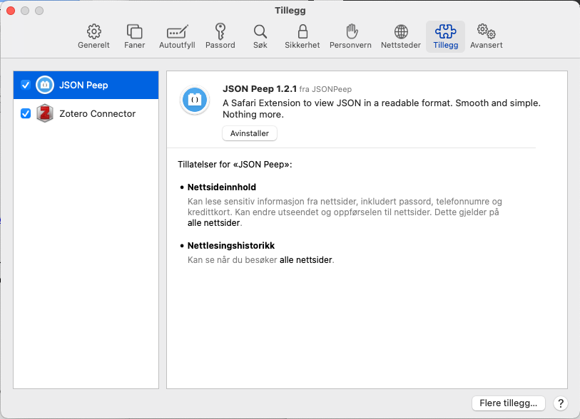
Enable Zotero Connector in Safari
Enable Zotero Connector in Safari

Slide 8
Installing Better BibTeX
Goto https://retorque.re/zotero-better-bibtex/
Click Download in menu at the left
Then click Installation in menu at the left to get installation instructions

Slide 9
Installing git
Goto https://git-scm.com/downloads
Download for your system
Choose binary installer (on mac)
Click download on https://sourceforge.net/projects/git-osx-installer/

Slide 10
For mac
Open the Terminal program (ligger i Verktøy mappen i Programmer mappen)
Give the following command (in Terminal)
xcode-select --install
An apple ID might be required to be able to download

Slide 11
Final configurations
Start RStudio
Check that you have a Git tab in upper right pane
Select the Terminal tab in lower right pane in RStudio
. . .
git config --global user.name 'Jane Doe'
git config --global user.email 'jane@example.com'
git config --global --list

Slide 12
Git editor
PC
git config --global core.editor C:\Program Files\RStudio\bin\rstudio.exe
mac
git config --global core.editor /Applications/RStudio.app

Slide 13
Define user on Github
hvl email og email you use
Use a serious name; you might be showing this to a future employer
Connect RStudio to Github
install packages
usethis
credentials
Use Github.R
See git-github slides for configuration

Slide 14
Install tinytex
Under Packages in lower right pane select:
Install
Under packages write tinytex
Make sure that Install dependencies is checked
Click install
When install check off tinytex in the lower left pane under tab Packages
Give the command install_tinytex() in Console in lower left pane.

