Slide 1
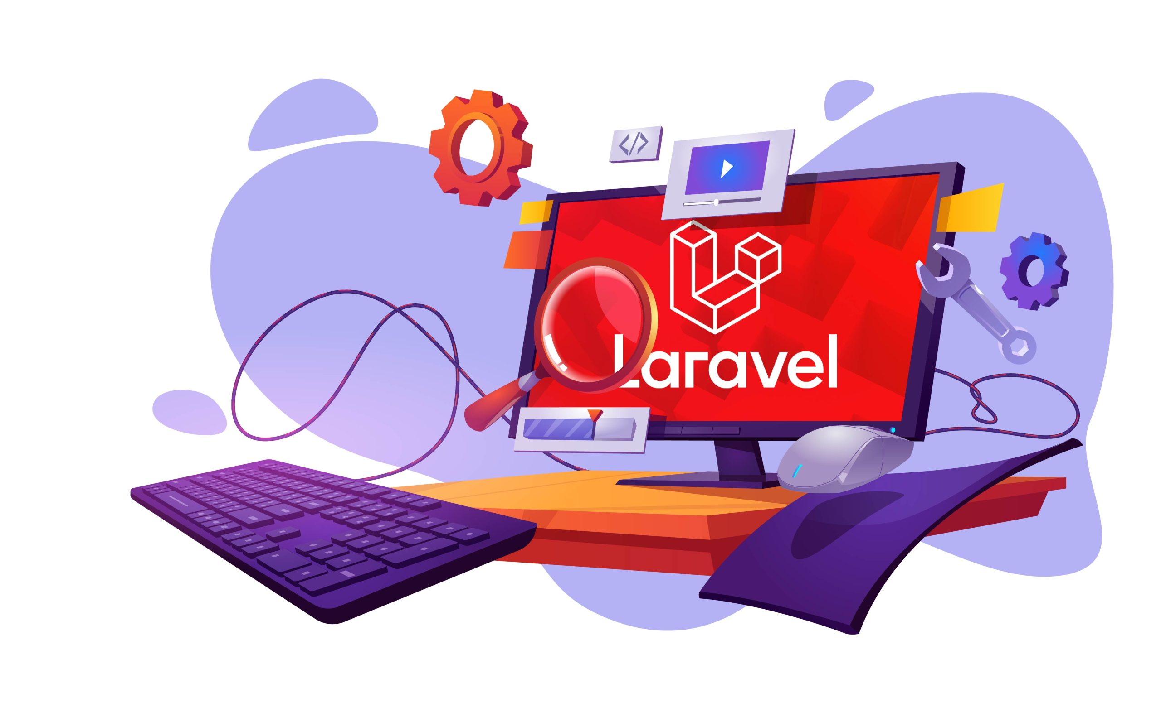

Root Directory
Installation
App Directory
MVC Pattern

Slide 2
Laragon Installation
Download laragon
https://laragon.org/download/
to install path : D:\
Download PHP (version 7.4.19)
https://www.php.net/downloads
Download Postman App
https://www.postman.com/downloads

Slide 3
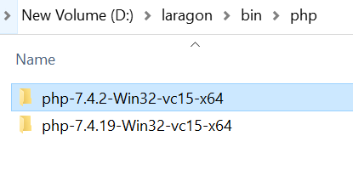
Place PHP folder in laragon
D:\laragon\bin\php

Slide 4
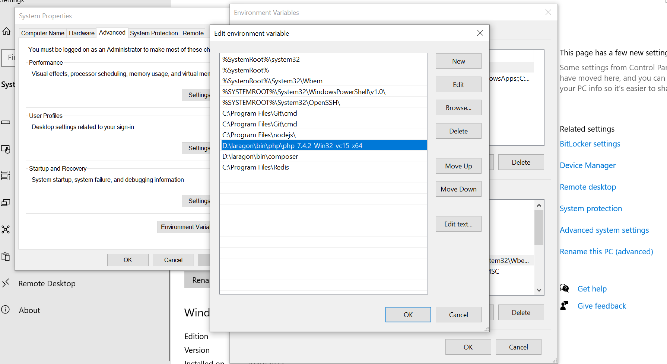
Browse php folder path in laragon
This PC => right click => Properties => Advanced System Setting => Environment Variables => System Variables => Path (double click) => Browse (file path) => OK

Slide 5
Select PHP Version
Laragon => Click Menu => PHP => Version[php - - -] => Select PHP version

Slide 6
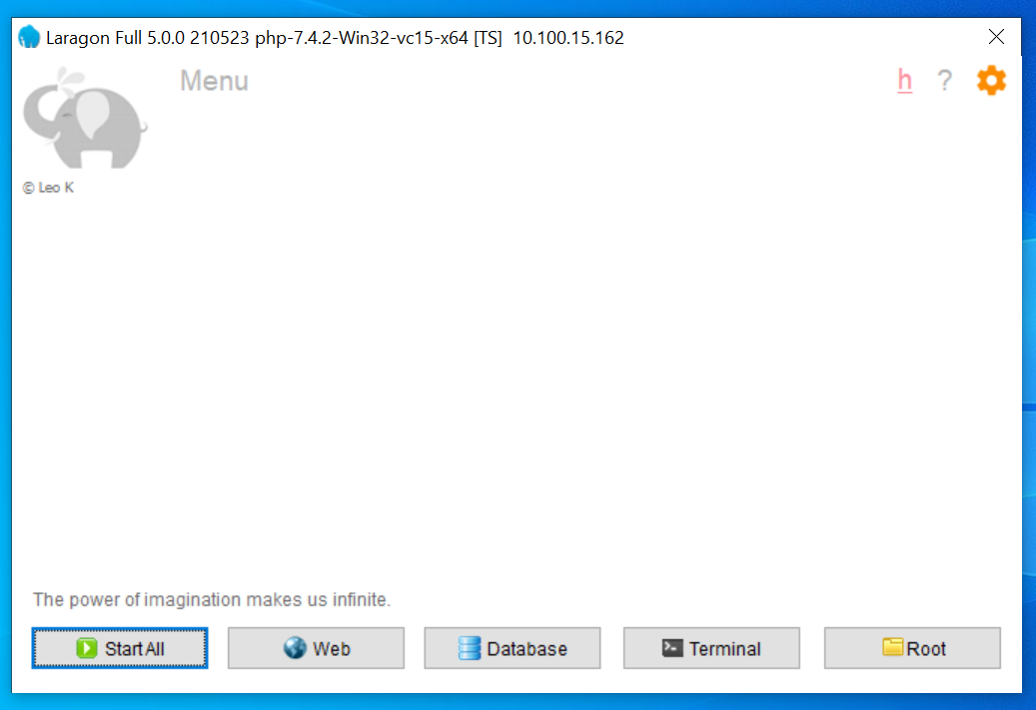
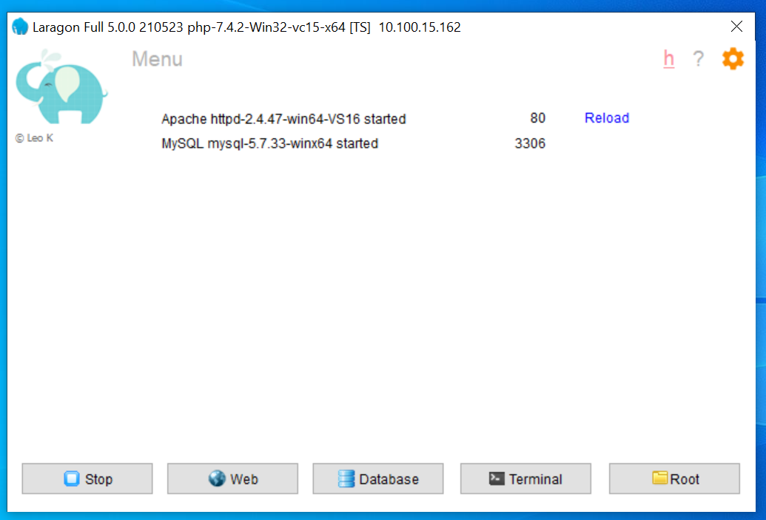
Run Laragon
Click Start All If want to stop, click Stop.

Slide 7
Laravel-Installation (version – 7.*)
Laravel framework needs a few requirements for getting installed on your system.
Installing Laravel Project
Create Laravel project path on your local machine - D:\laragon\www\laravel-project
Before creating your first Laravel project, you should ensure that your local machine has PHP and
Composer ( https://getcomposer.org ) installed.
After you have installed PHP and Composer, you may create a new Laravel project via the Composer
create-project command :
composer create-project --prefer-dist laravel/laravel:^7.0 project_name

Slide 8
The Root Directory Structure of Laravel
This directory is one of the most important directories, inside which you will find some other subdirectories. These are:
Directory | Description
app | The app directory holds the base code for your Laravel application.
bootstrap | The bootstrap directory contains all the bootstrapping scripts used for your application.
config | The config directory holds all your project configuration files (.config).
database | The database directory contains your database files.
public | The public directory helps start your Laravel project and maintains other necessary files such as JavaScript, CSS, and images of your project.
resources | The resources directory holds all the language (localization) files, and templates (if any).
routes | The routes directory contains all your definition files for routing, such as console.php, api.php, channels.php, web.php.
storage | The storage directory holds your session files, cache, compiled templates, and miscellaneous files generated by the framework.
vendor | The vendor directory holds all composer dependency files.

Slide 9
The App Directory Structure of Laravel
Directory | Description
Console | The Console directory contains all your project artisan commands.
Events | The Events directory holds event files that your laravel application may pop up. Events are used for sending messages or signals to other parts of the laravel project that any action has taken place within the project.
Exceptions | The Exceptions directory holds your laravel project's exception handling files, which handle all the exceptions thrown by your Laravel project.
Http | The Http directory holds different filters, requests, and controllers.
Jobs | The Jobs directory holds all lineup jobs in this directory. You need to type and run this artisan command: make:job
Listeners | The Listeners directory holds all your project's handler classes used for receiving and handling events.
Mail | The Main directory holds all the emails sent through your Laravel project, and this directory needs to be created using the command: make:mail
Notifications | The Notifications directory contains all your transactional notifications sent through your Laravel project, and this directory needs to be created using the command: make:notification
Providers | The Providers directory is used to contain different service providers.
Rules | The Rules directory holds all the different objects related to custom validation rules, and this directory needs to be created using the command: make:rule

Slide 10
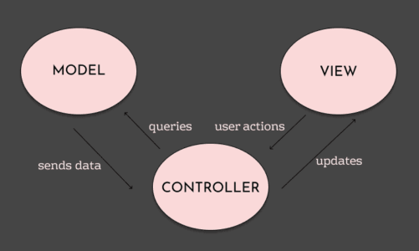
MVC Pattern
MVC is a software architecture pattern and it stands for Model View Controller.
A Model is a representation of a real-life instance or object in our code base. The View represents the interface through which the user interacts with our Application. When a user takes an action, the Controller handles the action and updates the Model if necessary.

Slide 11

Closing Slide With any Question
Thank You

