Slide 1
Route , Middleware and Controller

Slide 2
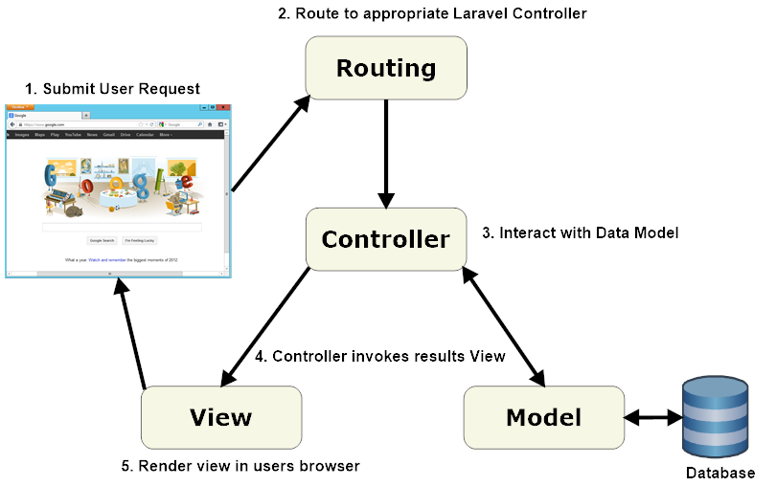
MVC Pattern
URL
Route
Controller
Model
Database
View

Slide 3
Uniform Resource Locators (URLs)
Protocol
Domain
Path
http://localhost:8000/welcome
protocol
domain
path

Slide 4
Route
Basic Route
The most basic Laravel routes accept a URI and a Closure, providing a very simple and expressive method of defining routes:
Route::get('/greeting', function () {
return 'Hello World';
});

Slide 5
Route
The Default Route Files
Route files are located in the routes directory.
Route files are automatically loaded by your application's App\Providers\RouteServiceProvider
The routes/web.php file defines routes that are for your web interface and are assigned the web middleware group.
The routes in routes/api.php are stateless and are assigned the api middleware group

Slide 6
Route
Available Router Methods
The router allows to register routes
Route::get($uri, $callback);
Route::post($uri, $callback);
Route::put($uri, $callback);
Route::patch($uri, $callback);
Route::delete($uri, $callback);
Route::options($uri, $callback);

Slide 7
Route
Redirect Routes
If you are defining a route that redirects to another URI,
redirect(‘redirect_url’);
If you are defining a route that redirects to another URI with name,
redirect()->route('home');
If you redirect to controller action,
redirect()->action(‘NameOfController@methodName’,[parameters]);

Slide 8
Route
Required Route parameters
Sometimes you will need to capture segments of the URI within your route.
For example, you may need to capture a user's ID from the URL.
You may do so by defining route parameters:
Route::get('user/{id}', function ($id) {
return 'User '.$id;
});

Slide 9
Route
You may define as many route parameters as required by your route:
Route::get('posts/{post}/comments/{comment}', function ($postId, $commentId) {
//
});
Note *
Route parameters are always encased within {} braces and should consist of alphabetic characters, and may not contain a - character.
Instead of using the - character, use an underscore (_).
Route parameters are injected into route callbacks / controllers based on their order - the names of the callback / controller arguments do not matter.

Slide 10
Middleware
Middleware provide a convenient mechanism for filtering HTTP requests entering your application.
All of these middleware are located in the app/Http/Middleware directory.
Defining Middleware
To create a new middleware, use the make:middleware Artisan command:
php artisan make:middleware MiddlewareName

Slide 11
Registering middleware
Global Middleware
If you want a middleware to run during every HTTP request to your application, list the middleware class in the $middleware property of your app/Http/Kernel.php class.
Assigning Middleware to Routes
If you would like to assign middleware to specific routes, you should first assign the middleware a key in the $routeMiddleware property of your app/Http/Kernel.php file.
protected $routeMiddleware = [
'auth' => \App\Http\Middleware\Authenticate::class,
];

Slide 12
Registering middleware
Once the middleware has been defined in the HTTP kernel, you may use the middleware method to assign middleware to a route:
Route::get('admin/profile', function () {
//
})->middleware('auth');
You may also assign multiple middleware to the route:
Route::get('/', function () {
//
})->middleware('first', 'second');

Slide 13
Registering middleware
When assigning middleware, you may also pass the fully qualified class name:
use App\Http\Middleware\Authenticate;
Route::get('admin/profile', function () {
//
})->middleware(Authenticate::class);
When assigning middleware to a group of routes, you may occasionally need to prevent the middleware from being applied to an individual route within the group. You may accomplish this using the withoutMiddleware method:

Slide 14
Registering middleware
use App\Http\Middleware\Authenticate::class;
Route::middleware([Authenticate::class])->group(function () {
Route::get('/', function () {
//
});
Route::get('admin/profile', function () {
})->withoutMiddleware([Authenticate::class]);
});
The withoutMiddleware method can only remove route middleware and does not apply to global middleware.

Slide 15
Registering middleware
Middleware Group
Sometimes you may want to group several middleware under a single key to make them easier to assign to routes.
You may do this using the $middlewareGroups property of your HTTP kernel.
Out of the box, Laravel comes with web and api middleware groups that contain common middleware you may want to apply to your web UI and API routes:

Slide 16
Registering middleware
protected $middlewareGroups = [
'web' => [
\App\Http\Middleware\EncryptCookies::class,
\Illuminate\Cookie\Middleware\AddQueuedCookiesToResponse::class,
\Illuminate\Session\Middleware\StartSession::class,
\Illuminate\View\Middleware\ShareErrorsFromSession::class,
\App\Http\Middleware\VerifyCsrfToken::class,
\Illuminate\Routing\Middleware\SubstituteBindings::class,
],
'api' => [
'throttle:60,1',
'auth:api', ],
];

Slide 17
Registering middleware
Middleware groups may be assigned to routes and controller actions using the same syntax as individual middleware. Again, middleware groups make it more convenient to assign many middleware to a route at once:
Route::get('/', function () {
})->middleware('web');
Route::group(['middleware' => ['web']], function () {
});
Route::middleware(['web', 'subscribed'])->group(function () {
});

Slide 18
Registering middleware
Sorting Middleware
You may need your middleware to execute in a specific order but not have control over their order when they are assigned to the route.
In this case, you may specify your middleware priority using the $middlewarePriority property of your app/Http/Kernel.php file:
protected $middlewarePriority = [
\Illuminate\Session\Middleware\StartSession::class,
\Illuminate\View\Middleware\ShareErrorsFromSession::class,
\Illuminate\Contracts\Auth\Middleware\AuthenticatesRequests::class,
\Illuminate\Routing\Middleware\ThrottleRequests::class,
\Illuminate\Session\Middleware\AuthenticateSession::class,
\Illuminate\Routing\Middleware\SubstituteBindings::class,
\Illuminate\Auth\Middleware\Authorize::class,
];

Slide 19
Registering middleware
Middleware Parameters
Middleware can also receive additional parameters.
For example, if your application needs to verify that the authenticated user has a given "role" before performing a given action,
you could create a CheckRole middleware that receives a role name as an additional argument
Additional middleware parameters will be passed to the middleware after the $next argument:

Slide 20
Registering middleware
<?php
namespace App\Http\Middleware;
use Closure;
class CheckRole
{
/**
* Handle the incoming request.
* @param \Illuminate\Http\Request $request
* @param \Closure $next
* @param string $role
* @return mixed
*/
public function handle($request, Closure $next, $role)
{
if (! $request->user()->hasRole($role)) {
// Redirect...
}
return $next($request);
}
}

Slide 21
Registering middleware
Middleware parameters may be specified when defining the route by separating the middleware name and parameters with a :. Multiple parameters should be delimited by commas:
Route::put('post/{id}', function ($id) {
//
})->middleware('role:editor');

Slide 22
Controller
Instead of defining all of your request handling logic as Closures in route files, you may wish to organize this behavior using Controller classes.
Controllers can group related request handling logic into a single class.
Controllers are stored in the app/Http/Controllers directory.
Defining Controller
To create a new controller, use the make:controller Artisan command:
php artisan make:controller ControllerName

Slide 23
controller
Below is an example of a basic controller class. Note that the controller extends the base controller class included with Laravel
<?php
namespace App\Http\Controllers;
use App\Http\Controllers\Controller;
use App\User;
class UserController extends Controller
{
public function show($id)
{
$user=User::findOrFail($id);
return $user;
}
}
?>

Slide 24
controller
You can define a route to this controller action like so:
Route::get('user/{id}', 'UserController@show');
Controllers & Namespaces
If full controller class is App\Http\Controllers\Photos\AdminController, you should register routes to the controller like so:
Route::get('foo', 'Photos\AdminController@method');

Slide 25
controller
Single Action Controllers
If you would like to define a controller that only handles a single action, you may place a single __invoke method on the controller:
<?php
namespace App\Http\Controllers;
use App\Http\Controllers\Controller;
use App\User;
class ShowProfile extends Controller
{
public function __invoke($id)
{
$user=User::findOrFail($id);
return $user;
}
}
?>

Slide 26
controller
When registering routes for single action controllers, you do not need to specify a method:
Route::get('user/{id}', 'ShowProfile');
You may generate an invokable controller by using the --invokable option of the make:controller Artisan command:
php artisan make:controller ShowProfile --invokable

Slide 27
controller
Resource Controllers
Laravel resource routing assigns the typical "CRUD" routes to a controller with a single line of code
php artisan make:controller PhotoController –resource
Next, you may register a resourceful route to the controller:
Route::resource('photos', 'PhotoController');
You may register many resource controllers at once by passing an array to the resources method:
Route::resources([
'photos' => 'PhotoController',
'posts' => 'PostController',
]);

Slide 28
controller
Actions Handled By Controller
Verb | URL | Action | Route Name
GET | /photos | index | photos.index
GET | /photos/create | create | photos.create
POST | /photos | store | photos.store
GET | /photos/{photo} | show | photos.show
GET | /photos/{photo}/edit | edit | photos.edit
PUT/PATCH | /photos/{photo} | update | photos.update
DELETE | /photos/{photo} | destroy | photos.destroy

Slide 29
controller
Specifying The Resource Model
php artisan make:controller PhotoController --resource --model=Photo

Slide 30
controller
Partial Resources Routes
Route::resource('photos', 'PhotoController')->only([
'index', 'show'
]);
Route::resource('photos', 'PhotoController')->except([
'create', 'store', 'update', 'destroy'
]);

Slide 31
controller
API Resources Routes
When declaring resource routes that will be consumed by APIs, you will commonly want to exclude routes that present HTML templates such as create and edit. For convenience, you may use the apiResource method to automatically exclude these two routes:
Route::apiResource('photos', 'PhotoController');
You may register many API resource controllers at once by passing an array to the apiResources method:
Route::apiResources([
'photos' => 'PhotoController',
'posts' => 'PostController',
]);
To quickly generate an API resource controller that does not include the create or edit methods, use the --api switch when executing the make:controller command:
php artisan make:controller API/PhotoController –api

Slide 32
controller
Dependency Injection & Controllers
Constructor Injection
The Laravel service container is used to resolve all Laravel controllers. As a result, you are able to type-hint any dependencies your controller may need in its constructor. The declared dependencies will automatically be resolved and injected into the controller instance:
<?php
namespace App\Http\Controllers;
use App\Repositories\UserRepository;
class UserController extends Controller
{
protected $users;
public function __construct(UserRepository $users)
{
$this->users = $users;
}
}

Slide 33
controller
Dependency Injection & Controllers
Method Injection
In addition to constructor injection, you may also type-hint dependencies on your controller's methods. A common use-case for method injection is injecting the Illuminate\Http\Request instance into your controller methods:
<?php
namespace App\Http\Controllers;
use Illuminate\Http\Request;
class UserController extends Controller
{
public function store(Request $request)
{
$name = $request->name;
}
}

Slide 34
controller
If your controller method is also expecting input from a route parameter, list your route arguments after your other dependencies. For example, if your route is defined like so:
Route::put('user/{id}', 'UserController@update');
You may still type-hint the Illuminate\Http\Request and access your id parameter by defining your controller method as follows:
<?php
namespace App\Http\Controllers;
use Illuminate\Http\Request;
class UserController extends Controller
{
public function update(Request $request, $id)
{
}
}

Slide 35
controller
Route Caching
If your application is exclusively using controller based routes, you should take advantage of Laravel's route cache. Using the route cache will drastically decrease the amount of time it takes to register all of your application's routes. In some cases, your route registration may even be up to 100x faster. To generate a route cache, just execute the route:cache Artisan command:
php artisan route:cache
After running this command, your cached routes file will be loaded on every request. Remember, if you add any new routes you will need to generate a fresh route cache. Because of this, you should only run the route:cache command during your project's deployment.
You may use the route:clear command to clear the route cache:
php artisan route:clear

