Slide 1
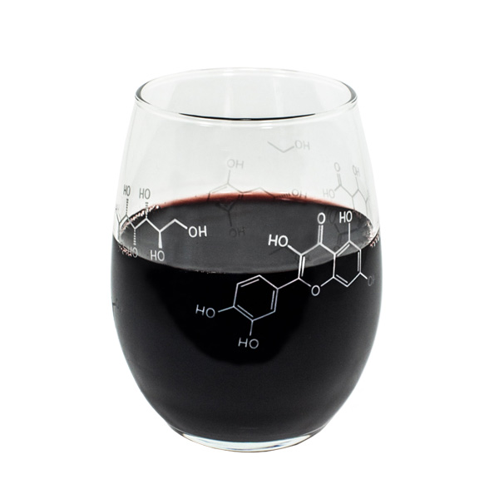
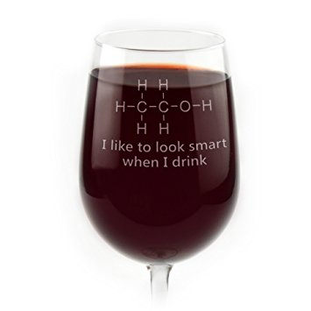
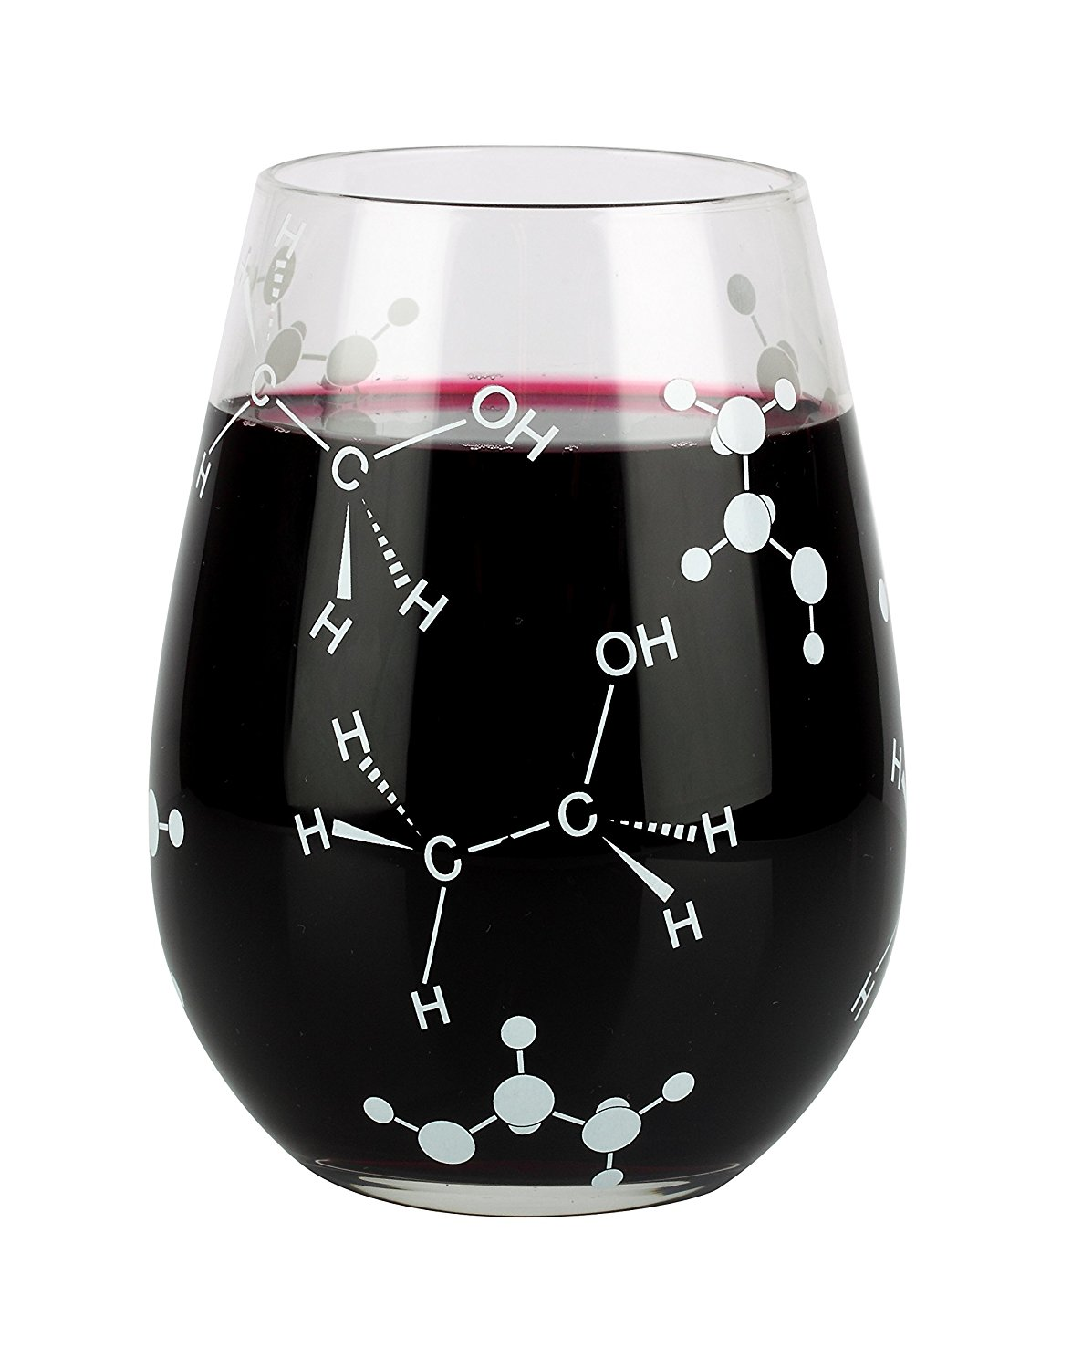
Quality and Chemistry of Wines
Aaron Levine
February 2017

Slide 2
Overview
Is it possible to predict the quality of a wine using chemistry?
  Determine top wines and reject poor wines based on chemical attributes alone
Business implications
  Restaurants can simply inquire about the chemistry of a wine before deciding wheter or not to request it
Public data available on the UCI machine learning repository
  **url**
  Contains 11 chemical attributes of red and white wines
    Density, pH, citric acid content, etc.
  Contains quality ratings for each wine as determined by professional critics
Let's develop a model to do this!

Slide 3
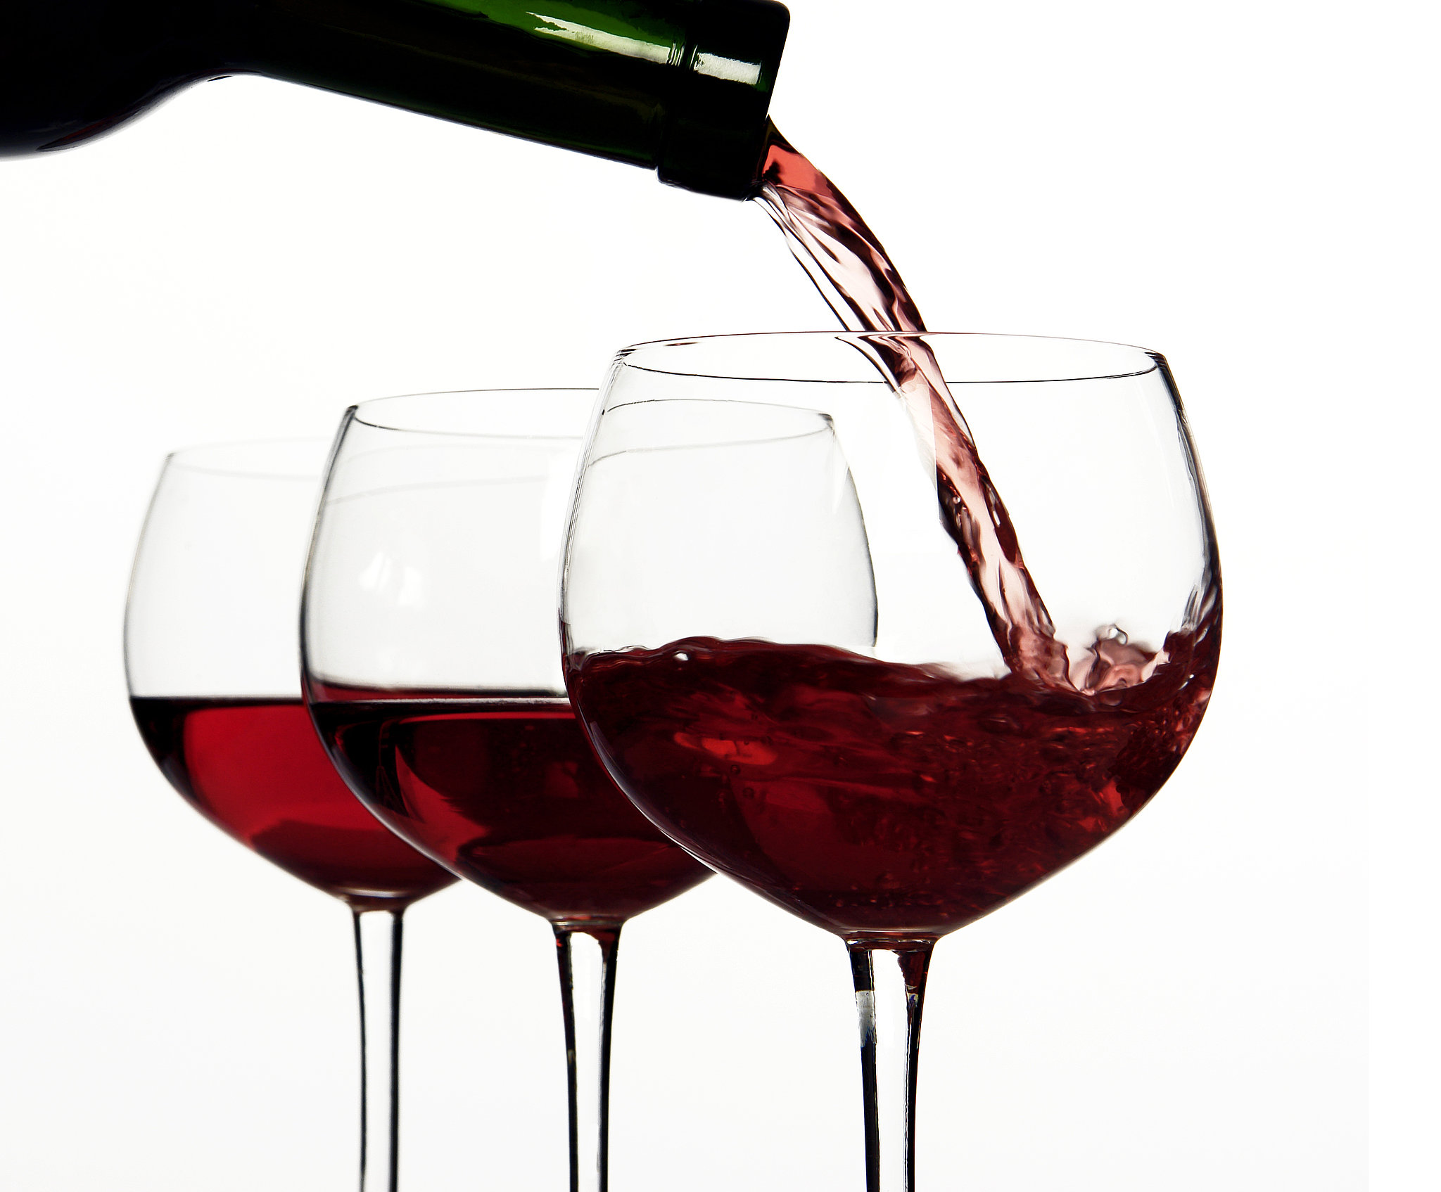
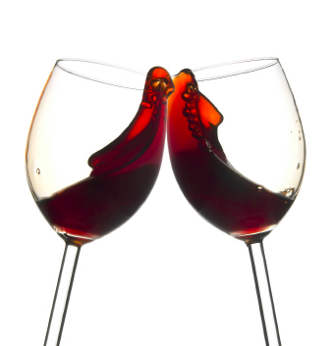
Red Wines

Slide 4
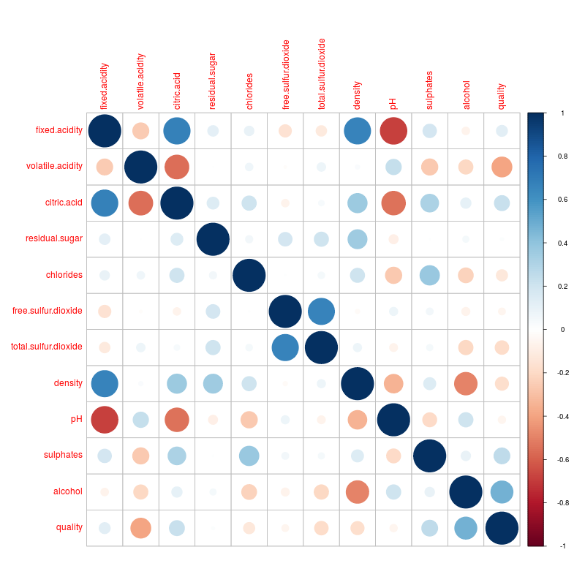
Correlation Matrix
quality
Which of the 11 features are important for identifying wines by their quality?
  With only 11 features, can make a matrix of correlation coefficients to visualize relationships
Strongest correlations to quality
  Volatile acidity
  Alcohol content
Correlation coefficients may not tell the full story

Slide 5
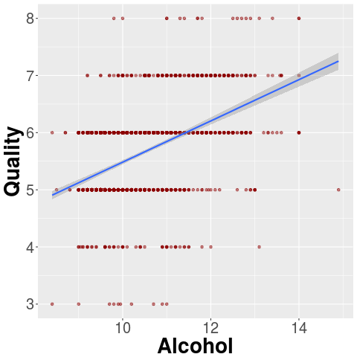
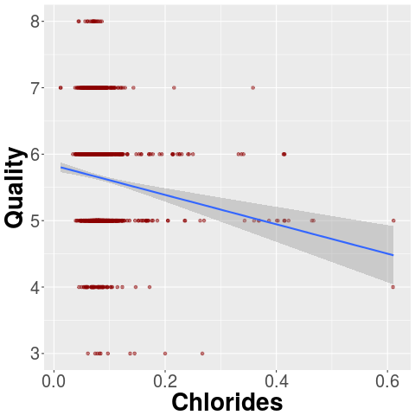
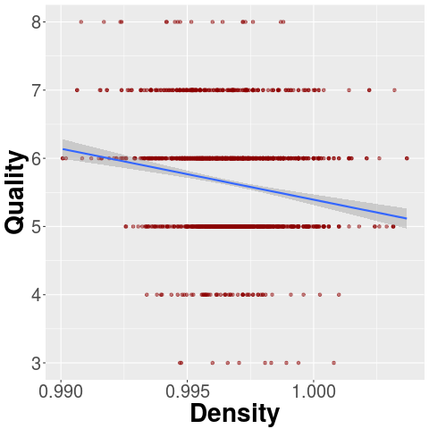
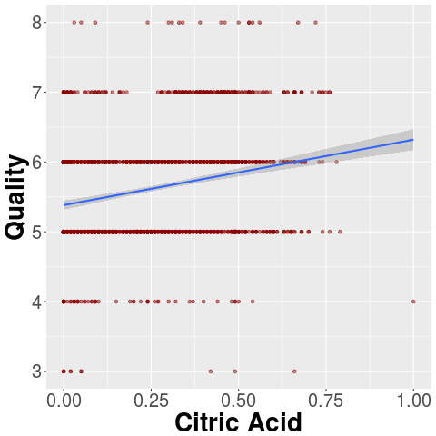
Visualize Relationships
Plot quality vs features
  Add linear regression for each plot

Slide 6
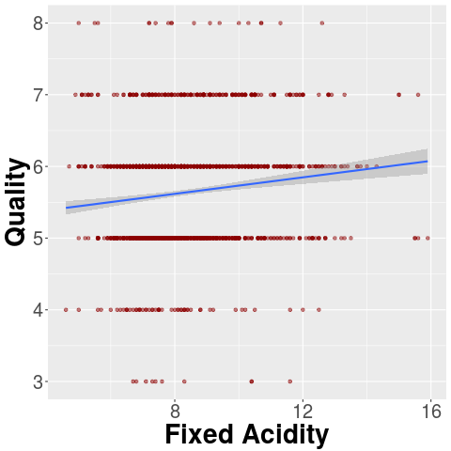
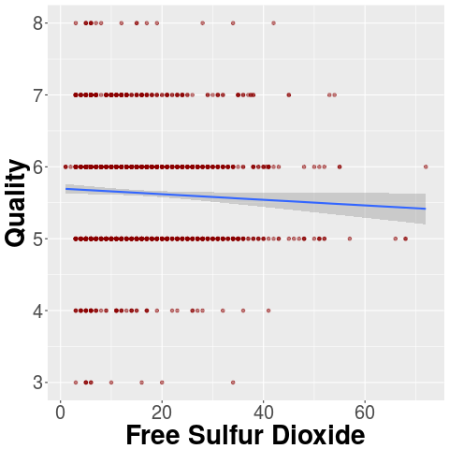
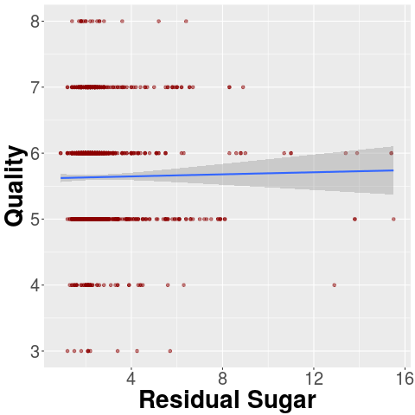
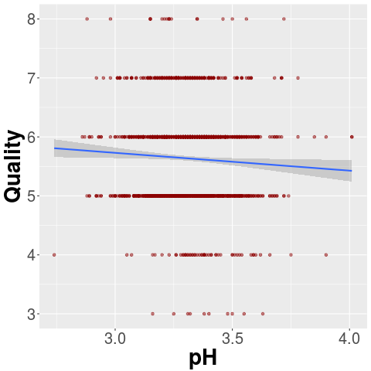
Visualization Continued weak relationships here

Slide 7
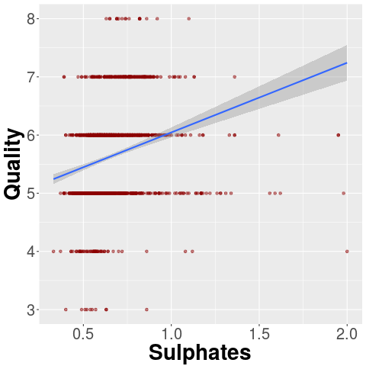
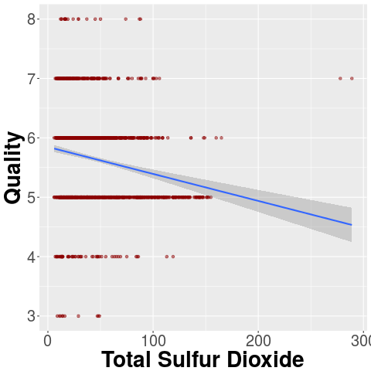
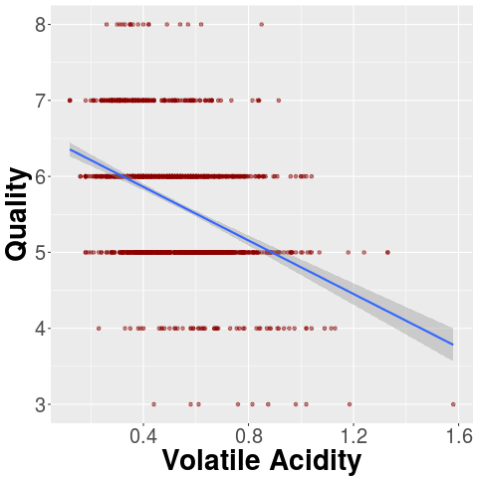
Visualization Part 3
No obvious relationships that correlation matrix missed

Slide 8
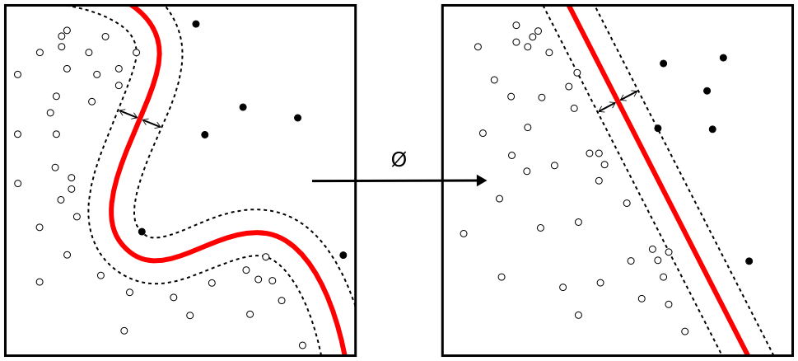
Building a Model
Now it's time to build a machine learning model that predicts the quality of a wine from it's chemistry
We have the quality classes
  Supervised learning
  Multiclass classification
Use a support vector machine (SVM) with a radial basis function (RBF) kernel
Image source: wikipedia

Slide 9
Training the SVM
Randomly divide the data into training, cross validation, and testing
  60% train, 20% cross validation, 20% testing
  Use same random seed in R for reproducibility
Use cross validation set to select optimal values of C and γ
  Higher values of C increase penalty for missclassification, results in tighter fit to training data (high variance)
  Higher values of γ: smoother variance of the RBF kernel near data points, results in looser fit to training data (high bias)

Slide 10
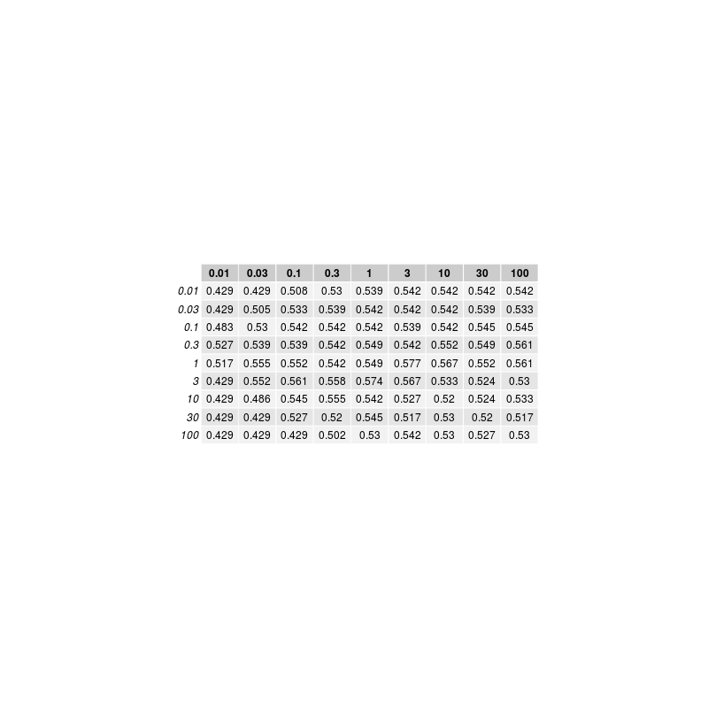
Cross Validation Results
Train with alcohol, volatile acidity
  Highest correlation to quality
  Start small to avoid overtraining
See table to right
Results in 52.8% accuracy on test set
  Can this be improved?

Slide 11

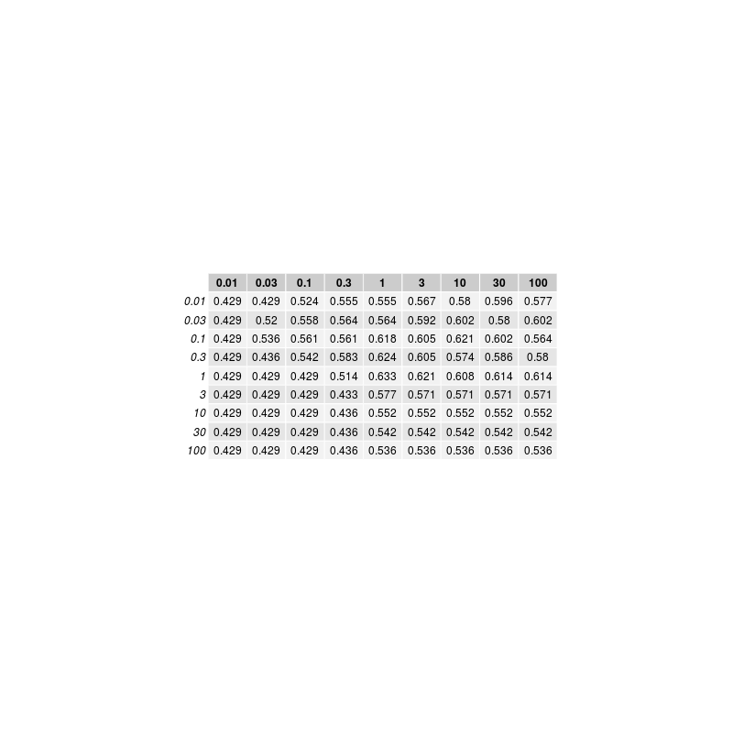
Cross Validation Results
Train with all 11 features
See CV in table to right
Results in 59.1% accuracy on test set
  58.8% chance 5 prediction is correct
  76.9% of 5's correctly identified
  55.7% chance 6 prediction is correct
  59.3% of 6's correctly identified
  84.2% chance 7 prediction is correct
  38.1% of 7's correctly identified
  No 3, 4, 8, predictions made

Slide 12
Identifying Best Red Wines: Overview
The previous model was sucessful in identifying average wines, but unsucessful in identifying outliers
Restaurants and consumers don't want to identify average with high accuracy, they want to identify the best and/or avoid the worst
Apply an SVM to two classes of wines: best(7-8) and not best(3-6)
  Highly skewed classes
  Precision (P) =
  Recall (R) =
Use F-Score metric =

Slide 13
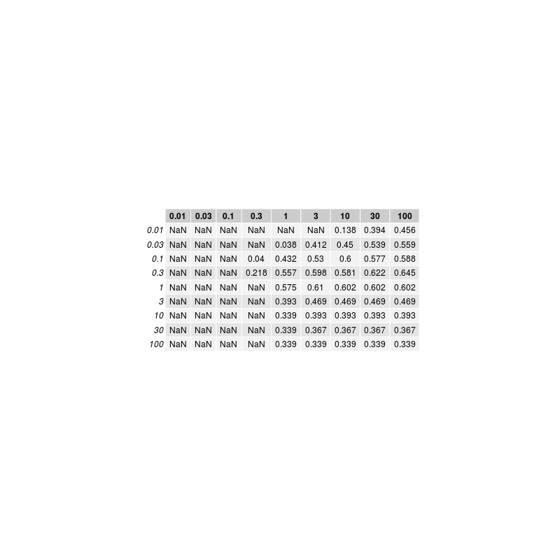
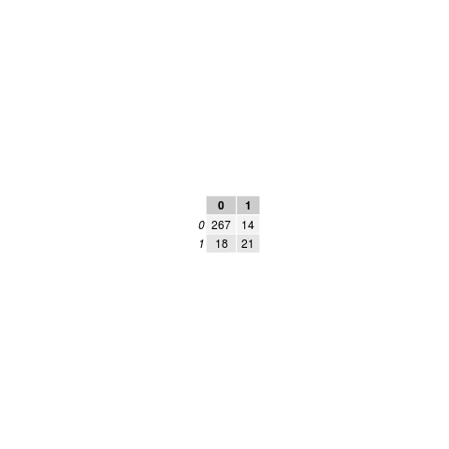
Identifying Best Red Wines: Results
Trained with all 11 features
Train SVM
  Class 0: Not bad wines
  Class 1: Bad wines
See CV in table to right
Results in 0.568 F score
In test set:
  5 5's, 13 6's, 18 7's, 3 8's identified as top wines (Class 1)
    Over half of wines are in fact top quality
    No terrible wines (3,4) were false positives
  10 7's, 4 8's missed identification (Class 0)
    Over half of top wines in the test set were correclty identified
    Room for improvement: over half of 8's are not correctly identified

Slide 14
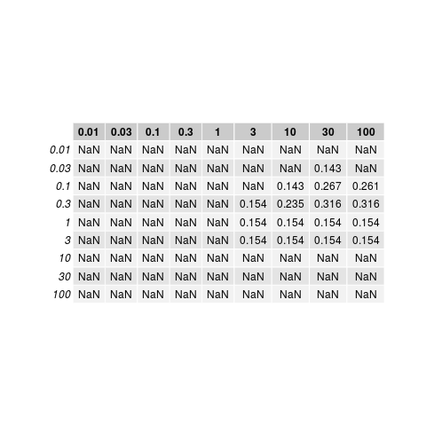

Identifying Worst Red Wines: Results
An average consumer might want to avoid bad wines (3,4 quality)
Train SVM
  Class 0: Not bad wines
  Class 1: Bad wines
See CV in table to right
  NaN: no true or false positives
Results in table to the right
  No terrible wines sucessfully identified

Slide 15
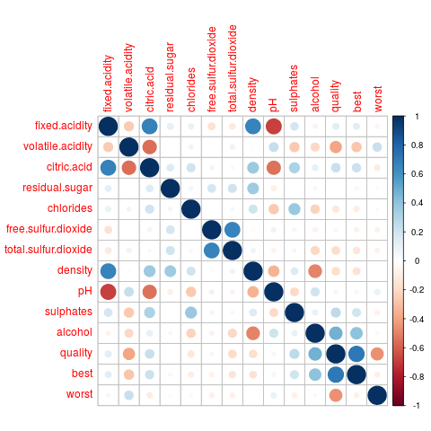
Full Red Wine Correlation Matrix
With Best, Worst
Reason for poor worst wines identification: no features strongly correlated
to poor quality.

Slide 16
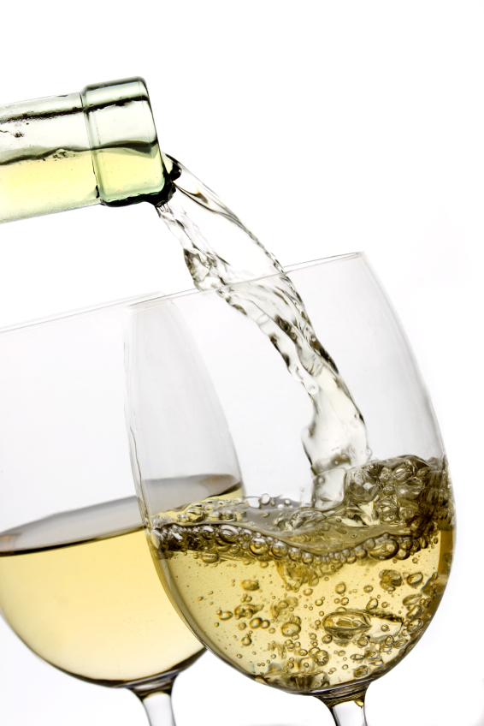
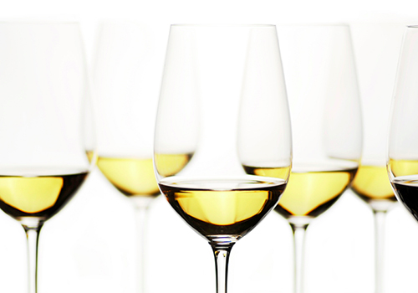
White Wines

Slide 17
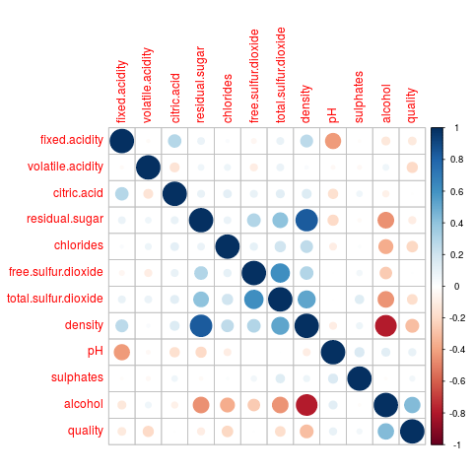
Correlation Matrix
Repeat analysis used in red wines
  Alcohol, density strongest indicators of quality
  Many weak correlations to quality

Slide 18
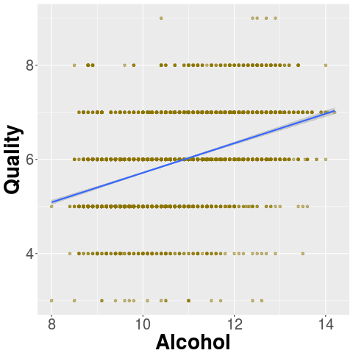
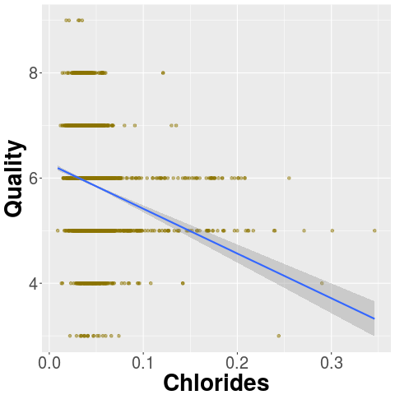
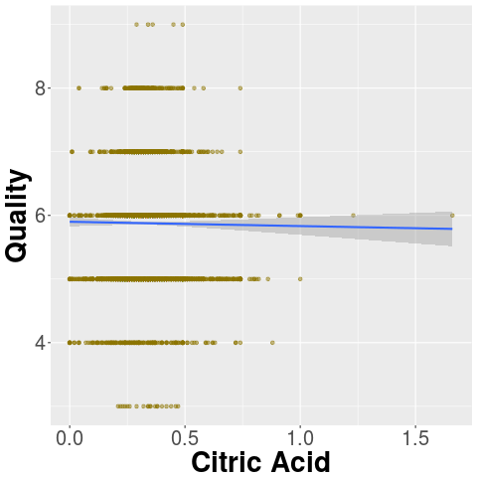
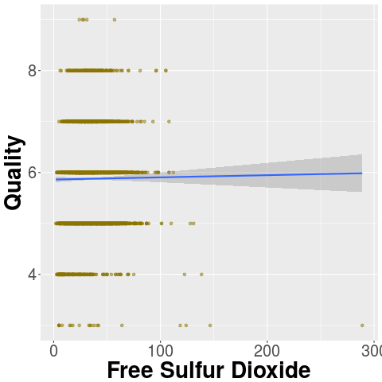
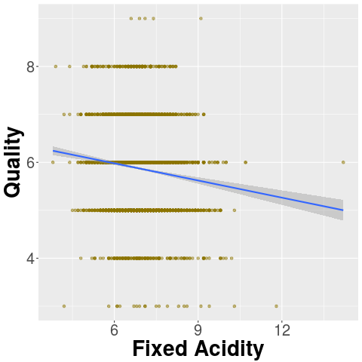
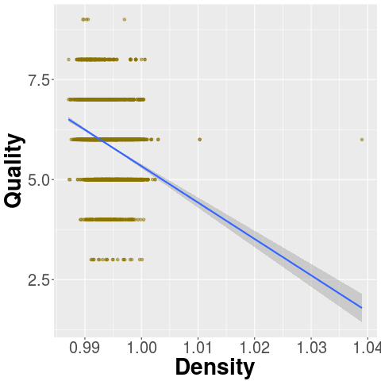
Visualize Relationships

Slide 19
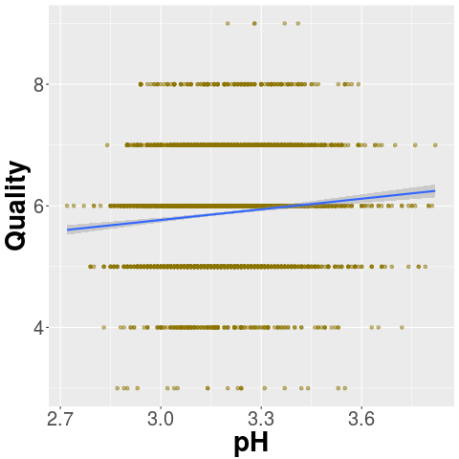
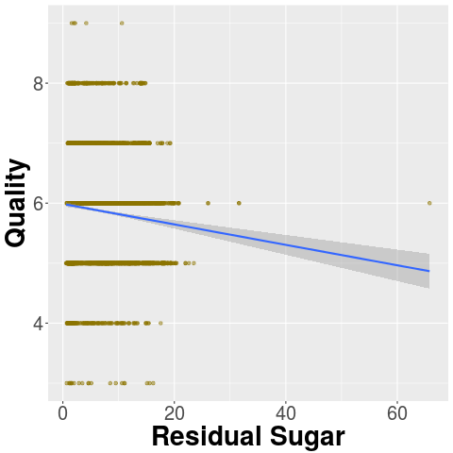
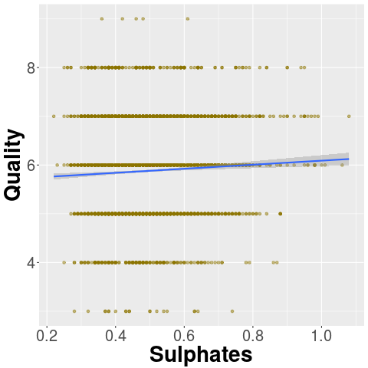
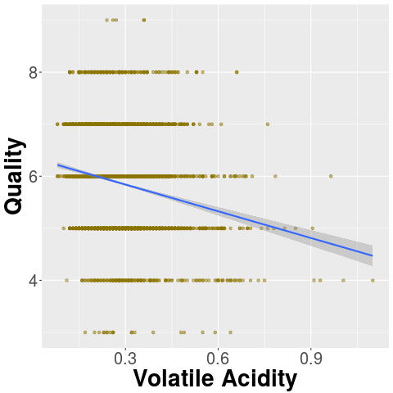
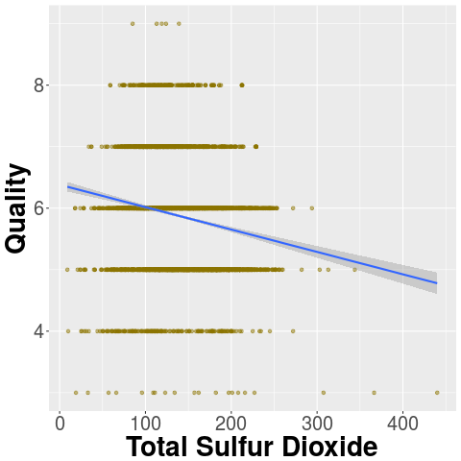
Visualize Relationships, Part 2

Slide 20
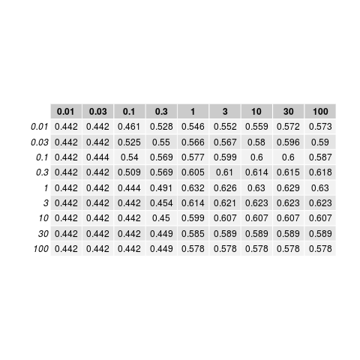
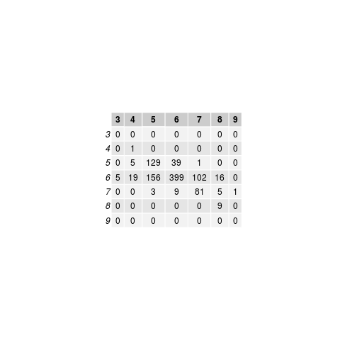
Identifying White Wines By Quality
Train SVM as discussed in red wine section
Results in 63.2% accuracy on test set
  100% chance 4 prediction is correct
  4% of 4's correctly identified
  74.6% chance 5 prediction is correct
  44.8% of 5's correctly identified
  73.8% chance 6 prediction is correct
  89.3% of 6's correclty identified
  100% chance 8 prediction is correct
  30% of 8's correctly identified
  No 3 or 9 predictions made

Slide 21
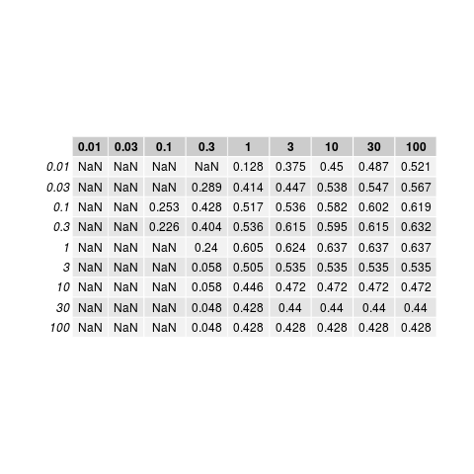

Identifying Best White Wines
Trained with all 11 features
Train SVM
  Class 0: Not bad wines
  Class 1: Bad wines
See CV in table to right
Results in 0.580 F score
In test set:
  5 5's, 28 6's, 88 7's, 13 8's, 1 9 identified as top wines (Class 1)
    Only 33 out of 102 predicted top wines were not of top quality
    No terrible wines (3,4) were false positives
    Sole 9 in test set identified as top wine
  98 7's, 17 8's, 0 9's missed identification (Class 0)
    Approximately half of top wines in the test set were sucessfully identified

Slide 22
Identifying Worst Wines
An average consumer might want to avoid bad wines (3,4 quality)
Train SVM
  Class 0: Not bad wines
  Class 1: Bad wines
See CV in table to right
  NaN: no true or false positives
Results in table to the right
  No terrible wines sucessfully identified

Slide 23
SVM with (7,8) as exceptional (1)
Test:
> print(f1score);
[1] 0.6585366
> print(c)
[1] 100
> print(g)
[1] 100
> print(predtable)
true
pred 0 1
0 265 17
1 11 27
Train:
[1] 0.617284
[1] 100
[1] 0.1
true
pred 0 1
0 263 22
1 9 25
11 false positives: 8 6's, 3 5's
So no wine lover will get horrible wine!
All 3 8's in test set are flagged as exceptional wines

Slide 24
SVM with (3,4) as horrible

Slide 25
Anomaly Detection for 3,8

Slide 26
Red vs White Wine

Slide 27
Correlation Matrix

Slide 28
Binomial Logistic Regression Train

Slide 29
Results

Slide 30
Conclusions

