Slide 1

Contributing to Community Codes: GitHub Workflow for Community software Development
S.J.L. Billinge
Department of Applied Physics and Applied Mathematics
Columbia University,
CMPMS, Brookhaven National Laboratory

Slide 2
Community Codes
Have you used numpy?
Matplotlib?
Pandas?
Scipy?
Scikit-learn? Scikit-beam?
…
If you write in python the answer is undoubtedly yes.
Same story, different package names if you use other languages

Slide 3
Who wrote those codes?
The Gods of programming
Professional codista’s getting paid the big bucks
They just appeared
No, it was people like you!
Wanted/needed something, coded it up, shared it with the community….

Slide 4
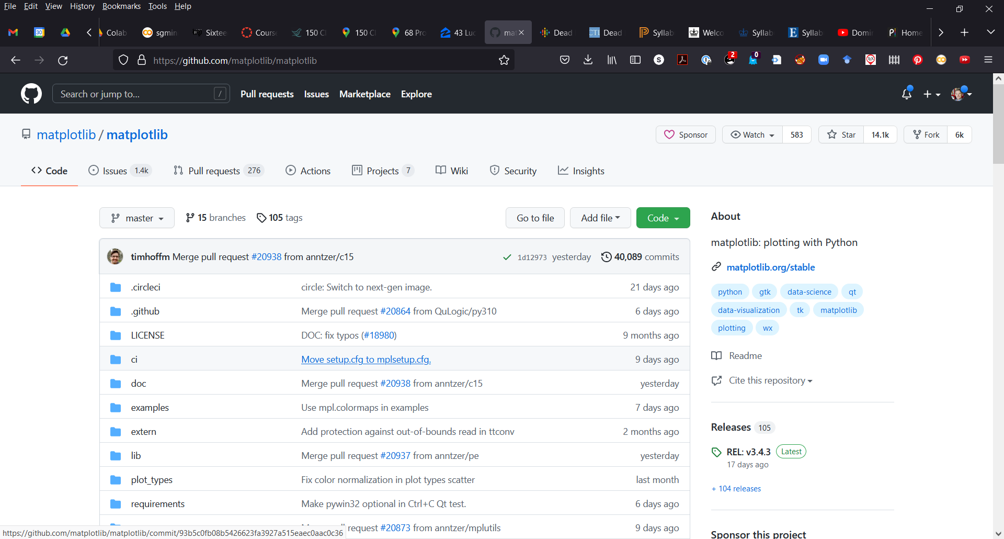

Slide 5
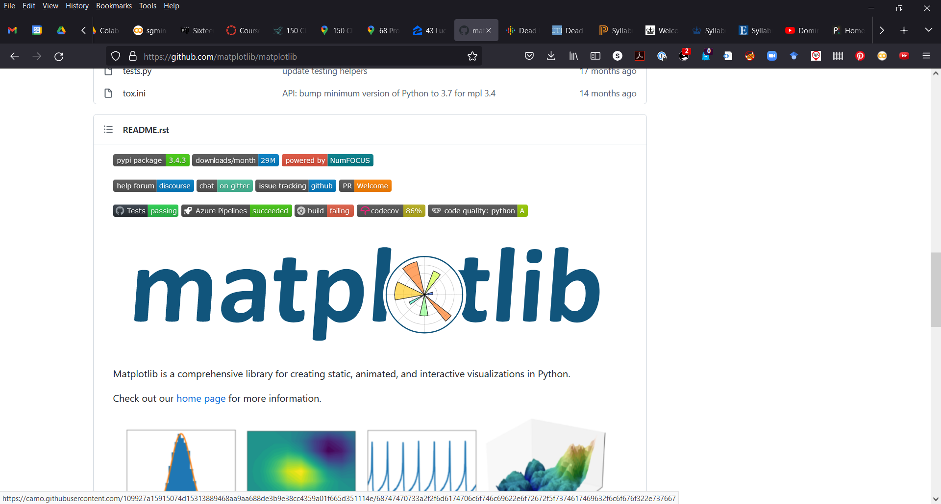

Slide 6
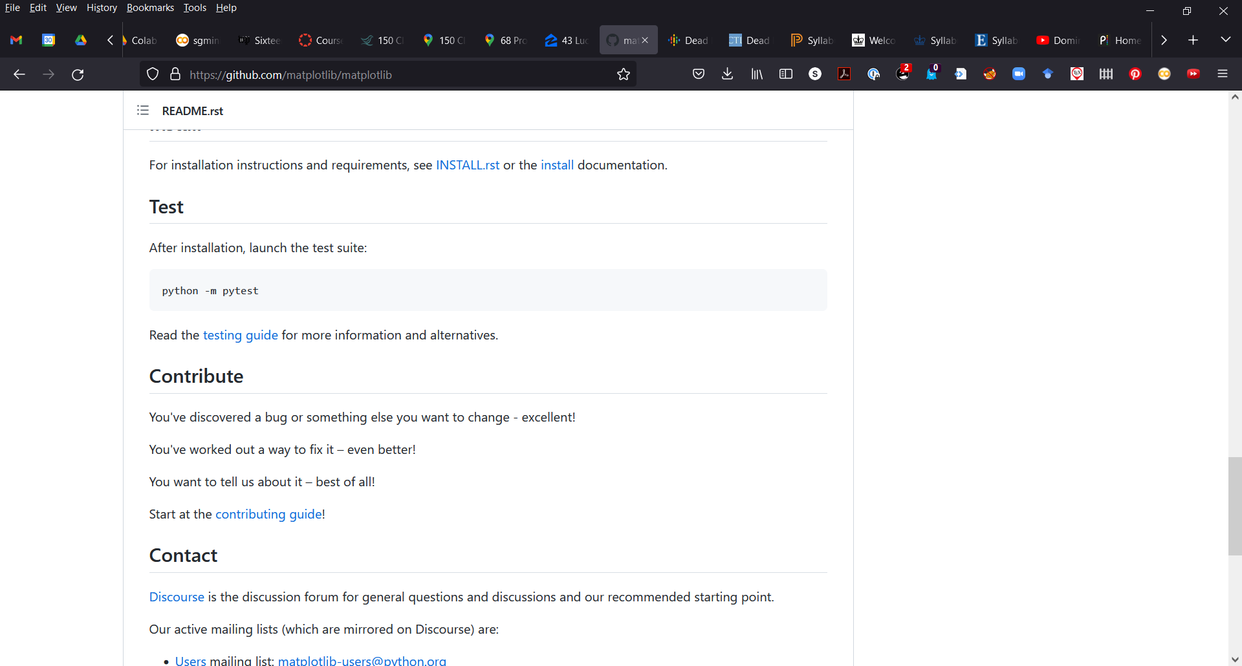

Slide 7
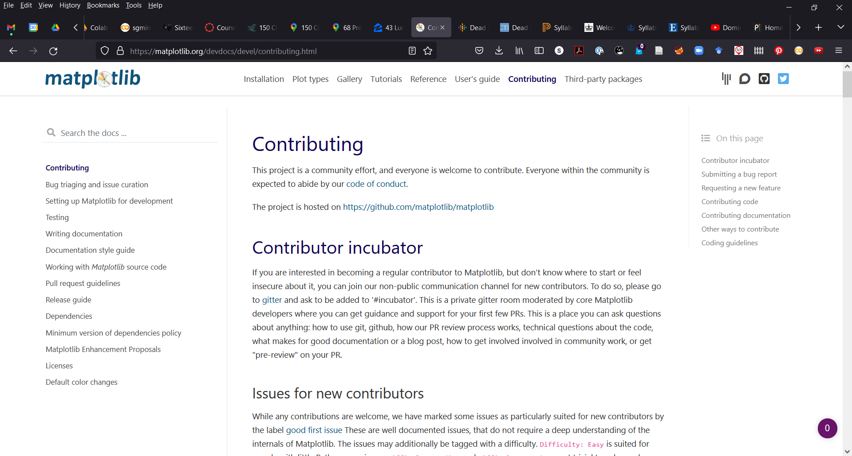

Slide 8
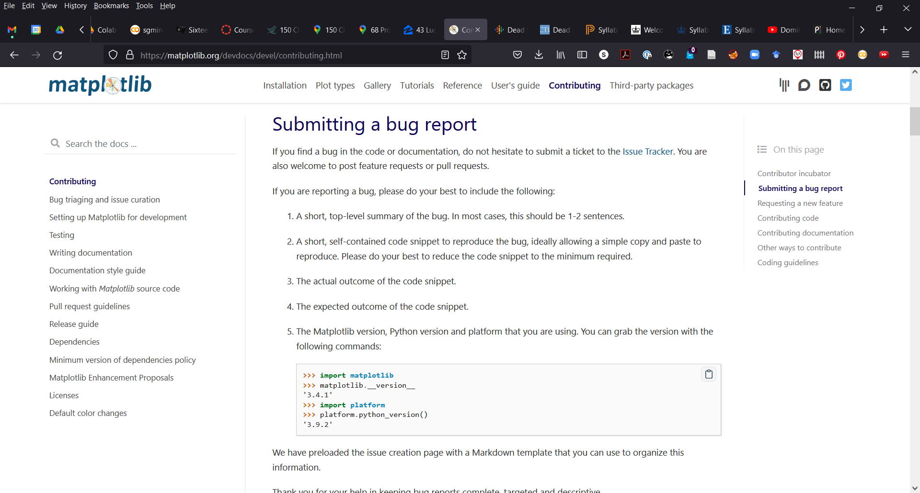

Slide 9
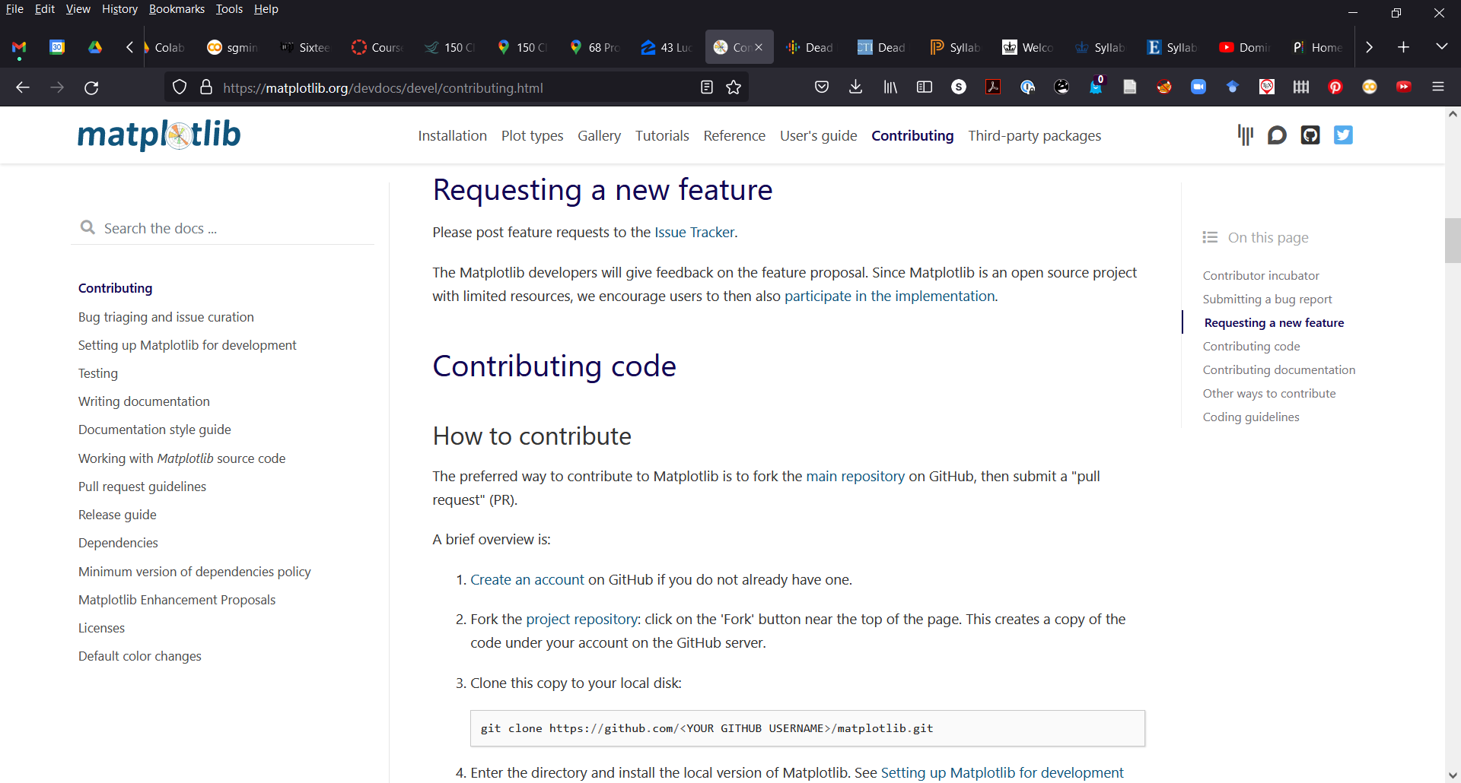

Slide 10
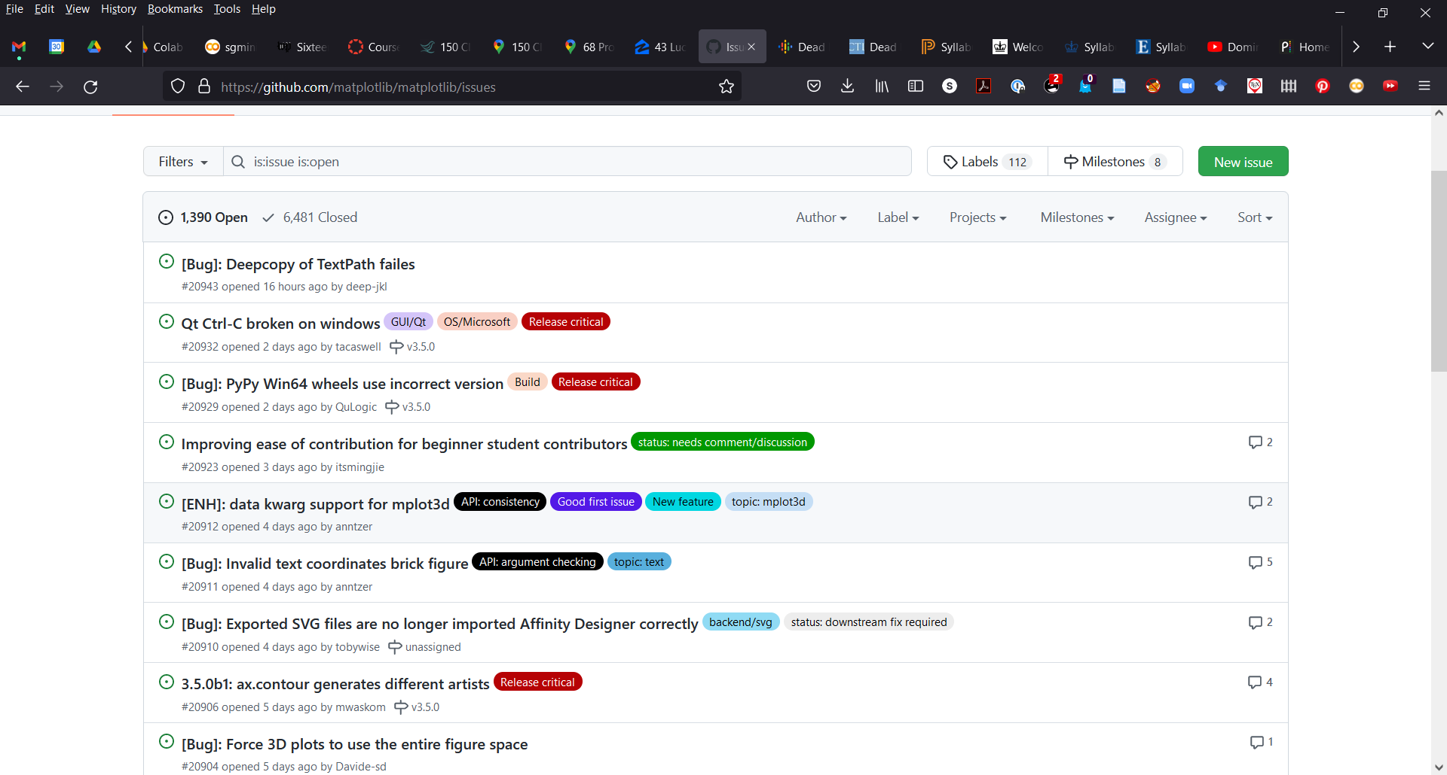

Slide 11
Now make it YOU rather some “someone like you!”
How do you get started?
What is the workflow?
What is the etiquette?
Today: the workflow

Slide 12
Let’s become community coders!
We will (ab)use the conference GitHub to learn this:
https://github.com/clacri/iucr2020_compschool

Slide 13
Let’s solve a problem:
I want to make a project that involves thousands of programmers all contributing, but it is of a uniformly high quality and doesn’t contain (more) bugs (than individual/small team projects)
Requirements:
Can be easily accessed by everyone
They can contribute code
Their contributed code can be reviewed and feedback given to improve it
This can be iterated until it is sufficiently high quality to be accepted
Only then can it be merged into the main code-base
Updated versions of the code are rolled out at various intervals in a controlled way, with documentation about what has changed

Slide 14
Git was developed to solve this (and other) problems
Developed by Linus Torvalds (developer of the linux operating system) for managing the linux project, actually
First appeared as recently as 2005
Distributed (thousands of people working in parallel). Not just the code is checked out but the entire database of changes is cloned to a user’s local computer
The key is a very powerful branching structure that allows multiple versions of code to be developed on in parallel and then merged sequentially
Designed to be “simple” but “simple” is a relative term here
Git is solving a really really complicated problem, so even though it does so “simply” that doesn’t mean it is simple or easy to use
Becoming git proficient is a gift that will keep on giving….like coffee, have it in your daily routine and learn to love it

Slide 15
This is not a Git tutorial
Despite giving the short history, the goal here is NOT to teach how to use Git, it is assumed you have already some git proficiency
If you are just getting started with git, you will find it already installed in linux and mac. For windows, I use Git Bash. Google it and you can download it.
If you are a beginner, please post git questions to the github workflow Discord channel.
If you are a git expert, please help the beginners by responding in discord!
There are some Git concepts that are important to understand to follow the logic.

Slide 16
Learn the difference between the Git database and your file-system
Files live on your file-system (the thing you navigate with Windows Explorer or Finder on Mac)
Git maintains a database of all changes that have ever been made to a git project back to the beginning of the project.
Typing “git init” in a folder on your file-system creates that database and turns everything in that folder (and its child folders) into a git project. We usually call it a “repository”
When you make “commits” using git you are taking changes you have made to the files in the repo and you are inserting them into the database.
By default a repo has a single default branch, which is called “main” by default, but can be called anything. Hereafter we will assume it is called main
You can create new branches from existing branches and work on them and when you are ready, you can merge them back into main

Slide 17
Where are my files?
Don’t worry, everything that you have committed to the database is there forever and can be retrieved.
To work on a branch,
check it out of the git database (git checkout <branchname>)
Make edits to files in there
Add them to a commit (git add <filename>)
When you are ready commit all the changes (git commit –m “commit message”)
ALWAYS USE HIGHLY DESCRIPTIVE COMMIT MESSAGES. This is how you will find work in the future if something happens (and it WILL happen)

Slide 18
Git and GitHub
Git is awesome, but GitHub (and GitLab which is its open source cousin) is superpower awesome because it really superchanges the accessibility and tools for large community projects.
What is GitHub? It is a cloud-based storage for all your Git projects/repos. It is also so much more but we can’t get into that rn.
Create an account on GitHub. Choose a serious username. GitHub activity can get you your next job so treat it like “LinkedIn”
Push your local git project to your space on GitHub and link the two.

Slide 19
Example
Project called “crysthack”
Create a folder on your filesystem called crysthack and add a file or two
“Git init”, “git add”, “git commit” (it is now also a git database). All the files exist
On your filesystem as files
On your hard-drive but in a git database
Create a repository (repo) of the same name in your personal space on GitHub
Link the GitHub repo and your local repo
Git remote
Sync the repos “git push” All the files exist
On your filesystem as files
On your hard-drive but in a git database
On the Microsoft cloud (GitHub) in a synchronized git database there

Slide 20
That’s cool.
I can back up my work and never lose it (assuming I made frequent pushes)
When my computer dies and I replace it, I can recreate all my work in a few small commands
Also, my friend who is a programmer can help me. I add her GitHub username to the repo and she can download all the work and make changes and push them back up fixing all my boo boos!
So cool.
Note: all the work in my group, including papers we are working on together, is handled in this way. Students graduate and we don’t lose anything.

Slide 21
But now a stranger wants to use my code and add to it
That’s great. Sharing is good and that is why I set my GitHub repo up as public
But what if Person C changes the code to make their project work and that means that the code becomes broken for me?
Not cool
Enter the full “Numpy” GitHub workflow
Don’t let people “push” code into your project
Have them politely request you to “pull” the code in (a “pull request”)
Then review the code and ask them to make changes, or make small changes yourself etc.
Only when it is ready, then merge the code into your main code-base

Slide 22
How does this work in practice?
Somone maintains the main project repository on Github. Let’s say its numpy, maintained by the programming gods of numpy (why not)
Where is it? On Microsoft cloud, in the numpy organization user-space on Github
Person C “forks” that repository.
Forking creates a clone of the repository but in the Microsoft cloud, on GitHub, but in YOUR user-space, that you own and have write-privileges on.
You have full write privileges (you can push and merge branches and commits here)
In fact, you can completely mess up the project so badly that it is irretrievable. But don’t worry, just delete the fork and all that mess goes away and no harm done, because you messed up your fork, not the main project. YOU DIDN’T BREAK THE INTERNET!

Slide 23
We work on our laptop, not on GitHub
So, next
Clone your fork.
The original code is on Microsoft cloud in the numpy org user-space
A copy (at the time of the copy) is on your fork, which has the same repo name but is in your user space on GitHub (and physically on Microsoft cloud)
A copy of what is on your fork is in the Git database on your local laptop computer
A subset of the files that are in that database are also sitting, checked-out, on your file-system in a folder on your laptop computer
#3 and #4 happened when you did the clone

Slide 24
Your local git database is connected to your fork
Type “git remote –v” to see this
By default (and don’t be tempted to change this without a good reason) the fork that you cloned is called “origin”. It is where the local git database originated from I guess.
But your local git repo doesn’t know anything about the original numpy repo which is the original source of all the code. So next we want to make a connection between our local git repo and that one. To do this type “git remote add upstream <url of that guy>”
upstream is now the short and memorable “name” of that numpy repo and when we ask git to do things we always will be telling it which branch on which repo we are asking it to do that thing to, and this is how it knows what to do
To make sure everything is set up ok, type “git remote –v”

Slide 25
We are now all set up to do some work. Here are the steps
Make sure your local git database is synced with upstream (all the good stuff that others have added since you last pulled!) ALWAYS DO THIS. DON’T FORGET!
git pull upstream main
Create a new branch to work on with a memorable name
git branch –b patch_specific_issue
This both creates a branch (on your local) with that name, based on the branch you currently have checked out, and also checks the new branch out from the database to your filesystem.
Edit edit edit
Commit commit commit

Slide 26
Push your changes to a branch of the same name on your fork
git push –u origin patch_specific_issue
if it is the first time you are pushing, or later
git push
Edit, commit, push
OK, you are ready to share with numpy folks. Politely ask them to merge your changes into their code base by creating a “pull request”
Go to github and create the PR
Talk to the “numpy” team by writing in the comments section what this is about, whether it is ready for review and merge or is a “work in progress (WIP)”
If it addresses an “issue”, in the opening comment box write “closes #236” if it fixes the issue number 236

Slide 27
OK, its time to practice
Exercise is to get a PR merged on the conference web-site
Follow the workflow laid out in slides 22-26 to contribute to https://github.com/clacri/iucr2020_compschool
The actual exercise can be found in the crysthack_day1_GitHub_workflow_exercise/README.mdDirectory of the conference GitHub
These slides are also in there
The open source community is open and welcoming. If you are not sure what to do, please post a question to the #simon_github channel in discord and someone will help you. There are no dumb questions

