Slide 1
Performance Balancing: Software-based On-chip Memory Management for Effective CMP Executions
Naoto Fukumoto, Kenichi Imazato, Koji Inoue, and Kazuaki Murakami
Kyushu University, Japan

Slide 2
Outline
Limitation factor of CMP performance
Performance balancing for effective CMP executions
Evaluation
Summary

Slide 3
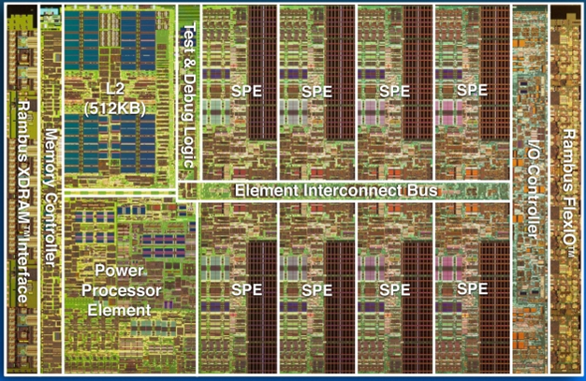
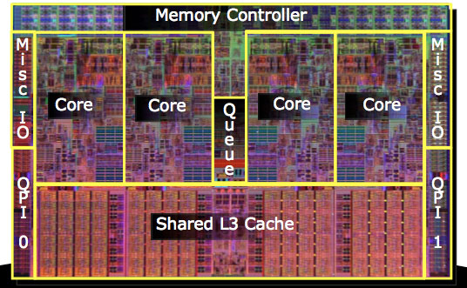
Chip MultiProcessors
CMPs (Chip MultiProcessors)
Have several processor cores integrated in a chip
Achieve high performance by parallel processing
Are widely used from server to embedded systems
Cell Broadband Engine (Sony/Toshiba/IBM)
Core i7 (Intel)
IBM:http://domino.research.ibm.com/comm/research_projects.nsf/pages/multicore.CellBE.html
http://ascii.jp/elem/000/000/124/124281/img.html
(scale is not correct)

Slide 4
Target CMP Model
Parallel program
Chip
Core
Core
Core
Core
Core
Core
Core
ScratchPad Memory: Software managed on-chip memory
SPM
SPM
SPM
SPM
SPM
SPM
SPM
On-chip interconnect
Main memory

Slide 5
What is Limitation Factor of CMP Performance?
“Memory Wall Problem” :Total performance is limited by low memory performance
Speed gap between processor and main memory
Will be getting more critical in CMPs
Program: Barnes
Program: Cholesky
Ideal memory
Ideal memory
256KB private memory
256KB private memory
Memory limits
the total performance
High scalability

Slide 6
Outline
Limitation factor of CMP performance
Performance balancing for effective CMP executions
Evaluation
Summary

Slide 7
Motivation of Performance Balancing
Conventional execution to exploit all cores is not always effective
From 6 to 8 cores, performance is slightly improved
Improving memory performance may largely improve total performance
Program: Cholesky
Ideal memory
Target
256KB private memory
Aim to improve total performance, we use the part of cores for memory performance improvement

Slide 8
Performance Balancing ~ Suitably Utilize the Processor Cores ~
Define two kinds of core
Helper cores
Do not execute threads
Provide SPMs to main core
Hold data for main cores
Main cores
Execute parallelized threads
Quickly obtain the data by on-chip data transfer to exploit helper cores’ SPM
Main cores
Helper cores
Idle
Core
Core
Core
Core
SPM
SPM
SPM
SPM
On-chip interconnect
Load
Main memory

Slide 9
Example of Advantage from Helper Cores
If helper cores exist
#of main memory accesses = 1
#of on-chip data transfers = 2
Helper cores replace main memory accesses to high-speed on-chip data transfers
Example code
func() {
DMAGET(dataA);
DMAGET(dataB);
DMAGET(dataC);
・・・
Main cores
Helper cores
A
B
C
A
C
Main memory
A
B
C

Slide 10
Importance of the Number of Helper Cores
(#of main cores + #of helper cores) = constant
Increase #of helper cores
Improves memory performance
Degrades computation performance
Need to find the appropriate number of helper cores

Slide 11
Changing the Number of Helper Cores According to Application Characteristic
Program: Barnes
Program: Cholesky
Ideal memory
Ideal memory
256KB private memory
256KB private memory
4 main cores
3 main cores
1 helper core
Core
Core
Core
Core
Core
Core
Core
Core
SPM
SPM
SPM
SPM
SPM
SPM
SPM
SPM
On-chip interconnect
On-chip interconnect
Performance improvement by executing
parallelized threads by all cores
Large Improvement of memory performance
Small degradation of computing performance

Slide 12
Compile Flow
Perform pre execution only one time with one main core to obtain profile information
Decide data mapping to helper cores’ SPM and estimate the best number of helper cores
Generate the objective source code supporting performance balancing
Pre execution
Analysis
Data mapping
to SPMs
Input
Original
source code
Profile information
Predicted #of
helper cores
Info. of DMA transfer
Info. of Parallelism...
Source-to-source transformation
Source code to support performance balancing

Slide 13
How to Decide the Data Mapping to Helper Cores’ SPM
Objective: Find the best data mapping that minimizes #of accesses to main memory by main cores
Count # of accesses for every address interval
Choose the data in decreasing order of the count
Pre execution
with 1 main cores
Count #of accesses
input
original
source code
Profile information
DMA transfer trace
Choose the data
Data mapping
to SPMs

Slide 14
How to Predict the Best #of Helper Cores
Objective: Find the best #of helper cores that maximizes the total performance
Predict the performance for all combinations
Find the best #of helper cores
Pre execution
with 1 main cores
Performance modeling
Predicted Relative Exe. Time
input
original
source code
profile information
Fraction of exe. time parallelized
#of on-chip data transfers …
Find the best # of helper cores
The predicted #of
helper cores

Slide 15
Outline
Limitation factor of CMP performance
Performance balancing for effective CMP executions
Evaluation
Summary

Slide 16
Experimental setup
Hardware platform
Cell Broadband Engine
# of cores: seven
Benchmark programs
Scientific domain: Himeno benchmark, LU (SPLASH-2), FFT (Cell SDK), Matrix multiplication (Cell SDK)
Embedded domain: Susan (MiBench)
Use the same input data for profiling and evaluation
Evaluation models
CONV: Conventional approach (execute by 7 cores)
PB-PREDICT: Performance Balancing (PB) with the predicted number of helper cores
PB-IDEAL: Performance Balancing (PB) with the best number of helper cores

Slide 17
Results of Evaluation
4:3
6 main cores and 1 helper core
5:2
5:2
6:1
6:1
6:1
6:1
7:0
7:0
7:0
7:0
7:0
7:0
7:0
7:0
7:0
7:0
6:1
7:0
7:0
7:0

Slide 18
Results of Evaluation
4:3
6 main cores and 1 helper core
5:2
5:2
6:1
#of on-chip transfers
#of DMA transfers
#of on-chip transfers
#of DMA transfers
6:1
6:1
6:1
7:0
7:0
7:0
7:0
7:0
7:0
7:0
7:0
7:0
7:0
6:1
7:0
7:0
7:0

Slide 19
Results of Evaluation
4:3
6 main cores and 1 helper core
5:2
5:2
6:1
Predicted
6:1
6:1
6:1
7:0
7:0
7:0
7:0
7:0
7:0
7:0
7:0
7:0
7:0
6:1
7:0
7:0
7:0
Optimal

Slide 20
Results of Evaluation
4:3
6 main cores and 1 helper core
5:2
5:2
6:1
6:1
6:1
6:1
7:0
7:0
7:0
7:0
7:0
7:0
7:0
7:0
7:0
7:0
6:1
7:0
7:0
7:0
Our technique improves performance to make a good balance between comp. and mem. performance

Slide 21
Outline
Limitation factor of CMP performance
Performance balancing for effective CMP executions
Evaluation
Summary

Slide 22
Summary and Future Work
Performance balancing for effective CMP executions
Remedies the memory-wall problem by reducing the bandwidth pressure and #of main memory accesses
Achieves an appropriate balance between computation and memory performance to change #of helper cores
Significantly improves performance to improve memory performance at the expense of computing performance
Future work
More detailed evaluation (e.g. energy consumption, parameter sensitivity)
Improving data mapping of helper cores

Slide 23
Any Questions? ~Please speak slowly~
Thank you

Slide 24
Back up slides

Slide 25
Effect of Helper Cores
#of on-chip transfers
#of DMA transfers
#of helper cores
#of helper cores
#of helper cores
#of helper cores
HIMENO (SS)
FFT
LU
MATRIX_MUL (256)
Low data size to be used in program execution → High hit rate

Slide 26
Effect of Helper Cores
#of on-chip transfers
#of DMA transfers

Slide 27
How to Predict the Best #of Main and Helper Cores
Estimating the execution time with all combinations of core allocation from profile information with 1 main core, 0 helper core
Exec. time with n main cores and m helper cores
Exec. time with n main cores (assume an ideal memory)
DMA transfer time with n main core, m helper core
Exec. time with 1 main core
Fraction of Exec. time parallelized
#of DMA transfers with n main core
#of main core
Average DMA time
Hit rate of helper cores’ SPM with m helper core
: Access time of helper core’s SPM
: Access time of main memory

Slide 28
Cell/B.E.
Parallelized program
PPE
chip
SPE
core
L1$
core
core
core
core
core
core
core
Software managed on-chip memory
L2$
LS
LS
LS
LS
LS
LS
LS
On-chip interconnection
Main memory

Slide 29
Accuracy of Predicting the Best #of Helper Cores
Predicted
Predicted
Optimal
Optimal
Predicted
Predicted
Optimal
Optimal
Our technique predicts the appropriate #of helper cores

Slide 30
Estimated Execution Time vs. Real Execution time
30

Slide 31
Estimated Execution Time and Real Execution time

