Slide 1
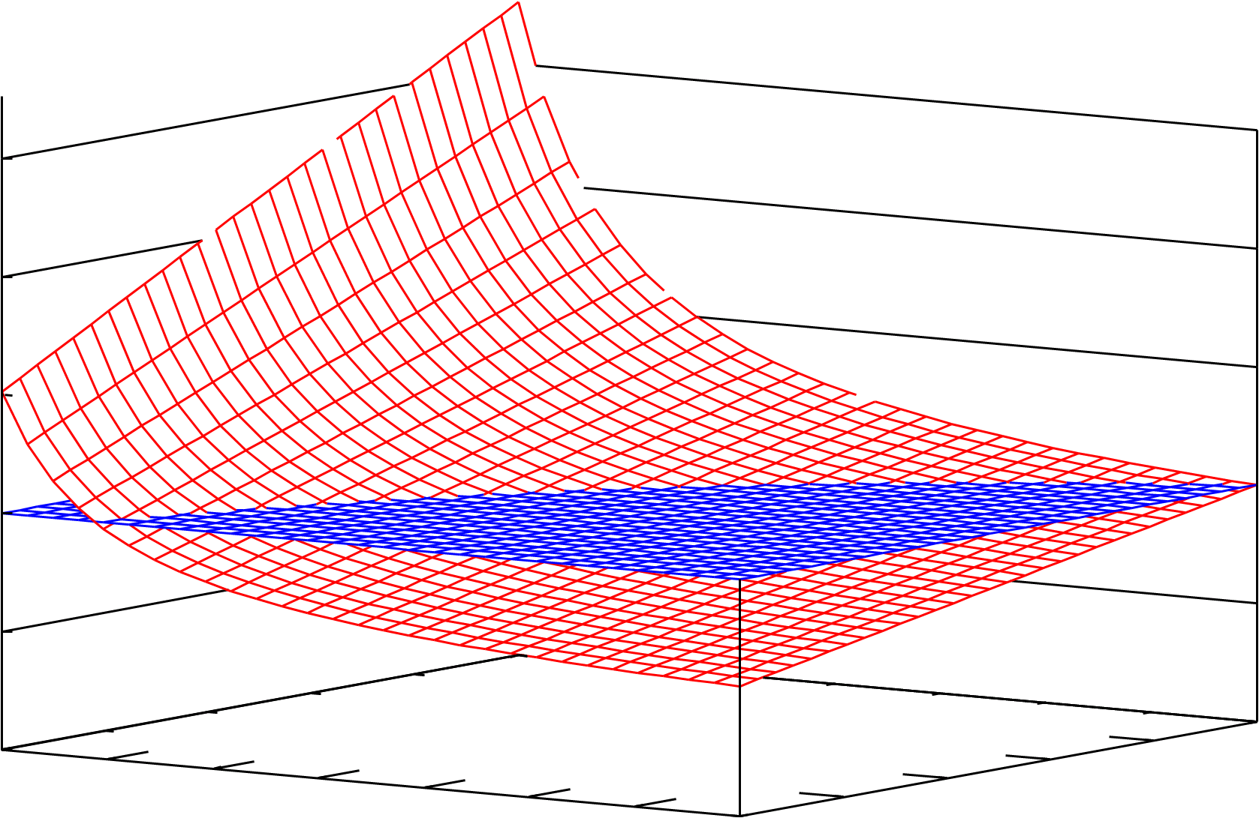

Performance Balancing: An Adaptive Helper-Thread Execution for Many-Core Era
Authors: Kenichi Imazato, Naoto Fukumoto, Koji Inoue, Kazuaki Murakami
(Kyushu University)
1. Concept
3. Analysis
Goal： High-Performance parallel processing on a chip multiprocessor
Execution time in clock cycles on an N-core CMP
Conventional approach： All cores execute a parallel program
Performance improvement is very small even if we increase the number of cores from 6 to 8.
Our approach： Core management considering the balance of processor-memory performance (Performance Balancing).
Some cores are used to improve the memory performance
Execute helper-threads for prefetching
Cholesky
The fraction of operations that can be parallelized
Relative execution cycles
Perfect L2 cache
(hit rate 100% )
The number of helper cores
Execution cycles on
N-core execution
Proposal
Conventional
Our approach!
Speed-Down
6.9%
The fraction of main-memory access time when all cores are used to execute the application threads.
The number of cores on a chip
1MB L2 cache
Reduction rate of L2 cache misses achieved by helper cores
Speed-Up!
If the effect of the software prefetching is larger than
the negative impact of the TLP throttling,
we can improve the CMP performance.
↓ , ↑ ⇒ Benchmark programs are more beneficial
↓ , ↑ ⇒ Our approach is more effective
The number of helper-cores
Reduction rate of
L2 cache miss rate
memory intensive
compute intensive
Performance analysis of Cholesky ( =0.73, =0.45)
execute an application thread
execute a helper thread
Helper cores work for computing cores.
By exploiting profile information, compiler can statically optimize the number of helper cores.
By monitoring the processor and memory performance, the OS determines the number of helper-cores and the type of prefetchers.
If memory performance is quite low, OS increases the number of helper-cores.
4. Preliminary Evaluation
computing cores
helper cores
core0
core1
…
…
coreN
Assumption: Execution threads is fixed in whole program execution The best numbers of helper-cores are given
Simulation Parameters: 8 in-order cores, 1MB L2 cache, 300 clock cycles Main Memory latency
MSB
L1D$
L1I$
MSB
L1D$
L1I$
MSB
L1D$
L1I$
shared bus
L2 shared cache
on-chip
47% speedup
main memory
off-chip
2. Architectural Support
For prefetching, helper cores need the information for cache misses caused by computing cores.
Miss Status Buffer (MSB): Records the information for cache misses caused by computing cores.
Each entry consists of a core-ID, a PC value, and an associated miss address.
Each core has an MSB. → Helper-threads can be executed on any core.
The cache-miss information can be obtained by snooping the coherence traffic.
By referring MSB, helper-thread emulates hardware prefetchers.
Introduce MSB
BASE: All cores are used to execute the application-threads.
PB-GS(PB-LS) : The model supporting performance balancing, and
executes global(local) stride prefetch as helper threads.
Our approach improves performance by up to 47% (Cholesky).

