Slide 1
Robust MIL based Feature Template Learning for Object Tracking
Shivam Agrawal (20172074)
Kshitij Nagar (20172046)
Sagar Thakur (20172103)
Vachaspathi Ramakrishnan (20172011)

Slide 2
PROBLEM STATEMENT
Because of appearance variations, online trackers requires updating of the tracking model.
This often leads to tracking drift problem.
Contaminated samples, and
Misaligned samples caused by tracking inaccuracy.

Slide 3
PROPOSED MODEL
The proposed feature template learning framework is capable of:
Adaptively learning uncontaminated feature templates by separating out contaminated samples, and
Resolving label ambiguities caused by misaligned samples via MIL.

Slide 4
PREVIOUS WORK
Sparsity-based trackers
Models the outliers in the corrupted target’s samples caused by occlusion or noise.
Advantage
Detect and prevent contaminated samples which increases robustness to tracker.
Problem
Do not explicitly handle the misaligned samples.
Most existing tracking algorithms which aim to reduce tracking drift are not effective in handling either or both scenarios.

Slide 5
PREVIOUS WORK
Weakly/semi-supervised learning-based methods
Aim to resolve the label ambiguities caused by misaligned samples.
Problem
More likely to update with contaminated samples and thereby deteriorates the discriminability.

Slide 6
ADVANTAGE OF PROPOSED MODEL
Integrates robustness of sparse representation & the flexibility of multiple instance learning into model updating process
Enables tracker to separate out corrupted samples & resolve label ambiguity.

Slide 7
Robust MIL-based Feature Template Learning

Slide 8
Probabilistic contaminated feature modelling
Objective of the learning model is to adaptively learn the uncontaminated feature templates for sparse representation of the tracked object while explicitly modeling the contaminated features.
Y = DX + E => E = Y-DX
Y = [ y₁,..., y_{n}] ∈ R^{d×n} denote the target samples.
D =[D1,...,D_{p}] = [(D₁)^{T},...,(D_{d})^{T}]^{T} ∈ R^{d×p} are the set of templates.
X = [X₁ ...X_{n}] is the sparse coefﬁcient matrix of target samples.
E = [E₁ ...E_{n}] are the separated contaminated features.

Slide 9
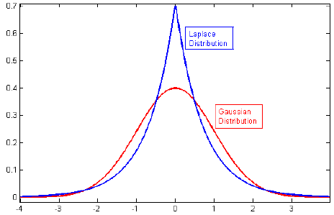
Probabilistic contaminated feature modelling
To explicitly model the uncertainty existing in the outliers for contaminated samples, we incorporate the probabilistic constraint that each element in E is independent and subjected to a zero-mean Laplace distribution with variance 1/b², i.e.
P(E|·;b) = (b/2)^{(nd)} exp(−b||E||₁),
which implies
P(Y | D,X;b) = (b/2)^{(nd)} exp(−b||Y −DX||₁)

Slide 10
Probabilistic contaminated feature modelling
The prior distribution for each X_{j} is deﬁned as:
P(X_{j}) ∝ exp(−λ φ(X_{j})),
where φ(·) is a sparsity function and λ is a constant. Here we use L1 penalty as the sparsity function,
i.e. φ(X_{j})=||X_{j}||₁.

Slide 11
Probabilistic contaminated feature modelling
By taking the logarithm of the joint distribution with respect to Y , D, and X, i.e. P (Y, D, X|b) = P (Y |D, X; b)P (D|; b)P (X|; b), then the maximum a posteriori (MAP) estimation turns out to be:
min(D,X) b||Y − DX|| ₁+ λ||X||₁
s.t. ||D.,j||₂ ≤ c, j = 1,...,n

Slide 12
Resolving Label Ambiguity via bag-level based MAP
Feature templates are learnt using the collection of weakly-labeled samples based on a probabilistic multiple instance learning (MIL) strategy.
Only the label information for collection of samples called bag are available.
A bag is positive if at least one of its samples is positive otherwise the bag is negative
For the j-th sample in the i-th sample bag the probablility P_{ij} can be given by (b/2)^{(d)} exp(−b||y_{ij} −Dx_{ij}||₁)

Slide 13
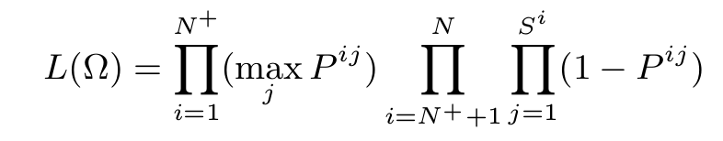
Resolving Label Ambiguity via bag-level based MAP
Therefore the probability of the i^{th} sample bag belonging to the foreground (target) can be defined as P_{i} = max_{(j)} P_{ij}
The likelihood at the bag level can be given as follows:
Since the samples from small neighborhood are partially overlapped, they are specially correlated.
So it makes sense to use a generalized mean for max_{j} P^{ij}

Slide 14
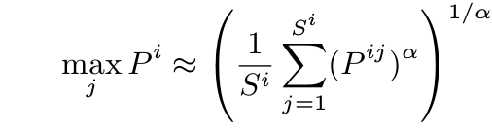
Resolving Label Ambiguity via bag-level based MAP
Generalized mean :
With the same prior distribution on the feature templates and sparse coefficients by taking the logarithm of L, the bag-level-based MAP estimation of the feature template and sparse coefficients can be obtained by the following:

Slide 15
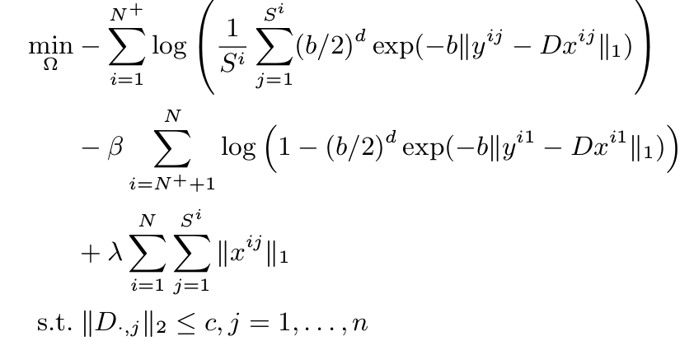
Resolving Label Ambiguity via bag-level based MAP

Slide 16
OPTIMIZATION

Slide 17
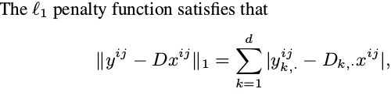


Smoothing
Thus we have

Slide 18

We get smoothened function as

Slide 19
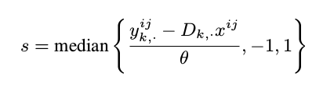
Finding value of ‘s’
By taking derivative of the smothened function and setting it to zero, we get

Slide 20

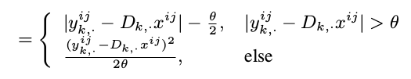
Final smoothed function

Slide 21

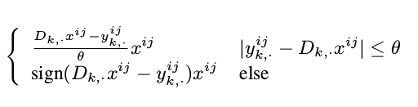
Finding gradient w.r.t D_{k}

Slide 22

Finding gradient w.r.t x^{i,j}

Slide 23
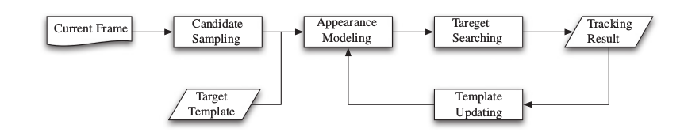
Flowchart for online object tracking

Slide 24
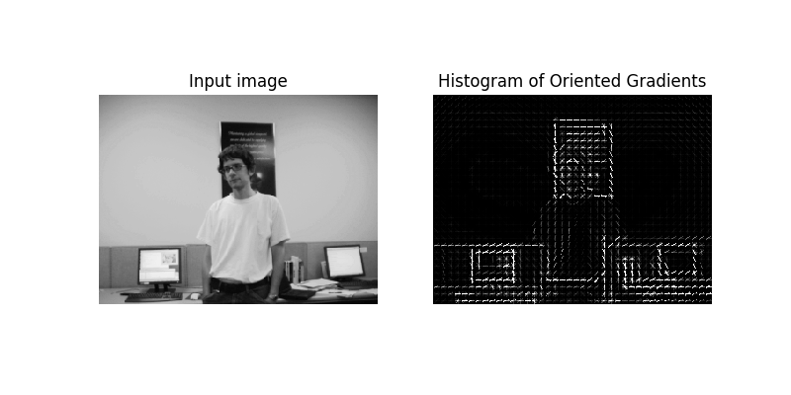
HOG FEATURES

