Slide 1
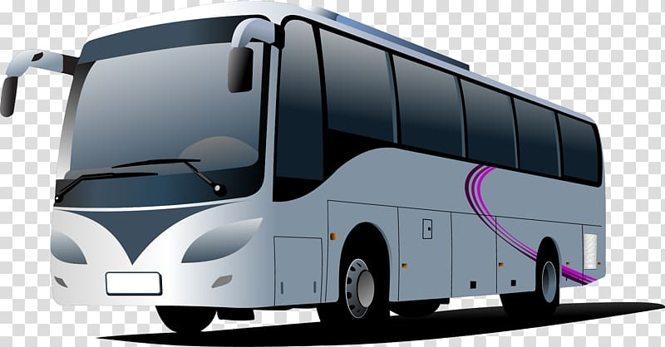
BusNama
(online bus reservation app)
By Tejaswini, Mayank and Aditya

Slide 2

Tech used:
Java 8 (base programming language)
Hibernate (JPA implementation)
MySQL (database storage)
Tomcat 8.5 (hosting server)
Spring framework (providing the necessary tools)

Slide 3

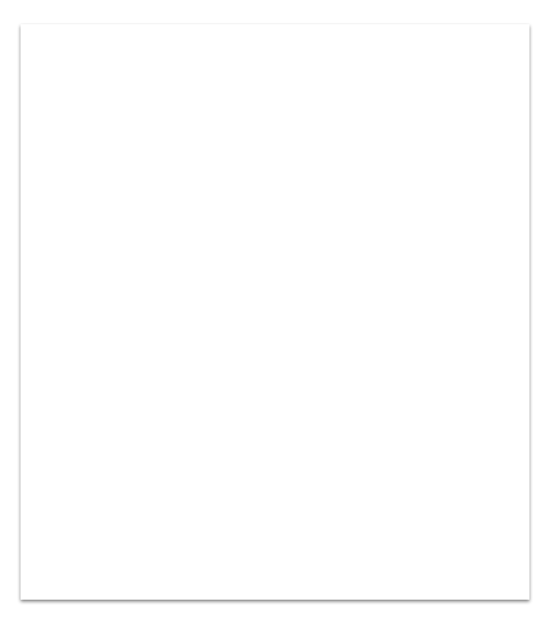
1. Intro
BusNama is created to meet the needs of online bus reservation system with the customer being able to :
Book From the existing list of buses which still have available seats
View From the existing tickets he/she has booked
Cancel Any particular ticket that has been booked

Slide 4
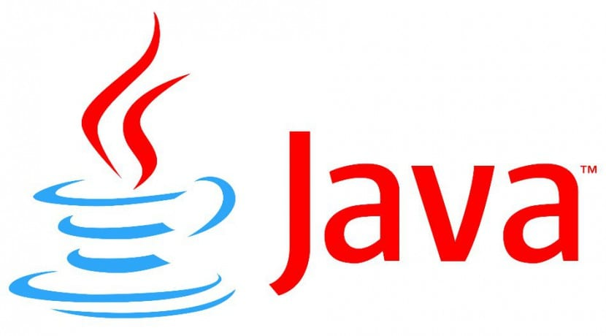
Java 8 :
OOP advantage
Platform independence
Rich APIs
Spring
We moved to Spring to not hardcode object creation and reduce such boilerplate coding.

Slide 5

JPA-Hibernate:
For Object Relational Mapping
Saving our entities into the database
with ease
Previously
We started off with storing in collections.
Later, that was extended into MySQL database and JDBC was used to connectivity to database.

Slide 6

MySQL is an open source database used to store our data. It is a RELATIONAL DATABASE allowing data to be stored in a related format, thereby improving insertion, updation and deletion operations and reducing redundancy.
ORM
We had to use JDBC Driver to connect initially but since JPA allows us to map entities into database directly, we utilized Hiberate’s JPA implementation.

Slide 7

Tomcat v8.5 is used for HOSTING our application online, allowing users to interact via webpages.
Spring MVC framework is used to create web app.
MVC
Using this, we transmit data (Model) from webpage to Java application (Controller), process the data and return via webpages (View).

Slide 8
Team
The team consists of:
Tejaswini Controller management with JPA
Aditya JSP and DAO implementation
Mayank Validation and Front End

Slide 9

Underway to integrate Spring Boot with Spring Data, Angular and AWS in order to successfully deploy our application.

