Slide 1
Введение в Semantic Web
А.Г.Марчук, д.ф.-м.н.

Slide 2
Что такое Semantic Web?
The Semantic Web provides a common framework that allows data to be shared and reused across application, enterprise, and community boundaries. It is a collaborative effort led by W3C with participation from a large number of researchers and industrial partners. It is based on the Resource Description Framework ( RDF).
Статья The Semantic Web A new form of Web content that is meaningful to computers will unleash a revolution of new possibilities by TIM BERNERS-LEE, JAMES HENDLER and ORA LASSILA
Expressing Meaning
Knowledge Representation
Ontologies
Agents
Evolution of Knowledge

Slide 3
Что такое RDF?
person
Фрагмент сети RDF
type
Work-in
p3817
o19302
type
org-sys
father
name
birth
name
p2817
Иванов .
1988
НГУ
P1
id1
id1
Базовые элементы
P2
id3
data
<rdf:RDF>
<person rdf:about=“p3817”>
<name>Иванов Иван Иванович</name>
<birth>1988</birth>
<work-in rdf:resource=“o19302”/>
</person>
<org-sys rdf:about=“o19302”>
<name>НГУ</name>
</org-sys>
</rdf:RDF>
XML представление

Slide 4
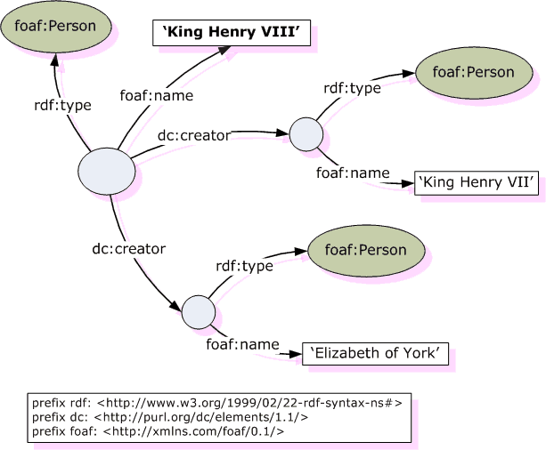
Формирование семантического графа

Slide 5
Частный случай: один класс. Дублинское ядро Dublin Core.
1. Title
2. Subject
3. Description
4. Type (напр. "Image", "Sound", "Text")
5. Source (напр. "Image from page 54 of the 1922 edition of Romeo and Juliet")
6. Relation (напр. is IsVersionOf)
7. Coverage (напр. "1995-1996", "Boston, MA")
8. Creator (напр. "Shakespeare, William")
9. Publisher (напр. "Funky Websites, Inc.")
10. Contributor (напр. using names of persons or organizations as Creators)
11. Rights (напр. "http://cornell.edu/Dienst/Repository/2.0/Terms")
12. Date
13. Format (напр. "image/gif")
14. Identifier
15. Language (напр. "en" или "ru")
Notes:
Комментарии о языке

Slide 6
FOAF – Friend Of A Friend ontology
Classes: Agent | Document | Group | Image | LabelProperty | OnlineAccount | OnlineChatAccount | OnlineEcommerceAccount | OnlineGamingAccount | Organization | Person | PersonalProfileDocument | Project
Properties: account | accountName | accountServiceHomepage | age | aimChatID | based_near | birthday | currentProject | depiction | depicts | dnaChecksum | familyName | firstName | focus | fundedBy | geekcode | gender | givenName | givenname | holdsAccount | homepage | icqChatID | img | interest | isPrimaryTopicOf | jabberID | knows | lastName | logo | made | maker | mbox | mbox_sha1sum | member | membershipClass | msnChatID | myersBriggs | name | nick | openid | page | pastProject | phone | plan | primaryTopic | publications | schoolHomepage | sha1 | skypeID | status | surname | theme | thumbnail | tipjar | title | topic | topic_interest | weblog | workInfoHomepage | workplaceHomepage | yahooChatID |

Slide 7
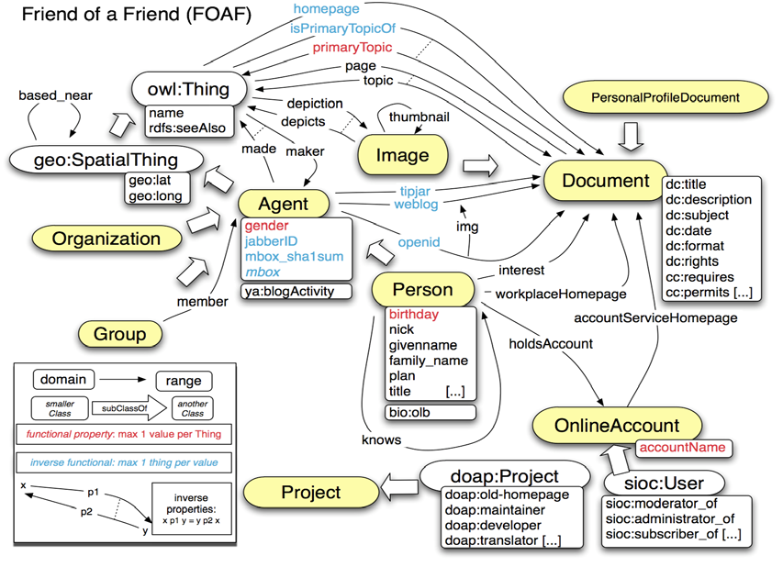

Slide 8
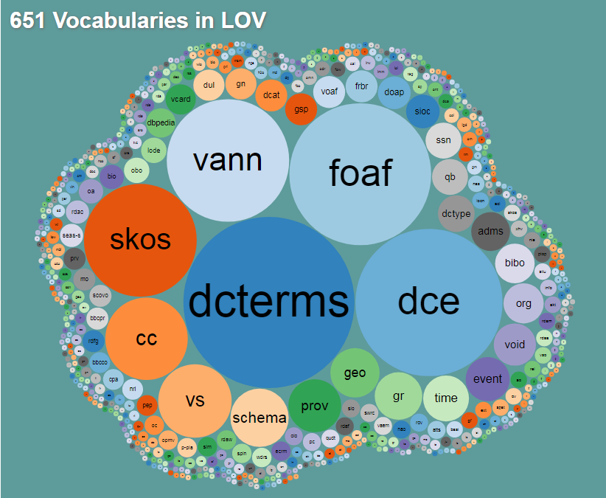
Словари

Slide 9
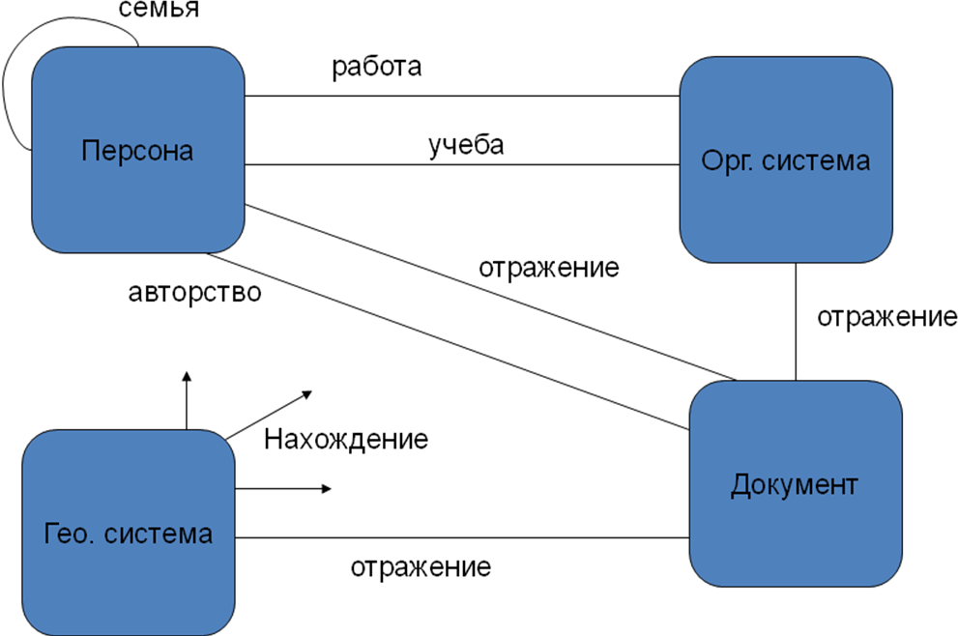
Онтология неспецифических сущностей

Slide 10
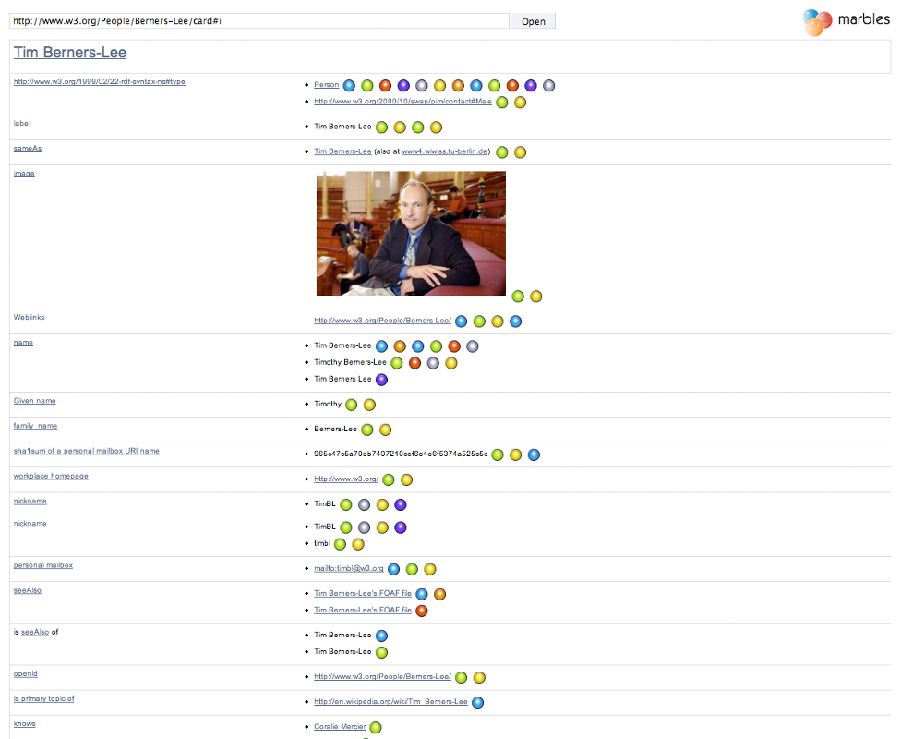

Slide 11
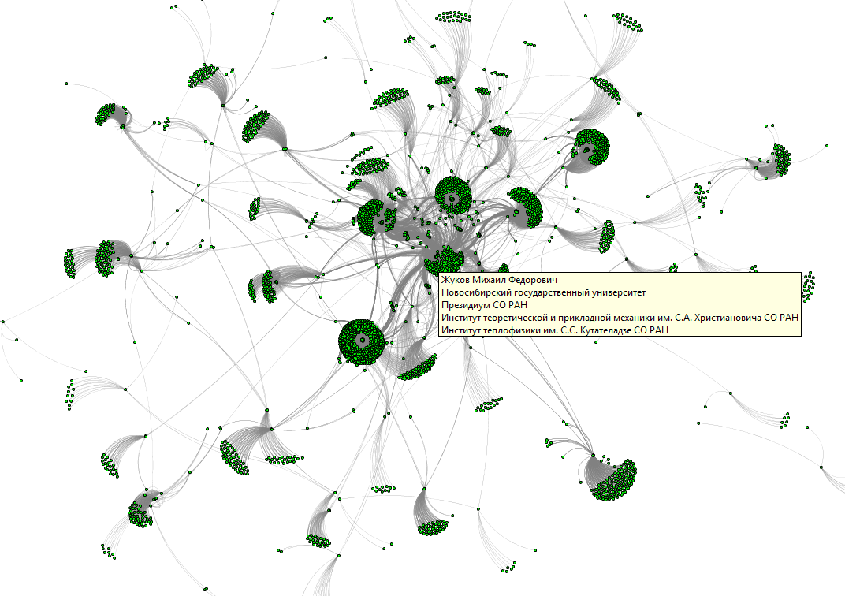

Slide 12
Пример данных и запроса
Graph: http://example.org/alice
@prefix foaf: <http://xmlns.com/foaf/0.1/> .
@prefix rdfs: <http://www.w3.org/2000/01/rdf-schema#> .
<http://example.org/alice#me> a foaf:Person .
<http://example.org/alice#me> foaf:name "Alice" .
<http://example.org/alice#me> foaf:mbox <mailto:alice@example.org> .
<http://example.org/alice#me> foaf:knows <http://example.org/bob#me> .
<http://example.org/bob#me> foaf:knows <http://example.org/alice#me> . <http://example.org/bob#me> foaf:name "Bob" .
<http://example.org/alice#me> foaf:knows <http://example.org/charlie#me> .
<http://example.org/charlie#me> foaf:knows <http://example.org/alice#me> .
<http://example.org/charlie#me> foaf:name "Charlie" .
<http://example.org/alice#me> foaf:knows <http://example.org/snoopy> <http://example.org/snoopy> foaf:name "Snoopy"@en .
PREFIX foaf: <http://xmlns.com/foaf/0.1/>
SELECT ?name (COUNT(?friend) AS ?count)
WHERE {
?person foaf:name ?name .
?person foaf:knows ?friend .
} GROUP BY ?person ?name
?name | ?count
"Alice" | 3
"Bob" | 1
"Charlie" | 1

Slide 13
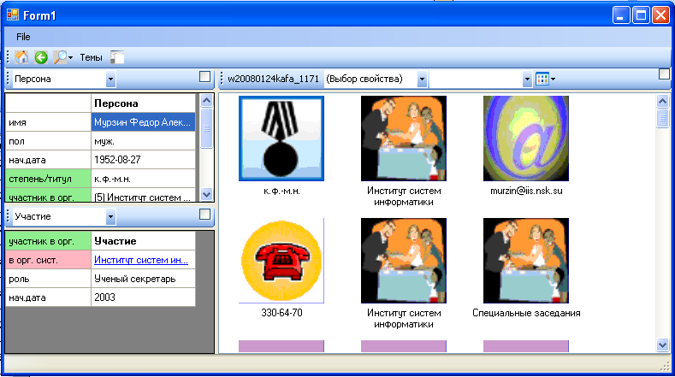
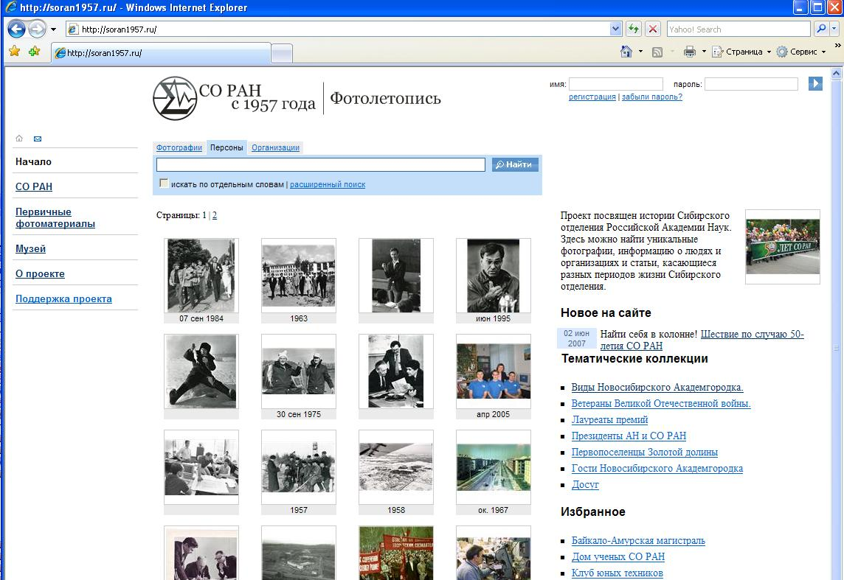
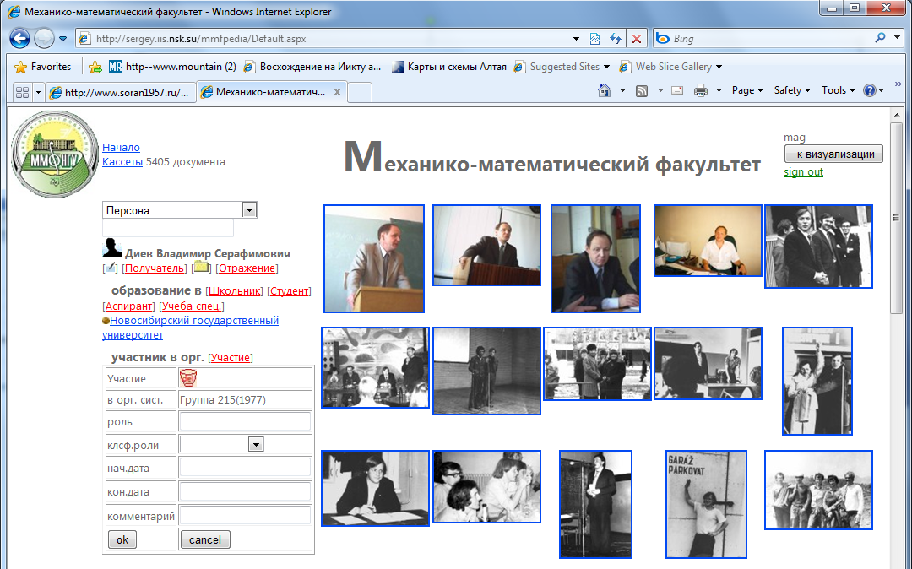
Экспериментальные системы

Slide 14
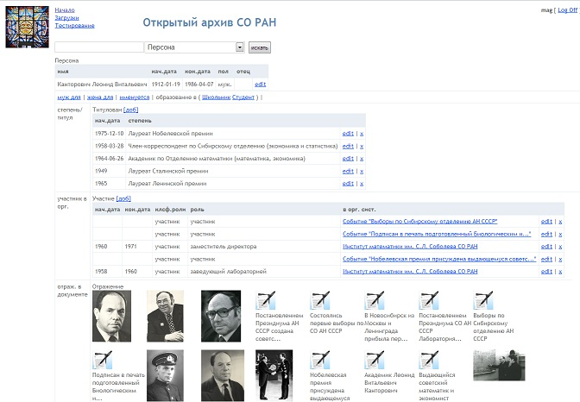
Редактирование базы данных

Slide 15
Источники
Сайт W3C // https://www.w3.org/

