Slide 1
Hypothesis Tests for a Single Population Mean
Determining whether a population mean is greater than, less than, or different from a prior assumed, historical, or required value

Slide 2
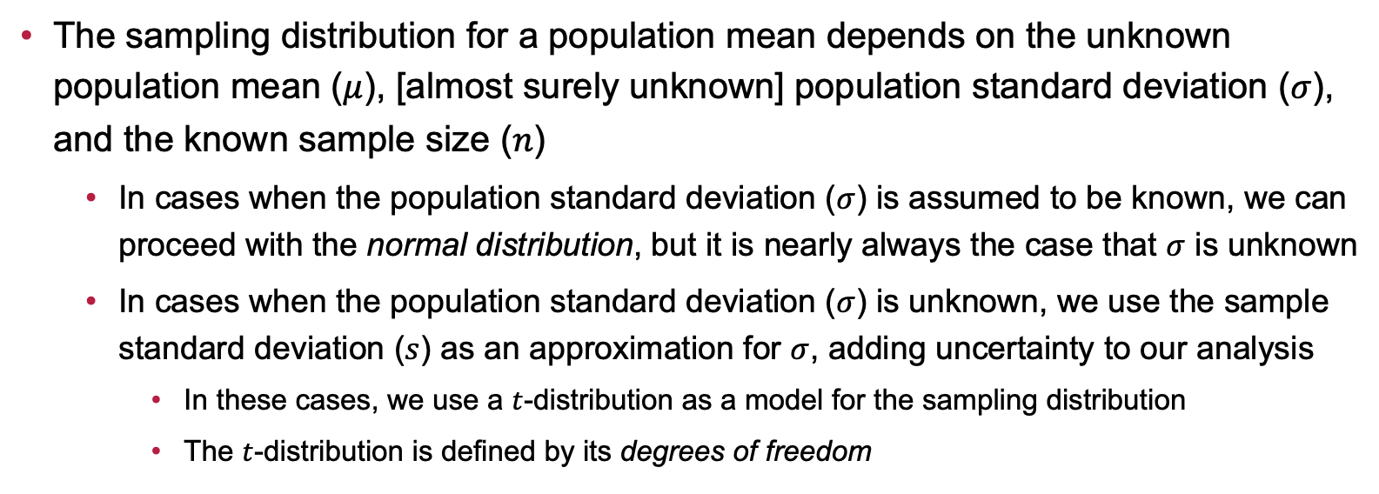
Additional Uncertainty with Inference On Means: A Reminder
The sampling distribution for a population mean depends on the unknown population mean ($μ$), [almost surely unknown] population standard deviation ($σ$), and the known sample size ($n$)
In cases when the population standard deviation ($σ$) is assumed to be known, we can proceed with the normal distribution, but it is nearly always the case that $σ$ is unknown
In cases when the population standard deviation ($σ$) is unknown, we use the sample standard deviation ($s$) as an approximation for $σ$, adding uncertainty to our analysis
In these cases, we use a $t$-distribution as a model for the sampling distribution
The $t$-distribution is defined by its degrees of freedom

Slide 3
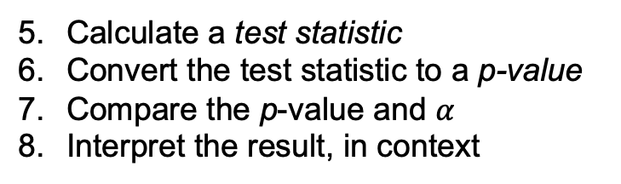
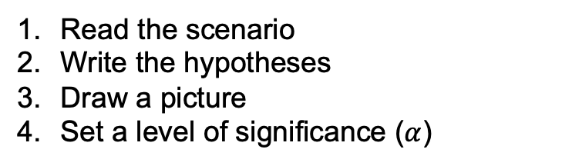
A General Strategy for Hypothesis Testing
In our previous discussion, we built some intuition for hypothesis testing
You can find a full strategy document here; remember that you’ll need the Standard Error Decision Tree to help you as well
Before we jump into completing examples, the steps involved in conducting a hypothesis test include:
Read the scenario
Write the hypotheses
Draw a picture
Set a level of significance ($α$)
Calculate a test statistic
Convert the test statistic to a p-value
Compare the p-value and $α$
Interpret the result, in context

Slide 4
Example: Fitness Tracker Accuracy
Scenario: A fitness company claims that its new fitness tracker accurately measures the number of steps walked per day with an average error of no more than 200 steps. To test this, a researcher collects data from a sample of 12 users, finding that the average error in their recorded steps is 258, with a standard deviation of 57 steps. The company wants to know if the tracker is significantly less accurate than advertised. Conduct a hypothesis test to evaluate whether the tracker’s error in step count exceeds the stated threshold. Use the 5% level of significance.

Slide 5
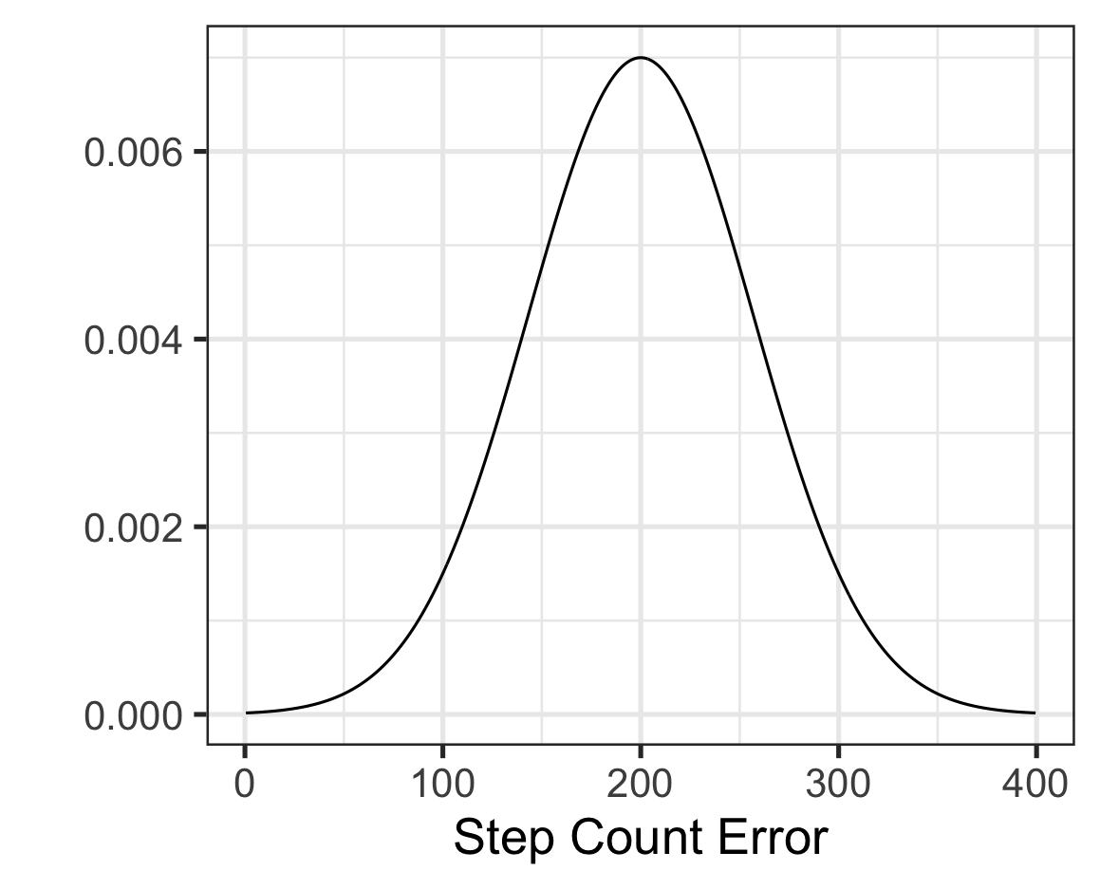
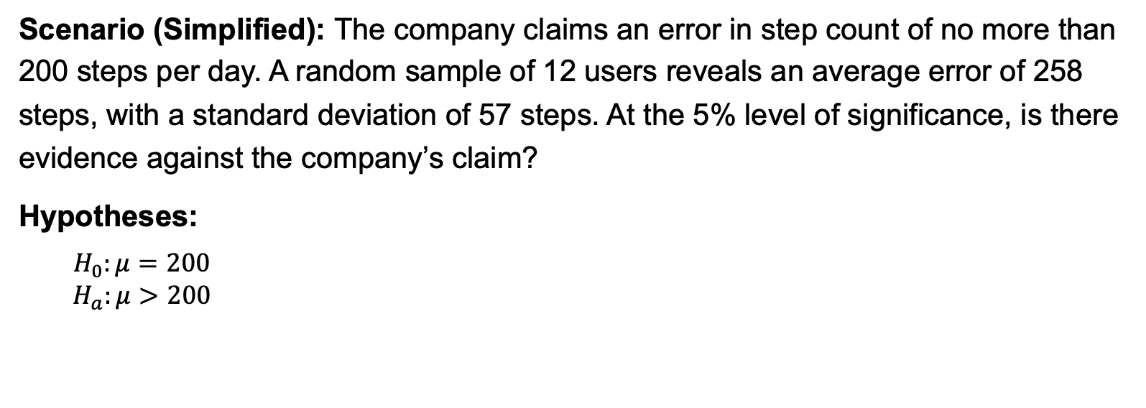
Example: Fitness Tracker Accuracy
Scenario (Simplified): The company claims an error in step count of no more than 200 steps per day. A random sample of 12 users reveals an average error of 258 steps, with a standard deviation of 57 steps. At the 5% level of significance, is there evidence against the company’s claim?
Hypotheses:
$$\begin{matrix}H_{0}:μ=200 \\ H_{a}:μ>200\end{matrix}$$

Slide 6
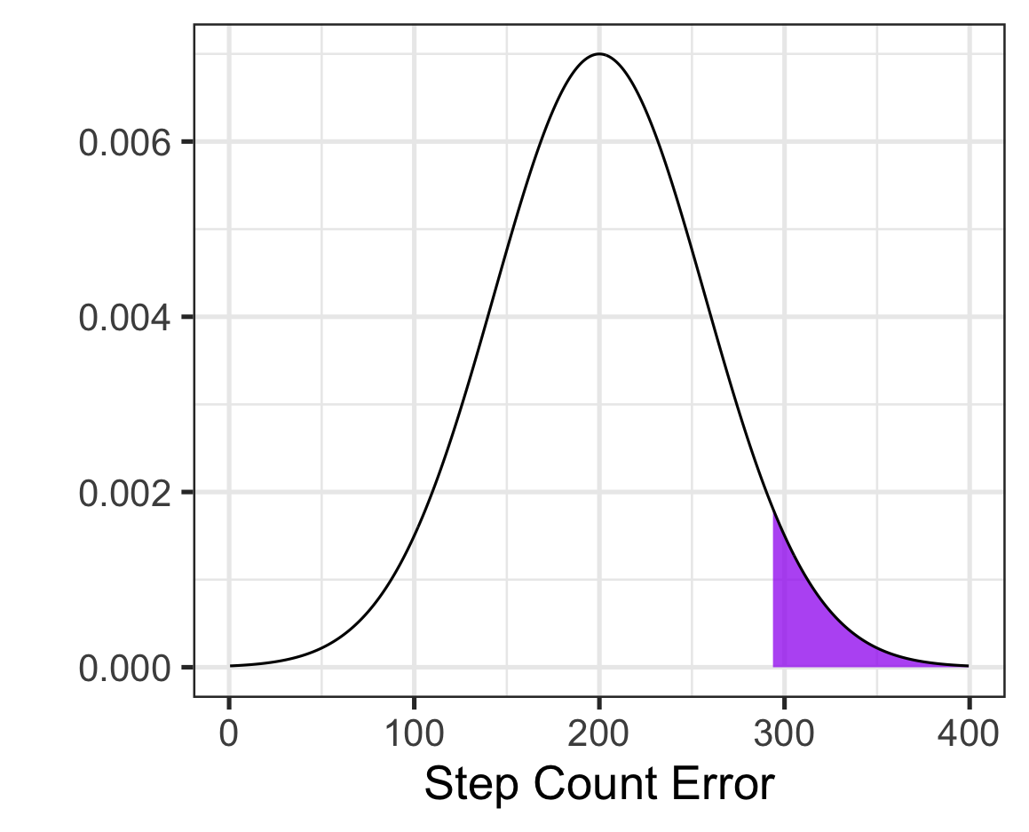

Example: Fitness Tracker Accuracy
Scenario (Simplified): The company claims an error in step count of no more than 200 steps per day. A random sample of 12 users reveals an average error of 258 steps, with a standard deviation of 57 steps. At the 5% level of significance, is there evidence against the company’s claim?
Hypotheses:
$$\begin{matrix}H_{0}:μ=200 \\ H_{a}:μ>200\end{matrix}$$
Level of Significance:
$$α=0.05$$
Test Statistic:
$$\frac{\left(point estimate\right)−(null value)}{S_{E}}$$
null value: 200
point estimate: 258
standard error: ???

Slide 7

Example: Fitness Tracker Accuracy
Scenario (Simplified): The company claims an error in step count of no more than 200 steps per day. A random sample of 12 users reveals an average error of 258 steps, with a standard deviation of 57 steps. At the 5% level of significance, is there evidence against the company’s claim?
Hypotheses:
$$\begin{matrix}H_{0}:μ=200 \\ H_{a}:μ>200\end{matrix}$$
Level of Significance:
$$α=0.05$$
Test Statistic:
$$\frac{\left(point estimate\right)−(null value)}{S_{E}}$$
null value: 200
point estimate: 258
standard error: $S_{E}= \frac{s}{\sqrt{n}}$

Slide 8

Example: Fitness Tracker Accuracy
Scenario (Simplified): The company claims an error in step count of no more than 200 steps per day. A random sample of 12 users reveals an average error of 258 steps, with a standard deviation of 57 steps. At the 5% level of significance, is there evidence against the company’s claim?
Hypotheses:
$$\begin{matrix}H_{0}:μ=200 \\ H_{a}:μ>200\end{matrix}$$
Level of Significance:
$$α=0.05$$
Test Statistic:
$$\frac{\left(point estimate\right)−(null value)}{S_{E}}$$
null value: 200
point estimate: 258
standard error: $S_{E}= \frac{57}{\sqrt{12}}$

Slide 9

Example: Fitness Tracker Accuracy
Scenario (Simplified): The company claims an error in step count of no more than 200 steps per day. A random sample of 12 users reveals an average error of 258 steps, with a standard deviation of 57 steps. At the 5% level of significance, is there evidence against the company’s claim?
Hypotheses:
$$\begin{matrix}H_{0}:μ=200 \\ H_{a}:μ>200\end{matrix}$$
Level of Significance:
$$α=0.05$$
Test Statistic:
$$\frac{\left(point estimate\right)−(null value)}{S_{E}}$$
null value: 200
point estimate: 258
standard error: $S_{E}≈16.45$

Slide 10
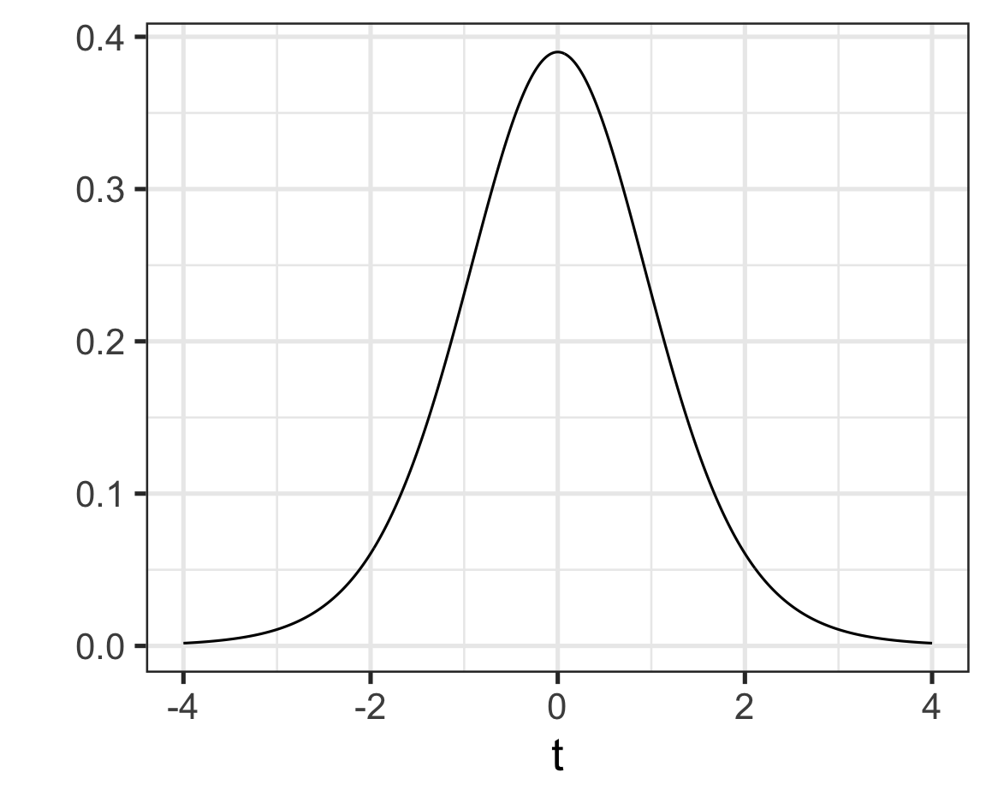
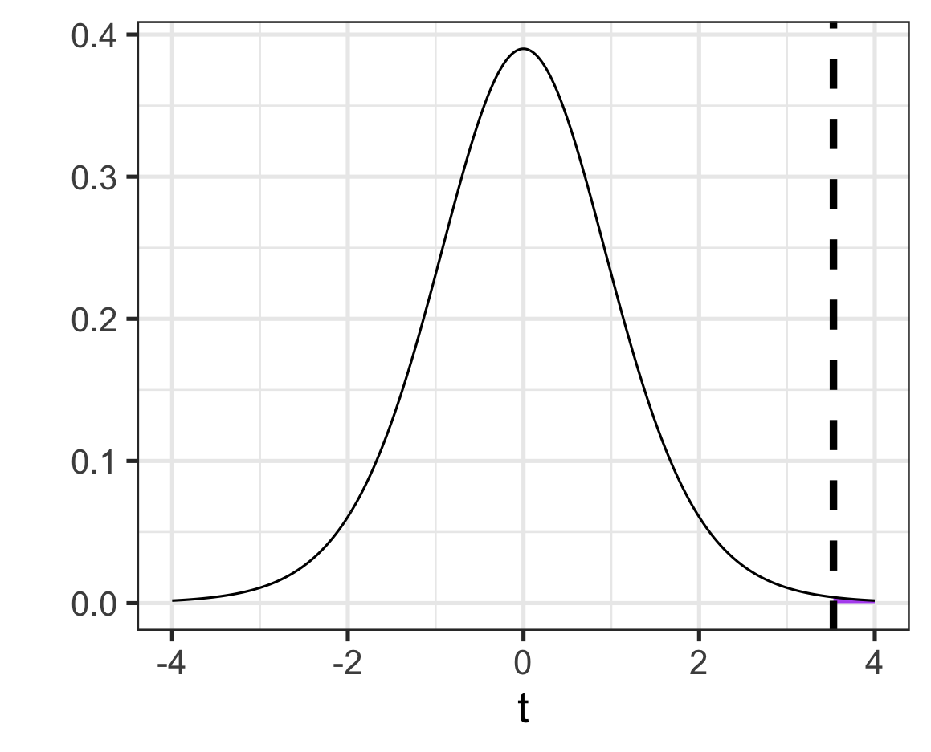

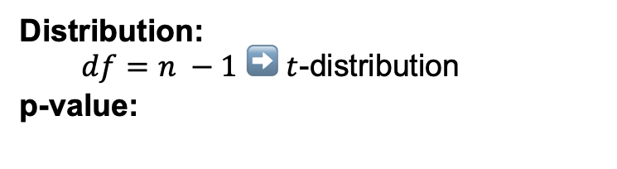

Example: Fitness Tracker Accuracy
Decision in Context:
The sample data provided significant evidence that the company’s claim is wrong. The average step-count error exceeds 200.
Scenario (Simplified): The company claims an error in step count of no more than 200 steps per day. A random sample of 12 users reveals an average error of 258 steps, with a standard deviation of 57 steps. At the 5% level of significance, is there evidence against the company’s claim?
Hypotheses:
$$\begin{matrix}H_{0}:μ=200 \\ H_{a}:μ>200\end{matrix}$$
Level of Significance:
$$α=0.05$$
Test Statistic:
$$\frac{\left(point estimate\right)−(null value)}{S_{E}}$$
$$≈ \frac{258 −200}{16.45}$$
$$≈3.53$$
Distribution:
$df=n −1$ ➡️ $t$-distribution
p-value:
$$1 − NORM.DIST(3.53, 0, 1, TRUE)$$
$$≈0.0002$$
Decision:
Since $p<α$, reject $H_{0}$ and accept $H_{a}$

Slide 11
Ask Me Two Questions
Ask me at least two questions before we move forward

Slide 12
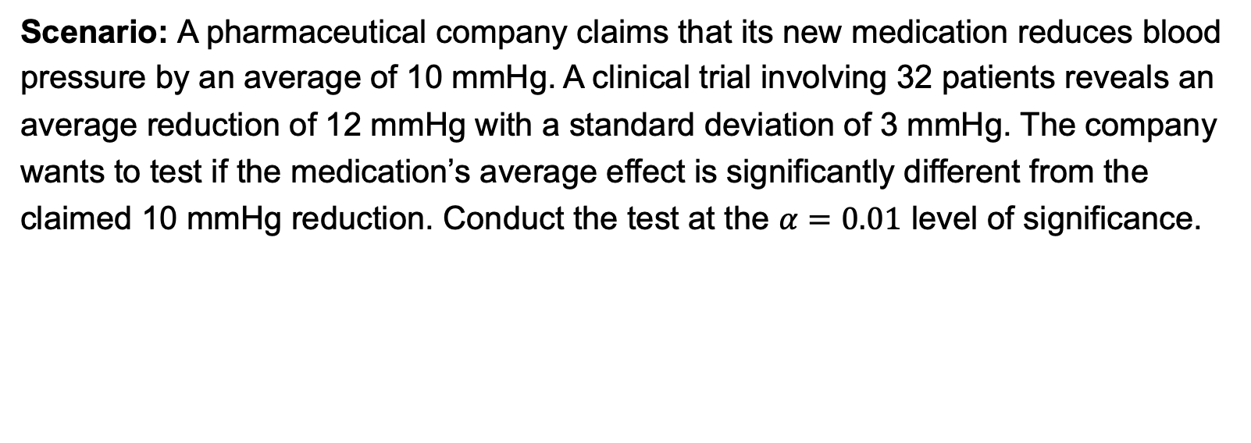
Example: Medication Effectiveness
Scenario: A pharmaceutical company claims that its new medication reduces blood pressure by an average of 10 mmHg. A clinical trial involving 32 patients reveals an average reduction of 12 mmHg with a standard deviation of 3 mmHg. The company wants to test if the medication’s average effect is significantly different from the claimed 10 mmHg reduction. Conduct the test at the $α=0.01$ level of significance.

Slide 13
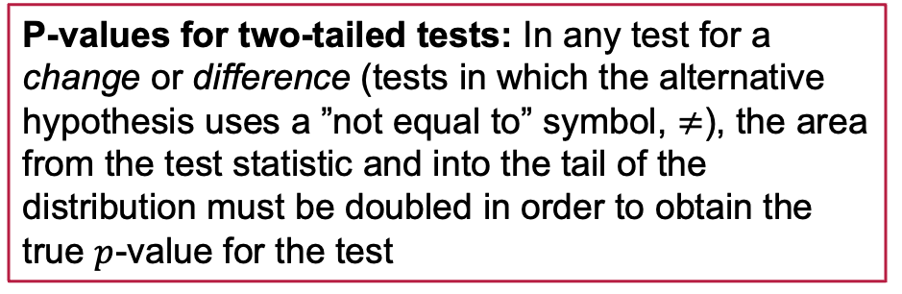
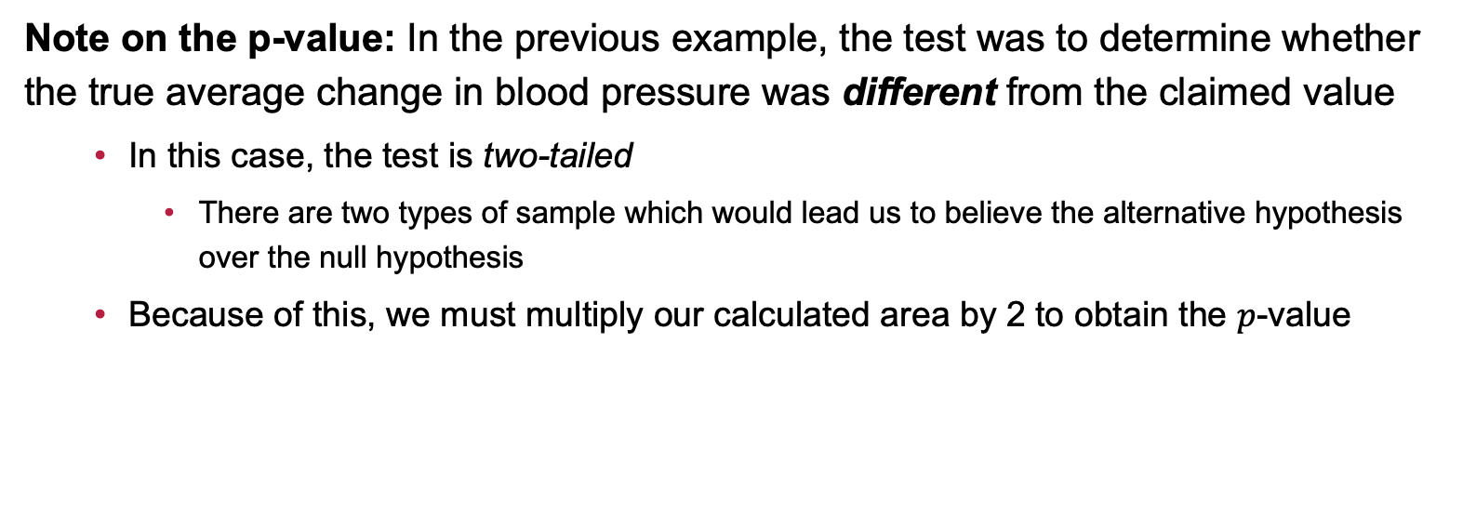
A Comment on the Previous Example
Note on the p-value: In the previous example, the test was to determine whether the true average change in blood pressure was different from the claimed value
In this case, the test is two-tailed
There are two types of sample which would lead us to believe the alternative hypothesis over the null hypothesis
Because of this, we must multiply our calculated area by 2 to obtain the $p$-value
P-values for two-tailed tests: In any test for a change or difference (tests in which the alternative hypothesis uses a ”not equal to” symbol, $≠$), the area from the test statistic and into the tail of the distribution must be doubled in order to obtain the true $p$-value for the test

Slide 14
Example: Flight Delays
Scenario: An airline asserts that its flights are on time 90% of the time, with an average delay of no more than 15 minutes. A researcher randomly selects 100 flights from the past month and finds that the average delay is 17 minutes with a standard deviation of 5 minutes. The researcher performs a hypothesis test to see if the average delay exceeds the claimed 15-minute threshold. Use a 10% level of significance.

Slide 15
Example: Smartphone Charging Times
Scenario: A smartphone brand claims that its battery takes, on average, 90 minutes to fully charge. A sample of 55 users report an average charging time of 97.5 minutes with a standard deviation of 11.2 minutes. Conduct a hypothesis test to evaluate if the average charging time is significantly longer than the claimed 90 minutes.

Slide 16
Example: Electric Car Battery Life
Scenario: An electric car manufacturer advertises that the average lifespan of its car batteries is 8 years. A study is conducted with a sample of 40 electric cars, and the average battery lifespan is found to be 7.6 years with a standard deviation of 0.9 years. Conduct a hypothesis test to assess whether the average battery life is significantly shorter than the advertised 8 years.

Slide 17
Example: Coffee Shop Wait Times
Scenario: A popular coffee shop prides itself on quick service, aiming to serve customers in an average time of 3.5 minutes. After receiving customer complaints about long wait times, the manager decides to test if the average wait time has exceeded this target. A random sample of 45 customers is observed, and the mean wait time is found to be 3.8 minutes with a standard deviation of 0.6 minutes. Conduct a hypothesis test to determine if the average wait time is significantly greater than 3.5 minutes.

Slide 18
Summary (Comments, mostly…)
We conducted several hypothesis tests to investigate questions and claims about a population mean
The hypothesis testing framework is a lengthy procedure which will take practice to become comfortable and confident with
You can find the general strategy for conducting hypothesis tests here
You’ll continue to make use of the standard error decision tree document as well
Seek out help -- visit office hours and walk-in tutoring
The good news is that hypothesis testing follows the same general framework, regardless of the context – we’ll get more practice!

Slide 19
Next Time…
What we’ll be doing…
The Hypothesis Testing for Claims About a Single Population Proportion
How to prepare…
Read section 8.8 in our textbook
Homework: Continue working on HW 7 (Hypothesis Tests for Parameters of a Single Population) on MyOpenMath

