Slide 1
Estimating a Population Parameter with Confidence Intervals
How to answer the questions: (i) what is the population mean? and (ii) what is the population proportion?

Slide 2
Warm-Up Problem: Coffee Shop Wait Times
Scenario: A popular coffee shop claims that the average wait time for an order is 4.5 minutes, with a standard deviation of 1.2 minutes. During a busy morning, a random sample of 50 customers is taken.
What is the probability that the sample mean wait time exceeds 5 minutes?
What is the probability that the sample mean wait time is between 4.2 and 4.8 minutes?
How likely is it that the sample mean wait time is less than 4 minutes?

Slide 3
Overview
A reminder on the Central Limit Theorem and Sampling Distributions
Descriptive Statistics versus Inferential Statistics
Sample Statistics and Population Parameters
Sampling variation and sampling error
The distribution of sampling errors and the distribution of sample statistics
The single-sample problem
Confidence Intervals
A first confidence interval

Slide 4
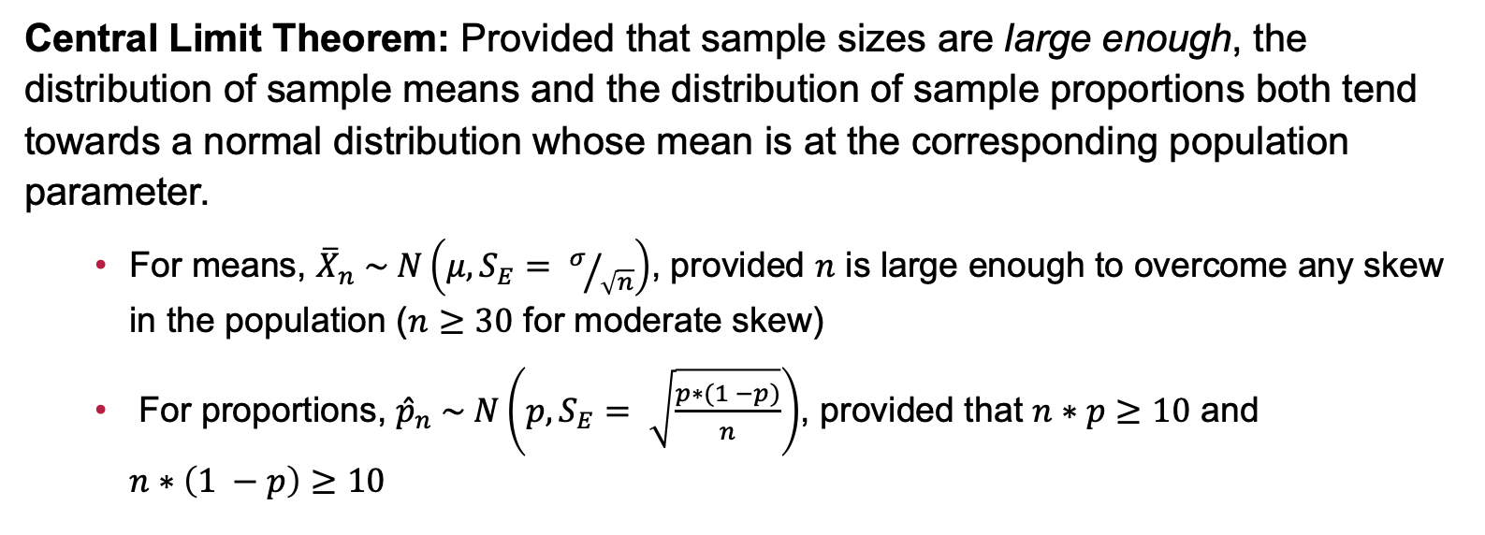
The Central Limit Theorem and Sampling Distributions
Central Limit Theorem: Provided that sample sizes are large enough, the distribution of sample means and the distribution of sample proportions both tend towards a normal distribution whose mean is at the corresponding population parameter.
For means, ${\overline{X}}_{n} \sim N\left(μ, S_{E}= σ/{\sqrt{n}}\right)$, provided $n$ is large enough to overcome any skew in the population ($n≥30$ for moderate skew)
For proportions, ${\hat{p}}_{n} \sim N\left(p, S_{E}= \sqrt{\frac{p∗(1 −p)}{n}}\right)$, provided that $n∗p≥10$ and $n∗\left(1 −p\right)≥10$

Slide 5
Describing Samples versus Describing Populations
Populations (Inferential Statistics)
Samples (Descriptive Statistics)
Population parameters
Population mean, μ
Population standard deviation, σ
Population proportion, ρ
Want to find or describe these parameters, but we can’t directly
Sample statistics
Sample mean, x̄
Sample standard deviation, s
Sample proportion, p or p̂
Can find these statistics directly and, under certain conditions, use them to approximate population parameters

Slide 6
Revisiting the Coffee Shop
Question: How can the coffee shop employees know that their average wait time is 4.5 minutes with a standard deviation of 1.2 minutes?
Perhaps their Point of Service (POS) software tracks all of this, they have complete data (a census), and they can compute it directly
Maybe they’ve just guessed
Perhaps, even without perfect information, they’ve justified this assertion with data.
We’ll investigate how with a hypothetical new coffee shop over the next several slides.

Slide 7
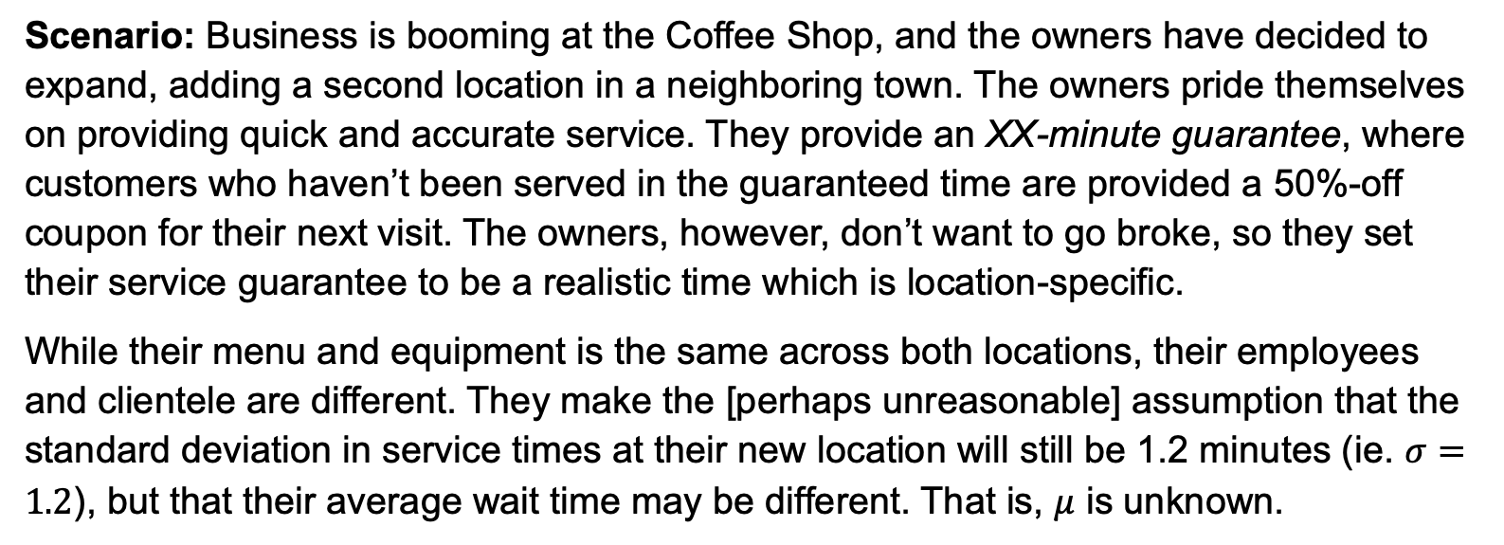
A Second Location
Scenario: Business is booming at the Coffee Shop, and the owners have decided to expand, adding a second location in a neighboring town. The owners pride themselves on providing quick and accurate service. They provide an XX-minute guarantee, where customers who haven’t been served in the guaranteed time are provided a 50%-off coupon for their next visit. The owners, however, don’t want to go broke, so they set their service guarantee to be a realistic time which is location-specific.
While their menu and equipment is the same across both locations, their employees and clientele are different. They make the [perhaps unreasonable] assumption that the standard deviation in service times at their new location will still be 1.2 minutes (ie. $σ=1.2$), but that their average wait time may be different. That is, $μ$ is unknown.

Slide 8
Sampling Wait Times
After their grand opening, the shop employees begin investigating wait times at the new location. The randomly sample 8 customers and observe their wait times.
Wait Times (min): 7.2, 5.8, 6.2, 5.2, 4.7, 6.3, 7.5, 4.5
The average wait time is about 5.9 minutes
Is the average wait time at the new shop 5.9 minutes?
New Wait Times (min): 5.8, 6.2, 3.8, 6.9, 4.2, 5.5, 5.3, 5.3 (mean ~5.3)
A Third Sample (min): 3.0, 6.2, 4.6, 7.1, 6.9, 3.2, 4.7, 5.8 (mean ~5.2)

Slide 9
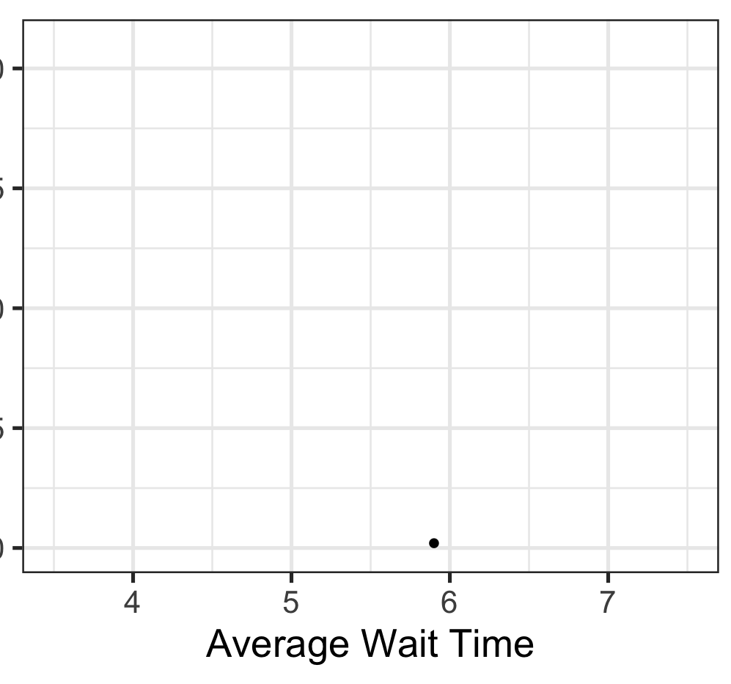
Sampling Wait Times: Sample Variation
We see that the average wait times vary from one sample to the next
This is called sampling variation, and it is unavoidable
So, what can the results of a sample actually tell us?
We’ll take a look at the results visually on the right

Slide 10

Sampling Wait Times: Sample Variation
We see that the average wait times vary from one sample to the next
This is called sampling variation, and it is unavoidable
So, what can the results of a sample actually tell us?
We’ll take a look at the results visually on the right

Slide 11

Sampling Wait Times: Sample Variation
We see that the average wait times vary from one sample to the next
This is called sampling variation, and it is unavoidable
So, what can the results of a sample actually tell us?
We’ll take a look at the results visually on the right

Slide 12
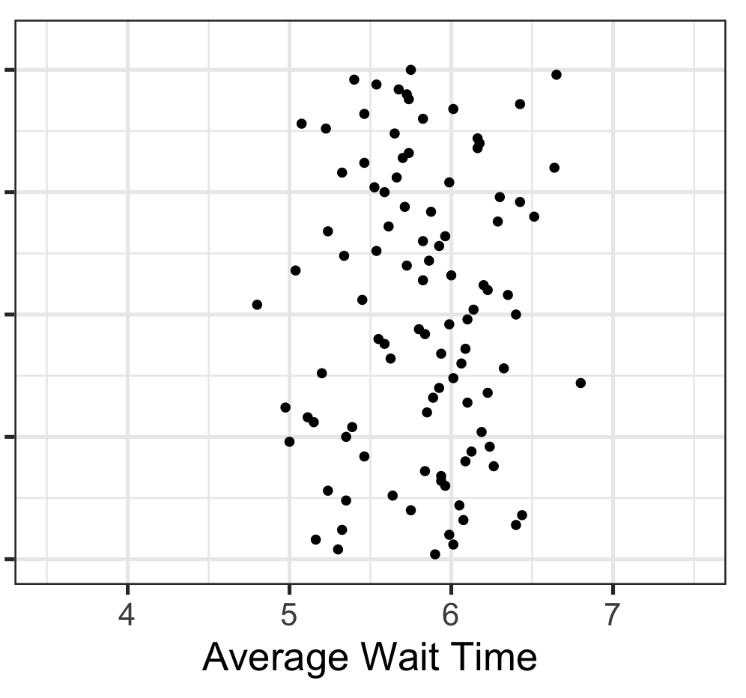
Sampling Wait Times: Sample Variation
We see that the average wait times vary from one sample to the next
This is called sampling variation, and it is unavoidable
So, what can the results of a sample actually tell us?
We’ll take a look at the results visually on the right
Here are the results of 97 more samples

Slide 13
Sampling Wait Times: Sample Variation
We see that the average wait times vary from one sample to the next
This is called sampling variation, and it is unavoidable
What can we take away from the average wait times from these 100 samples of 8 customers each?

Slide 14
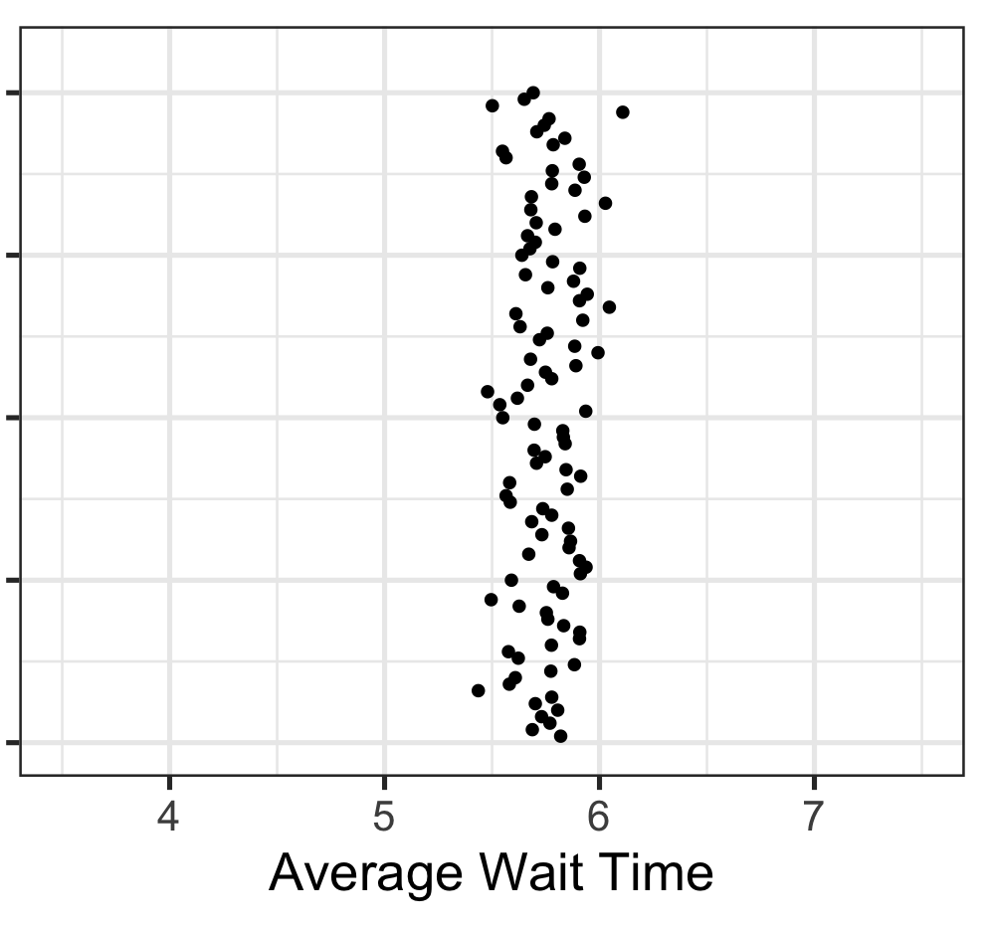
Sampling Wait Times: Sample Variation
Samples of only 8 customers are quite small, leaving lots of room for uncertainty
Let’s revisit this with samples of 72 customers each
Here are the average wait times resulting from 100 samples of 72 customers each
What do you feel comfortable claiming now?

Slide 15
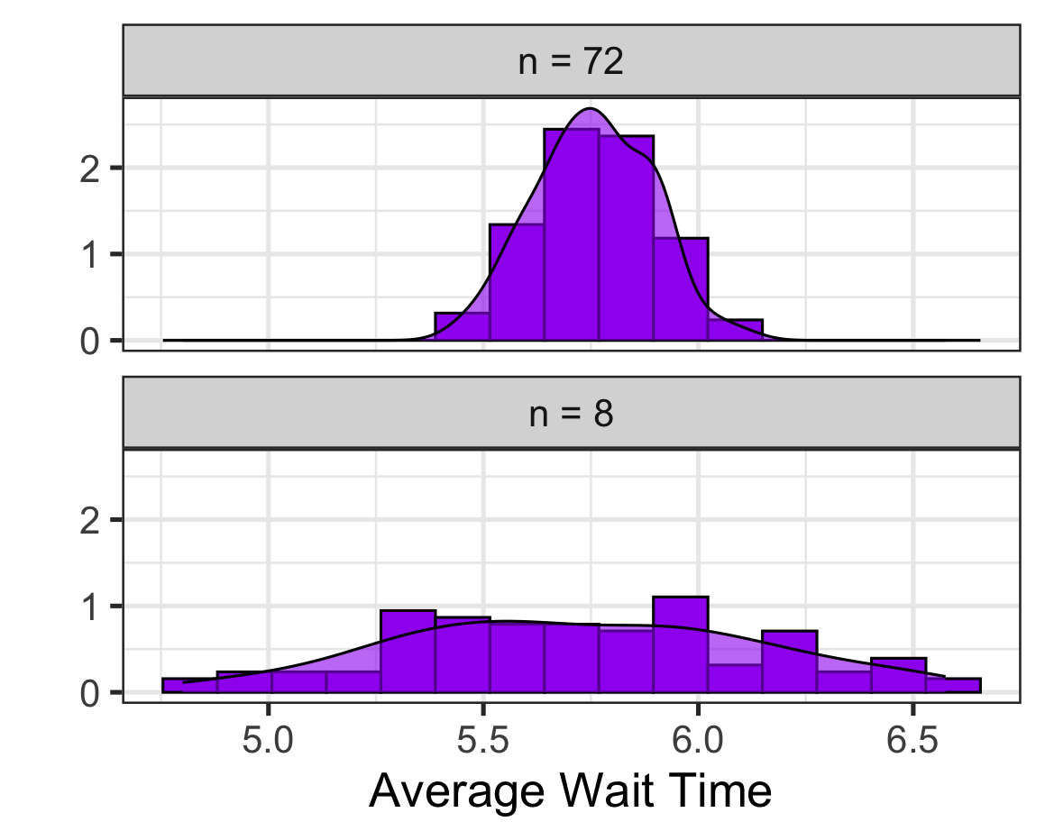
The Distribution of Sample Average Wait Times
Let’s take a look at the distributions of the average wait times for our samples
What do you notice?

Slide 16
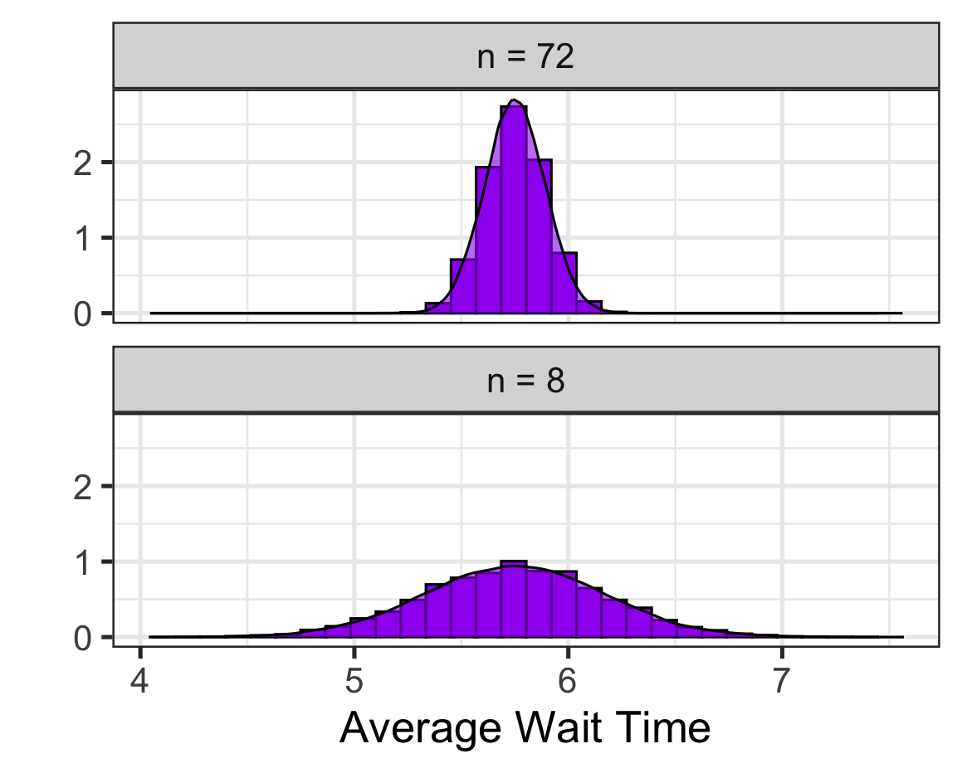
The Distribution of Sample Average Wait Times
In case you aren’t convinced, here are collections of 50,000 samples of size 8 and 50,000 samples of size 72
Can you estimate the average wait time at the new location?

Slide 17
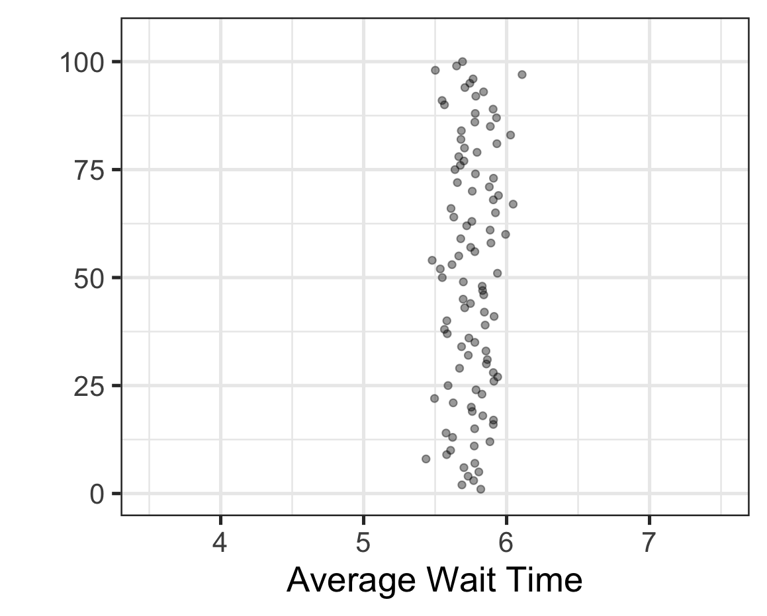
A Serious Problem…
The strategy we’ve just walked through is unreasonable
We don’t have the time or resources to conduct 50,000 random samples (or even 100 random samples)
Realistically: We take one sample and need to draw inferences from that one, but which sample do we get?

Slide 18
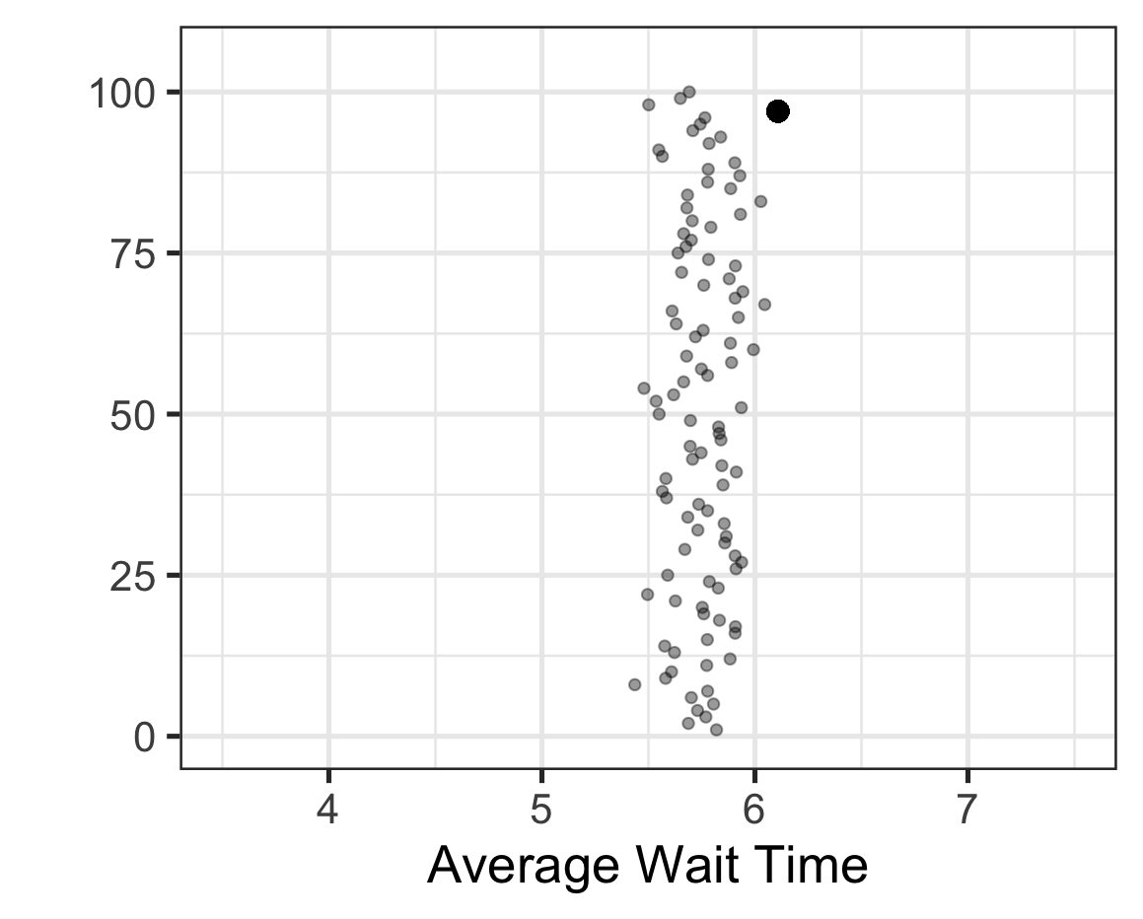
A Serious Problem…
The strategy we’ve just walked through is unreasonable
We don’t have the time or resources to conduct 50,000 random samples (or even 100 random samples)
Realistically: We take one sample and need to draw inferences from that one, but which sample do we get?

Slide 19

A Serious Problem…
The strategy we’ve just walked through is unreasonable
We don’t have the time or resources to conduct 50,000 random samples (or even 100 random samples)
Realistically: We take one sample and need to draw inferences from that one, but which sample do we get?

Slide 20

A Serious Problem…
The strategy we’ve just walked through is unreasonable
We don’t have the time or resources to conduct 50,000 random samples (or even 100 random samples)
Realistically: We take one sample and need to draw inferences from that one, but which sample do we get?

Slide 21
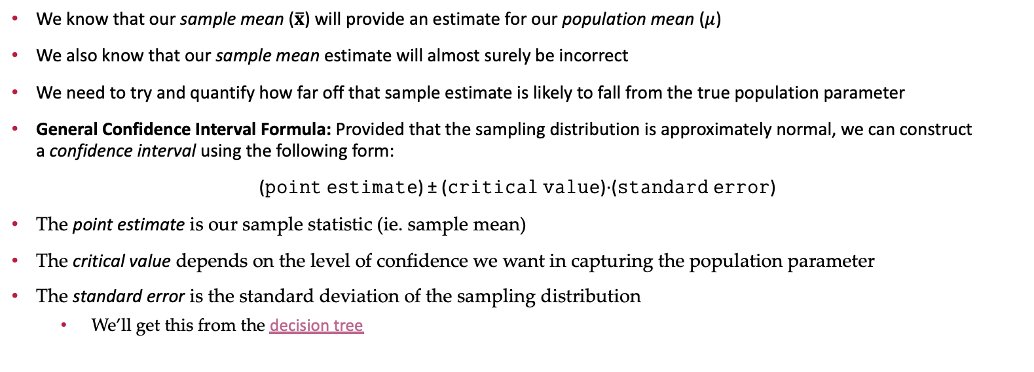
Confidence Intervals: Estimating Population Parameters
We know that our sample mean ($\overline{x}$) will provide an estimate for our population mean ($μ$)
We also know that our sample mean estimate will almost surely be incorrect
We need to try and quantify how far off that sample estimate is likely to fall from the true population parameter
General Confidence Interval Formula: Provided that the sampling distribution is approximately normal, we can construct a confidence interval using the following form:
(𝚙𝚘𝚒𝚗𝚝 𝚎𝚜𝚝𝚒𝚖𝚊𝚝𝚎) ± (𝚌𝚛𝚒𝚝𝚒𝚌𝚊𝚕 𝚟𝚊𝚕𝚞𝚎)⋅(𝚜𝚝𝚊𝚗𝚍𝚊𝚛𝚍 𝚎𝚛𝚛𝚘𝚛)
The point estimate is our sample statistic (ie. sample mean)
The critical value depends on the level of confidence we want in capturing the population parameter
The standard error is the standard deviation of the sampling distribution
We’ll get this from the decision tree

Slide 22
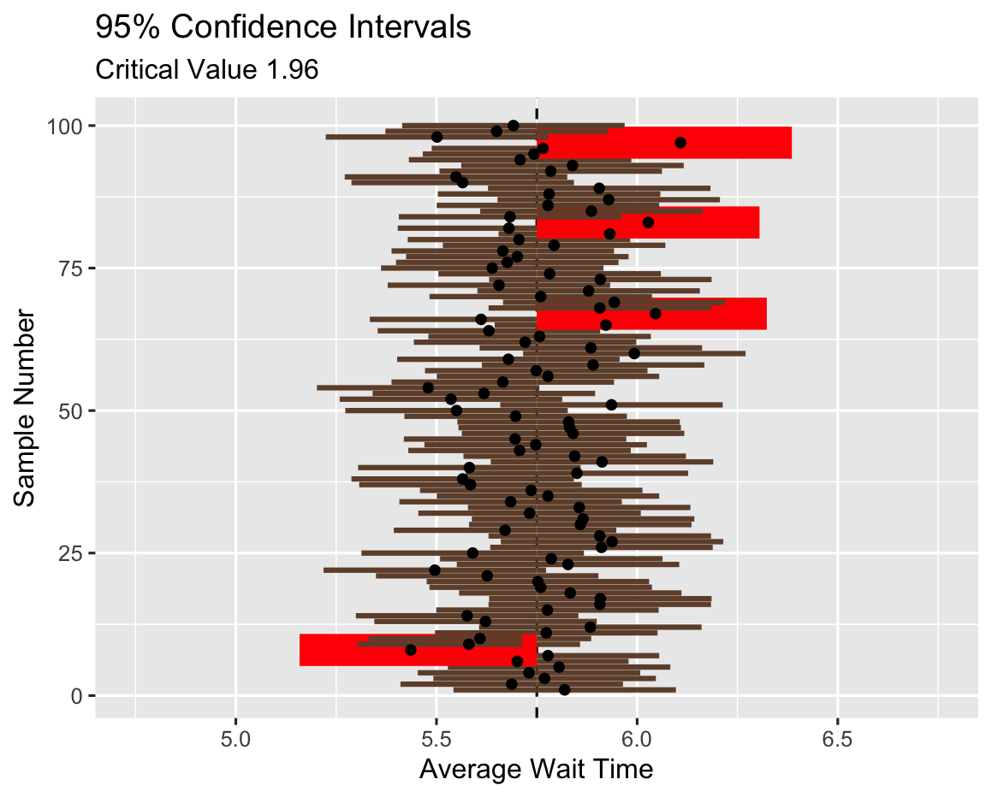
Visual Intuition for Confidence Intervals
Before we work through the construction of a confidence interval, let’s build some intuition
What does a confidence interval actually mean?

Slide 23
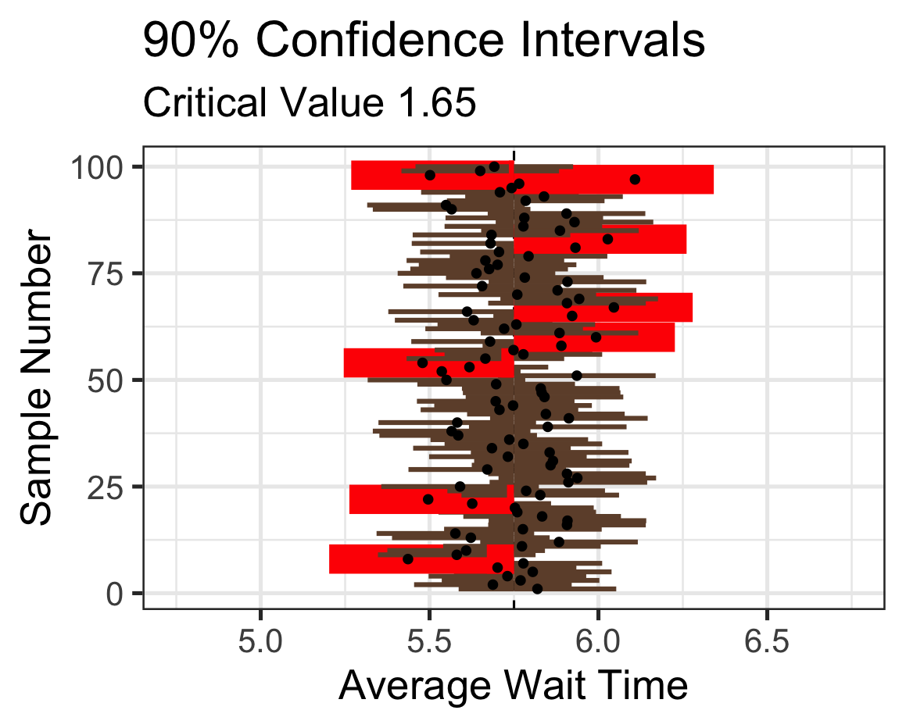
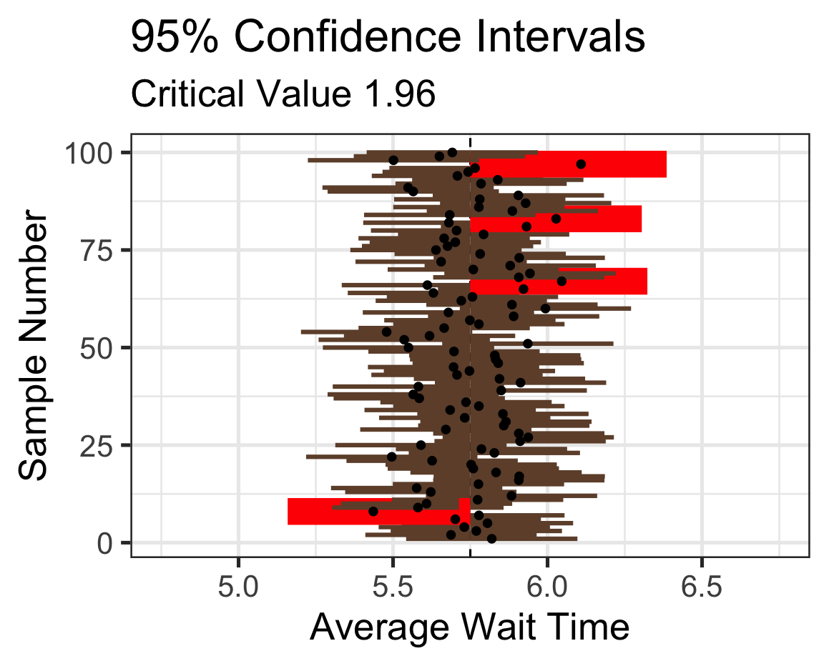
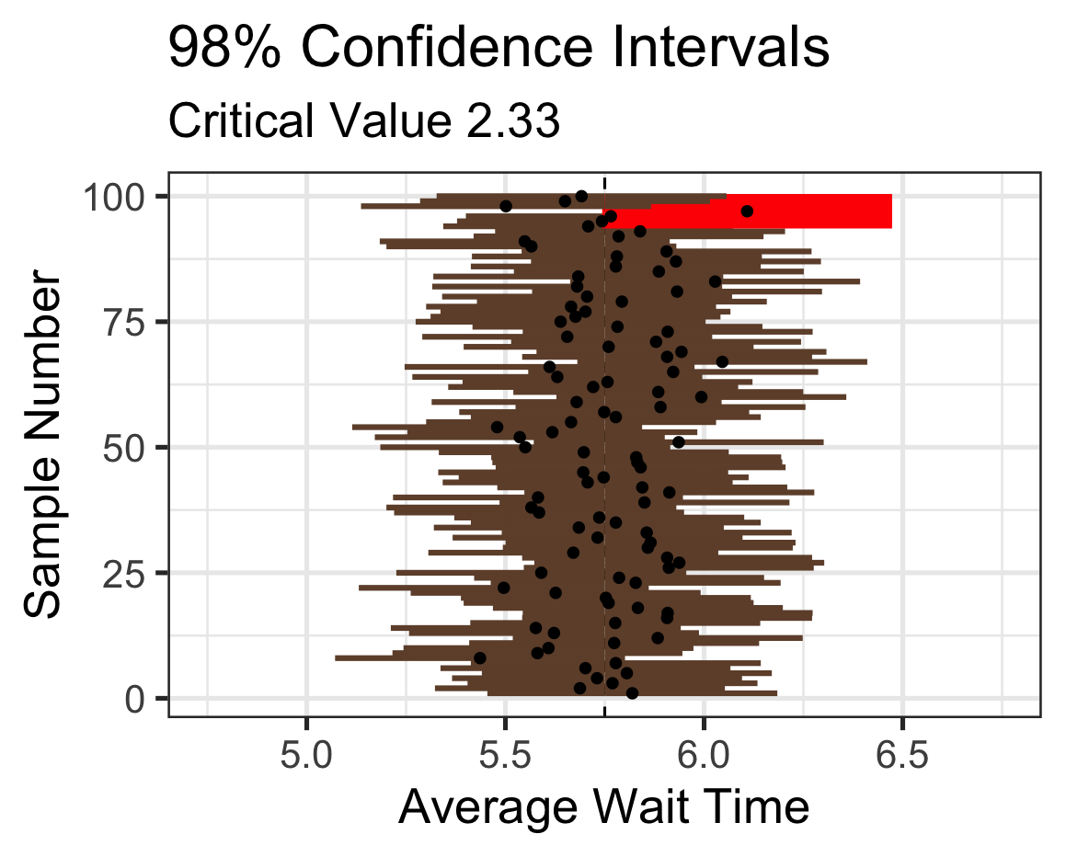
Confidence Level and Confidence Intervals
How does the confidence level impact the confidence intervals?
Confidence intervals with lower levels of confidence are narrower, but also more likely to miss the parameter

Slide 24
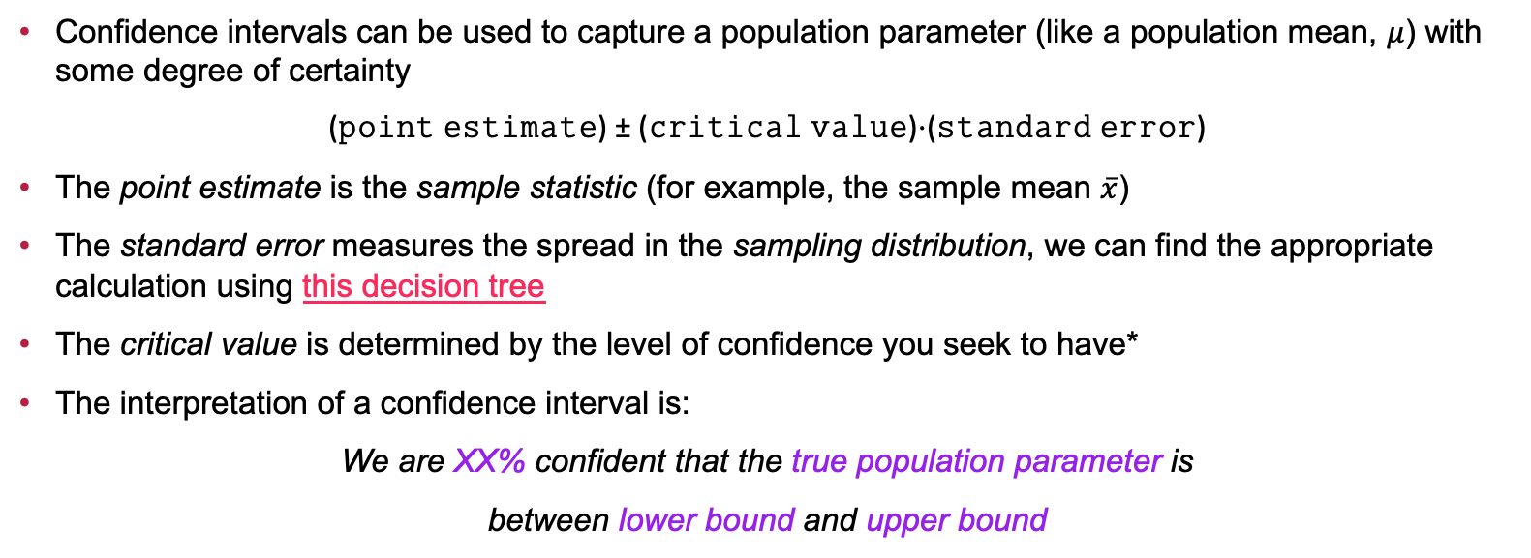
Summary
Confidence intervals can be used to capture a population parameter (like a population mean, $μ$) with some degree of certainty
(𝚙𝚘𝚒𝚗𝚝 𝚎𝚜𝚝𝚒𝚖𝚊𝚝𝚎) ± (𝚌𝚛𝚒𝚝𝚒𝚌𝚊𝚕 𝚟𝚊𝚕𝚞𝚎)⋅(𝚜𝚝𝚊𝚗𝚍𝚊𝚛𝚍 𝚎𝚛𝚛𝚘𝚛)
The point estimate is the sample statistic (for example, the sample mean $\overline{x}$)
The standard error measures the spread in the sampling distribution, we can find the appropriate calculation using this decision tree
The critical value is determined by the level of confidence you seek to have*
The interpretation of a confidence interval is:
We are XX% confident that the true population parameter is
between lower bound and upper bound

Slide 25
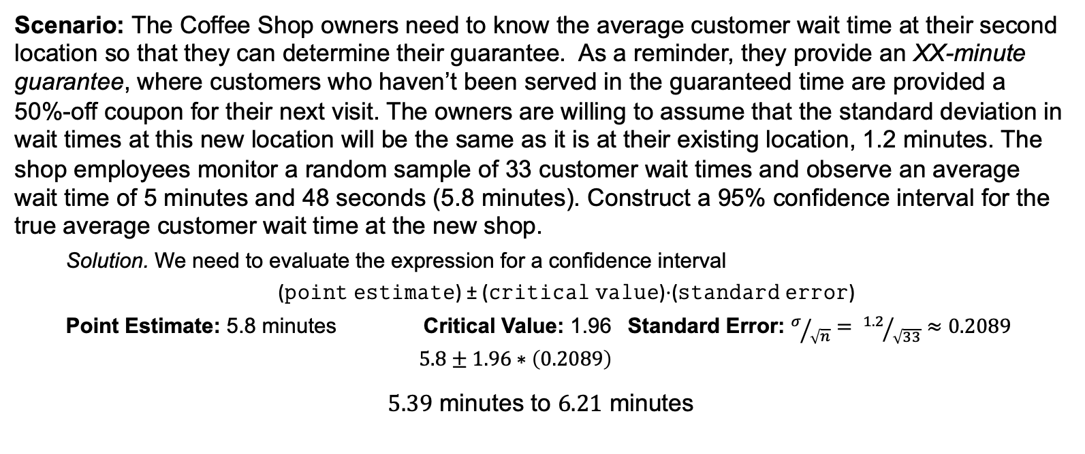
Example: Coffee Shop Wait Times
Scenario: The Coffee Shop owners need to know the average customer wait time at their second location so that they can determine their guarantee. As a reminder, they provide an XX-minute guarantee, where customers who haven’t been served in the guaranteed time are provided a 50%-off coupon for their next visit. The owners are willing to assume that the standard deviation in wait times at this new location will be the same as it is at their existing location, 1.2 minutes. The shop employees monitor a random sample of 33 customer wait times and observe an average wait time of 5 minutes and 48 seconds (5.8 minutes). Construct a 95% confidence interval for the true average customer wait time at the new shop.
Solution. We need to evaluate the expression for a confidence interval
(𝚙𝚘𝚒𝚗𝚝 𝚎𝚜𝚝𝚒𝚖𝚊𝚝𝚎) ± (𝚌𝚛𝚒𝚝𝚒𝚌𝚊𝚕 𝚟𝚊𝚕𝚞𝚎)⋅(𝚜𝚝𝚊𝚗𝚍𝚊𝚛𝚍 𝚎𝚛𝚛𝚘𝚛)
Point Estimate: 5.8 minutes Critical Value: 1.96 Standard Error: $σ/{\sqrt{n}}= {1.2}/{\sqrt{33}}≈0.2089$
$$5.8±1.96∗\left(0.2089\right)$$
$5.39$ minutes to $6.21$ minutes

Slide 26
Example: Coffee Shop Wait Times
Scenario: The Coffee Shop owners need to know the average customer wait time at their second location so that they can determine their guarantee. As a reminder, they provide an XX-minute guarantee, where customers who haven’t been served in the guaranteed time are provided a 50%-off coupon for their next visit. The owners are willing to assume that the standard deviation in wait times at this new location will be the same as it is at their existing location, 1.2 minutes. The shop employees monitor a random sample of 33 customer wait times and observe an average wait time of 5 minutes and 48 seconds (5.8 minutes). Construct a 95% confidence interval for the true average customer wait time at the new shop.
We are 95% confident that the true, population mean customer wait time at the new shop is between 5.39 minutes and 6.21 minutes
Note. The average alone doesn’t address the owners’ needs, but we’ll leave the remaining work up to them.

Slide 27

Summary (Repeated)
Confidence intervals can be used to capture a population parameter (like a population mean, $μ$) with some degree of certainty
(𝚙𝚘𝚒𝚗𝚝 𝚎𝚜𝚝𝚒𝚖𝚊𝚝𝚎) ± (𝚌𝚛𝚒𝚝𝚒𝚌𝚊𝚕 𝚟𝚊𝚕𝚞𝚎)⋅(𝚜𝚝𝚊𝚗𝚍𝚊𝚛𝚍 𝚎𝚛𝚛𝚘𝚛)
The point estimate is the sample statistic (for example, the sample mean $\overline{x}$)
The standard error measures the spread in the sampling distribution, we can find the appropriate calculation using this decision tree
The critical value is determined by the level of confidence you seek to have*
The interpretation of a confidence interval is:
We are XX% confident that the true population parameter is
between lower bound and upper bound

Slide 28
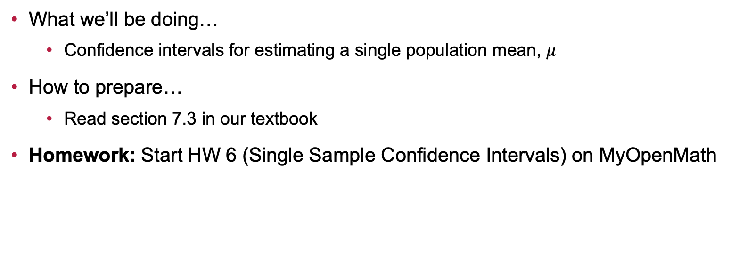
Next Time…
What we’ll be doing…
Confidence intervals for estimating a single population mean, $μ$
How to prepare…
Read section 7.3 in our textbook
Homework: Start HW 6 (Single Sample Confidence Intervals) on MyOpenMath

