Slide 1
Confidence Intervals for a Single Population Mean
Answering “What is the population mean?”

Slide 2
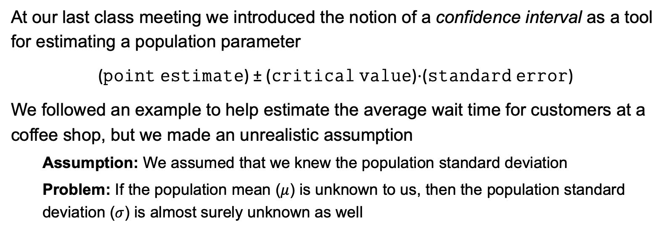
Removing an Unreasonable Assumption
At our last class meeting we introduced the notion of a confidence interval as a tool for estimating a population parameter
(𝚙𝚘𝚒𝚗𝚝 𝚎𝚜𝚝𝚒𝚖𝚊𝚝𝚎) ± (𝚌𝚛𝚒𝚝𝚒𝚌𝚊𝚕 𝚟𝚊𝚕𝚞𝚎)⋅(𝚜𝚝𝚊𝚗𝚍𝚊𝚛𝚍 𝚎𝚛𝚛𝚘𝚛)
We followed an example to help estimate the average wait time for customers at a coffee shop, but we made an unrealistic assumption
Assumption: We assumed that we knew the population standard deviation
Problem: If the population mean ($μ$) is unknown to us, then the population standard deviation ($σ$) is almost surely unknown as well

Slide 3
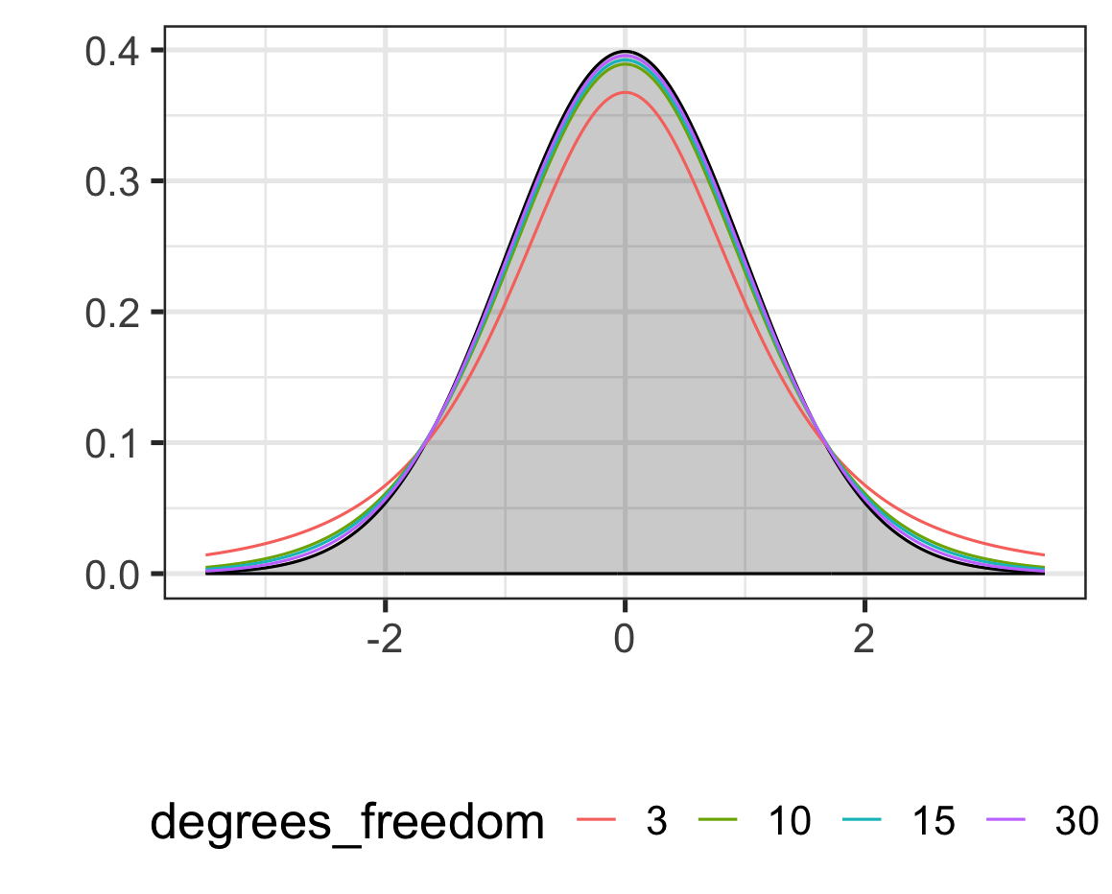
The t-distributions
The tails of the t-distributions are “fatter” (higher up) than the normal distribution
The t-distributions have more area (probability) in the tails of the distribution
As the degrees of freedom increase, the t-distribution gets closer to the normal distribution

Slide 4
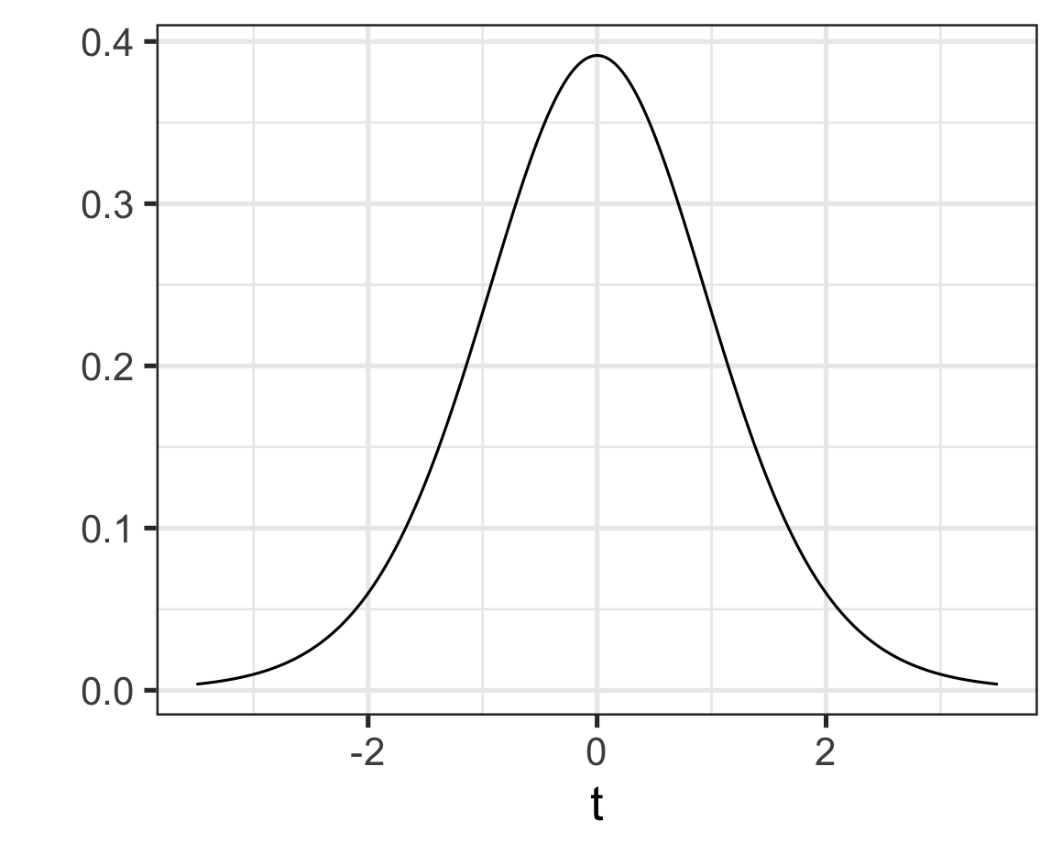

Calculating Probability Under a t-distribution
We calculate probabilities with the t-distributions just like with the normal distribution
Excel includes a $T.DIST()$ which will give us the area to the left of a boundary value as long as we provide the degrees of freedom
The syntax for the function is $T.DIST(boundaryValue, df, TRUE)$
Example: Find $P(t>1.5)$ in a t-distribution with 13 degrees of freedom

Slide 5
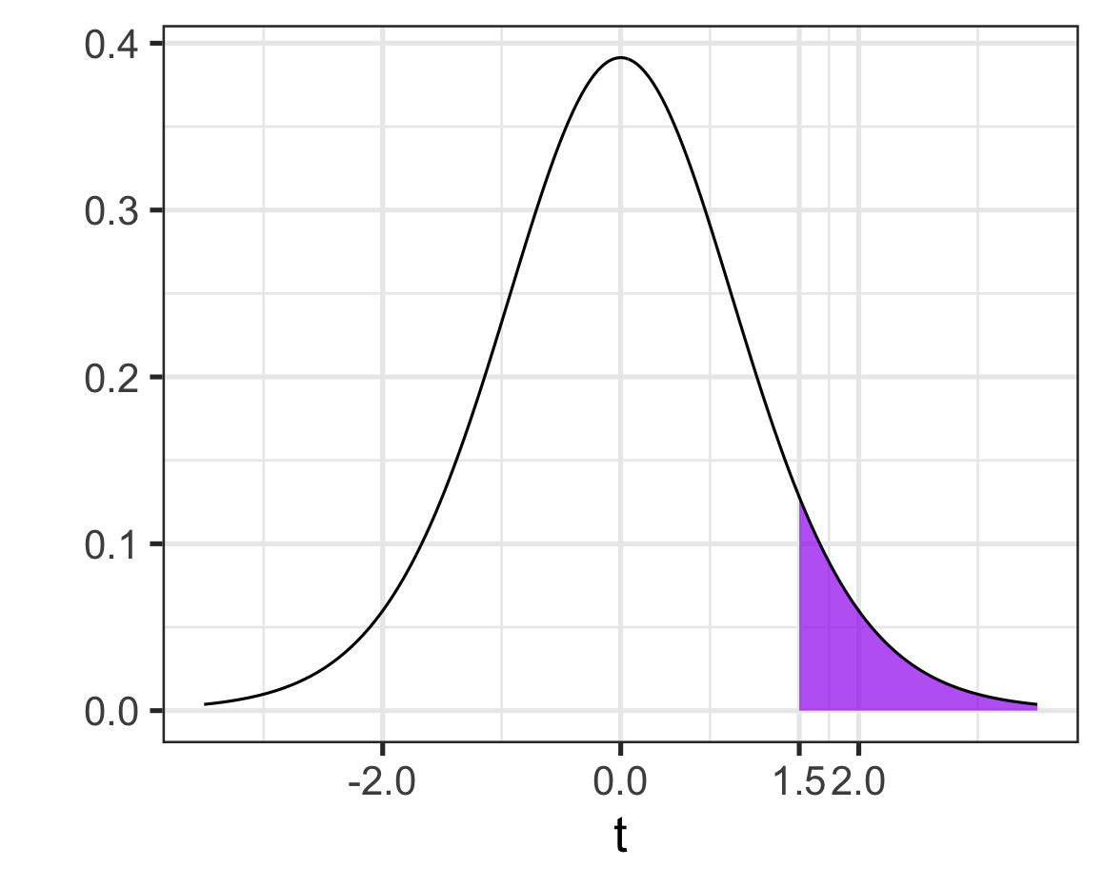
Calculating Probability Under a t-distribution
We calculate probabilities with the t-distributions just like with the normal distribution
Excel includes a $T.DIST()$ which will give us the area to the left of a boundary value as long as we provide the degrees of freedom
The syntax for the function is $T.DIST(boundaryValue, df, TRUE)$
Example: Find $P(t>1.5)$ in a t-distribution with 13 degrees of freedom
$$P\left(t>1.5\right)=1 −T.DIST\left(1.5, 13, TRUE\right)$$
$$≈0.0788$$

Slide 6
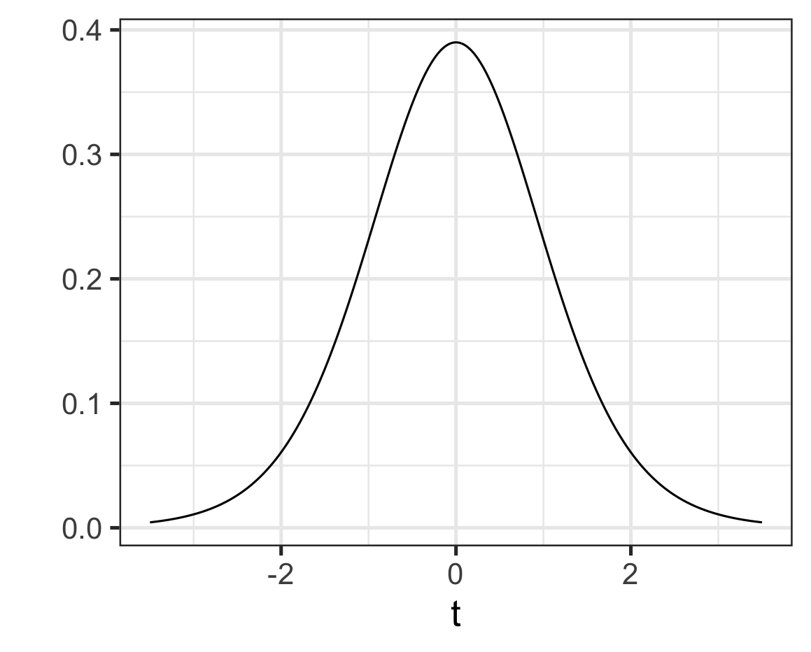
Calculating Critical Values on a t-distribution
Because the t-distributions differ from the standard normal distribution, we’ll need to calculate the critical value we use when constructing confidence intervals
Example: Find the critical value for a 90% confidence interval, using a t-distribution with 11 degrees of freedom

Slide 7
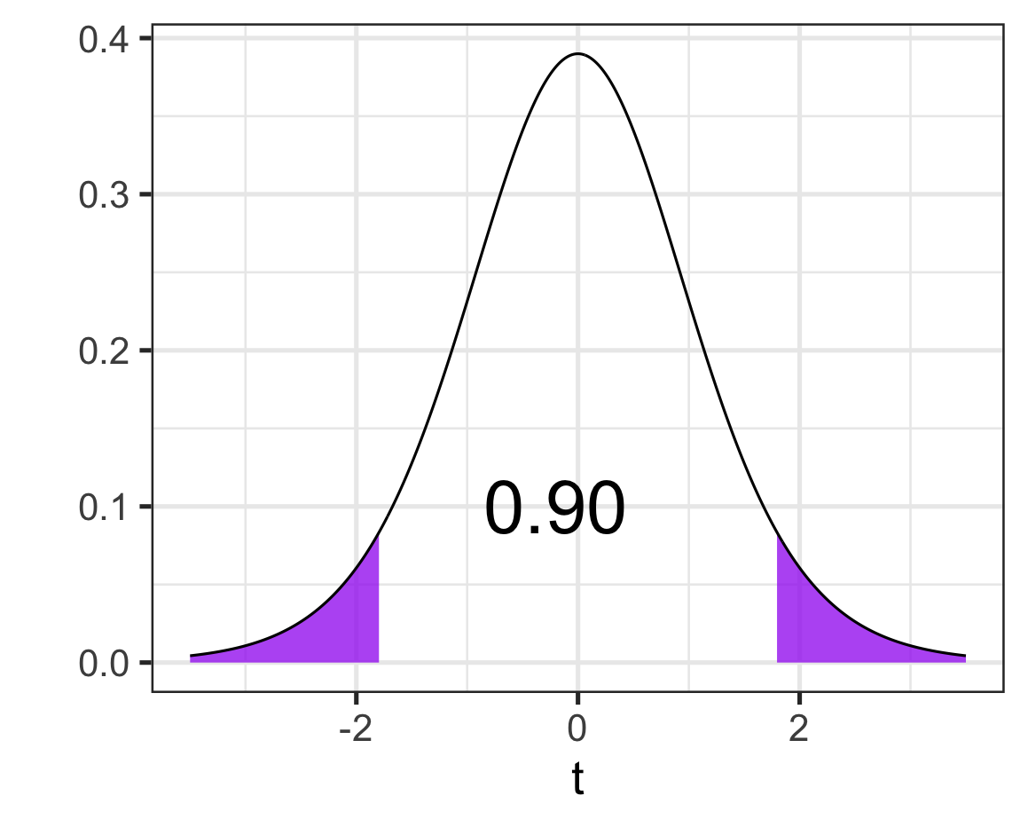
Calculating Critical Values on a t-distribution
Because the t-distributions differ from the standard normal distribution, we’ll need to calculate the critical value we use when constructing confidence intervals
Example: Find the critical value for a 90% confidence interval, using a t-distribution with 11 degrees of freedom

Slide 8
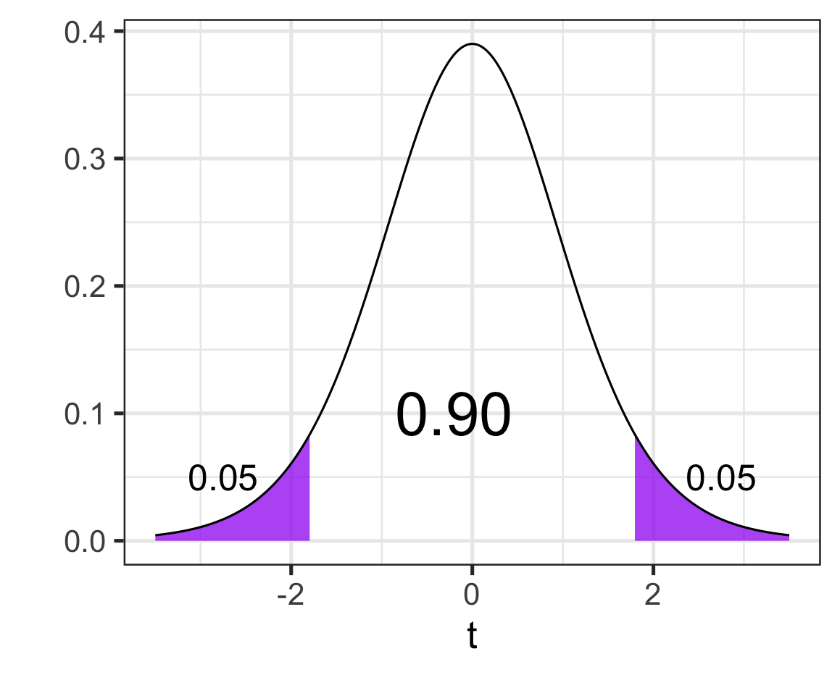
Calculating Critical Values on a t-distribution
Because the t-distributions differ from the standard normal distribution, we’ll need to calculate the critical value we use when constructing confidence intervals
Example: Find the critical value for a 90% confidence interval, using a t-distribution with 11 degrees of freedom

Slide 9
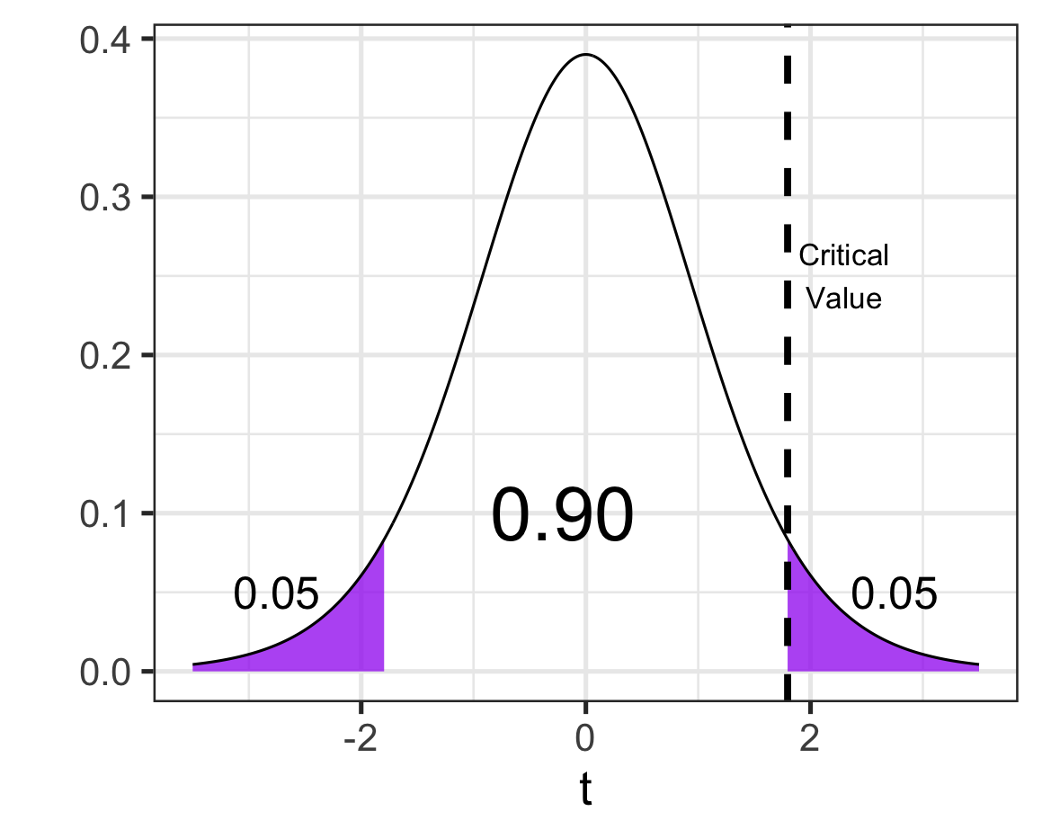
Calculating Critical Values on a t-distribution
Because the t-distributions differ from the standard normal distribution, we’ll need to calculate the critical value we use when constructing confidence intervals
Example: Find the critical value for a 90% confidence interval, using a t-distribution with 11 degrees of freedom
We can use $T.INV()$, like how we previously used $NORM.INV()$, to find our critical value
The syntax is $T.INV(AreaToLeft, df)$

Slide 10
Calculating Critical Values on a t-distribution
Because the t-distributions differ from the standard normal distribution, we’ll need to calculate the critical value we use when constructing confidence intervals
Example: Find the critical value for a 90% confidence interval, using a t-distribution with 11 degrees of freedom
$$Critical Value=T.INV(0.95, 11)$$

Slide 11
Calculating Critical Values on a t-distribution
Because the t-distributions differ from the standard normal distribution, we’ll need to calculate the critical value we use when constructing confidence intervals
Example: Find the critical value for a 90% confidence interval, using a t-distribution with 11 degrees of freedom
$$Critical Value=T.INV\left(0.95, 11\right)≈1.796$$

Slide 12
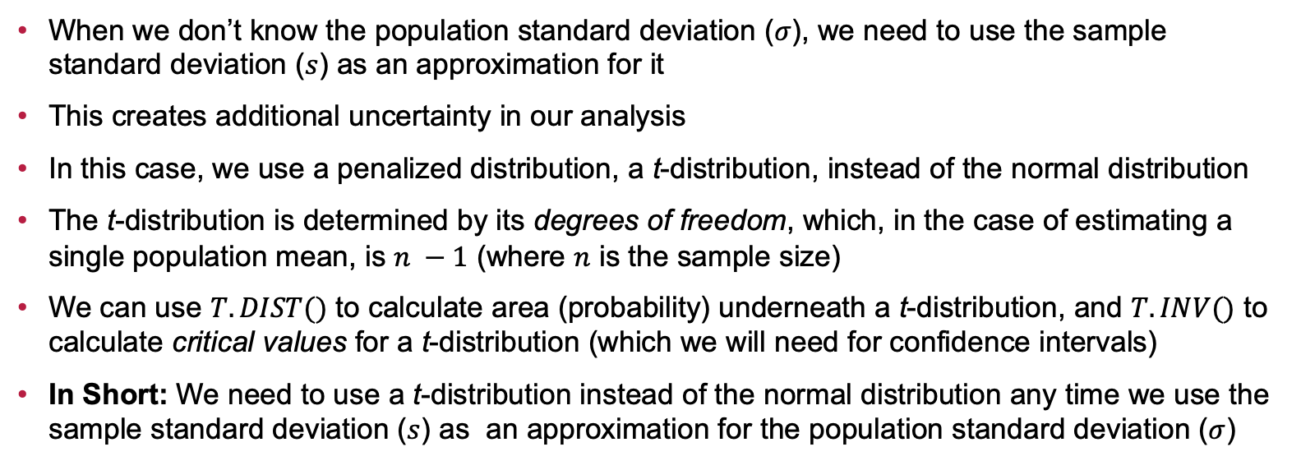
Summary (So Far…)
When we don’t know the population standard deviation ($σ$), we need to use the sample standard deviation ($s$) as an approximation for it
This creates additional uncertainty in our analysis
In this case, we use a penalized distribution, a t-distribution, instead of the normal distribution
The t-distribution is determined by its degrees of freedom, which, in the case of estimating a single population mean, is $n −1$ (where $n$ is the sample size)
We can use $T.DIST()$ to calculate area (probability) underneath a t-distribution, and $T.INV()$ to calculate critical values for a t-distribution (which we will need for confidence intervals)
In Short: We need to use a t-distribution instead of the normal distribution any time we use the sample standard deviation ($s$) as an approximation for the population standard deviation ($σ$)

Slide 13
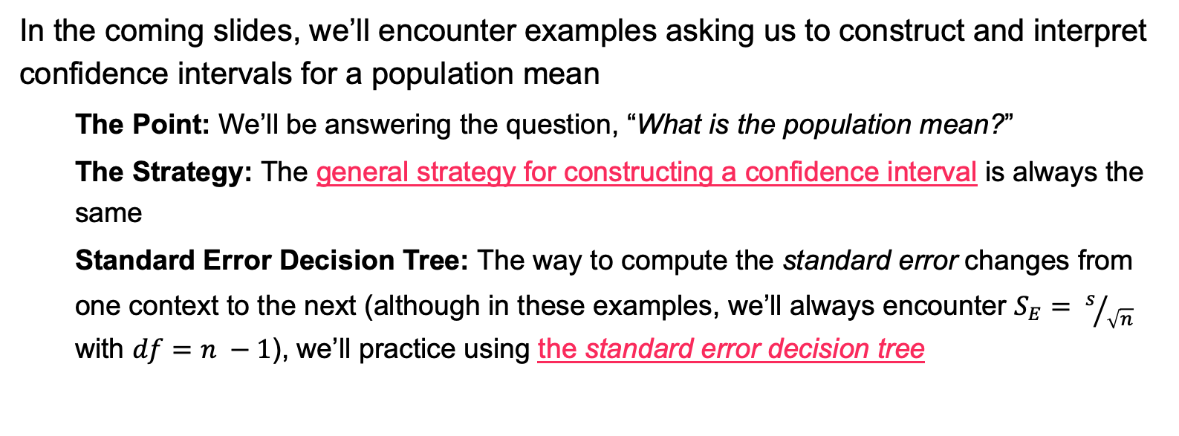
Examples
In the coming slides, we’ll encounter examples asking us to construct and interpret confidence intervals for a population mean
The Point: We’ll be answering the question, “What is the population mean?”
The Strategy: The general strategy for constructing a confidence interval is always the same
Standard Error Decision Tree: The way to compute the standard error changes from one context to the next (although in these examples, we’ll always encounter $S_{E}= s/{\sqrt{n}}$ with $df=n −1$), we’ll practice using the standard error decision tree

Slide 14
Examples: Video Game Playtime
Scenario: A gaming company is analyzing player engagement for their newest game. They collected data from 42 players, finding an average daily playtime of 3.6 hours with a standard deviation of 0.8 hours. Use the sample data to construct a 95% confidence interval for the mean daily playtime of all players.

Slide 15
Examples: Coffee Shop Spending
Scenario: A coffee shop is interested in estimating the average amount customers spend during a visit. A sample of 30 customers revealed an average spending of $8.45 with a standard deviation of $2.12. Construct a 90% confidence interval for the mean amount spent by customers at this coffee shop.

Slide 16
Examples: Daily Text Messages Sent
Scenario: A phone company is analyzing the texting habits of teenagers. From a sample of 25 teenagers, the average number of text messages sent daily is 84.3, with a standard deviation of 15.7 messages. Determine a 95% confidence interval for the average daily number of text messages sent by teenagers.

Slide 17
Examples: Streaming Service Viewing Time
Scenario: A streaming service wants to estimate the weekly viewing habits of its users. Data from 60 users show an average of 12.4 hours spent watching shows or movies each week, with a standard deviation of 4.2 hours. Calculate a 90% confidence interval for the mean weekly viewing time of all users.

Slide 18
Examples: Concert Ticket Prices
Scenario: A music fan group is interested in estimating the average ticket price for popular concerts in their city. A sample of 20 concerts shows an average ticket price of $92.15, with a standard deviation of $13.58. Determine a 95% confidence interval for the mean ticket price.

Slide 19
Examples: Sleep Duration for Young Adults
Scenario: A health organization is examining the sleep habits of young adults aged 18–24. Data from 45 individuals show an average nightly sleep duration of 6.9 hours with a standard deviation of 1.2 hours. What is a 98% confidence interval for the mean nightly sleep duration of young adults?

Slide 20
Examples: Delivery Times for Food Orders
Scenario: A food delivery app wants to estimate the average delivery time for its orders. A sample of 38 orders shows an average delivery time of 27.4 minutes, with a standard deviation of 5.9 minutes. Calculate a 99% confidence interval for the mean delivery time of all orders.

Slide 21
Example: Monthly Social Media Posts by Influencers
Scenario: A social media marketing agency is studying the posting habits of influencers. A sample of 28 influencers shows an average of 49.2 posts per month, with a standard deviation of 7.3 posts. Determine a 95% confidence interval for the mean number of posts made by influencers each month.

Slide 22
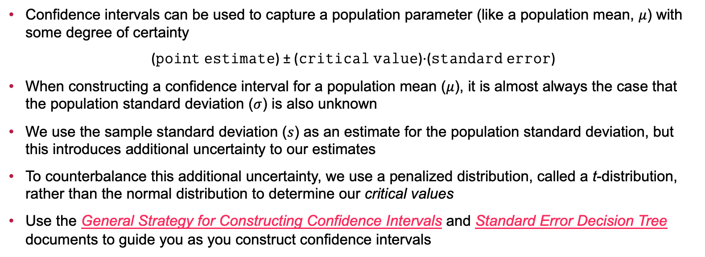
Summary
Confidence intervals can be used to capture a population parameter (like a population mean, $μ$) with some degree of certainty
(𝚙𝚘𝚒𝚗𝚝 𝚎𝚜𝚝𝚒𝚖𝚊𝚝𝚎) ± (𝚌𝚛𝚒𝚝𝚒𝚌𝚊𝚕 𝚟𝚊𝚕𝚞𝚎)⋅(𝚜𝚝𝚊𝚗𝚍𝚊𝚛𝚍 𝚎𝚛𝚛𝚘𝚛)
When constructing a confidence interval for a population mean ($μ$), it is almost always the case that the population standard deviation ($σ$) is also unknown
We use the sample standard deviation ($s$) as an estimate for the population standard deviation, but this introduces additional uncertainty to our estimates
To counterbalance this additional uncertainty, we use a penalized distribution, called a t-distribution, rather than the normal distribution to determine our critical values
Use the General Strategy for Constructing Confidence Intervals and Standard Error Decision Tree documents to guide you as you construct confidence intervals

Slide 23
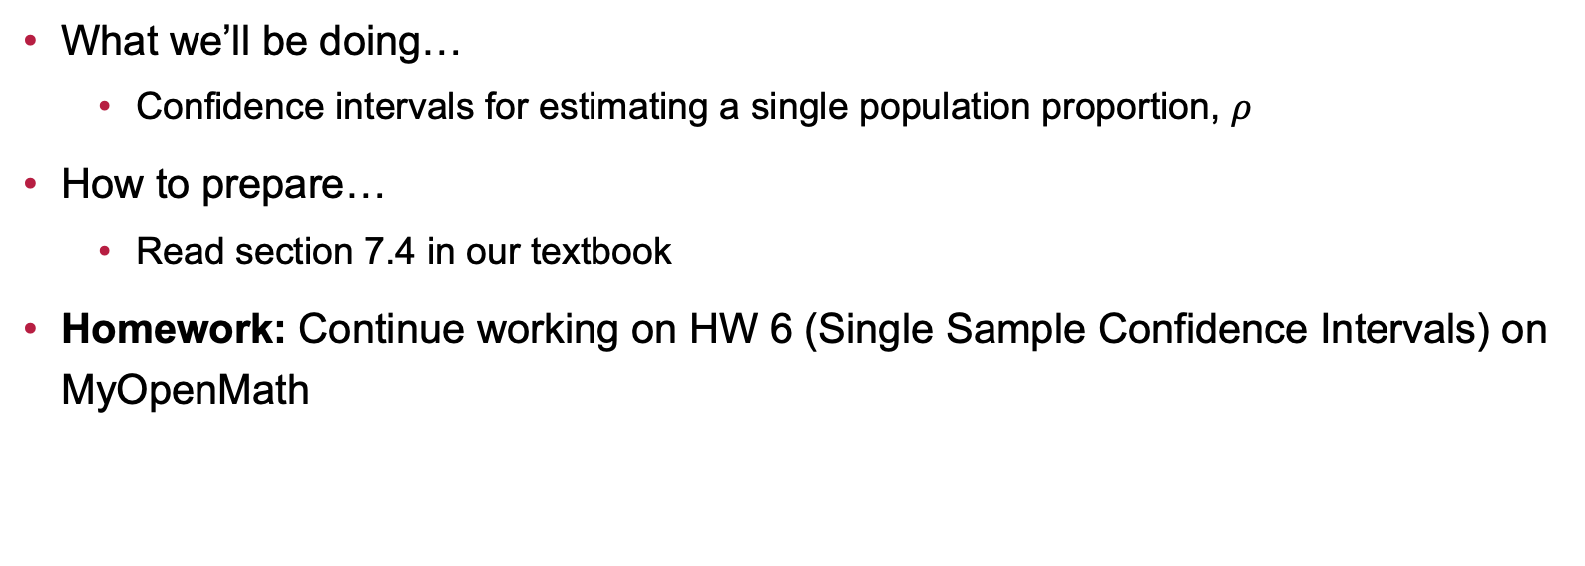
Next Time…
What we’ll be doing…
Confidence intervals for estimating a single population proportion, $ρ$
How to prepare…
Read section 7.4 in our textbook
Homework: Continue working on HW 6 (Single Sample Confidence Intervals) on MyOpenMath

