Slide 1
Confidence Intervals for a Single Population Proportion
Answering “What is the population proportion?”

Slide 2
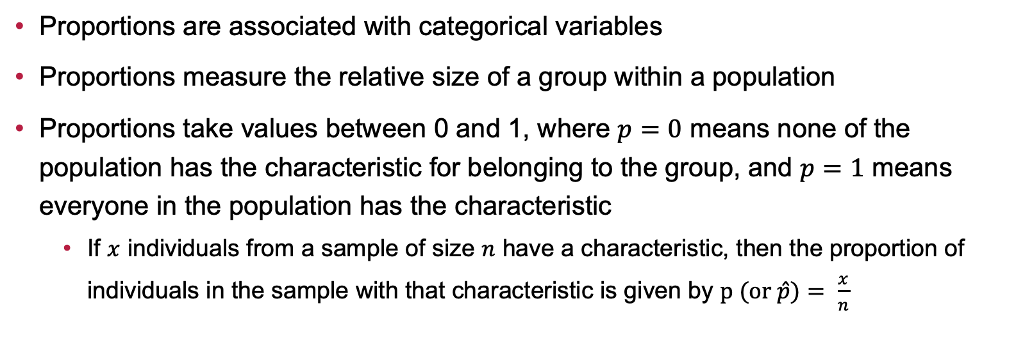
A Reminder on Proportions
Proportions are associated with categorical variables
Proportions measure the relative size of a group within a population
Proportions take values between 0 and 1, where $p=0$ means none of the population has the characteristic for belonging to the group, and $p=1$ means everyone in the population has the characteristic
If $x$ individuals from a sample of size $n$ have a characteristic, then the proportion of individuals in the sample with that characteristic is given by $p (or \hat{p})= \frac{x}{n}$

Slide 3
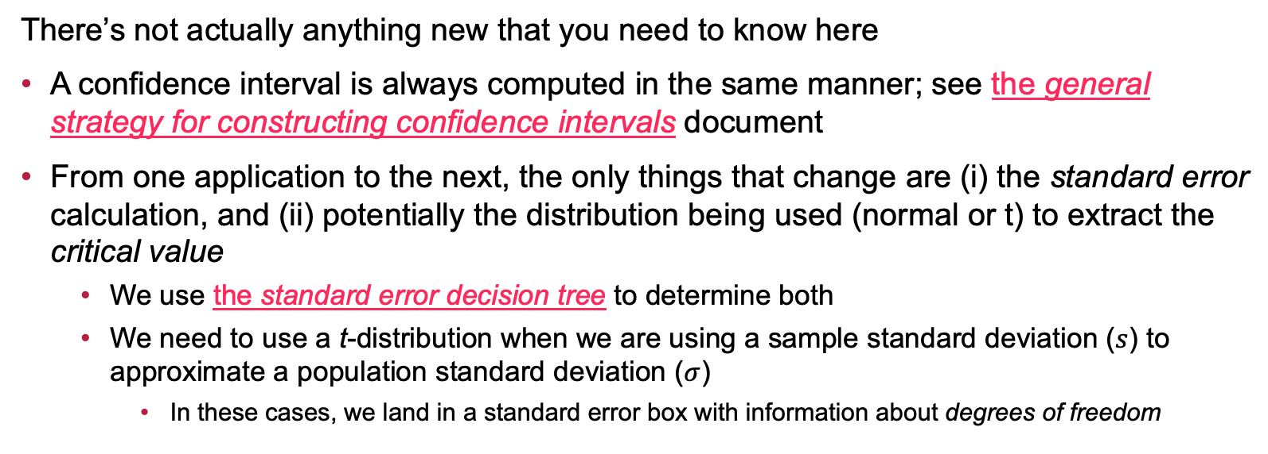
Good News…
There’s not actually anything new that you need to know here
A confidence interval is always computed in the same manner; see the general strategy for constructing confidence intervals document
From one application to the next, the only things that change are (i) the standard error calculation, and (ii) potentially the distribution being used (normal or t) to extract the critical value
We use the standard error decision tree to determine both
We need to use a t-distribution when we are using a sample standard deviation ($s$) to approximate a population standard deviation ($σ$)
In these cases, we land in a standard error box with information about degrees of freedom

Slide 4
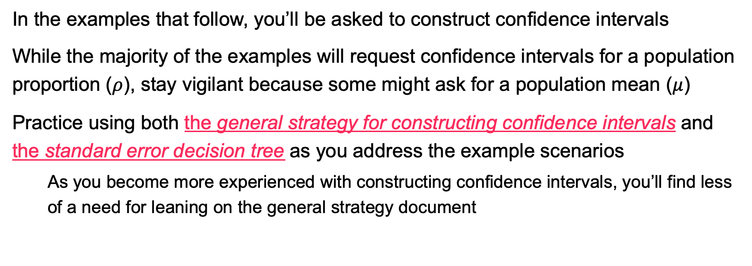
Examples
In the examples that follow, you’ll be asked to construct confidence intervals
While the majority of the examples will request confidence intervals for a population proportion ($ρ$), stay vigilant because some might ask for a population mean ($μ$)
Practice using both the general strategy for constructing confidence intervals and the standard error decision tree as you address the example scenarios
As you become more experienced with constructing confidence intervals, you’ll find less of a need for leaning on the general strategy document

Slide 5
Example: Commuter Students
Scenario: A university wants to estimate the proportion of students who commute to campus rather than live in dormitories. A survey of 641 randomly selected students found that about 41.8% of them commute. Construct a 95% confidence interval for the proportion of students who commute to campus.

Slide 6
Example: Time in a Coffee Shop
Scenario: A coffee shop manager wants to know the average time customers spend in the shop. Over a random sample of 35 customers, the manager found a mean time of 42.3 minutes with a standard deviation of 15.7 minutes. Construct a 90% confidence interval for the average time customers spend in the coffee shop.

Slide 7
Example: Video Game Completion
Scenario: A game developer is interested in estimating the proportion of players who completed a new game within the first month of its release. Out of 1,200 player accounts surveyed, 783 showed 100% completion of the game. Construct a 99% confidence interval for the proportion of players who completed the game within the first month.

Slide 8
Example: Recycling at National Parks
Scenario: A national park is trying to estimate the proportion of visitors who recycle their trash at the designated recycling bins. A ranger observed 322 visitors over a weekend and found that 192 of them used the recycling bins. Construct a 95% confidence interval for the proportion of visitors who recycle their trash.

Slide 9
Example: Binge Watching
Scenario: A streaming service wants to estimate the average number of episodes watched in a single binge-watching session. A sample of 48 users reported watching an average of 4.9 episodes with a standard deviation of 1.8 episodes. Construct a 98% confidence interval for the average number of episodes watched in a binge-watching session.

Slide 10
Example: Sneaker Design and Marketing
Scenario: A sportswear company wants to know the proportion of customers who prefer their newest sneaker design over their competitors' models. A survey of 851 customers found that 55.6% preferred the company’s newest design. Construct a 95% confidence interval for the proportion of customers who prefer the newest sneaker design.

Slide 11
Example: Traffic Jam
Scenario: A city wants to estimate the average amount of time drivers spend stuck in traffic each day. A sample of 29 drivers reported an average of 51.2 minutes with a standard deviation of 11.3 minutes. Construct a 95% confidence interval for the average time drivers spend in traffic daily.

Slide 12
Example: Visitor Donations
Scenario: A wildlife conservation organization is interested in the proportion of visitors who donate to their cause after visiting their center. A review of 411 visitor records found that 128 visitors made a donation. Construct a 90% confidence interval for the proportion of visitors who make a donation.

Slide 13
Example: E-Book Usage
Scenario: A university library is curious about the proportion of students who use e-books instead of physical textbooks. A survey of 258 students revealed that 129 prefer e-books. Construct a 99% confidence interval for the proportion of students who use e-books.

Slide 14
Example: Dark Mode
Scenario: A mobile app development team wants to know the proportion of users who enabled dark mode on their app. Out of 1,000 installations surveyed, 67.2% had been set to dark mode. Construct a 95% confidence interval for the proportion of users who use dark mode.

Slide 15
Example: Voter Participation
Scenario: A polling agency wants to estimate the proportion of eligible voters who plan to vote in an upcoming election. A random sample of 1,113 eligible voters found that 759 intend to vote. Construct a 98% confidence interval for the proportion of eligible voters who plan to vote.

Slide 16
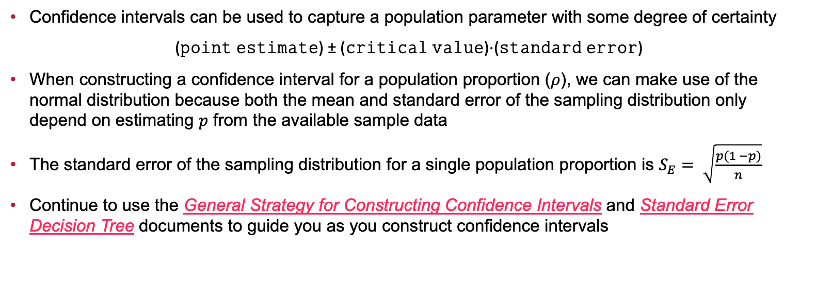
Summary
Confidence intervals can be used to capture a population parameter with some degree of certainty
(𝚙𝚘𝚒𝚗𝚝 𝚎𝚜𝚝𝚒𝚖𝚊𝚝𝚎) ± (𝚌𝚛𝚒𝚝𝚒𝚌𝚊𝚕 𝚟𝚊𝚕𝚞𝚎)⋅(𝚜𝚝𝚊𝚗𝚍𝚊𝚛𝚍 𝚎𝚛𝚛𝚘𝚛)
When constructing a confidence interval for a population proportion ($ρ$), we can make use of the normal distribution because both the mean and standard error of the sampling distribution only depend on estimating $p$ from the available sample data
The standard error of the sampling distribution for a single population proportion is $S_{E}= \sqrt{\frac{p(1 −p)}{n}}$
Continue to use the General Strategy for Constructing Confidence Intervals and Standard Error Decision Tree documents to guide you as you construct confidence intervals

Slide 17
Next Time…
What we’ll be doing…
The Hypothesis Testing Framework and Statistical Errors
How to prepare…
Read sections 8.1 – 8.3 in our textbook
Homework: Complete HW 6 (Single Sample Confidence Intervals) on MyOpenMath

