Slide 1
The Hypothesis Testing Framework
Investigating questions and claims about population parameters.

Slide 2
Objectives and Tools for Inferential Statistics
Most recently, we’ve discussed how we can use confidence intervals to capture population parameters
The result of constructing a confidence interval is a range of values, within which we are reasonably confident (90%, 95%, etc.) that the population parameter falls
Purpose: These confidence intervals help us answer “What is the value of a population parameter?”
We won’t always want to estimate the value of a population parameter; sometimes we’ll want to answer questions or investigate claims about it instead
The hypothesis testing framework provides a strategy for doing this

Slide 3
Examples of Questions/Claims to Investigate
Is the average delivery weight of a one-ton order of wood stove pellets less than the 2000lbs promised?
Is the proportion of granted requests for promotions at XYZ Home Heating below 25%?
Is there evidence to suggest that the proportion of granted promotion requests differs by gender identity?
Is there evidence to suggest that employee salaries at XYZ Home Heating increase during an individual’s first three years, after adjusting for inflation?
Is there evidence to suggest a difference in customer satisfaction ratings between XYZ Home Heating’s Manchester and Plymouth offices.

Slide 4
Intuition for Testing Claims
Let’s begin with the accusation that a one-ton delivery of home heating pellets from XYZ Home Heating actually contains less than one ton (2000lbs) of pellets
How might we investigate this claim?
Collecting and weighing a random sample of pellet deliveries on its own is not sufficient, because we know that the average weight will vary from one sample to the next
The burden of proof should be on the accusers, so we should begin from the assumption that a pellet delivery from XYZ Home Heating weighs at least the guaranteed 2000lbs
We then collect and weigh our random sample of pellets and measure the likelihood that that sample came from a population whose mean weight is at least 2000lbs
If our observed data is extremely unlikely (say our sample appears with less than 5% probability), then our sample is not compatible with a reality in which the average delivery weight is at least 2000lbs
Otherwise, our observed data is consistent with the assumption, and the population may have an average weight of at least 2000lbs

Slide 5
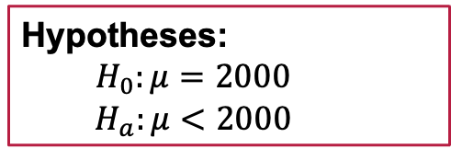
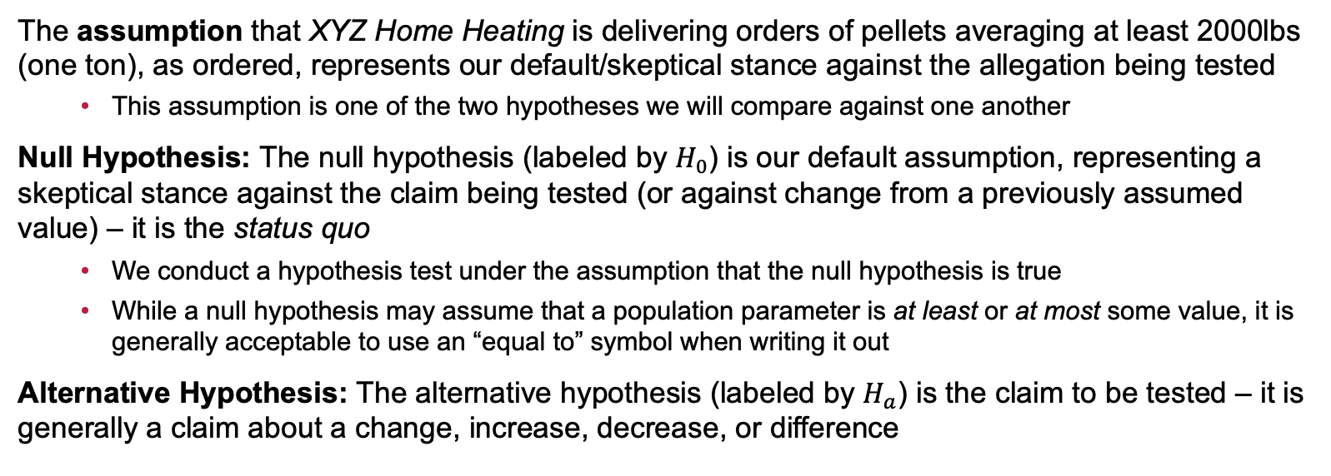
The Null and Alternative Hypotheses
Hypotheses:
$$H_{0}:μ=2000$$
$$H_{a}:μ<2000$$
The assumption that XYZ Home Heating is delivering orders of pellets averaging at least 2000lbs (one ton), as ordered, represents our default/skeptical stance against the allegation being tested
This assumption is one of the two hypotheses we will compare against one another
Null Hypothesis: The null hypothesis (labeled by $H_{0}$) is our default assumption, representing a skeptical stance against the claim being tested (or against change from a previously assumed value) – it is the status quo
We conduct a hypothesis test under the assumption that the null hypothesis is true
While a null hypothesis may assume that a population parameter is at least or at most some value, it is generally acceptable to use an “equal to” symbol when writing it out
Alternative Hypothesis: The alternative hypothesis (labeled by $H_{a}$) is the claim to be tested – it is generally a claim about a change, increase, decrease, or difference

Slide 6
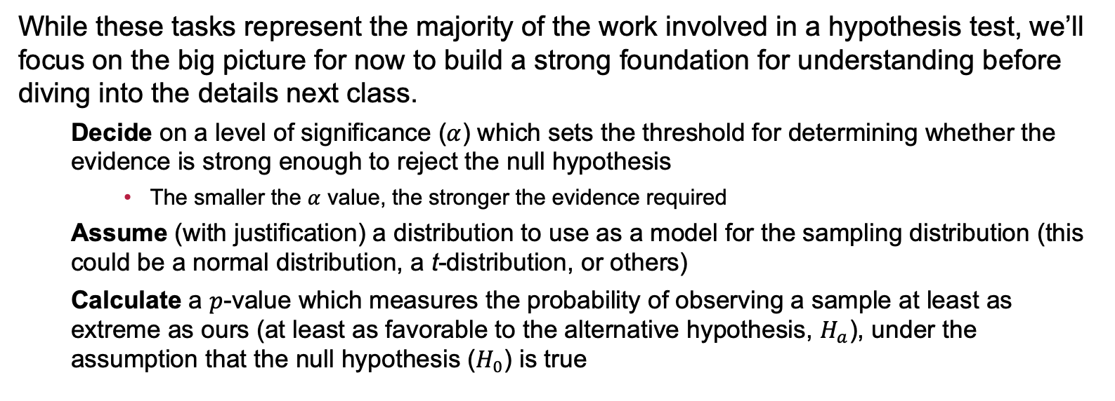
Intermediate Decisions, Assumptions, and Calculations in Hypothesis Tests
While these tasks represent the majority of the work involved in a hypothesis test, we’ll focus on the big picture for now to build a strong foundation for understanding before diving into the details next class.
Decide on a level of significance ($α$) which sets the threshold for determining whether the evidence is strong enough to reject the null hypothesis
The smaller the $α$ value, the stronger the evidence required
Assume (with justification) a distribution to use as a model for the sampling distribution (this could be a normal distribution, a t-distribution, or others)
Calculate a $p$-value which measures the probability of observing a sample at least as extreme as ours (at least as favorable to the alternative hypothesis, $H_{a}$), under the assumption that the null hypothesis ($H_{0}$) is true

Slide 7
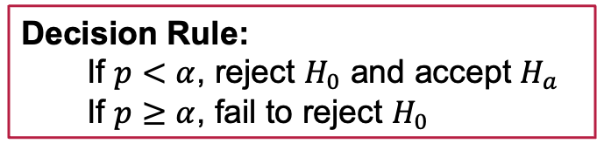
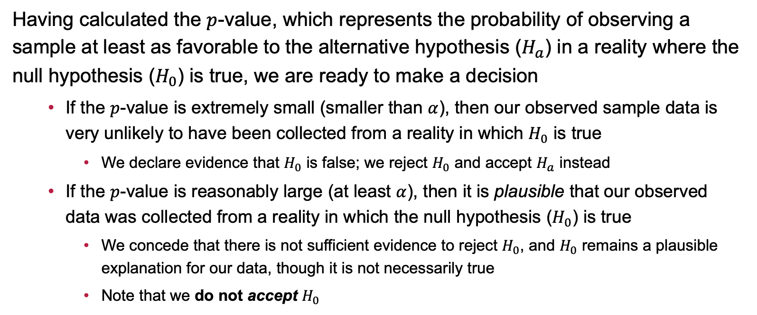
Determining the Result of the Test
Decision Rule:
If $p<α$, reject $H_{0}$ and accept $H_{a}$
If $p≥α$, fail to reject $H_{0}$
Having calculated the $p$-value, which represents the probability of observing a sample at least as favorable to the alternative hypothesis ($H_{a}$) in a reality where the null hypothesis ($H_{0}$) is true, we are ready to make a decision
If the $p$-value is extremely small (smaller than $α$), then our observed sample data is very unlikely to have been collected from a reality in which $H_{0}$ is true
We declare evidence that $H_{0}$ is false; we reject $H_{0}$ and accept $H_{a}$ instead
If the $p$-value is reasonably large (at least $α$), then it is plausible that our observed data was collected from a reality in which the null hypothesis ($H_{0}$) is true
We concede that there is not sufficient evidence to reject $H_{0}$, and $H_{0}$ remains a plausible explanation for our data, though it is not necessarily true
Note that we do not accept $H_{0}$

Slide 8
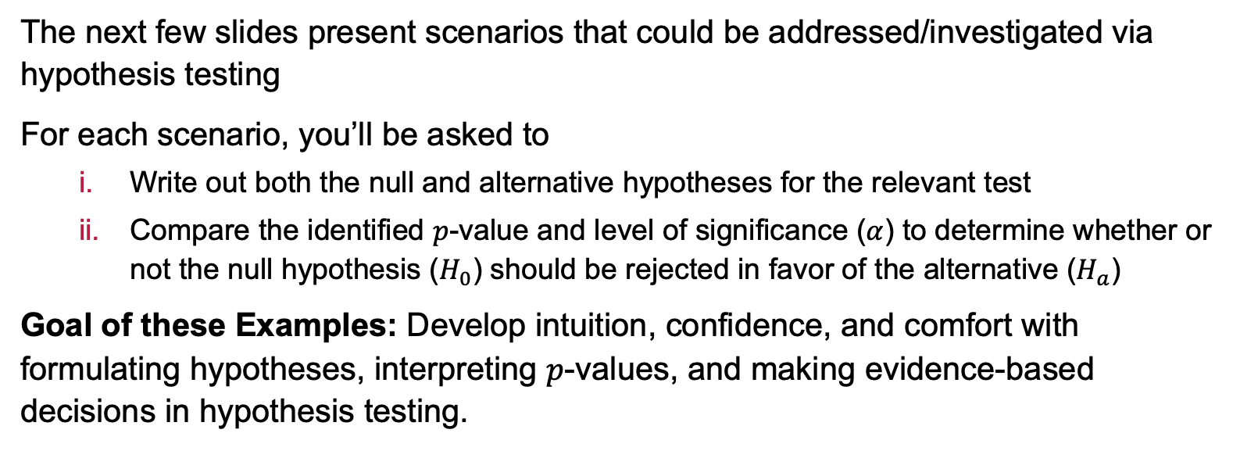
Examples
The next few slides present scenarios that could be addressed/investigated via hypothesis testing
For each scenario, you’ll be asked to
Write out both the null and alternative hypotheses for the relevant test
Compare the identified $p$-value and level of significance ($α$) to determine whether or not the null hypothesis ($H_{0}$) should be rejected in favor of the alternative ($H_{a}$)
Goal of these Examples: Develop intuition, confidence, and comfort with formulating hypotheses, interpreting $p$-values, and making evidence-based decisions in hypothesis testing.

Slide 9
Examples: Intramural Sport Participation
Scenario: Prior to the COVID-19 pandemic, a college reported that 35% of its students participate in intramural sports. They wonder if post-COVID participation in intramural sports is lower than it was pre-COVID. They conducted a test at the 0.05 significance level and observed a p-value of 0.0733.
Write out the hypotheses for the test and determine the result, with justification.

Slide 10
Example: Electric Scooter Range
Scenario: An electric scooter manufacturer claims their scooters can travel further than their leading competitor’s scooters after a full charge. The competitor’s scooters average a 25-mile range after charging to full capacity. The manufacturer conducts a test at the 10% level of significance and observes a p-value of 0.1013.
Write out the hypotheses for the test and determine the result, with justification.

Slide 11
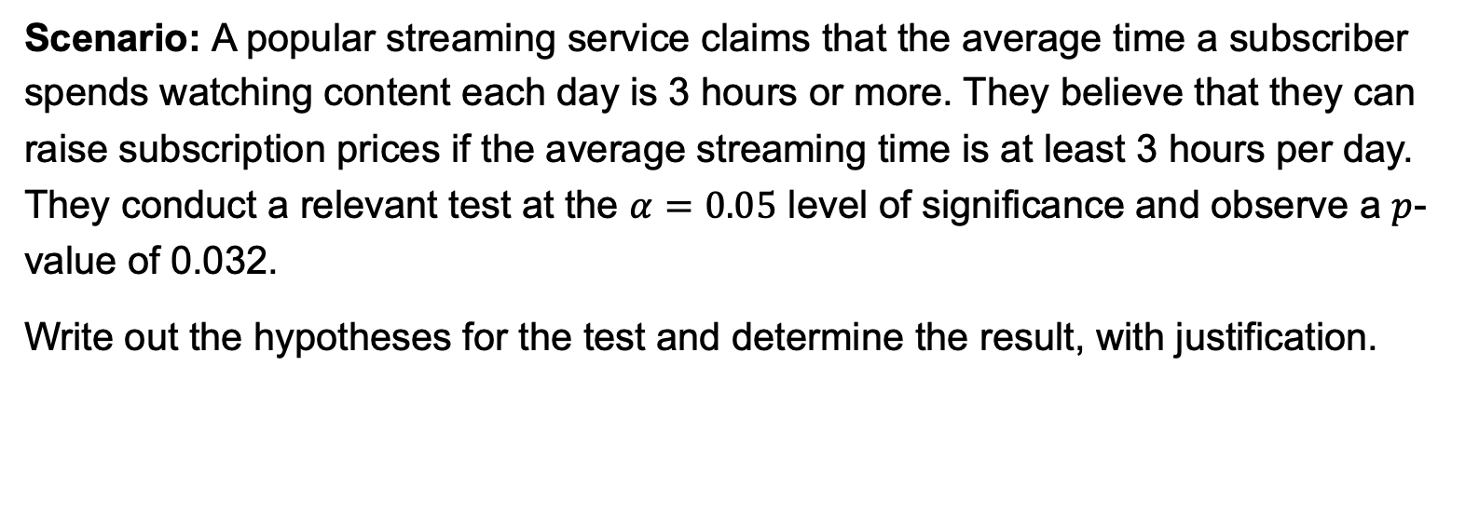
Example: Streaming Platform Usage
Scenario: A popular streaming service claims that the average time a subscriber spends watching content each day is 3 hours or more. They believe that they can raise subscription prices if the average streaming time is at least 3 hours per day. They conduct a relevant test at the $α=0.05$ level of significance and observe a $p$-value of 0.032.
Write out the hypotheses for the test and determine the result, with justification.

Slide 12
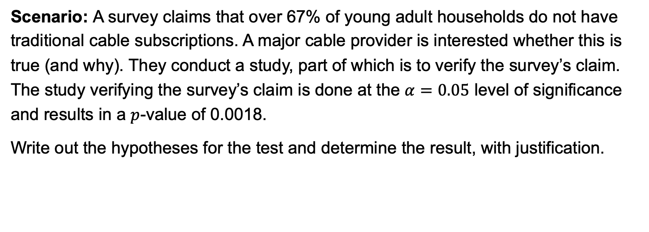
Example: Streaming Service Subscriptions
Scenario: A survey claims that over 67% of young adult households do not have traditional cable subscriptions. A major cable provider is interested whether this is true (and why). They conduct a study, part of which is to verify the survey’s claim. The study verifying the survey’s claim is done at the $α=0.05$ level of significance and results in a $p$-value of 0.0018.
Write out the hypotheses for the test and determine the result, with justification.

Slide 13
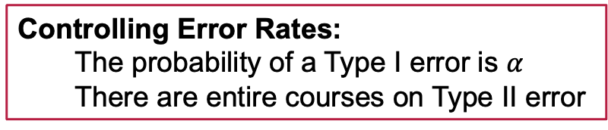
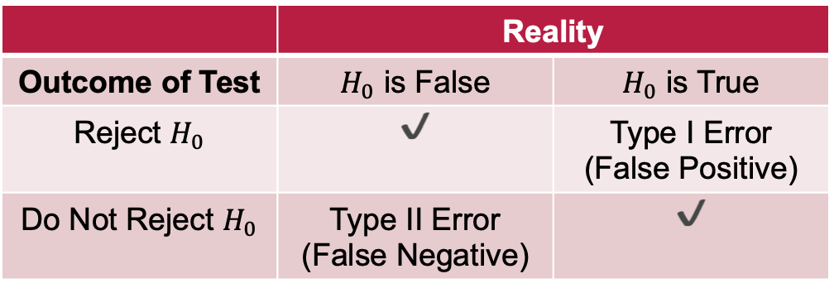
Errors in Statistical Inference
Controlling Error Rates:
The probability of a Type I error is $α$
There are entire courses on Type II error
In using statistical inference, there is no guarantee that the conclusions we arrive at are correct
We are dealing with imperfect information, resulting from random sampling and noisy data
The Null Hypothesis Significance Testing (NHST) methods we are utilizing result in one of four scenarios:
 | Reality
Outcome of Test | $H_{0}$ is False | $H_{0}$ is True
Reject $H_{0}$ | ✔️ | Type I Error (False Positive)
Do Not Reject $H_{0}$ | Type II Error (False Negative) | ✔️

Slide 14
Example: Manufacturing
Scenario: A company makes custom bolts that are used in a specialized manufacturing process. The bolts produced in the process are not perfectly identical – there is some slight variation in the length of a completed bolt. Bolts that are more than 1.5mm too long or too short cannot be used in the manufacturing process and must be discarded. Engineers have determined that as long as the average length of a produced bolt is 3.25”, then nearly all bolts are compliant. After receiving complaints, the company wonders whether the average length of a manufactured bolt is no longer 3.25”.
Write the hypotheses involved in a test of average bolt length. Discuss what a Type I error is in this context, as well as what a Type II error is. What are the consequences of each, and which one is more severe?

Slide 15
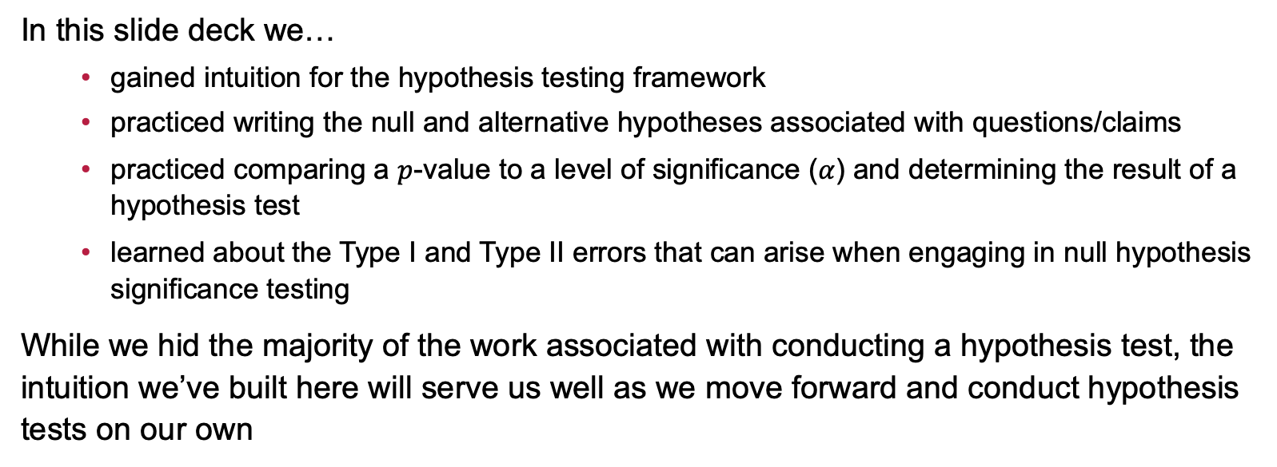
Summary
In this slide deck we…
gained intuition for the hypothesis testing framework
practiced writing the null and alternative hypotheses associated with questions/claims
practiced comparing a $p$-value to a level of significance ($α$) and determining the result of a hypothesis test
learned about the Type I and Type II errors that can arise when engaging in null hypothesis significance testing
While we hid the majority of the work associated with conducting a hypothesis test, the intuition we’ve built here will serve us well as we move forward and conduct hypothesis tests on our own

Slide 16
Next Time…
What we’ll be doing…
Hypothesis Tests for a Single Population Mean
How to prepare…
Read sections 8.4 and 8.5 in our textbook
Homework: Start HW 7 (Hypothesis Tests for Parameters of a Single Population) on MyOpenMath

