Slide 1
Descriptive Statistics: Summary Statistics and Data Visualizations
Investigating the data we have

Slide 2
Variable Types, Revisited
Categorical Variables
Numerical Variables
Group observations into categories
Nominal – named categories (colors)
Ordinal – ordered categories (military rank)
Variables for which taking an average is meaningful
Interval – differences are meaningful, but ratios are not; no minimum or “starting” value (temperatures)
Ratio – ratios are meaningful (heights)

Slide 3
Describing Categorical Data
Numerical Summaries
Visualizations
Frequency tables
Frequency (counts)
Relative frequency (proportions)
Bar plots
Frequency polygons
Waffle charts
Pie and Donut charts (try to avoid these)

Slide 4
Try It!
Answer the following questions using our credit risk data set, and interpret the results
Determine which variables are categorical and which ones are numeric
Are there any that are neither? Is such a thing possible?
Use a pivot table to calculate the frequencies for the person_home_ownership variable
Add a column to the end of the pivot table, computing relative frequencies
In the same tab as your frequency table, use the Insert menu on the ribbon and insert a bar graph for the person_home_ownership variable
Explore additional/alternative plot types
Investigate at least one other categorical variable by building a frequency table, relative frequency table, and appropriate plot

Slide 5
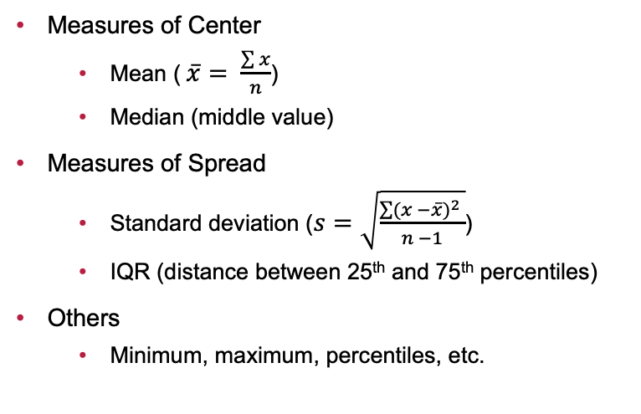
Describing Numerical Data
Numerical Summaries
Visualizations
Measures of Center
Mean ($\overline{x}= \frac{\sum{x}}{n}$)
Median (middle value)
Measures of Spread
Standard deviation ($s=\sqrt{\frac{\sum{{(x −\overline{x})}^{2} }}{n −1}}$)
IQR (distance between 25th and 75th percentiles)
Others
Minimum, maximum, percentiles, etc.
Histograms
Density plots
Boxplots

Slide 6
Try It!
Answer the following questions using our credit risk data set, and interpret the results
In a new DescriptiveStatistics sheet, calculate each of the following for the loan_amnt variable
Minimum, 25th percentile, mean, median, 75th percentile, maximum, standard deviation and interquartile range
Use the Insert menu on the ribbon to insert a histogram for the loan_amnt variable
Explore additional/alternative plot types
Investigate at least one other categorical variable by calculating the summary statistics listed above and building at least one appropriate plot

Slide 7
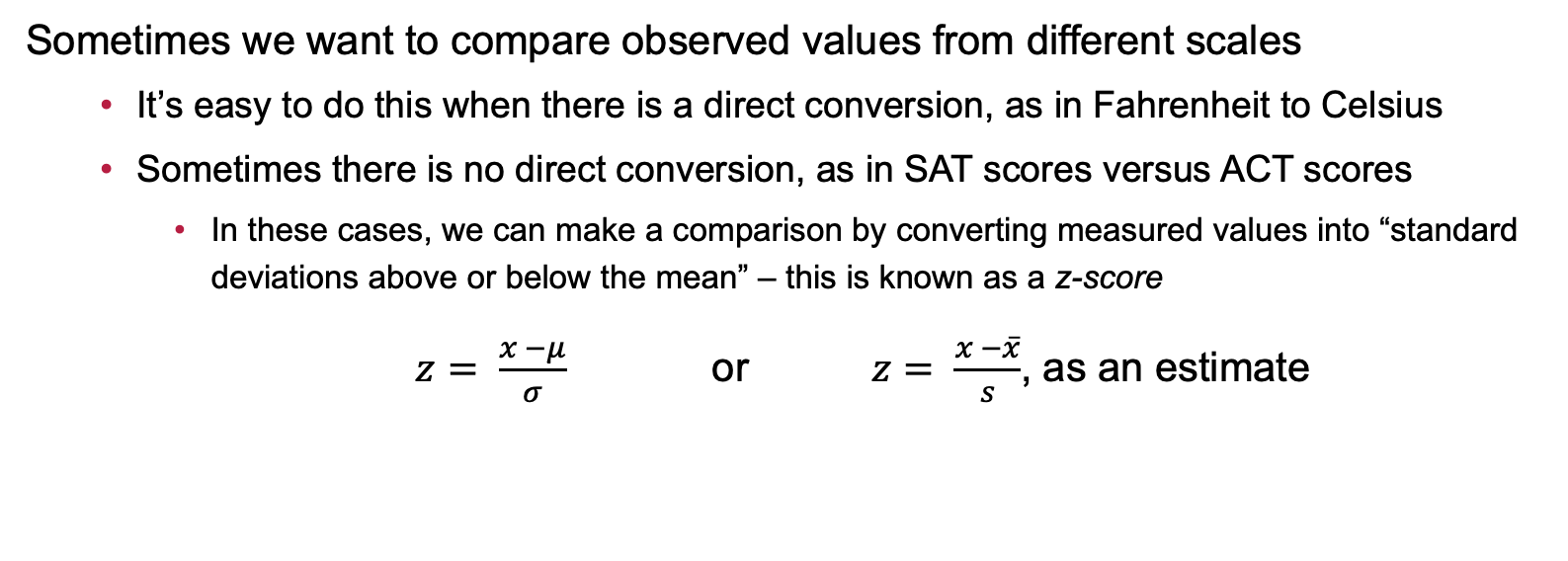
Additional Comments About Numerical Variables: Standard Deviations and z-scores
Sometimes we want to compare observed values from different scales
It’s easy to do this when there is a direct conversion, as in Fahrenheit to Celsius
Sometimes there is no direct conversion, as in SAT scores versus ACT scores
In these cases, we can make a comparison by converting measured values into “standard deviations above or below the mean” – this is known as a z-score
$z= \frac{x −μ}{σ}$ or $z= \frac{x −\overline{x}}{s}$, as an estimate

Slide 8
An Example
Scenario: Assume that the distribution of SAT scores has a mean of 1050 with a standard deviation of 210, while the distribution of ACT scores has a mean of 19.4 with a standard deviation of 5.8. Sam scored a 1210 on the SAT and Charlie scored a 24.6 on the ACT. Who scored relatively better?

Slide 9
Additional Comments About Numerical Data: Skew in Distributions
Numerical data can be symmetric or skewed
Symmetric
Numerically: the mean and the median agree (they are nearly equal)
Graphically: the histogram (or density, etc.) have nearly identical “tails” to the left and right of the center
Right-skewed
Numerically: the mean is larger than the median
Graphically: the distribution has a stretched out right tail (may have large outliers)
Left-skewed
Numerically: the mean is smaller than the median
Graphically: the distribution has a stretched out left tail (may have small outliers)

Slide 10
Working with Skewed Data
When data are skewed…
The mean is no longer an appropriate measure of center
We should use the median instead because the median is robust against outliers
The standard deviation is no longer an appropriate measure of spread
We should use the interquartile range (the distance between the 25th percentile and 75th percentile) instead because the IQR is robust against outliers

Slide 11
Multivariable Investigations: Summary Statistics and Visualizations
We are often interested in the potential for associations between pairs of variables
Categorical and Categorical
Numerical summaries: frequencies and relative frequencies
Visualizations: bar plots with fill color (stacked bars)
Numerical and Categorical
Numerical summaries: grouped means, grouped medians, etc.
Visualizations: side-by-side boxplots, overlayed densities, etc.
Numerical and Numerical
Numerical summaries: correlation
Visualizations: scatterplots

Slide 12
Try It!
Answer the following questions using our credit risk data set, and interpret the results
Create a pivot table to calculate frequencies for the combination of loan_intent and loan_grade
Add a column, computing relative frequencies within each loan_intent category
Build a stacked bar graph to visualize the results
Create a pivot table to calculate relevant numerical summary statistics for loan_interest_rate by loan_intent category
Build a set of side-by-side boxplots to visualize the results
Calculate the correlation between loan_interest_rate and loan_amnt
Build a scatterplot to visualize the association (or lack thereof)

Slide 13
Next Time…
What we’ll be doing…
Discrete Random Variables and Probability
How to prepare…
Read sections 3.1 – 3.3, and 4.1, 4.2, and 4.4 of our textbook
Homework: Complete Homework 2 (Summary Statistics and Data Visualizations) on MyOpenMath

