Slide 1
Discrete Probability and the Binomial Distribution
An introduction to probability and probabilistic thinking

Slide 2
Discrete versus Continuous Random Variables
Discrete Random Variables
Continuous Random Variables
Have outcomes that can be counted
Number of times heads comes up on a coin flip out of 10 total flips
Number of cars arriving at a parking garage in one hour
Number of participants falling within a category
Have [theoretically] infinitely many outcomes
Temperatures
Commute times

Slide 3
Terminology for Probability
An experiment is an action whose outcome is uncertain
An outcome is the result of an experiment
The sample space is the set of all outcomes of an experiment
An event is a, perhaps complex, outcome of an experiment (perhaps a combination of outcomes)

Slide 4
Approaches to Probability
Classical / Frequentist approach
The probability of an event is the relative frequency of the event when the experiment is conducted for a very large number of trials
Empirical approach
The probability of an event is the number of times the event has been observed, divided by the number of times the experiment has been run
Subjective / Belief-based approach
The probability of an event is our educated belief that the event may occur (for example, the believe that our favorite sports team will win a championship this year)

Slide 5
Estimating Probabilities: Example Scenarios
Determine each of the following (if possible) or describe the information you would need / use to do so…
Scenario 1: What is the probability that a coin flip results in “heads”?
Scenario 2: What is the probability that a manufactured item produced along this assembly line is defective?
Scenario 2: What is the probability that a baby is born an anatomical female?
Scenario 3: What is the probability that a 6 or lower is flipped next at this Blackjack table?

Slide 6
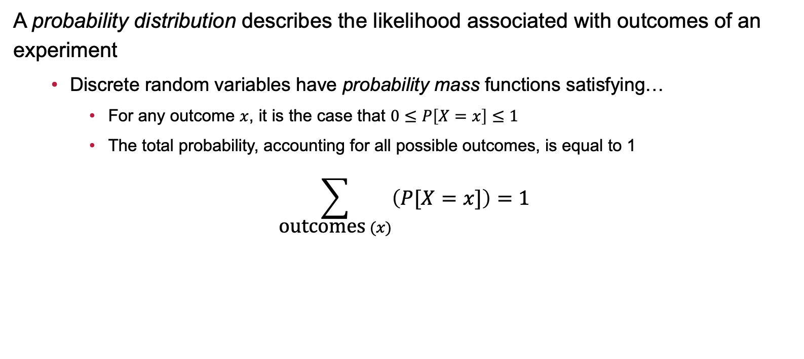
Probability Distributions: Probability Mass
A probability distribution describes the likelihood associated with outcomes of an experiment
Discrete random variables have probability mass functions satisfying…
For any outcome $x$, it is the case that $0≤P\left[X=x\right]≤1$
The total probability, accounting for all possible outcomes, is equal to 1
$$\sum_{\text{outcomes} (x)}{\left(P[X=x]\right)=1}$$

Slide 7
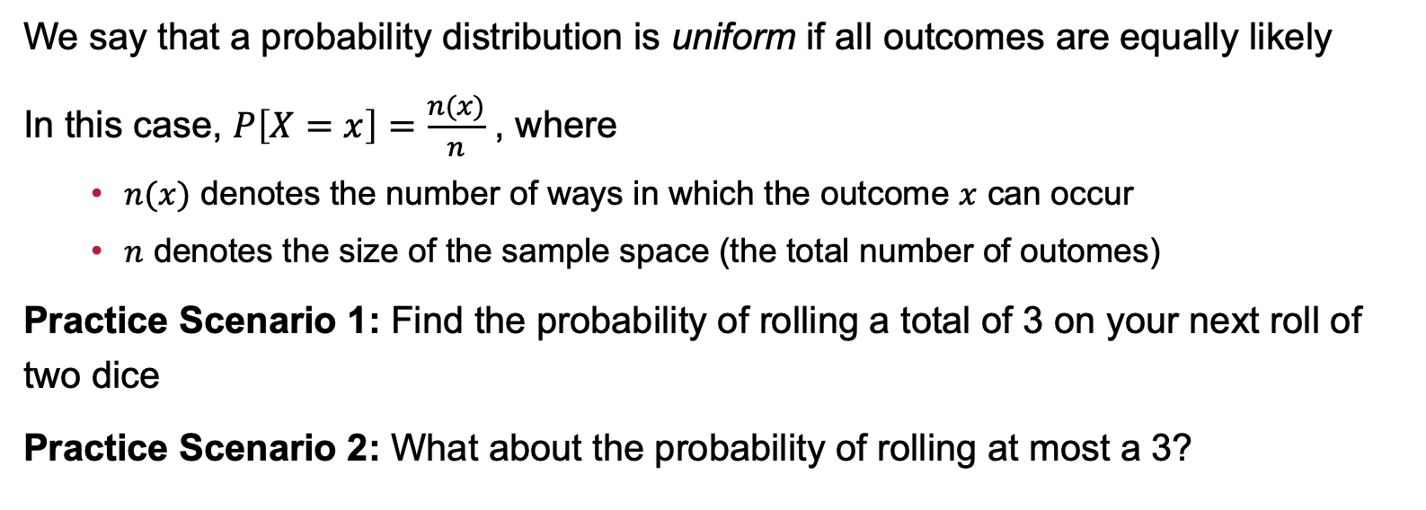
Uniform Probability and Calculations
We say that a probability distribution is uniform if all outcomes are equally likely
In this case, $P\left[X=x\right]=\frac{n(x)}{n}$ , where
$n(x)$ denotes the number of ways in which the outcome $x$ can occur
$n$ denotes the size of the sample space (the total number of outomes)
Practice Scenario 1: Find the probability of rolling a total of 3 on your next roll of two dice
Practice Scenario 2: What about the probability of rolling at most a 3?

Slide 8
Contingency Tables and Probability
A contingency table lists the number of outcomes falling within categories
For example,
 | Number of Clubs
Hours Worked Per Week |  | None | One | Multiple | Total
 | None | 171 | 239 | 175 | 585
 | < 10 | 328 | 481 | 369 | 1178
 | 10 - 20 | 323 | 17 | 371 | 711
 | 20 + | 87 | 118 | 90 | 295
 | TOTAL | 909 | 855 | 1005 | 2769

Slide 9
Working with a Contingency Table
 | Number of Clubs
Hours Worked Per Week |  | None | One | Multiple | Total
 | None | 171 | 239 | 175 | 585
 | < 10 | 328 | 481 | 369 | 1178
 | 10 - 20 | 323 | 17 | 371 | 711
 | 20 + | 87 | 118 | 90 | 295
 | TOTAL | 909 | 855 | 1005 | 2769
P(20+ hours)
P(at most one club)
P(20+ hours and one club)
P(No clubs or No work)
P(multiple clubs given not working)
Are being involved in no clubs and working 20+ hours independent?
Find the probabilities associated with a randomly chosen individual from this sample satisfying the events on the right.

Slide 10
Before We Move Forward, Ask Me Two Questions…

Slide 11
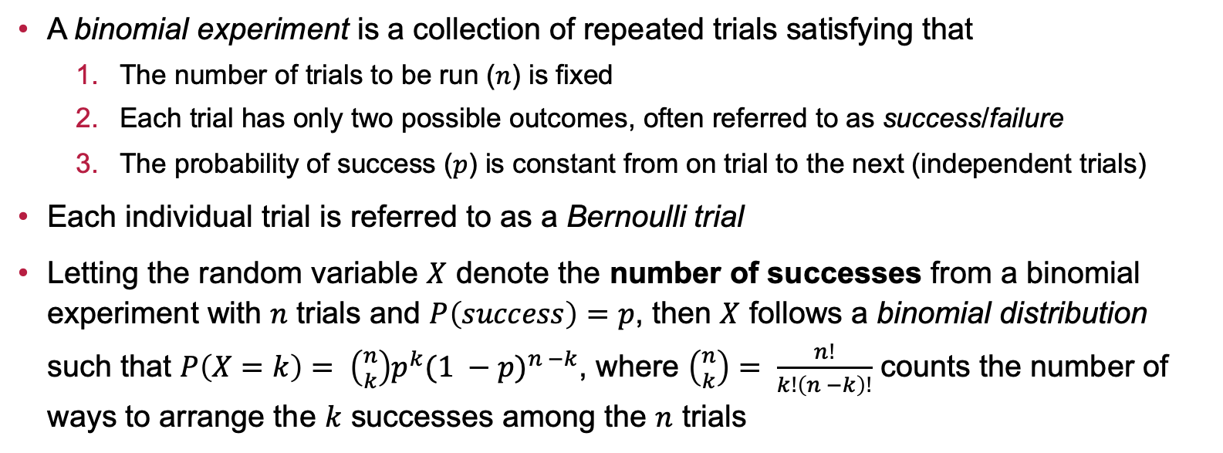
A Special Class of [non-Uniform] Discrete Distributions: The Binomial Distribution
A binomial experiment is a collection of repeated trials satisfying that
The number of trials to be run ($n$) is fixed
Each trial has only two possible outcomes, often referred to as success/failure
The probability of success ($p$) is constant from on trial to the next (independent trials)
Each individual trial is referred to as a Bernoulli trial
Letting the random variable $X$ denote the number of successes from a binomial experiment with $n$ trials and $P\left(success\right)=p$, then $X$ follows a binomial distribution such that $P\left(X=k\right)= \left({n \atop k}\right)p^{k}{(1 −p)}^{n −k}$, where $\left({n \atop k}\right)= \frac{n!}{k!\left(n −k\right)!}$ counts the number of ways to arrange the $k$ successes among the $n$ trials

Slide 12
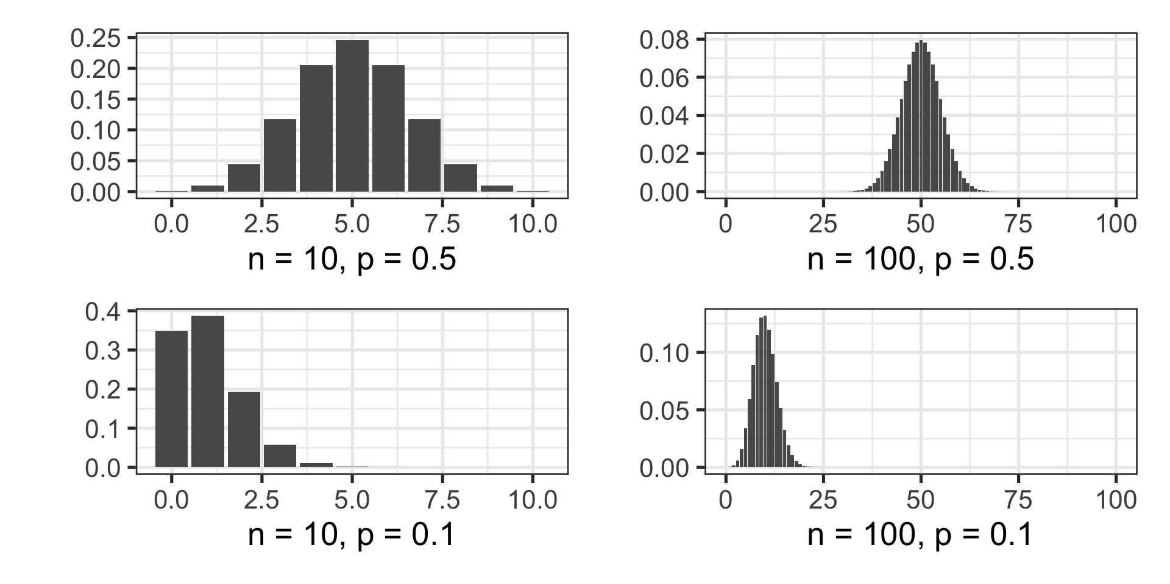
Examples of Binomial Distributions

Slide 13
Identifying Binomial Experiments
Which of the following scenarios correspond to binomial experiments? Why?
It is estimated that 77% of people have been in at least one car accident in their lives. Researchers asked 48 randomly selected individuals whether they have ever been in a car accident.
A researcher surveys students one by one, asking if they agree with a policy. The researcher continues until exactly 50 students say they agree with the policy.
You are measuring the time until a machine fails. Each machine’s lifespan is recorded, but failures occur at unpredictable times based on complex factors such as wear and tear.
A factory has a defect rate of 3% in the products it manufactures. Inspectors randomly select and evaluate 100 products.

Slide 14
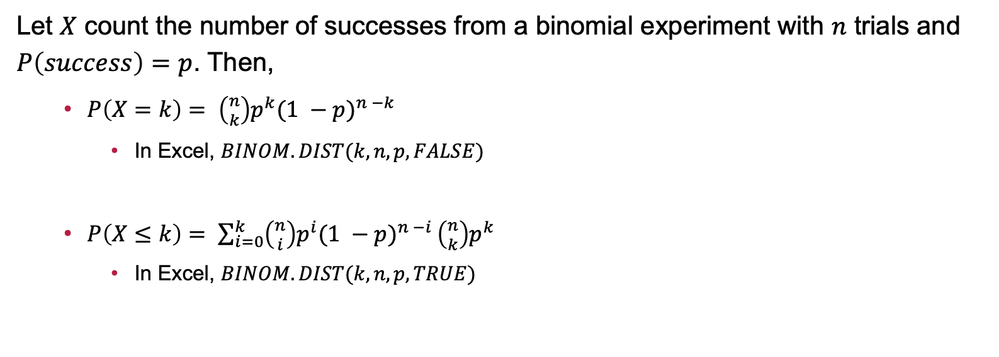
Calculating Probabilities with the Binomial Distribution
Let $X$ count the number of successes from a binomial experiment with $n$ trials and $P\left(success\right)=p$. Then,
$P\left(X=k\right)= \left({n \atop k}\right)p^{k}{(1 −p)}^{n −k}$
In Excel, $BINOM.DIST(k, n, p, FALSE)$
$P\left(X≤k\right)= \sum_{i=0}^{k}{\left({n \atop i}\right)p^{i}{(1 −p)}^{n −i}}\left({n \atop k}\right)p^{k}$
In Excel, $BINOM.DIST(k, n, p, TRUE)$

Slide 15
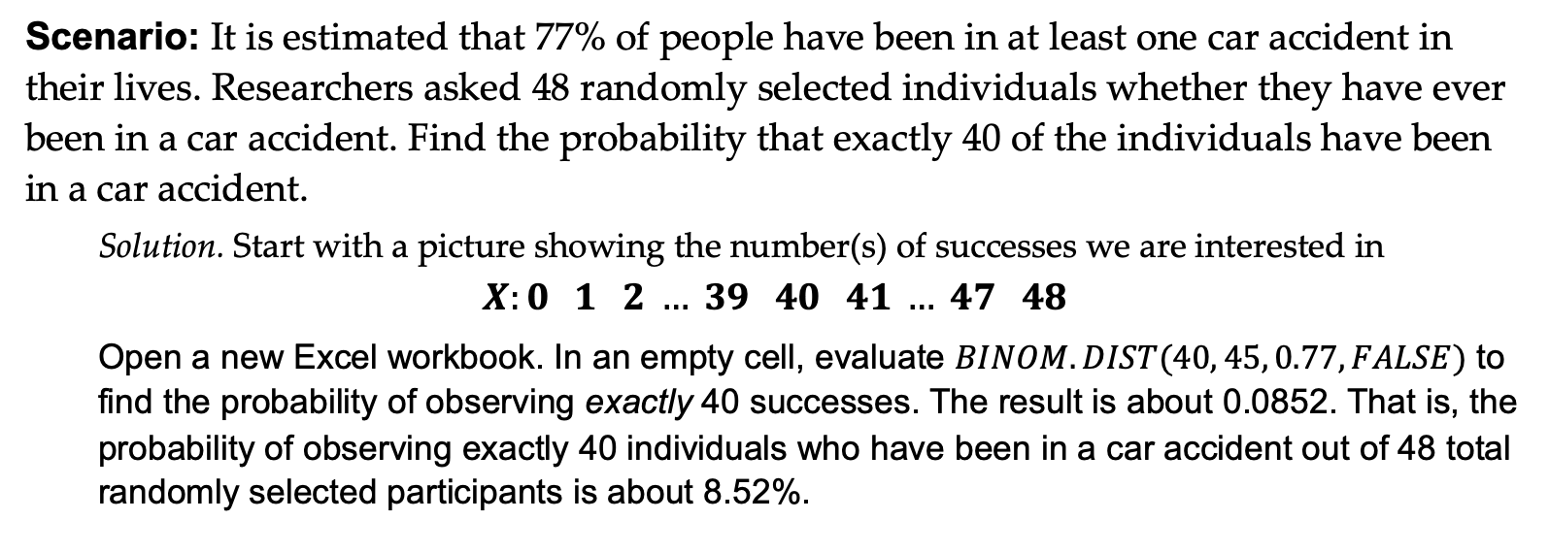
Completed Example: Car Accidents, Part I
Scenario: It is estimated that 77% of people have been in at least one car accident in their lives. Researchers asked 48 randomly selected individuals whether they have ever been in a car accident. Find the probability that exactly 40 of the individuals have been in a car accident.
Solution. Start with a picture showing the number(s) of successes we are interested in
$$X:0 1 2 … 39 40 41 … 47 48$$
Open a new Excel workbook. In an empty cell, evaluate $BINOM.DIST(40, 45, 0.77, FALSE)$ to find the probability of observing exactly 40 successes. The result is about 0.0852. That is, the probability of observing exactly 40 individuals who have been in a car accident out of 48 total randomly selected participants is about 8.52%.

Slide 16
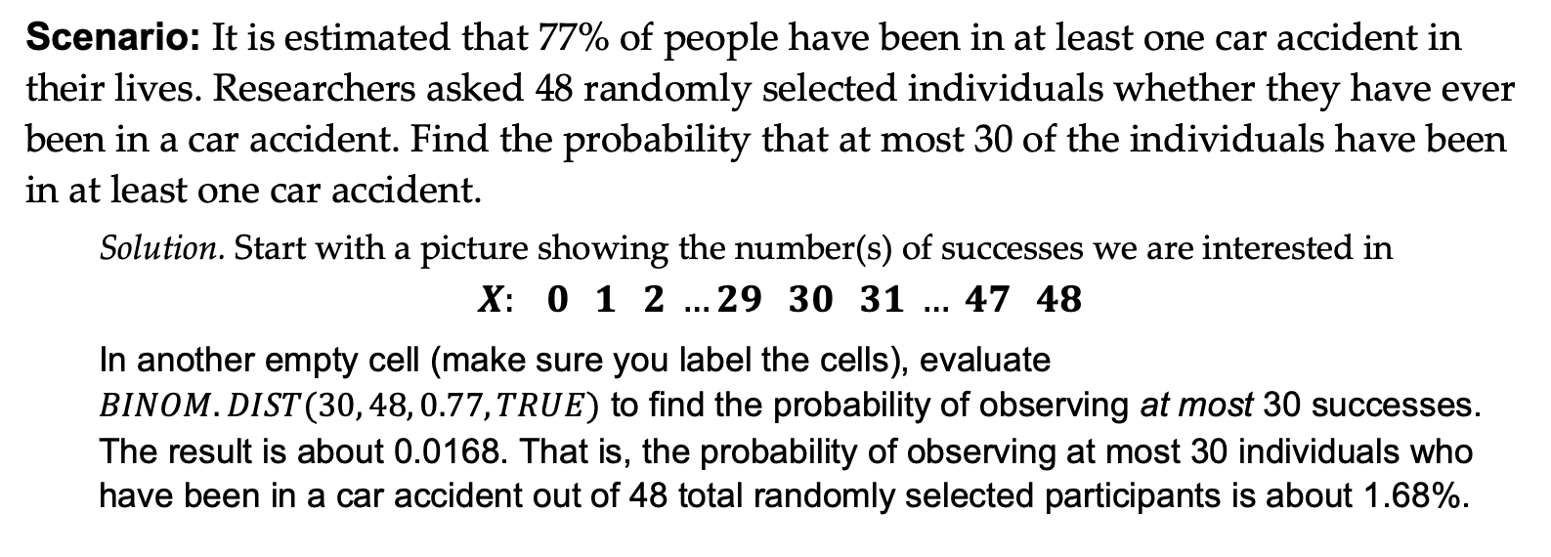
Completed Example: Car Accidents, Part II
Scenario: It is estimated that 77% of people have been in at least one car accident in their lives. Researchers asked 48 randomly selected individuals whether they have ever been in a car accident. Find the probability that at most 30 of the individuals have been in at least one car accident.
Solution. Start with a picture showing the number(s) of successes we are interested in
$$X: 0 1 2 …29 30 31 … 47 48$$
In another empty cell (make sure you label the cells), evaluate $BINOM.DIST(30, 48, 0.77, TRUE)$ to find the probability of observing at most 30 successes. The result is about 0.0168. That is, the probability of observing at most 30 individuals who have been in a car accident out of 48 total randomly selected participants is about 1.68%.

Slide 17
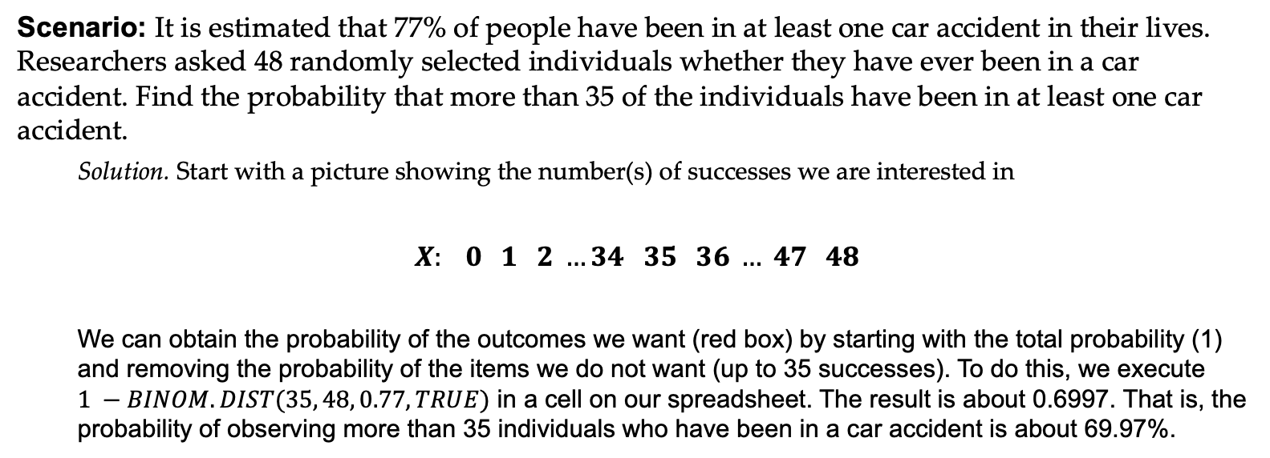
Completed Example: Car Accidents, Part III
Scenario: It is estimated that 77% of people have been in at least one car accident in their lives. Researchers asked 48 randomly selected individuals whether they have ever been in a car accident. Find the probability that more than 35 of the individuals have been in at least one car accident.
Solution. Start with a picture showing the number(s) of successes we are interested in
$$X: 0 1 2 …34 35 36 … 47 48$$
We can obtain the probability of the outcomes we want (red box) by starting with the total probability (1) and removing the probability of the items we do not want (up to 35 successes). To do this, we execute $1 −BINOM.DIST(35, 48, 0.77, TRUE)$ in a cell on our spreadsheet. The result is about 0.6997. That is, the probability of observing more than 35 individuals who have been in a car accident is about 69.97%.

Slide 18
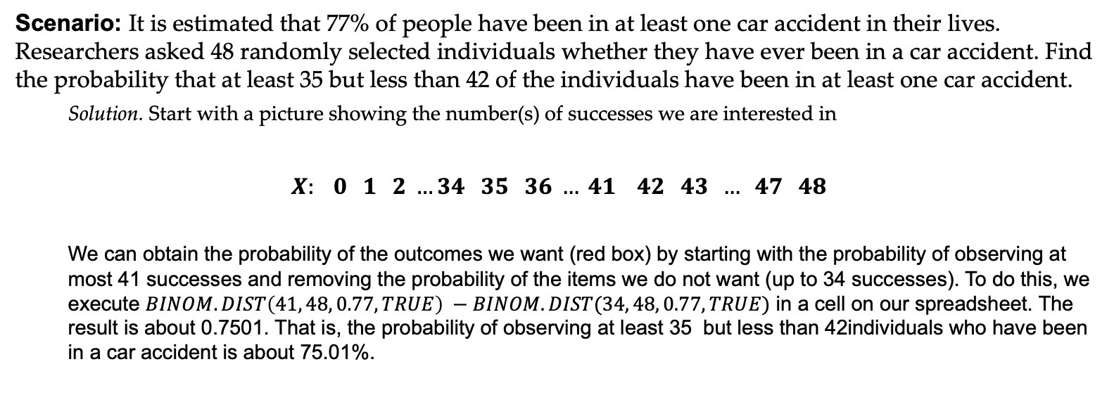
Completed Example: Car Accidents, Part IV
Scenario: It is estimated that 77% of people have been in at least one car accident in their lives. Researchers asked 48 randomly selected individuals whether they have ever been in a car accident. Find the probability that at least 35 but less than 42 of the individuals have been in at least one car accident.
Solution. Start with a picture showing the number(s) of successes we are interested in
$$X: 0 1 2 …34 35 36 … 41 42 43 … 47 48$$
We can obtain the probability of the outcomes we want (red box) by starting with the probability of observing at most 41 successes and removing the probability of the items we do not want (up to 34 successes). To do this, we execute $BINOM.DIST\left(41, 48, 0.77, TRUE\right) −BINOM.DIST(34, 48, 0.77, TRUE)$ in a cell on our spreadsheet. The result is about 0.7501. That is, the probability of observing at least 35 but less than 42individuals who have been in a car accident is about 75.01%.

Slide 19
Example: Defective Products
Scenario: A factory has a defect rate of 3% in the products it manufactures. Inspectors randomly select 100 products. Find the probability of
exactly 5 products having defects?
at most 5 products having defects?
at least 5 products having defects?

Slide 20
Example: Growing plants from seeds
Scenario: A botanist finds that a certain species of plant successfully grows 60% of the time under controlled greenhouse conditions. The botanist plants 25 seeds.
What is the probability that fewer than 20 of the seeds grow?
What is the probability that at least 17 and no more than 21 of the seeds grow?
What is the probability that more than 20 of the seeds grow?
Should the botanist be surprised if fewer than 13 of the seeds grow?

Slide 21
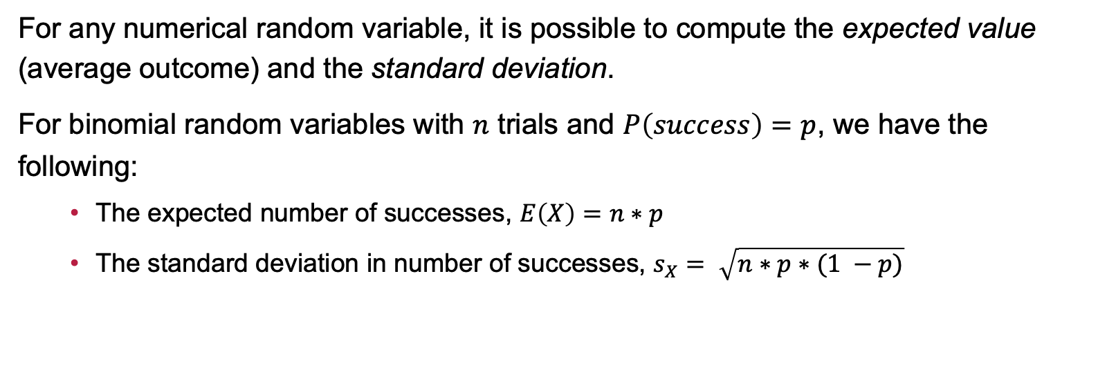
Expected Value and Standard Deviation
For any numerical random variable, it is possible to compute the expected value (average outcome) and the standard deviation.
For binomial random variables with $n$ trials and $P\left(success\right)=p$, we have the following:
The expected number of successes, $E\left(X\right)=n∗p$
The standard deviation in number of successes, $s_{X}= \sqrt{n∗p∗(1 −p)}$

Slide 22
Example: Growing plants from seeds (Revisited)
Scenario: A botanist finds that a certain species of plant successfully grows 60% of the time under controlled greenhouse conditions. The botanist plants 25 seeds.
Find the expected number of seeds to grow
Find the standard deviation in the number of seeds to grow
Does this change, weaken, strengthen, or confirm your response to whether or not the botanist should be surprised if fewer than 13 of the seeds grow?

Slide 23
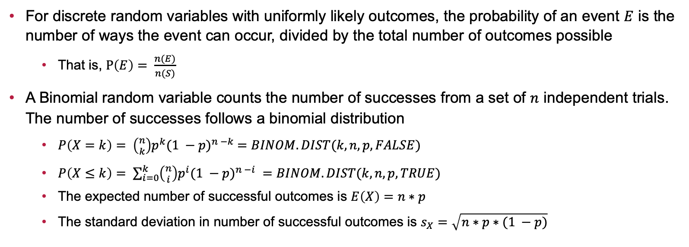
Summary
For discrete random variables with uniformly likely outcomes, the probability of an event $E$ is the number of ways the event can occur, divided by the total number of outcomes possible
That is, $P\left(E\right)= \frac{n(E)}{n(S)}$
A Binomial random variable counts the number of successes from a set of $n$ independent trials. The number of successes follows a binomial distribution
$P\left(X=k\right)= \left({n \atop k}\right)p^{k}{(1 −p)}^{n −k} =BINOM.DIST(k, n, p, FALSE)$
$P\left(X≤k\right)= \sum_{i=0}^{k}{\left({n \atop i}\right)p^{i}{(1 −p)}^{n −i}} =BINOM.DIST(k, n, p, TRUE)$
The expected number of successful outcomes is $E\left(X\right)=n∗p$
The standard deviation in number of successful outcomes is $s_{X}=\sqrt{n∗p∗(1 −p)}$

Slide 24
Next Time…
What we’ll be doing…
Continuous Random Variables and the Normal Distribution
How to prepare…
Read sections 5.1 – 5.5 of our textbook
Homework: Complete Homework 3 (Discrete Probability and the Binomial Distribution) on MyOpenMath

