Slide 1
Continuous Probability and the Normal Distribution

Slide 2
Discrete versus Continuous Random Variables
Discrete Random Variables
Continuous Random Variables
Have outcomes that can be counted
Number of times heads comes up on a coin flip out of 10 total flips
Number of cars arriving at a parking garage in one hour
Number of participants falling within a category
Have [theoretically] infinitely many outcomes
Temperatures
Commute times

Slide 3
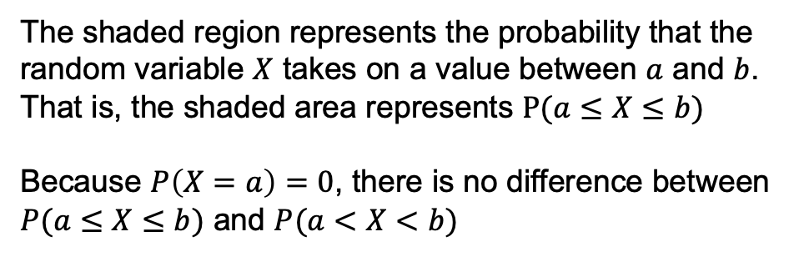
Continuous Random Variables and Probability Densities
Continuous random variables can take on infinitely many values
Because of this, the probability of observing exactly one specified outcome is 0
Continuous random variables have probability distributions defined by densities rather than masses
The shaded region represents the probability that the random variable $X$ takes on a value between $a$ and $b$. That is, the shaded area represents $P(a≤X≤b)$
Because $P\left(X=a\right)=0$, there is no difference between $P(a≤X≤b)$ and $P(a<X<b)$
a
b
X

Slide 4
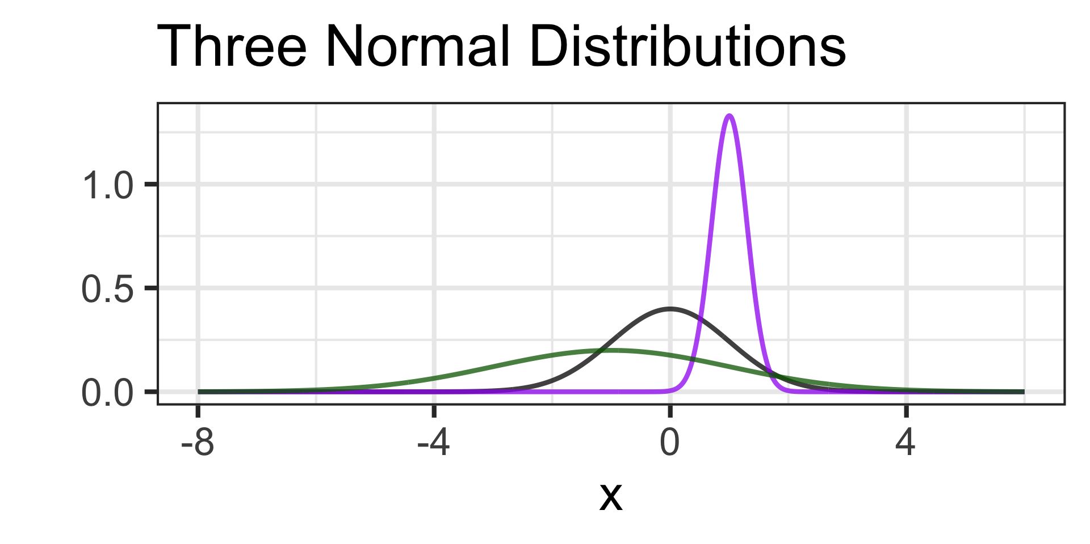

The Normal Distribution(s)
The normal distribution is a symmetric, bell-shaped distribution defined by its mean $μ$ and standard deviation $σ$
If a continuous random variable $X$ is normally distributed with mean $μ$ and standard deviation $σ$, we write $X \sim N(μ, σ)$

Slide 5

The Normal Distribution(s)
The purple distribution has mean $μ=1$ and standard deviation $σ=0.5$
The black distribution has mean $μ=0$ and standard deviation $σ=1$
The green distribution has mean $μ=−1$ and standard deviation $σ=2$

Slide 6

The Normal Distribution(s)
The black distribution with mean $μ=0$ and standard deviation $σ=1$ is often called the Standard Normal Distribution
It is common to refer to a standard normal variable as $z$ and say
$$z \sim N(μ=0, σ=1)$$

Slide 7
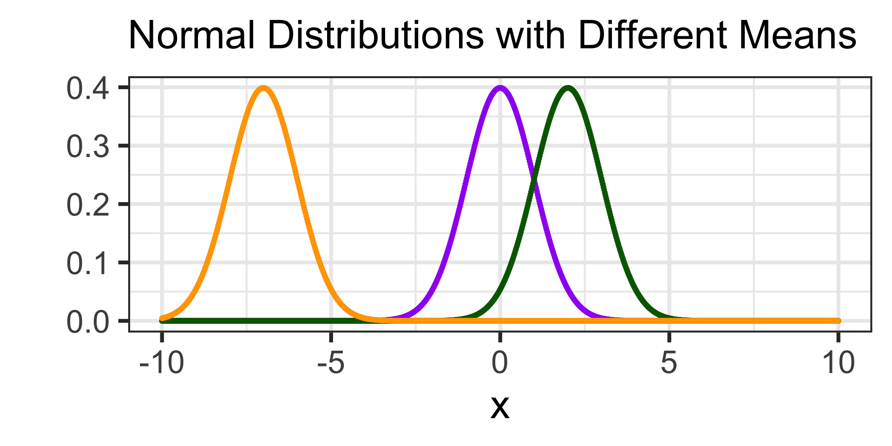
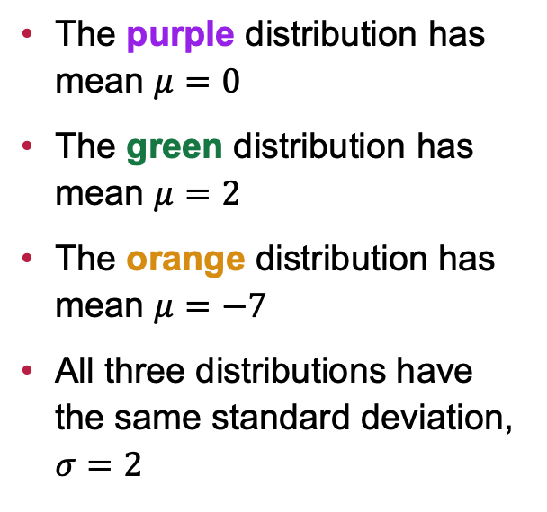
The Center of a Normal Distribution
The purple distribution has mean $μ=0$
The green distribution has mean $μ=2$
The orange distribution has mean $μ=−7$
All three distributions have the same standard deviation, $σ=2$

Slide 8
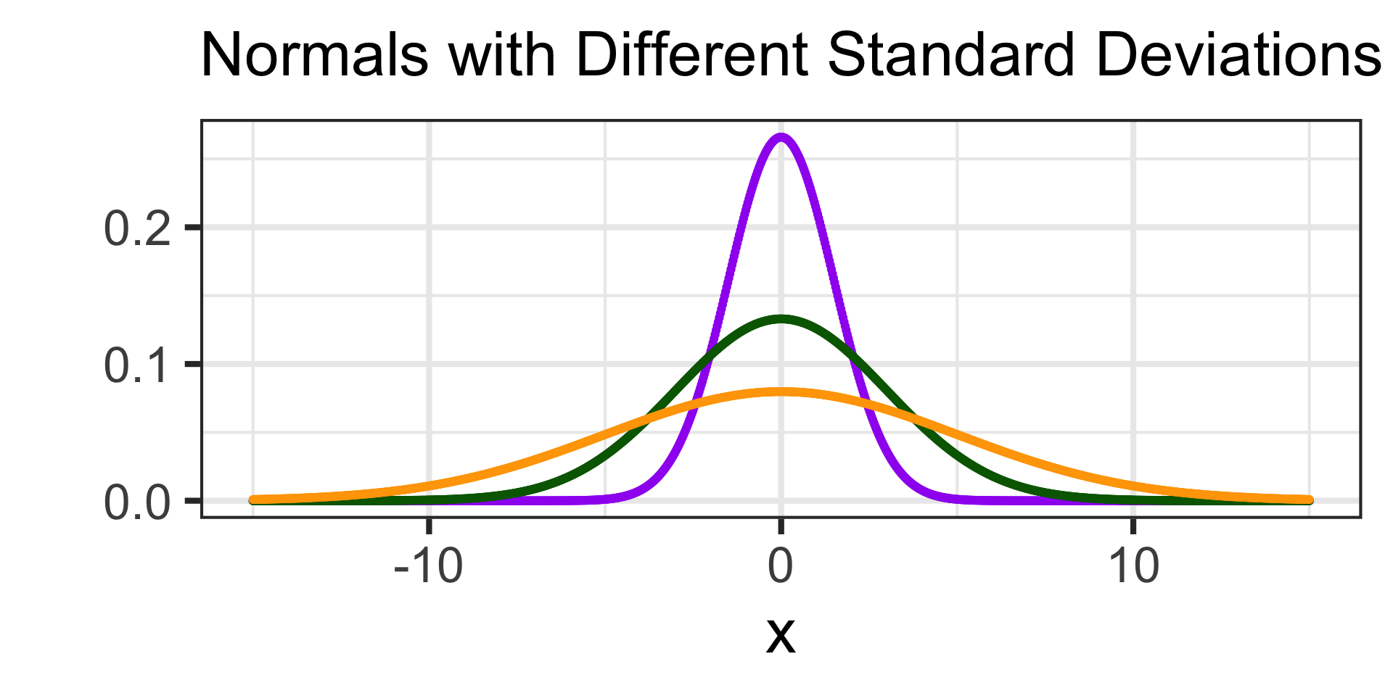

The Spread of a Normal Distribution
All three distributions have mean $μ=0$
The purple distribution has standard deviation $σ=1.5$
The green distribution has standard deviation $σ=3$
The orange distribution has standard deviation $σ=5$

Slide 9
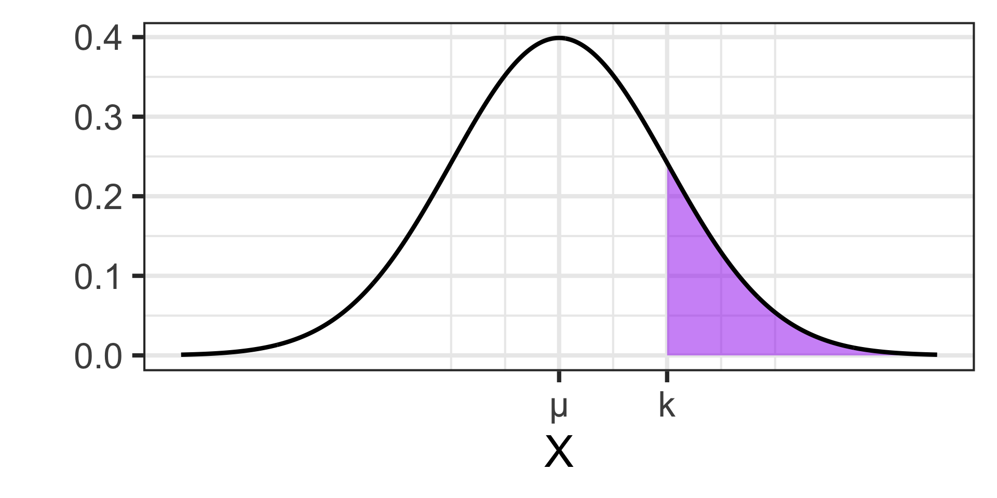
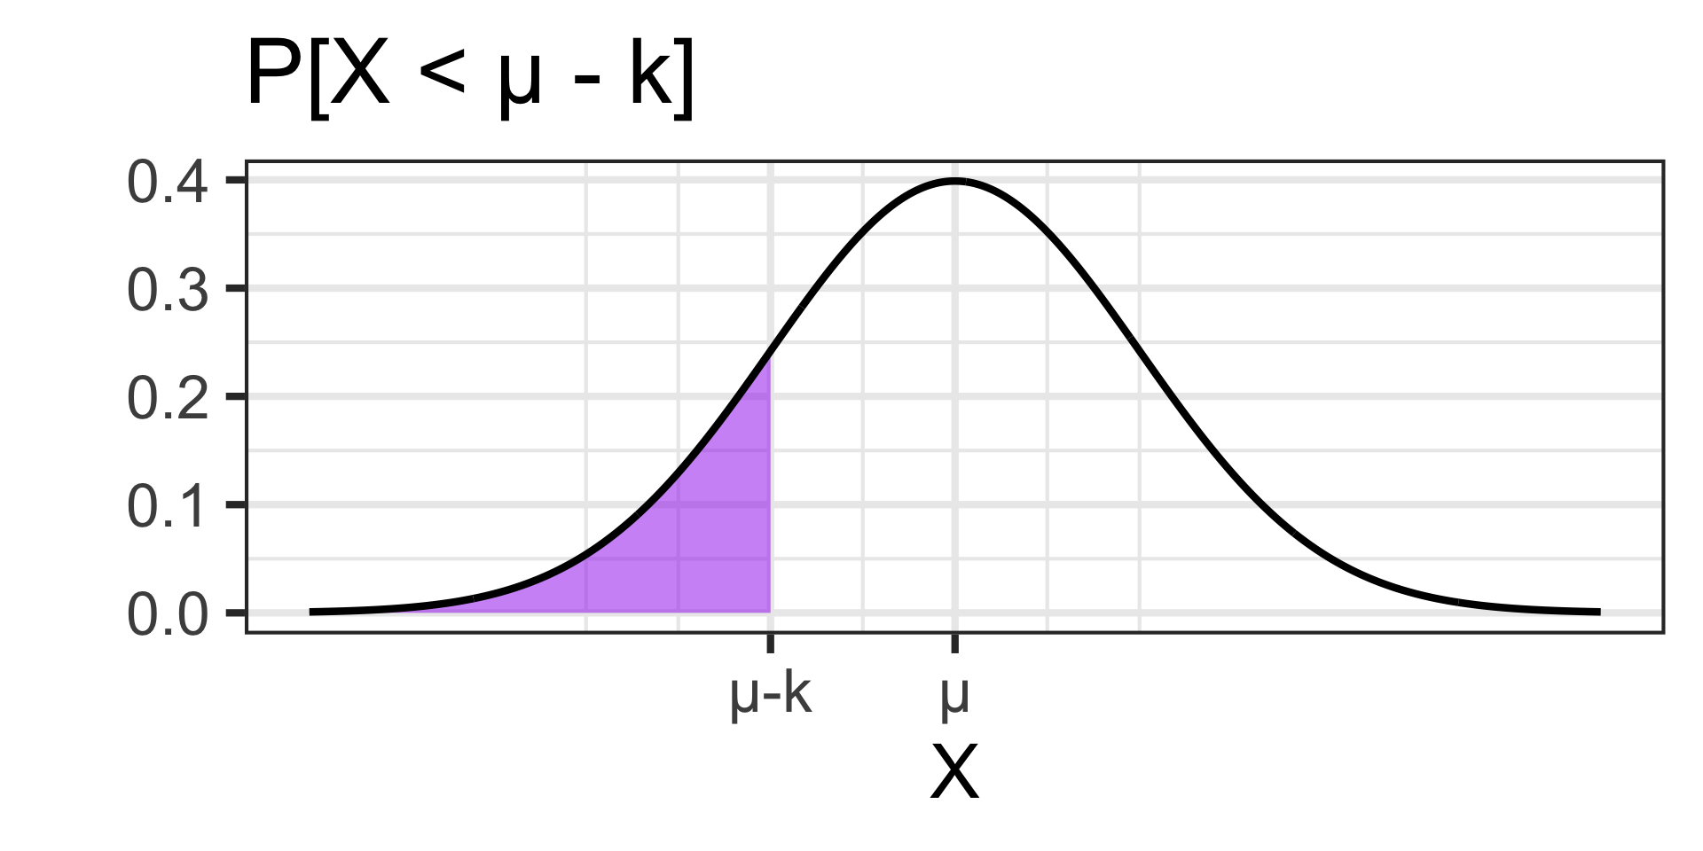
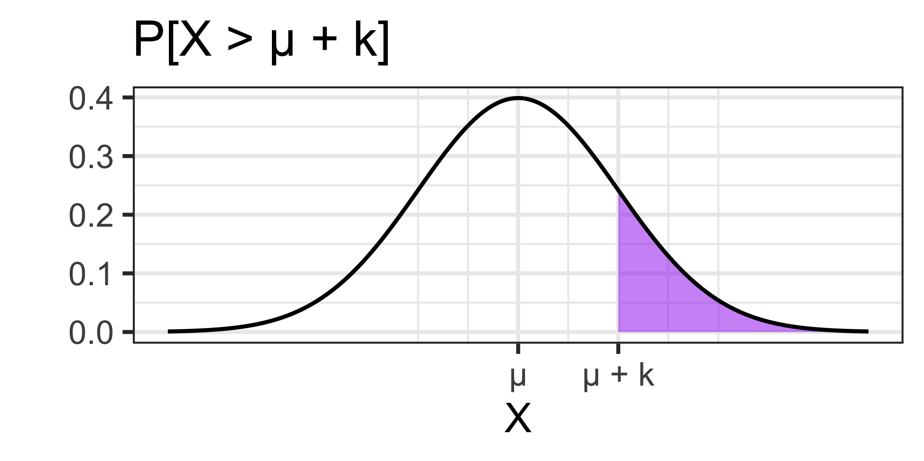
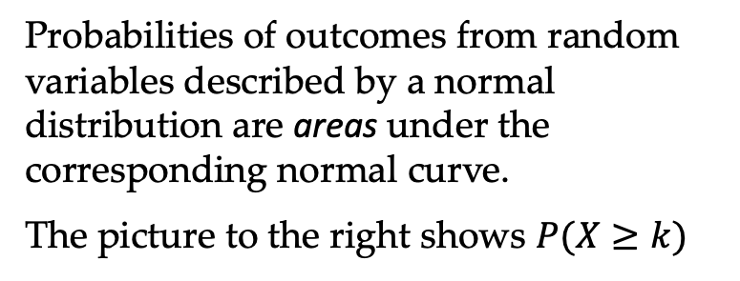
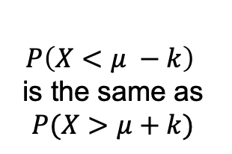
Probabilities and the Normal Distribution
Probabilities of outcomes from random variables described by a normal distribution are areas under the corresponding normal curve.
The picture to the right shows $P(X≥k)$
Note: It is also worth knowing that the Normal Distribution is symmetric
$$P\left(X<μ −k\right)$$
is the same as
$$P(X>μ+k)$$

Slide 10
Normal, Binomial, or Neither
Determine, if possible, which of the following scenarios are well-modeled by a normal distribution, binomial distribution, or neither
Scenario 1: The time it takes runners to complete a marathon is approximately normally distributed with a mean of 4.5 hours and a standard deviation of 0.75 hours.
Scenario 2: You roll a fair six-sided die repeatedly until a six appears, and you want to know how many rolls it takes.
Scenario 3: A factory has a 2% defect rate. Each day, 200 items are produced, and the number of defective items is counted.
Scenario 4: The lifespan of a certain smartphone battery is approximately normally distributed with a mean of 18 months and a standard deviation of 3 months.
Scenario 5: The number of cars passing through a toll booth in a 10-minute period is recorded. On average, 50 cars pass through every 10 minutes.

Slide 11
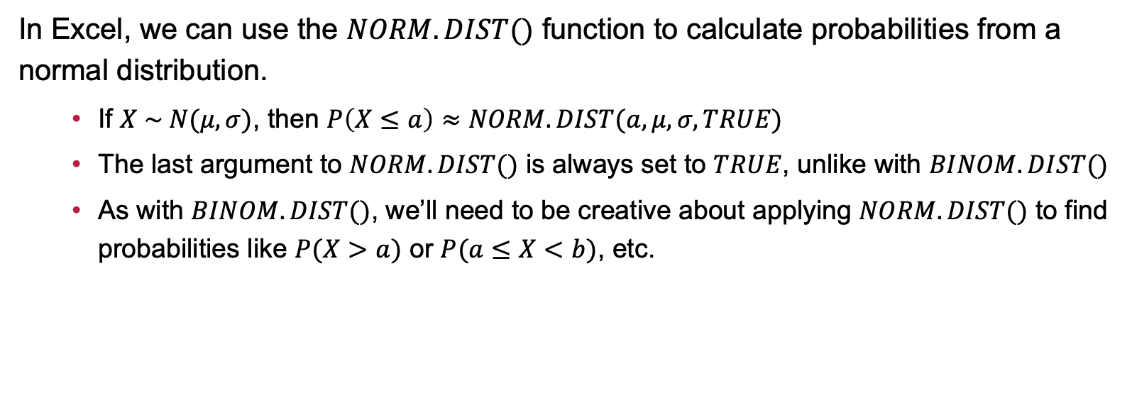
Finding Probabilities Using a Normal Distribution
In Excel, we can use the $NORM.DIST()$ function to calculate probabilities from a normal distribution.
If $X \sim N(μ, σ)$, then $P\left(X≤a\right)≈NORM.DIST(a, μ, σ, TRUE)$
The last argument to $NORM.DIST()$ is always set to $TRUE$, unlike with $BINOM.DIST()$
As with $BINOM.DIST()$, we’ll need to be creative about applying $NORM.DIST()$ to find probabilities like $P(X>a)$ or $P(a≤X<b)$, etc.

Slide 12
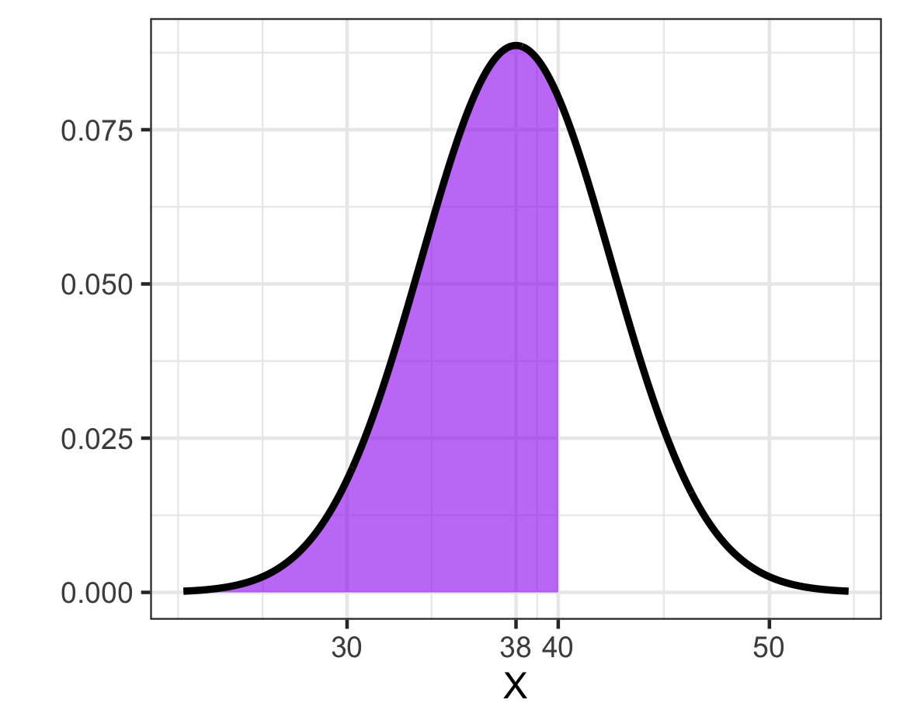

Calculating Probability: A Completed Example, Part I
Scenario: Assume that we have $X \sim N(μ=38, σ=4.5)$. Evaluate $P(X<40)$.
Solution. Start with a picture…
Since we want the area to the left of 40, we can use $NORM.DIST()$ directly
$$NORM.DIST\left(40, 38, 4.5, TRUE\right)$$
$≈0.6716$

Slide 13
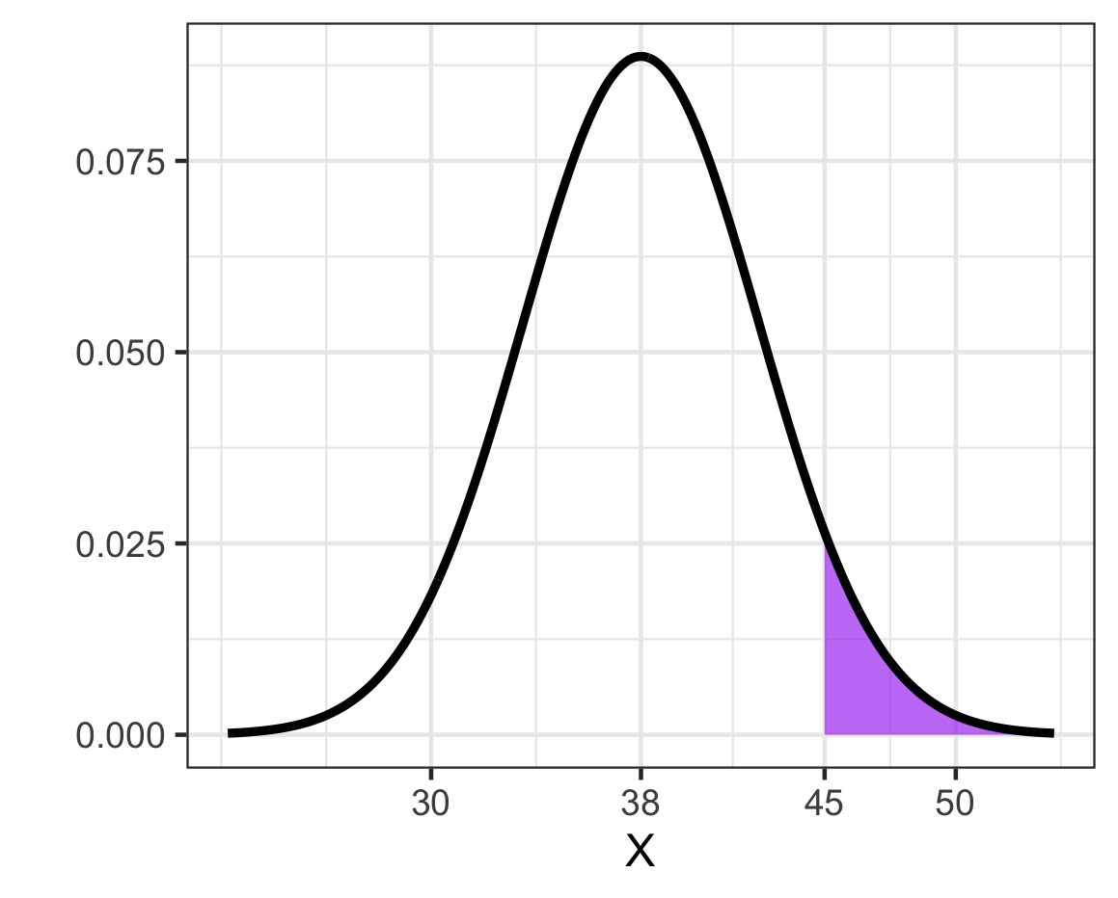

Calculating Probability: A Completed Example, Part II
Scenario: Assume that we have $X \sim N(μ=38, σ=4.5)$. Evaluate $P(X≥45)$.
Solution. Start with a picture…
Since we want the area to the right of 40, we’ll need to use the strategy of removing the area we don’t want.
We start with 1 and remove the unshaded region
1 - $NORM.DIST\left(45, 38, 4.5, TRUE\right)$
$≈0.0599$

Slide 14
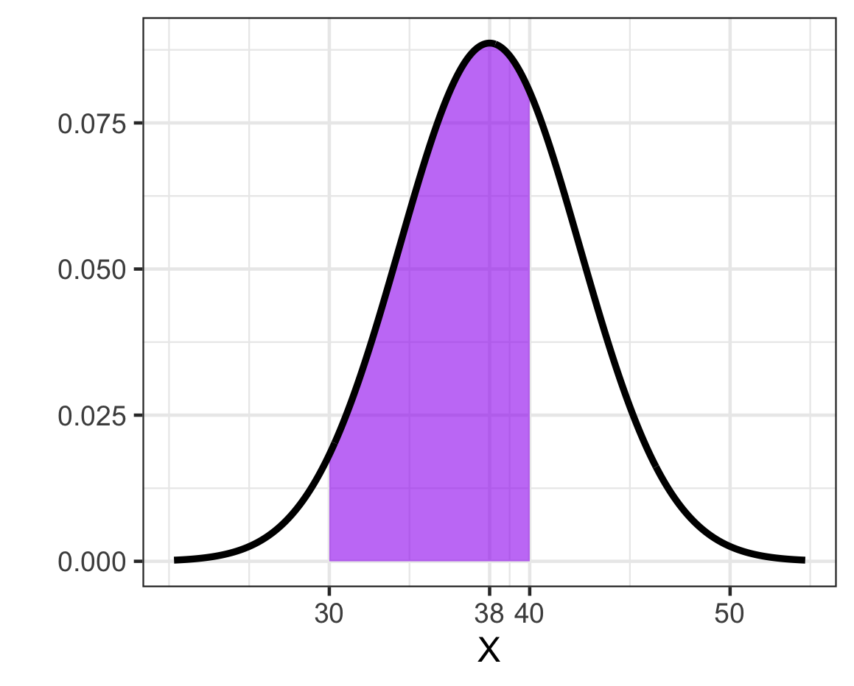


Calculating Probability: A Completed Example, Part III
Scenario: Assume that we have $X \sim N(μ=38, σ=4.5)$. Evaluate $P(30<X<40)$.
Solution. Start with a picture…
Since we want the area between two boundaries, we’ll calculate the area to the left of 40 and then remove the area to the left of 30
$$NORM.DIST\left(40, 38, 4.5, TRUE\right)−NORM.DIST(30, 38, 4.5, TRUE)$$
$$≈0.6339$$

Slide 15
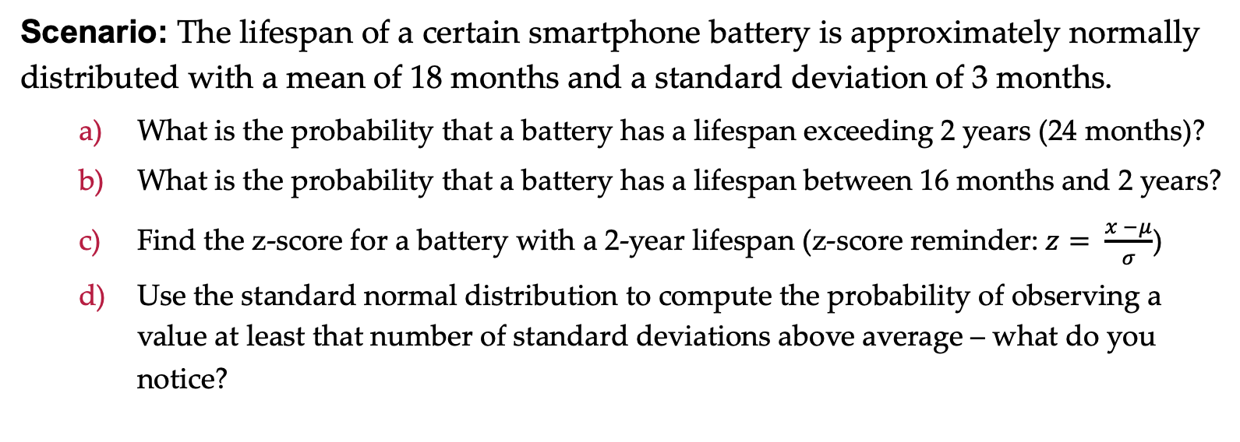
Examples: Smartphone Battery Lifespan
Scenario: The lifespan of a certain smartphone battery is approximately normally distributed with a mean of 18 months and a standard deviation of 3 months.
What is the probability that a battery has a lifespan exceeding 2 years (24 months)?
What is the probability that a battery has a lifespan between 16 months and 2 years?
Find the z-score for a battery with a 2-year lifespan (z-score reminder: $z= \frac{x −μ}{σ}$)
Use the standard normal distribution to compute the probability of observing a value at least that number of standard deviations above average – what do you notice?

Slide 16
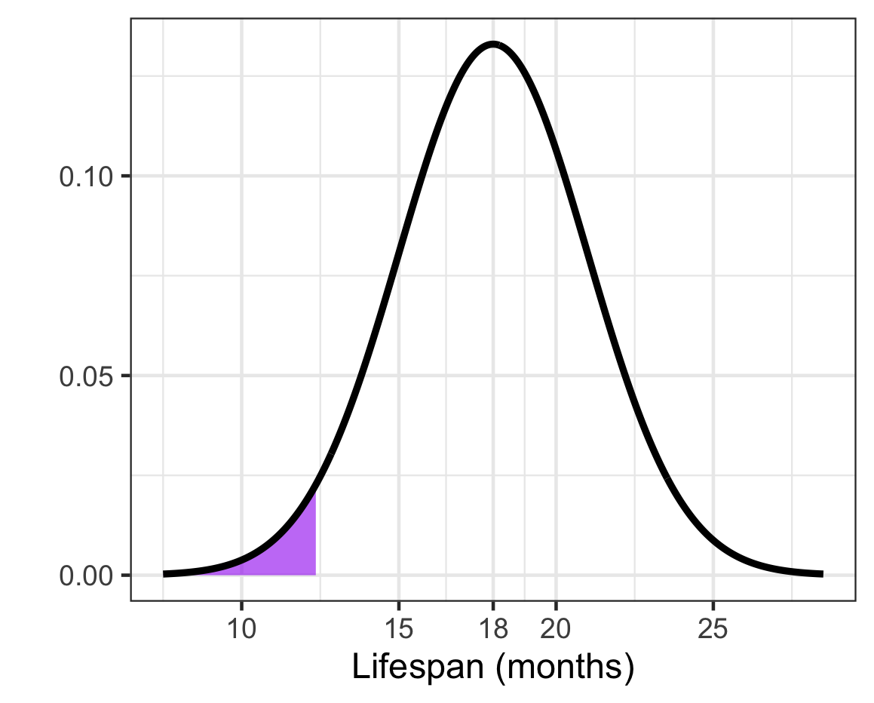
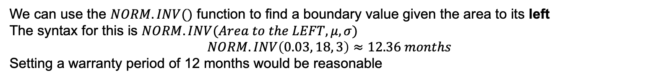
Calculating Percentiles/Quantiles
Sometimes, rather than looking for the probability of an event, we’re more interested in finding the event corresponding to a probability
Example: The manufacturer wants to put a warranty on their batteries, but they want to replace no more than 3% of batteries via warranty. What is the cutoff for the lifespan of these shortest lasting batteries?
Solution. The answer here will be a lifespan in hours rather than a probability. Let’s start with a picture.
We can use the $NORM.INV()$ function to find a boundary value given the area to its left
The syntax for this is $NORM.INV(Area to the LEFT, μ, σ)$
$$NORM.INV\left(0.03, 18, 3\right)≈12.36 months$$
Setting a warranty period of 12 months would be reasonable

Slide 17
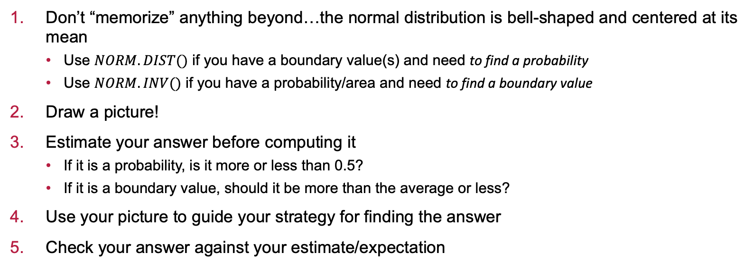
Some Advice on Approaching Problems
Don’t “memorize” anything beyond…the normal distribution is bell-shaped and centered at its mean
Use $NORM.DIST()$ if you have a boundary value(s) and need to find a probability
Use $NORM.INV()$ if you have a probability/area and need to find a boundary value
Draw a picture!
Estimate your answer before computing it
If it is a probability, is it more or less than 0.5?
If it is a boundary value, should it be more than the average or less?
Use your picture to guide your strategy for finding the answer
Check your answer against your estimate/expectation

Slide 18
Examples: Marathon Runners
Scenario: The time it takes runners to complete a marathon is approximately normally distributed with a mean of 4.5 hours and a standard deviation of 0.75 hours.
What is the probability that a randomly selected runner finishes the marathon in less than 4 hours?
What is the probability that a randomly selected runner finishes the marathon in 3 and a half hours or more?
What is the probability that a randomly selected runner finishes the marathon between 3 hours and 5 hours?
At what finishing time do the slowest 20% of runners finish the marathon?

Slide 19
Examples: Apple Orchard
Scenario: The weight of apples grown in an orchard is approximately normally distributed with a mean of 150 grams and a standard deviation of 20 grams.
What is the probability that a randomly selected apple weighs less than 100 grams?
What is the probability that a randomly selected apple weighs more that 175 grams?
What is the probability that a randomly selected apple weighs between 160 and 195 grams?
What is the cutoff for the lightest 5% of apples?
What is the cutoff for the heaviest 1% of apples?

Slide 20
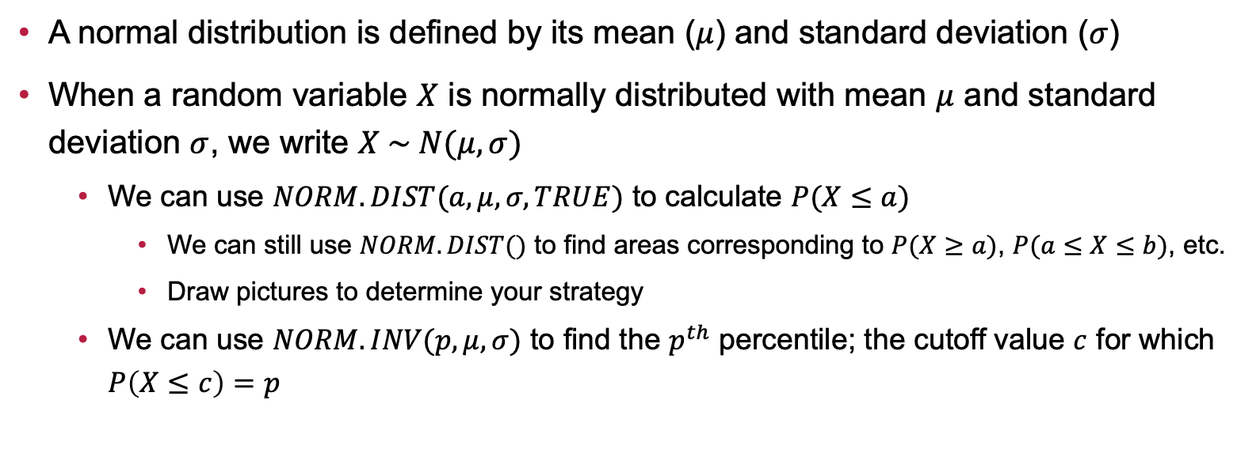
Summary
A normal distribution is defined by its mean ($μ$) and standard deviation ($σ$)
When a random variable $X$ is normally distributed with mean $μ$ and standard deviation $σ$, we write $X \sim N(μ, σ)$
We can use $NORM.DIST(a, μ, σ, TRUE)$ to calculate $P(X≤a)$
We can still use $NORM.DIST()$ to find areas corresponding to $P(X≥a)$, $P(a≤X≤b)$, etc.
Draw pictures to determine your strategy
We can use $NORM.INV(p, μ, σ)$ to find the $p^{th}$ percentile; the cutoff value $c$ for which $P\left(X≤c\right)=p$

Slide 21
Next Time…
What we’ll be doing…
The Central Limit Theorem and Sampling Distributions
How to prepare…
Read sections 6.1 – 6.3 in our textbook
Homework: Complete Homework 4 (Probability and the Normal Distribution) on MyOpenMath

