Slide 1

Energy Consumption Forecasting
Proposal Presentation
Adriana Matos, Hamzah Issa, and William Appelt
March 7, 2025

Slide 2

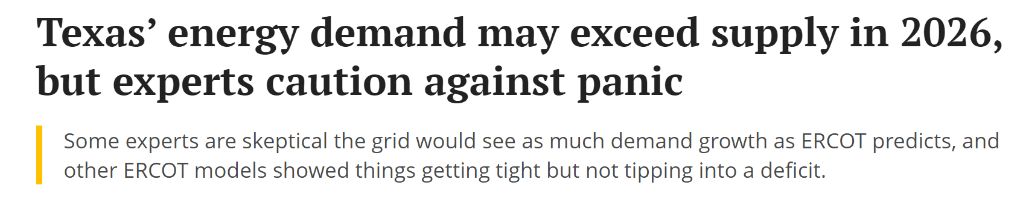
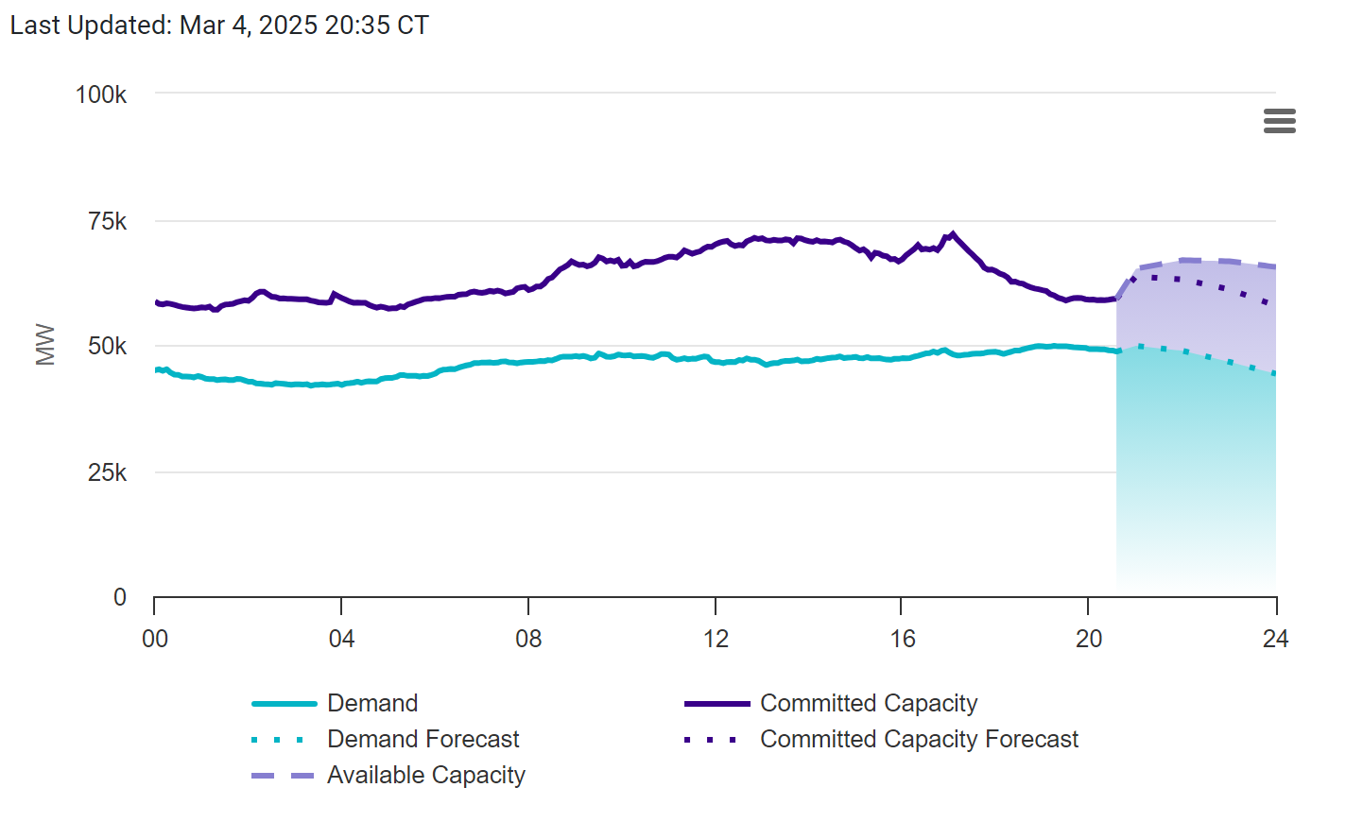
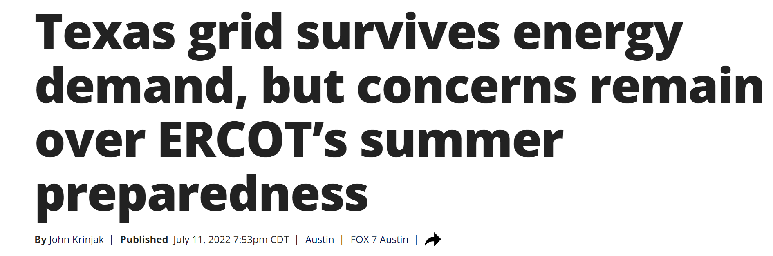
Problem Tackled
Texas experiences extreme energy demand fluctuations.
Better forecasting can prevent blackouts and optimize power generation.
We need an accurate model to predict energy usage.
Notes:
Texas experiences extreme energy demand fluctuations due to heatwaves and winter storms. Without accurate forecasting, we risk blackouts during peak demand or inefficient power generation when demand is overestimated. Our goal is to develop a predictive model that enables power companies to better anticipate and manage future energy needs.
The graph on the left, sourced from the ERCOT website, illustrates current demand, committed capacity, and projected future trends. Additionally, the headlines highlight ongoing concerns about Texas’ energy grid, including a 2026 forecast that suggests demand may surpass supply and a 2022 report on grid resilience during summer but with uncertainties.

Slide 3
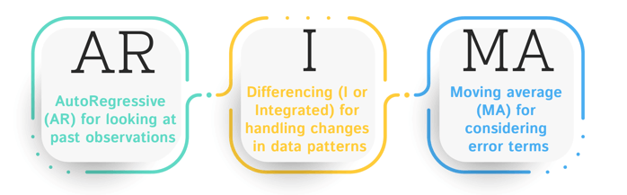
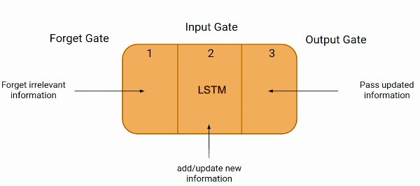
Current Methods & Their Limitations
Traditional Models: ARIMA (Autoregressive Integrated Moving Average), LSTMs (Long Short-Term Memory).
Limitations:
ARIMA struggles with nonlinear trends.
LSTMs have trouble capturing long-term dependencies.
Notes:
Many energy companies rely on traditional forecasting models like ARIMA and LSTMs. However, these models have significant limitations.
ARIMA is effective for linear trends but struggles with capturing nonlinear energy consumption patterns.
Meanwhile, LSTMs, while better suited for sequential data, have difficulty retaining very long-term dependencies, which is crucial for accurate energy forecasting.
Given these challenges, we need a more advanced approach that can handle complex patterns and improve long-term prediction accuracy

Slide 4
Our Proposed Solution - Transformer Model
Why Transformer-based model?
Captures long-range dependencies better.
Uses self-attention to focus on important trends.
Performs well on time-series forecasting.
Notes:
Our proposed solution is a Transformer-based model, which offers significant advantages for energy forecasting. Unlike traditional models, Transformers effectively capture long-range dependencies, making them well-suited for identifying trends in energy demand over time. The key to their success is the self-attention mechanism, which allows the model to focus on the most relevant data points, improving accuracy.
Because Transformers excel in time-series forecasting, they provide a more reliable and scalable approach for predicting energy consumption patterns, ultimately helping power companies optimize grid management and prevent disruptions
Unlike LSTMs, which process data sequentially and struggle with long-term dependencies, Transformers leverage self-attention to analyze the entire dataset at once. This allows them to focus on the most critical time points, capturing trends more effectively and improving forecasting accuracy for complex energy consumption patterns

Slide 5
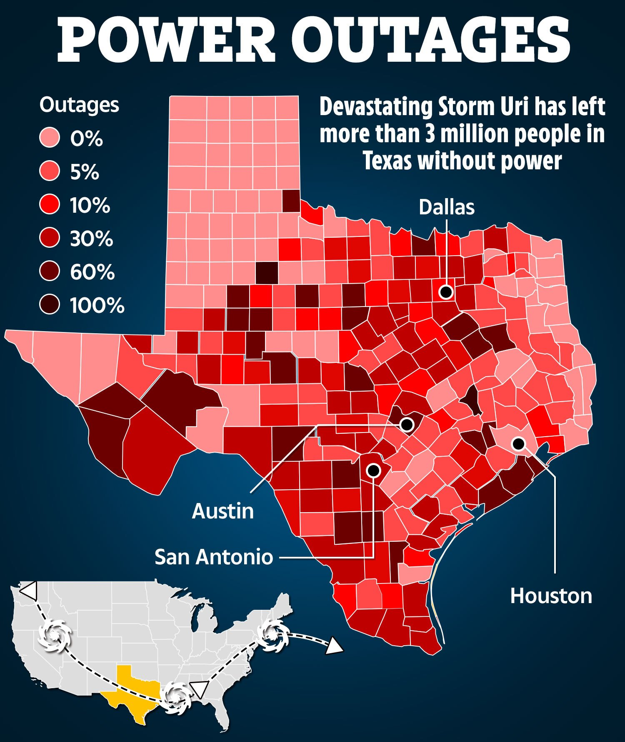
Data Sources & Preprocessing
Data Sources:
ERCOT energy usage data
NOAA weather data
Preprocessing:
Handle missing values.
Normalize data.
Create time-based features.
Notes:
Our data will come from ERCOT, which tracks Texas electricity usage, and NOAA, which provides weather information. We’ll clean the data, remove missing values, and add features like temperature and time of day

Slide 6
Model Implementation Plan
Baseline Model: LSTM
Proposed Model: Transformer
Evaluation Metrics: RMSE, MAPE, R² Score
Notes:
We will compare two models: LSTM as our baseline and Transformer as our new approach. We’ll measure how well each model predicts energy use using RMSE, MAPE, and R² scores.
LSTM is a type of recurrent neural network (RNN) designed to handle sequential data efficiently.
It is commonly used for time-series forecasting, natural language processing (NLP), and other sequence-dependent tasks.
The LSTM model serves as a baseline, meaning its performance will be compared against a more advanced model.
LSTM processes data step by step while Transformers process data all at once making it faster and it also can find patterns faster
Transformers are deep learning models that utilize self-attention mechanisms to process sequential data in parallel rather than sequentially.
They have outperformed LSTMs in many NLP and time-series forecasting tasks.
The proposed Transformer model aims to improve upon LSTM in handling dependencies and extracting patterns in the data.
RMSE (Root Mean Square Error): Measures the average error magnitude of a model’s predictions.
MAPE (Mean Absolute Percentage Error): Expresses prediction errors as a percentage of actual values, useful in business and financial applications.
R² Score (Coefficient of Determination): Indicates how well the model explains the variance in the target variable (higher is better, with a maximum value of 1).

Slide 7
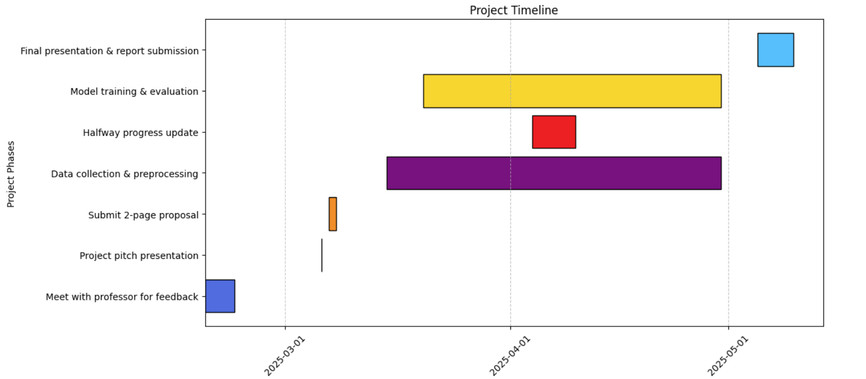
Project Timeline (Milestones)
Notes:
Our project follows a structured timeline. We met with our professor for feedback in February, and now we’re at the proposal stage. By mid-March, we’ll finish data collection. April is for model training and evaluations, and in May, we will present our final report

Slide 8
Computing Resources & Challenges
Storage & Processing Needs:
Dataset ~1GB
Google Colab for training
Potential Challenges:
Model training time
Computational power limits
Notes:
Since we are working with deep learning models, we need enough storage and processing power. We plan to use Google Colab if needed. One challenge might be training time, but we’ll optimize our models to improve efficiency

Slide 9
Contingency Plan
If a milestone is delayed:
Focus on model tuning.
If a team member can’t complete work:
Redistribute tasks.
Backup Plan:
Use LSTM model if Transformer doesn’t work well.
Notes:
If we face delays, we will focus on improving model accuracy instead. If a team member is unavailable, we will adjust tasks among us. If the Transformer model underperforms, we will refine the LSTM approach

Slide 10
Conclusion & Q&A
Our project aims to improve energy forecasting accuracy.
Each team member contributed equally in this proposal.
Thank you! Questions?
Notes:
In summary, our goal is to make energy forecasting more accurate by using Transformers. We’ll compare our results to LSTM models to see the improvements. Thank you for listening! We’re happy to answer any questions.

