Slide 1
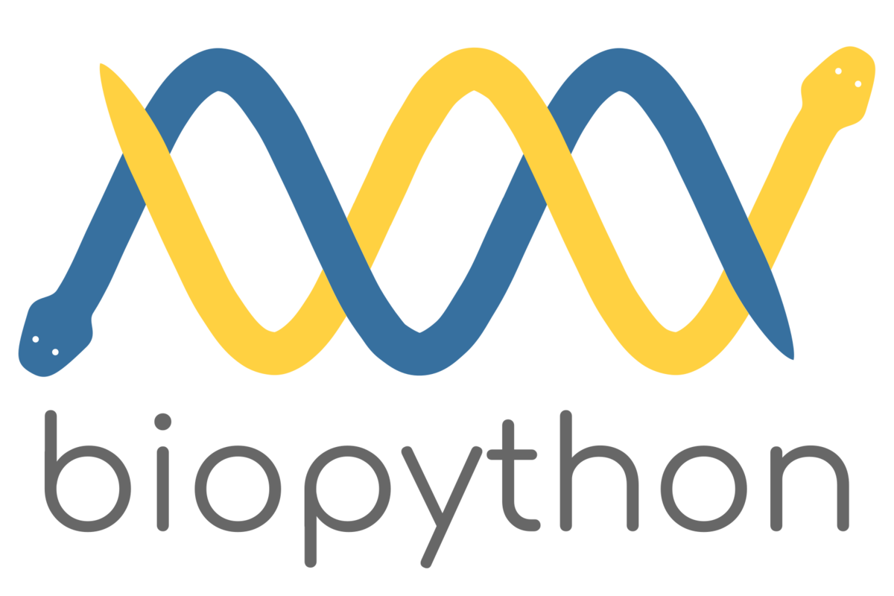
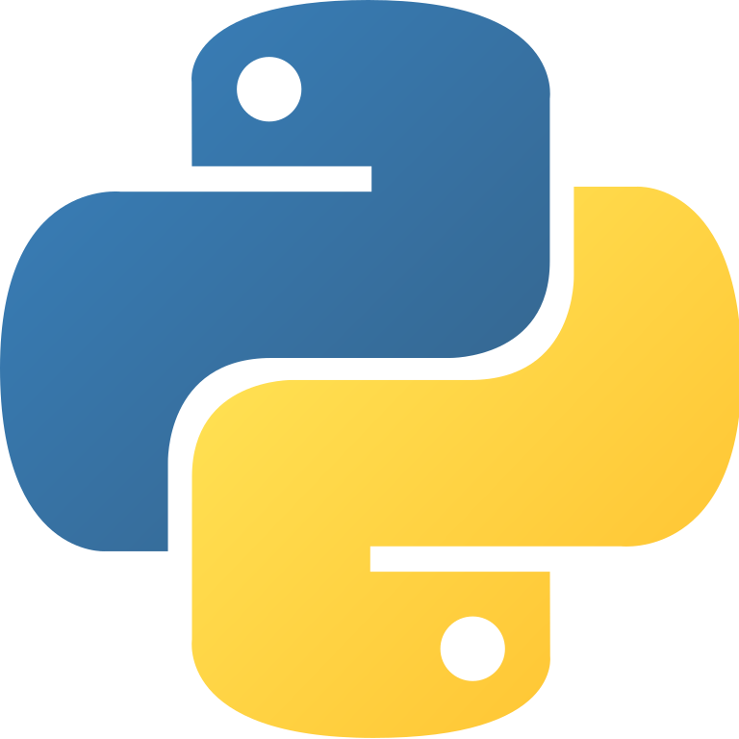
Biopython Work with biological sequence data in Python
Alexander McFarland
NUIT Research Computing Services
Northwestern University
July 19-23, 2021
Biopython Work with biological sequence data in Python is brought to you by NUIT Research Computing Services.
Have a programming or data question about your research? We're here to help. bit.ly/rcsconsult

Slide 2
Running the workshop code
The contents of this workshop are available at
https://github.com/agmcfarland/biopython_workshop
Please use look over the contents of the README in github
Two ways to run the code:
Open the main github directory in Google Colab and select the notebook (.ipynb) you wish to run (easy)
Clone the repository, go to the repository directory, open the notebook you wish to run.
This assumes you have a way of running a jupyter notebook already set (VScode, JupyterLab (anaconda)

Slide 3
Biopython is designed to work with biological sequences and their formats
Biological sequences are DNA, RNA, and amino acids
When working with more than a handful of sequence, manual editing becomes inefficient and time-consuming
Manual work can become error prone and irreproducible
Biopython is a Python package that is built to interact with all types of sequences found in formats used by biologists, including
Fasta (.fasta)
GenBank file-format (.gbk)
Biopython can help to make analyses efficient and reproducible

Slide 4
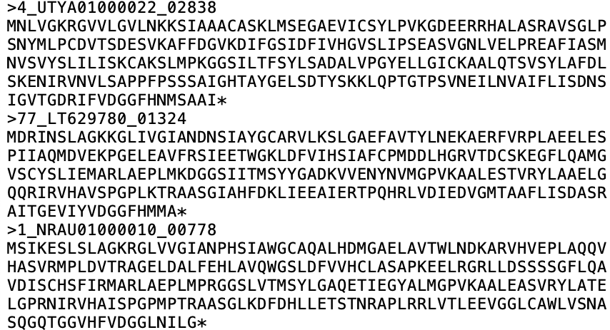
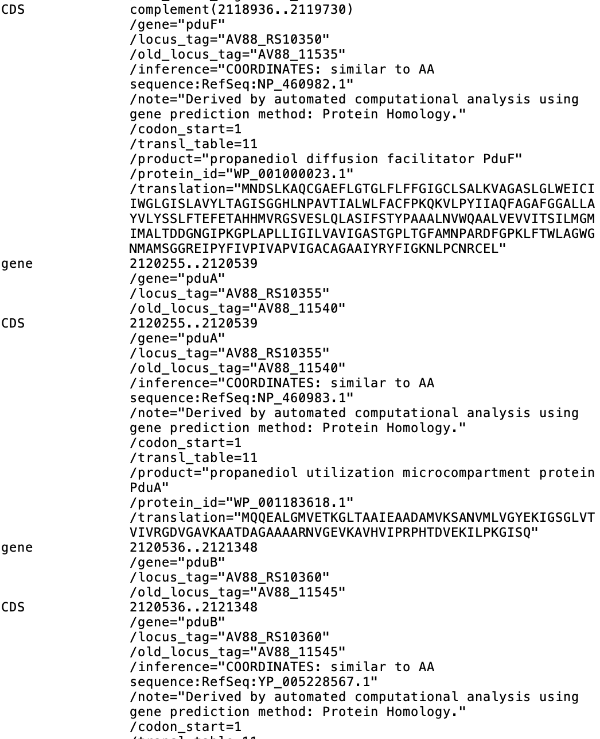
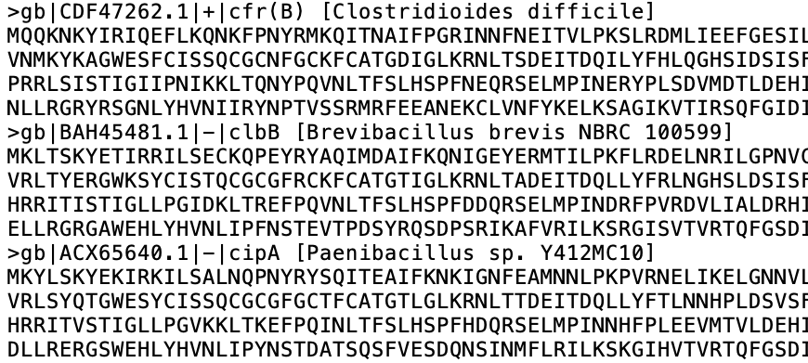
Biopython can help overcome many everyday sequence challenges
By the end of Day 3 you will know how to do all these things!
Remove the * at the end of each sequence and calculate GC content
Extract specific gene names and associated sequences
Rename headers to gene name and species, count the number of times a genus is found
Notes:
--

Slide 5
Biopython applications covered by this workshop
Working with sequences
Remove certain characters (*)
Remove first or last ‘X’ number of nucleotides/amino acids
Transcribe/translate DNA sequences
Calculate GC content
Calculate length of sequences
Find motifs
Modifying headers
Make headers more readable
Extract information from headers
Extracting and storing sequences
Write only certain sequences to new file
Write modified sequences/headers to new file
BLAST-ing against the NCBI database
Set homology thresholds and store results

Slide 6
Workshop overview
Five days of one-hour sessions
4-5 pm July 19-23
All code is run on a Jupyter notebook
When necessary, Python basics will be reviewed prior to their use with Biopython
Focus on writing code that can be adapted to workflows
Feel free to ask questions/for clarifications in the chat – I will read over them during examples and find the best time to address them!
Session outline
Monday – Introduction to strings, Biopython, and Biopython sequences
Tuesday – Opening, closing, and saving sequence files with Biopython
Wednesday – More sequence modification and data extraction
Thursday – Extracting and storing sequence data, working with GenBank files
Friday – BLAST-ing against the NCBI database

Slide 7



Expected ‘easiness’
100
75
This is so easy!
50
25
0
1
2
3
4
5
Time (Lesson Day)

