Slide 1
Introduction to Linux Booting

Slide 2
Introduction to Linux kernel
The whole Linux sources are Free Software released under the GNU General Public License version 2 (GPL v2).
When you receive or buy a device with Linux on it, you should receive the Linux sources, with the right to study, modify and redistribute them.
Portability and hardware support. Runs on most architectures.
Scalability. Can run on super computers as well as on tiny devices (4 MB of RAM is enough).
Security. It can’t hide its flaws. Its code is reviewed by many experts.
Userspace applications usually never make a system call directly but rather use the corresponding C library function
Allows to have a higher budget for the hardware or to increase the company’s skills and knowledge
Allows to have full control over the software part of yoursystem.

Slide 3
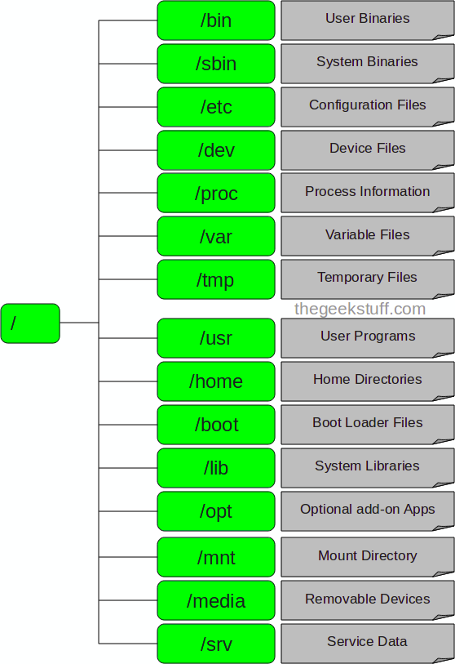
Linux File Structure.

Slide 4

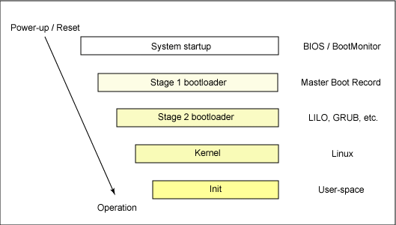
Booting a linux Kernel
Booting takes place in a two stages before control is passed into the kernel.

Slide 5
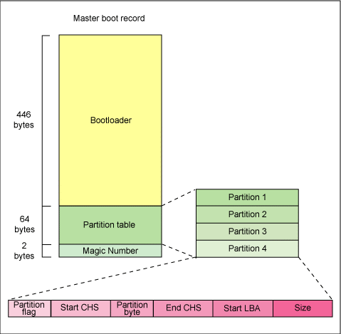
Cont..
Booting Linux begins in the BIOS at address 0xFFFF0.
The first step of the BIOS is the power-on self test (POST)(Checks hardware). The second step of the BIOS is local device enumeration and initialization.
The MBR is a 512-byte sector, located in the first sector on the disk (sector 1 of cylinder 0, head 0). After the MBR is loaded into RAM, the BIOS yields control to it.

Slide 6
Cont..
The secondary, or second-stage, boot loader could be more aptly called the kernel loader.
The first- and second-stage boot loaders combined are called Linux Loader (LILO) or GRand Unified Bootloader (GRUB) in the x86 PC environment.
With the second-stage boot loader in memory, the default kernel image and initrd image are loaded into memory.
Initrd will be the initial file system, once boot completed main file system will be mounted.

Slide 7
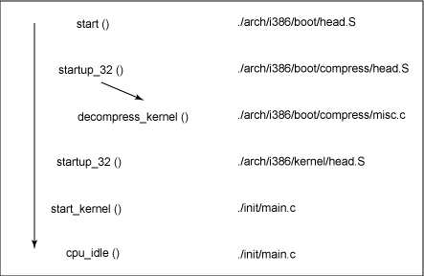
Cont..
Typically this is a zImage (compressed image, less than 512KB) or a bzImage (big compressed image, greater than 512KB), that has been previously compressed with zlib.
When the bzImage (for an i386 image) is invoked, begins at ./arch/i386/boot/head.S in the start assembly routine.
This routine does some basic hardware setup and invokes the startup_32 routine in ./arch/i386/boot/compressed/head.S. This routine sets up a basic environment (stack, etc.) and clears the Block Started by Symbol (BSS). The kernel is then decompressed through a call to a C function called decompress_kernel (located in ./arch/i386/boot/compressed/misc.c).

Slide 8
Cont..
Another startup_32 function in ./arch/i386/kernel/head.S. (also called the swapper or process 0), the page tables are initialized and memory paging is enabled. The type of CPU is detected along with any optional floating-point unit (FPU) and stored away for later use.
The start_kernel function is then invoked (init/main.c), which takes you to the non-architecture specific Linux kernel.
With the call to start_kernel, a long list of initialization functions are called to set up interrupts, perform further memory configuration, and load the initial RAM disk.
Finally call is made to kernel_thread (in arch/i386/kernel/process.c) to start the init function, which is the first user-space process.

Slide 9
/sbin/init
In Unix-based computer operating systems, init (short for initialization) is the first process started during booting, and is typically assigned PID number 1.
It looks for the file /etc/inittab to see if there is an entry of the type initdefault
A runlevel is a software configuration of the system which allows only a selected group of processes to exist.
The runlevel is changed by having a privileged user run telinit, which sends appropriate signals to init, telling it which runlevel to change to.
When entering single user mode, init reads the console's ioctl states from /etc/ioctl.save. If this file does not exist, init initializes the line at 9600 baud and with CLOCAL settings.
When entering a multi-user mode for the first time, init performs the boot and bootwait entries to allow file systems to be mounted before users can log in.

Slide 10
Cont..
When starting a new process, init first checks whether the file /etc/initscript exists. If it does, it uses this script to start the process.
Each time a child terminates, init records the fact and the reason it died in /var/run/utmp and /var/log/wtmp, provided that these files exist.

Slide 11
/etc/inittab
When we boot the system or change run levels with the init or shutdown command, the init daemon starts processes by reading information from the /etc/inittab file.
Defines these important items for the init process: That the init process will restart, What processes to start, monitor, and restart if they terminate, What actions to take when the system enters a new run level.

Slide 12
Introduction to ARM
Arm is a RISC(uses a small, highly-optimized set of instructions) controller.
Thumb coding to save space and gain speed.
Two types of memory management 1) Memory mapped, 2) I/O Mapped.
Two types of intterupt controller 1) Standard, 2) Vector.
Initialization of code 1) Hardware Configuration, 2) Diagnostic, 3) Booting.
Registers : It has 16 general purpose register, one Current program status register and 5 banked register.
Fast interrupt mode : registers r8_fiq – r14_fiq.
Interrupt, supervisory, undefined, abort mode each has 3 registers. r13_x – r14_x.
Interrupt, supervisory, undefined, abort mode each has 3 registers. r13_x – r14_x.

Slide 13
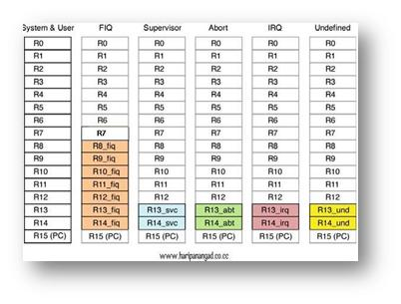

Slide 14
ARM Modes
Abort Mode is a mode, when there is a failed attempt to access memory.
Fast Interrupt request and Interrupt request Mode correspond to interrupt levels available on ARM. Fast Interrupt Request (FIQ) supports high speed interrupt handling. Interrupt Request (IRQ) supports, all other interrupt sources in a system.
Supervisor Mode is a state in which a processor goes after RESET. Generally, it is a mode in which OS Kernal executes
System mode is Special Version of User Mode, that allows full read\write access to CPSR. It is also targeted for supervisory applications.
Processor Enters Undefined Mode when it encounters an undefined instruction. Example: - illegal opcodes.
User Mode is used by program and applications. It is used to run the application codes. Modes can only be changed when an exception is generated.

Slide 15
Refference
http://www.thegeekstuff.com/2010/09/linux-file-system-structure/
http://en.wikipedia.org/wiki/Loadable_kernel_module
http://www.eetimes.com/design/embedded/4008796/Fundamentals-of-Booting-for-Embedded-Processors
http://www.ibm.com/developerworks/linux/library/l-linuxboot/
http://www.embeddedrelated.com/showarticle/59.php
http://en.wikipedia.org/wiki/Initrd
http://www.ibm.com/developerworks/library/l-busybox/
http://www.unix.com/programming/4816-what-daemon-process.html
http://www.linux.com/news/hardware/peripherals/180950-udev
http://www.makelinux.net/ldd3/chp-15-sect-1
https://wiki.archlinux.org/index.php/Init_and_initta
http://linux.about.com/od/commands/l/blcmdl8_init.htm

Slide 16
Thank you.

