Slide 1
Project 3: NBA Player Performance Analytics
Michael Ezeanioma
Andrew Millman
Elizabeth Jones
Xiaolong Liu
John Sebesta

Slide 2
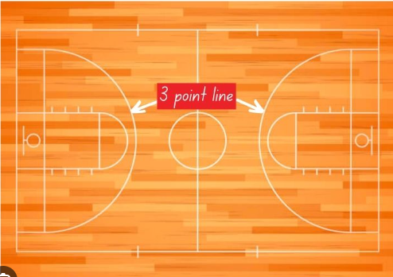
Objective
Over the last decade the number of 3-point shots attempted has surged. The application we have designed is meant to enable analysis of how this shift has impacted scoring trends and efficiency metrics.

Slide 3



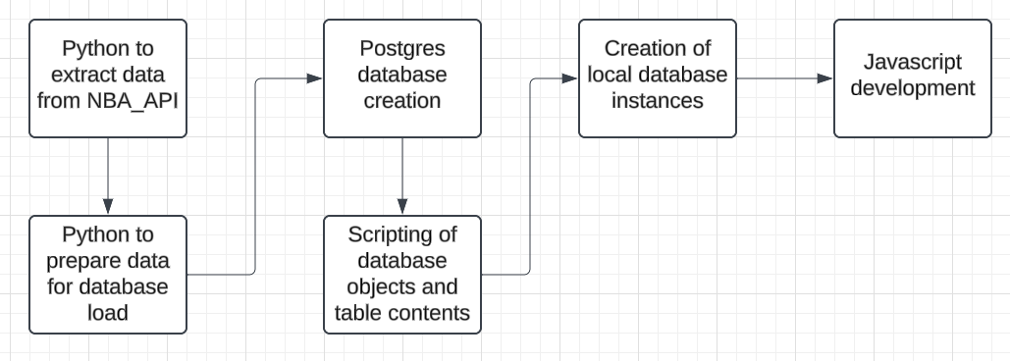






Process

Slide 4
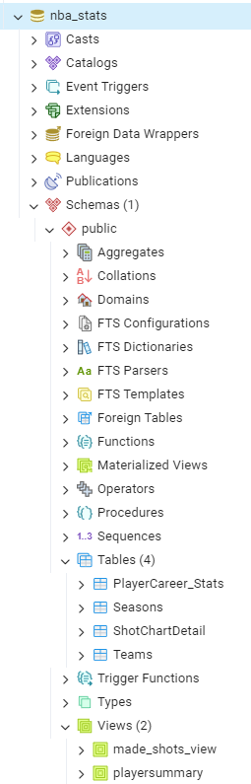
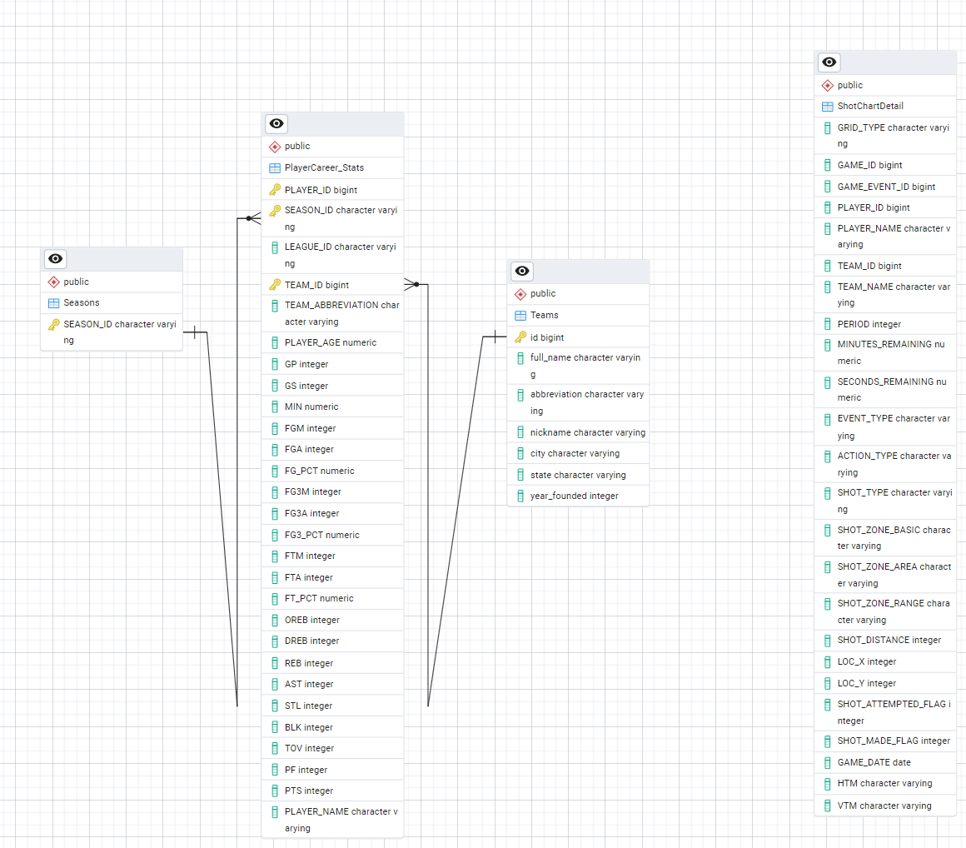

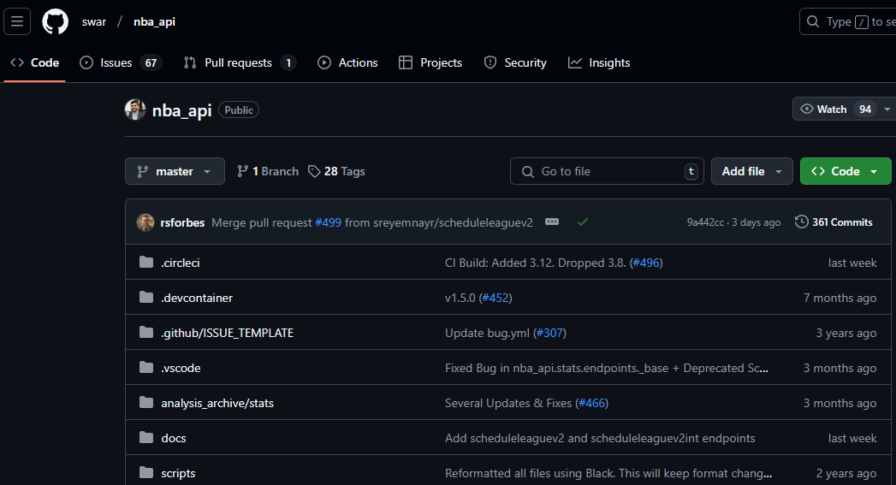
Data
NBA_API provides historical data for all players and statistics
Over 13,000 records in 4 tables and 2 views
Shot chart data was at the game level and needed to be rolled up to the season level
The player statistics were aggregated in a view to enable season level statistics like scoring average per season

Slide 5
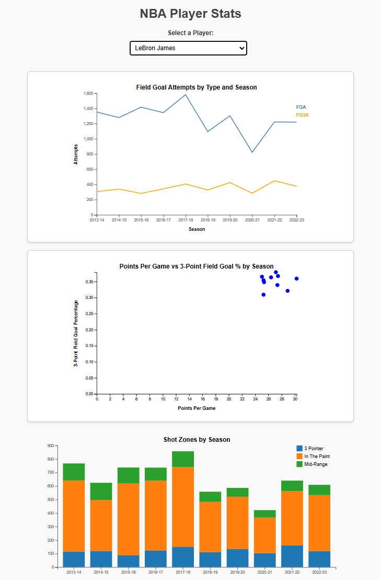
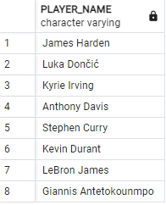
Application
Data set consists over just over 13,000 records
Application contains 3 visualizations that are dynamically updated based on player selected from the drop down menu
Hovering over the scatter plot points will display the season specific to the point selected
Data for the stacked bar chart was limited to 8 players due to the size of the data source
http://localhost:3000

Slide 6
Considerations
Eliminating the database requirement would enable inclusion of all seasons, players, and statistics by allowing for querying of the API directly from the application

