Slide 1
Quantune: An Automatic Music Generation Using Quantum Computing
Md Shahidur Rahaman
Agm Islam

Slide 2
Outline
Background
Problem Statement
Algorithm Details
Music Generation
Implementation

Slide 3

Music Generation
As quantum computing has recently advanced rapidly, researchers are trying to take advantage of the principles and algorithms they can utilize in the music industry.
01
02
The computational method of creating compelling music has become a crucial component of the music industry.
03
In classical computation, the tune generation is cost ineffective, as the note can be only one state at a time.
As researchers shifted their interest to quantum simulation, we can reduce the limitation as a note can be at multiple states that speed up the simulation using superposition.
04

Slide 4
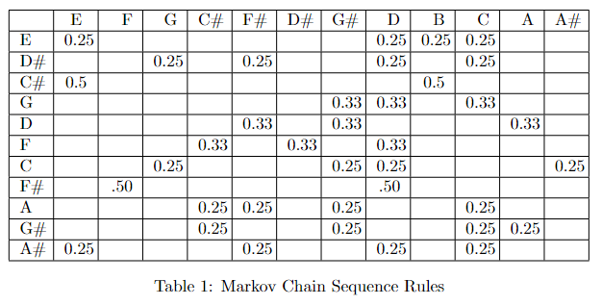
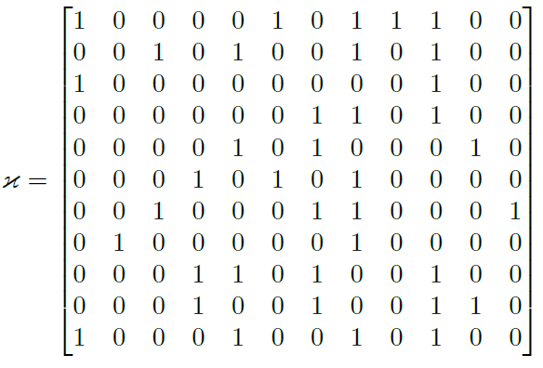
Algorithm Details
Music Generation with Random Walk with Markov Chain Probability Distribution [1]
The discrete version of this approach uses multiple qubits with Markov Chains and conventional random walks for each possible movement from a graph vertex.
A quantum die is used to compose music using a set of twelve-tone notes to perform the quantum walk in one dimension.
Music Generation with Basik-Miranda Algorithm [2] with Sequence Matrix Rule
Using the Markov Chain representation of the sequence rule, this method creates a rule matrix for the target states.
We have two equilibrium probability states in the Markov chain implementation, for instance, if the input note is C#. The Rule 3 is now obtained from the matrix. We can choose the one from the rule that matches the intended states represented by the qubits. Here, we obtain the two qubits |0>2 and |8>2 for the states E and B. If the next pitch in the simulation is taken, we may infer from the matrix that the winner is |0>4.
We will follow the same procedure to finish the input pitch simulation
Figure 2: Sequence Matrix

Slide 5
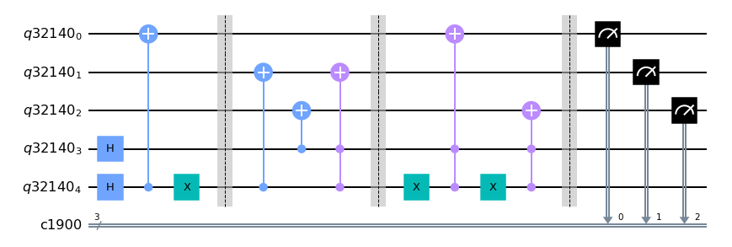
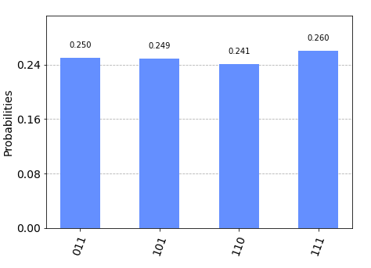
Implementation Details
Creating Method for circuit Creation
Transpilation
Note Generation
Rhythm Generation
Figure 4: Quantum Circuit of our implementation
Audio File Generation
Figure 3: Workflow Diagram
Figure 5: Histogram for 100th Note Generation
Figure 6: Histogram for 100th Rhythm Generation

Slide 6
Implementation
To meet our goal and motivation, we developed an interactive web application to play the generated music, which is now publicly available. We used the frontend with React.Js and ran the code we created for the backend to play the music in the music gallery.
Web Url: http://quantune.thepixel.men/

Slide 7
References
Xin-She Yang, TO Ting, and Mehmet Karamanoglu. Random walks,l ́evy flights Markov chains, and metaheuristic optimization. In Futureinformation communication technology and applications, pages 1055–1064. Springer, 2013.
Eduardo R Miranda and Suchitra T Bask. Quantum computer music:Foundations and initial experiments. arXiv preprint arXiv:2110.12408, 2021

