Slide 1
CYB 2311 - Introduction to Applied Cryptography
Zhonghao Liao

Slide 2
Course Personnel
Instructor: Dr. Zhonghao Liao
Office: DH436
Email: liao@msoe.edu
Office hours:
Monday & Tuesday 10:00 am - 11:00 am
Wednesday 2:00 pm – 3:00 pm, 4:00 pm – 5:00 pm
Thursday 2:00 pm – 4:00 pm
Feel free to knock on the door when I'm in the office
Watch the Canvas
Assignments, reading materials, announcements, lecture notes, etc.

Slide 3
Course Materials
Textbook:
1. Jean-Philippe Aumasson (JPA): Serious Cryptography, 2nd Edition
2. Menezes, Oorschot, and Vanstone (MOV): Handbook of Applied Cryptography
3. Boneh and Shoup (BS): A Graduate Course in Applied Cryptography
Lecture slides, notes, etc.
Prerequisites: Discrete Mathematics (MTH 2310)

Slide 4
Course Logistics
Lectures
In-class quizzes/exercises (10% of the grade)
Homework assignments (15% of the grade)
Programming labs (individual) (30% of the grade)
Midterm: Week 8 (20% of the grade)
Final: TBD (25% of the grade)
MSOE Code of Conduct will be strictly enforced

Slide 5
Welcome!
Crypto is amazing!
Can do things that seem impossible…
Crypto is important and pervasive
It impacts each of us every day
Crypto is fun!
Deep theory interacting with practice
Attackers’ mindset, fun assignments
Mathematical prerequisites
Discrete math, probability, modular arithmetic
Mathematical maturity
Definitions, theorems, proofs, abstraction
CS prerequisites
Pseudocode/algorithms, big-O notation
Programming assignments
Hard part should not be the programming, but the thought behind it

Slide 6
Course goals
Understand the theoretical foundations for real-world cryptography
Use cryptography in the real-word applications (web, apps, infra, etc.)
When you encounter crypto in your career:
Understand the key terms
Understand the security guarantees needed/provided
Know how to use crypto
Understand what goes on “under the hood”
“Crypto mindset”

Slide 7
Tips for doing well
Read relevant sections of book
If you fall behind on the reading it will be hard to catch up!
Attend in-person lectures
Lectures will not be recorded
Come to office hours

Slide 8
Homework assignments & Labs
Expected HWs/Labs every week
Multi-week programming labs
Submit HWs and Labs to Canvas
Type solutions using LaTex (preferred): overleaf
Word doc converted to pdf
Clear scan of neat handwritten solutions
Cheating will not be tolerated
Must write your own code/solutions
GenAI will make mistakes!

Slide 9
Questions?
Please ask questions throughout!

Slide 10
What is cryptography?
Historically, cryptography was an art
Heuristic, ad hoc design and analysis
Historically, cryptography focused exclusively on ensuring private communication between two parties sharing secret information in advance using “codes” (aka private-key encryption)
In the late 1970s and early 1980s, cryptography began to develop into more of a science

Slide 11
What is Modern cryptography?
Secure communications in the presence of malicious adversaries
And much broader scope!
Data integrity, authentication, protocols, …
The public-key setting
Group communication
More-complicated trust models
Foundations (e.g., number theory, quantum-resistance) to systems (e.g., electronic voting, privacy-preserving ML, blockchain, DeFi)
Notes:
Design, analysis, and implementation of mathematical techniques for securing information, systems, and distributed computations against adversarial attack

Slide 12
What is Modern cryptography?
Design, analysis, and implementation of mathematical techniques for securing information, systems, and distributed computations against adversarial attack
Cryptography is now much more of a science
Rigorous analysis, firm foundations, deeper understanding, rich theory
The “crypto mindset” has permeated other areas of computer security
Threat modeling
Proofs of security

Slide 13
Core principles of modern crypto
Formal definitions
Precise, mathematical model and definition of what security means
Assumptions
Clearly stated and unambiguous
Proofs of security
Propose a scheme along with a proof of security that no one can break it
Move away from design-break-patch

Slide 14
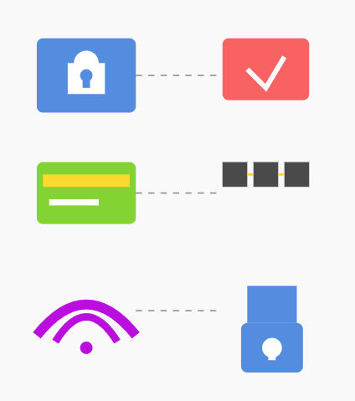


Cryptography is ubiquitous!
Password-based authentication
Secure credit-card transactions over the internet
Encrypted WiFi
Disk encryption (BitLocker)
Digitally signed software updates
Blockchain
Cryptocurrency (Bitcoin, Ethereum)

Slide 15
Rough course outline
 | Secrecy | Integrity
Private-key setting | Private-key encryption | Message authentication codes
Public-key setting | Public-key encryption | Digital signatures
Building blocks
Pseudorandom (number) generators
Pseudorandom functions/block ciphers
Hash functions
Number theory

