Slide 1
Fitting a Model
CSC4601 Theory of Machine Learning

Slide 2
Logistic Regression

Slide 3



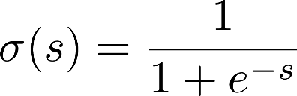













Logistic Regression
$$P(y=1|x)$$
$$\frac{1}{1+e^{−(x^{T}w+w_{0})}}≥0.5$$
$$x_{1}$$
$$w_{1}$$
$$x_{2}$$
$$w_{2}$$
$$\frac{1}{1+e^{−(x^{T}w+w_{0})}}$$
$$x^{T}w+w_{0}$$
+
$$w_{m}$$
$$x_{m}$$
$$w_{0}$$
Logistic Function
$$\frac{1}{1+e^{−(x^{T}w+w_{0})}}<0.5$$
$$1$$
Thresholding

Slide 4


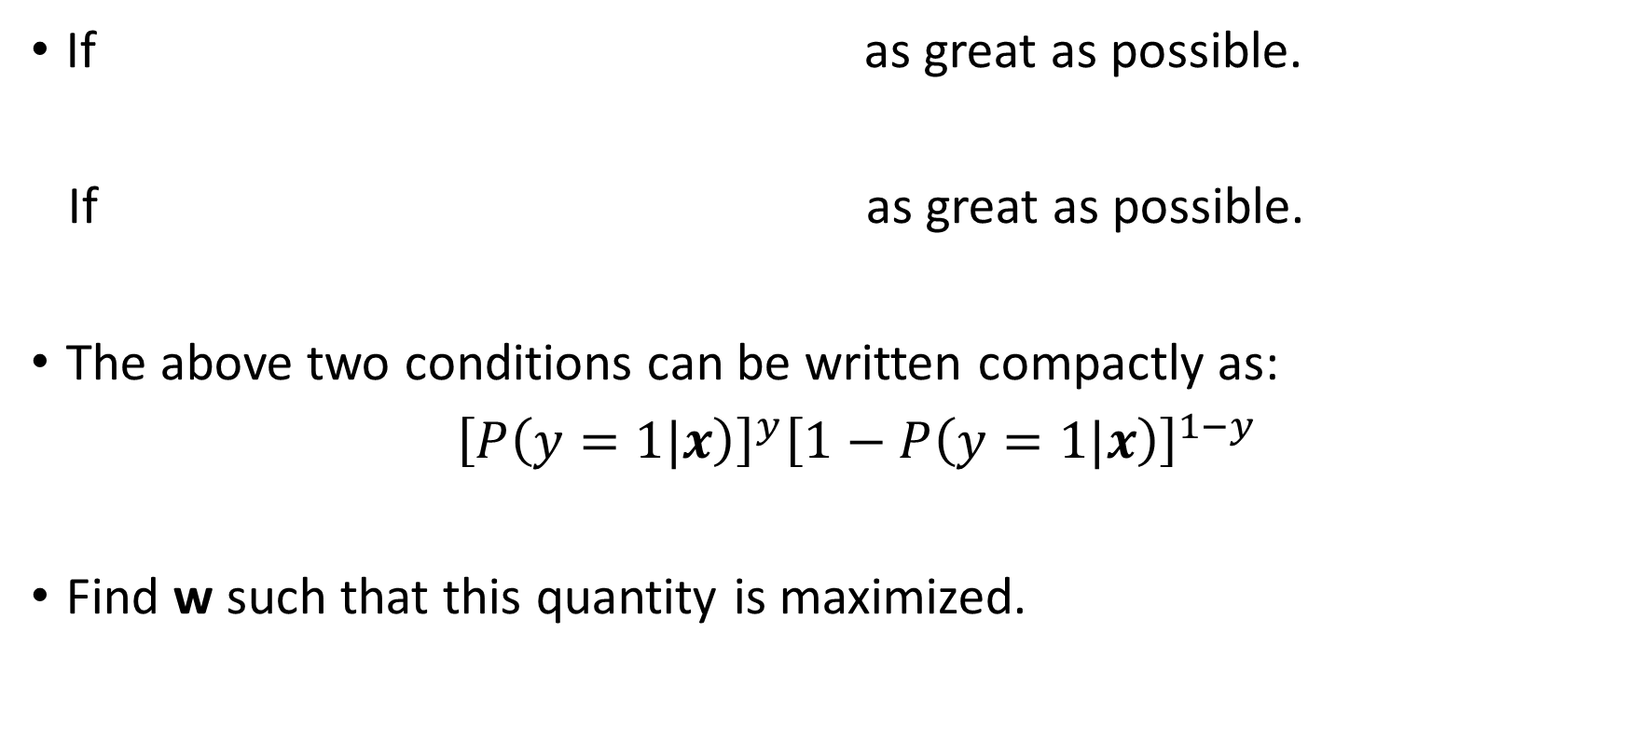
Formulation of the Optimization Problem
If as great as possible.
If as great as possible.
The above two conditions can be written compactly as:
${\left[P\left(y=1|x\right)\right]}^{y}{\left[1−P\left(y=1|x\right)\right]}^{1−y}$
Find w such that this quantity is maximized.
$$P(y=1|x)$$
find w such that
$$1−P(y=1|x)$$

Slide 5
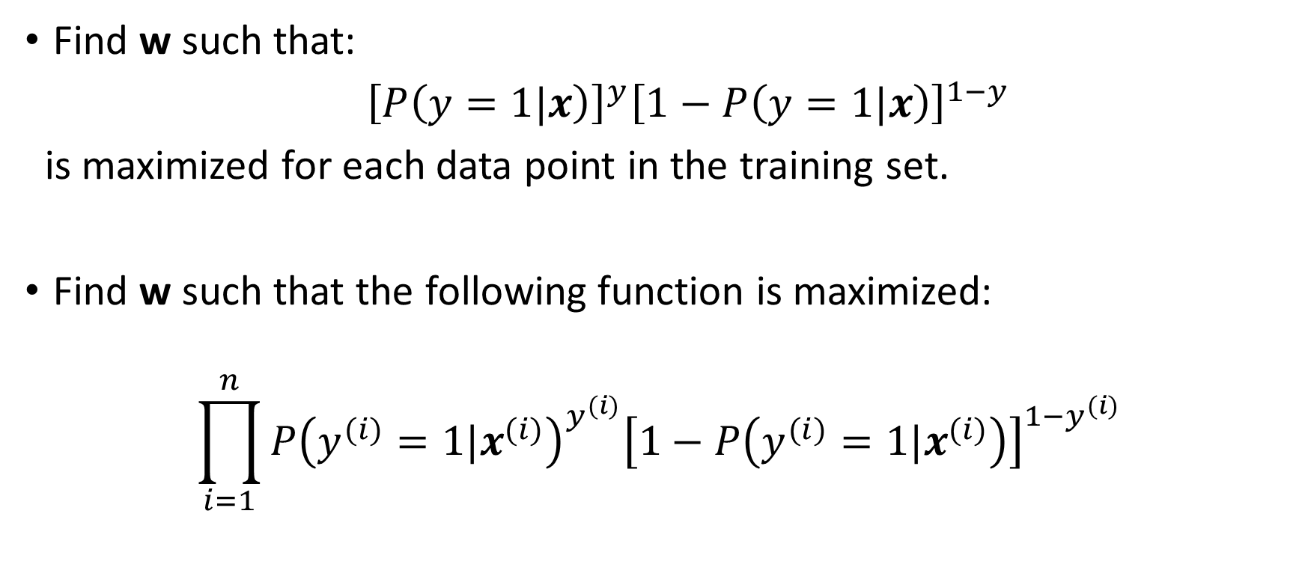
Formulation of the Optimization Problem
Find w such that:
${\left[P\left(y=1|x\right)\right]}^{y}{\left[1−P\left(y=1|x\right)\right]}^{1−y}$
is maximized for each data point in the training set.
Find w such that the following function is maximized:
$$\prod_{i=1}^{n}{{P\left(y^{(i)}=1|x^{(i)}\right)}^{y^{(i)}}{\left[1−P\left(y^{(i)}=1|x^{(i)}\right)\right]}^{1−y^{(i)}}}$$

Slide 6
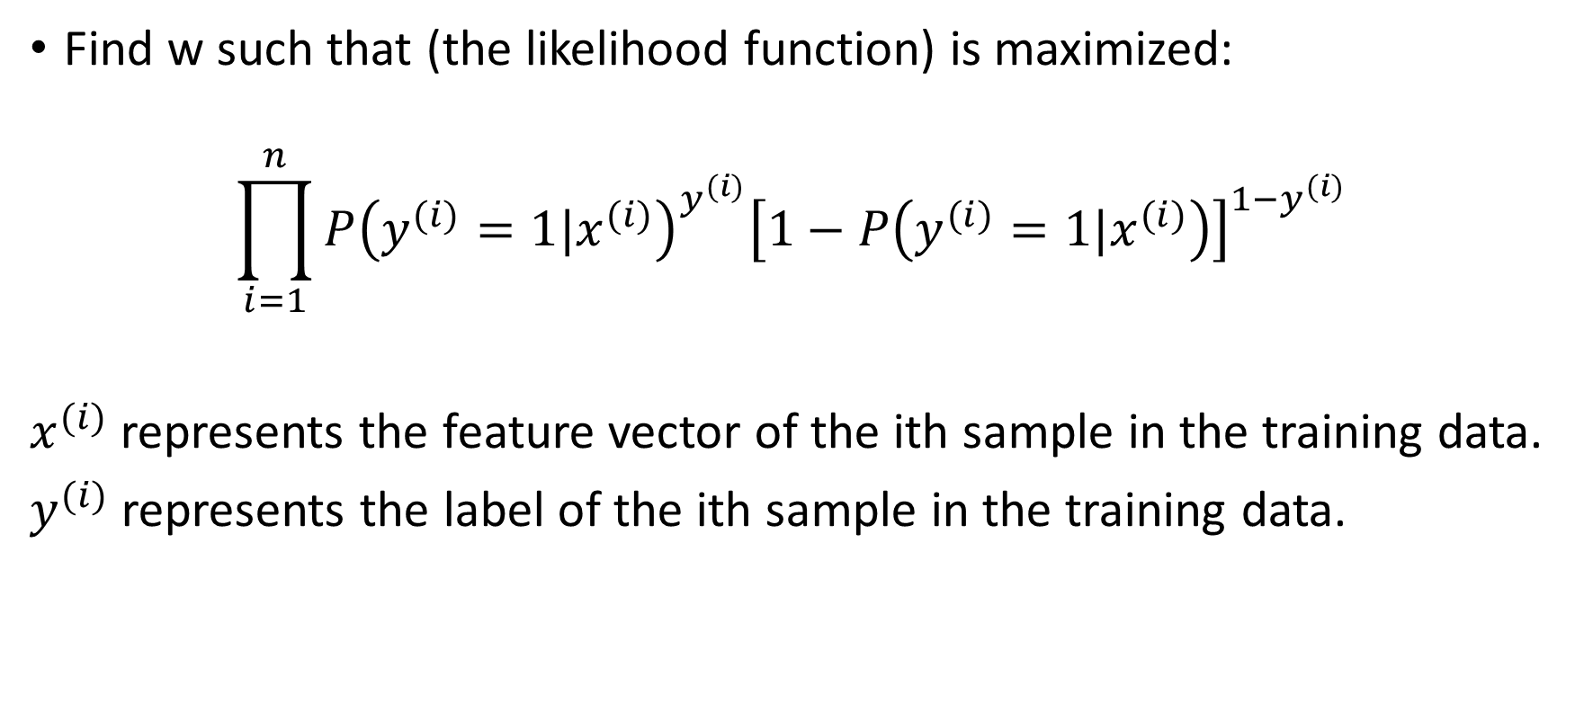
Formulation of the Optimization Problem
Find w such that (the likelihood function) is maximized:
$$\prod_{i=1}^{n}{{P\left(y^{(i)}=1|x^{(i)}\right)}^{y^{(i)}}{\left[1−P\left(y^{(i)}=1|x^{(i)}\right)\right]}^{1−y^{(i)}}}$$
$x^{(i)}$represents the feature vector of the ith sample in the training data.
$y^{(i)}$represents the label of the ith sample in the training data.

Slide 7
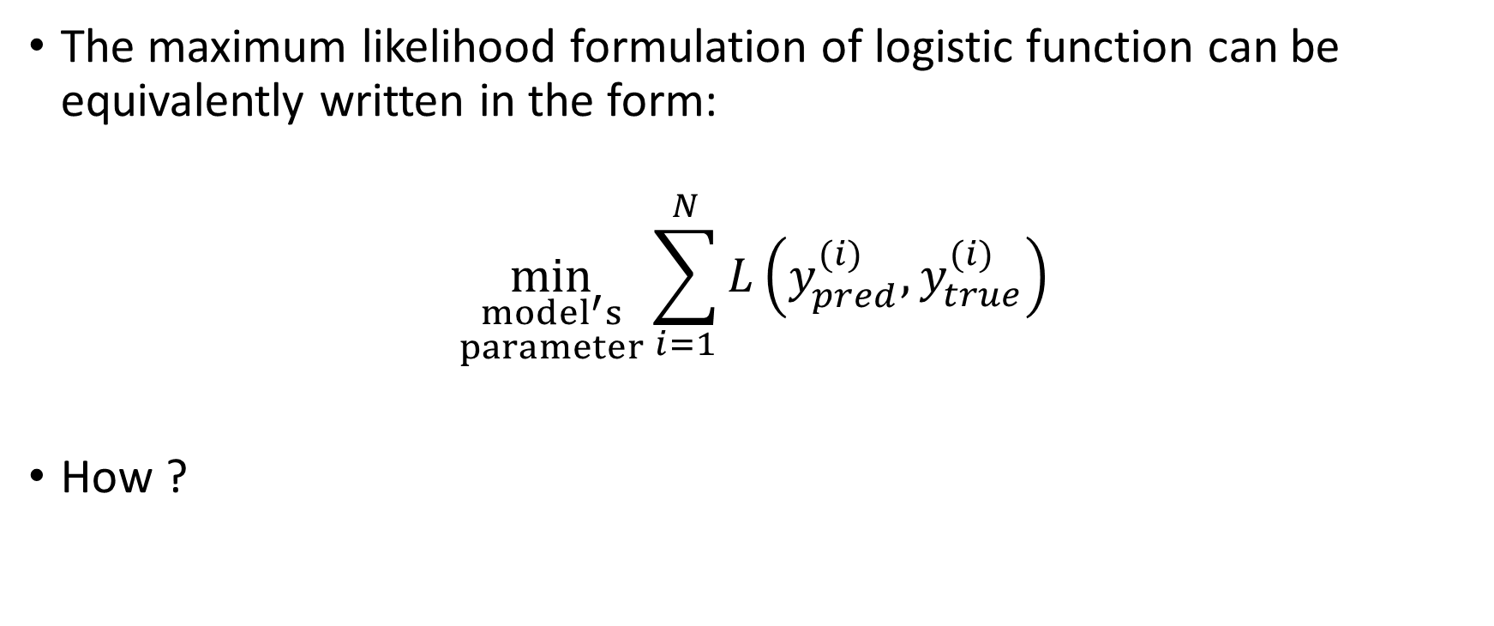
Fitting a logistic Regression Model
The maximum likelihood formulation of logistic function can be equivalently written in the form:
$$\min_{\begin{aligned}model^{′}s \\ parameter\end{aligned}}{\sum_{i=1}^{N}{L\left(y_{pred}^{(i)}, y_{true}^{(i)}\right)}}$$
How ?

Slide 8
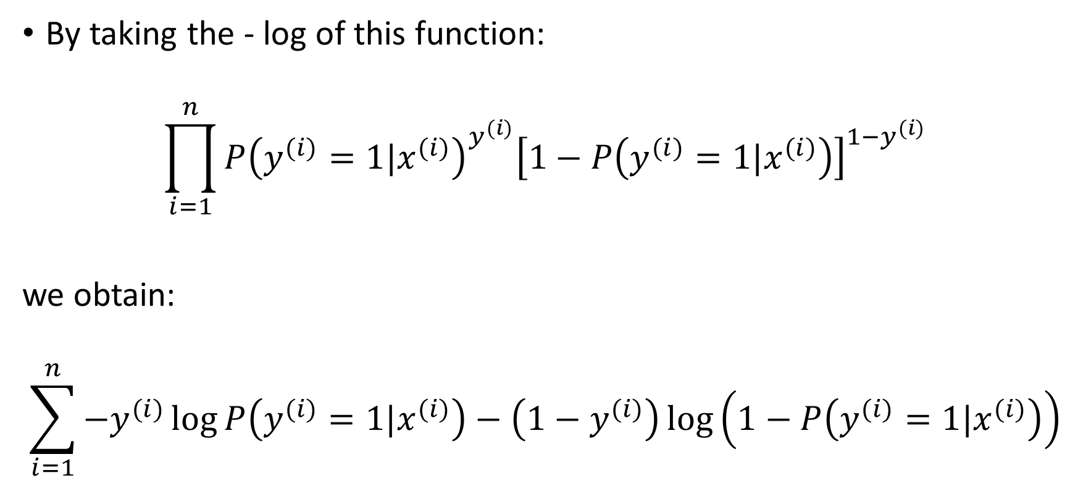
Formulation of the Optimization Problem
By taking the - log of this function:
$$\prod_{i=1}^{n}{{P\left(y^{(i)}=1|x^{(i)}\right)}^{y^{(i)}}{\left[1−P\left(y^{(i)}=1|x^{(i)}\right)\right]}^{1−y^{(i)}}}$$
we obtain:
$$\sum_{i=1}^{n}{−y^{(i)}\log{P\left(y^{(i)}=1|x^{(i)}\right)−\left(1−y^{(i)}\right)}}\log\left(1−P\left(y^{(i)}=1|x^{(i)}\right)\right)$$

Slide 9
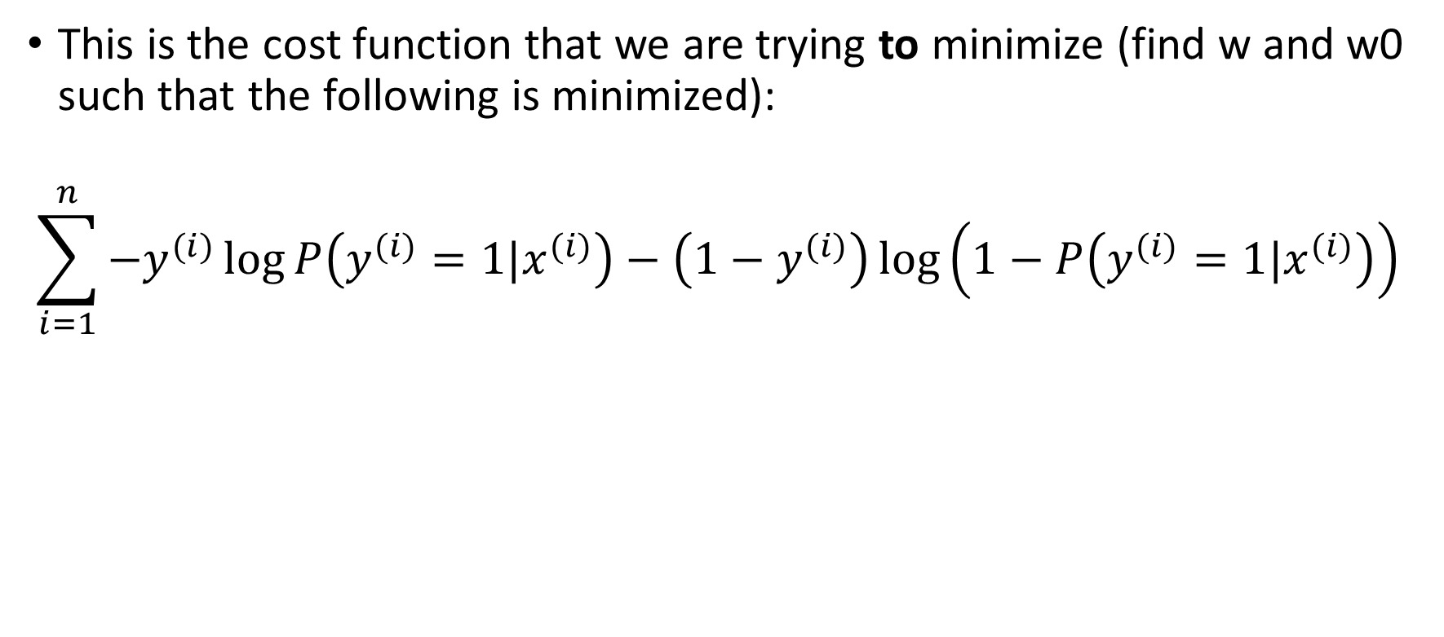
Formulation of the Optimization Problem
This is the cost function that we are trying to minimize (find w and w0 such that the following is minimized):
$$\sum_{i=1}^{n}{−y^{(i)}\log{P\left(y^{(i)}=1|x^{(i)}\right)−\left(1−y^{(i)}\right)}}\log\left(1−P\left(y^{(i)}=1|x^{(i)}\right)\right)$$

Slide 10
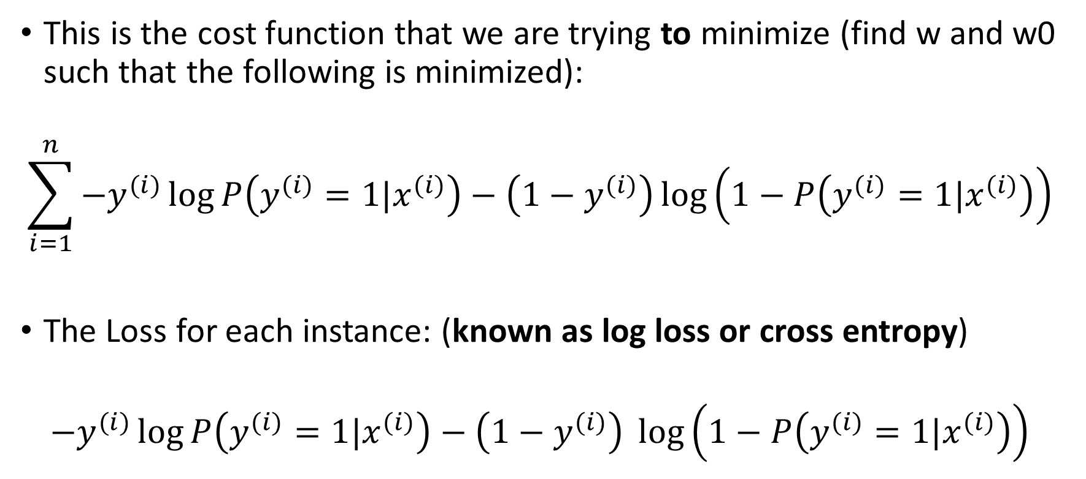
Formulation of the Optimization Problem
This is the cost function that we are trying to minimize (find w and w0 such that the following is minimized):
$$\sum_{i=1}^{n}{−y^{(i)}\log{P\left(y^{(i)}=1|x^{(i)}\right)−\left(1−y^{(i)}\right)}}\log\left(1−P\left(y^{(i)}=1|x^{(i)}\right)\right)$$
The Loss for each instance: (known as log loss or cross entropy)
$${−y}^{(i)}\log{P\left(y^{(i)}=1|x^{(i)}\right)−\left(1−y^{(i)}\right)} \log\left(1−P\left(y^{(i)}=1|x^{(i)}\right)\right)$$

Slide 11
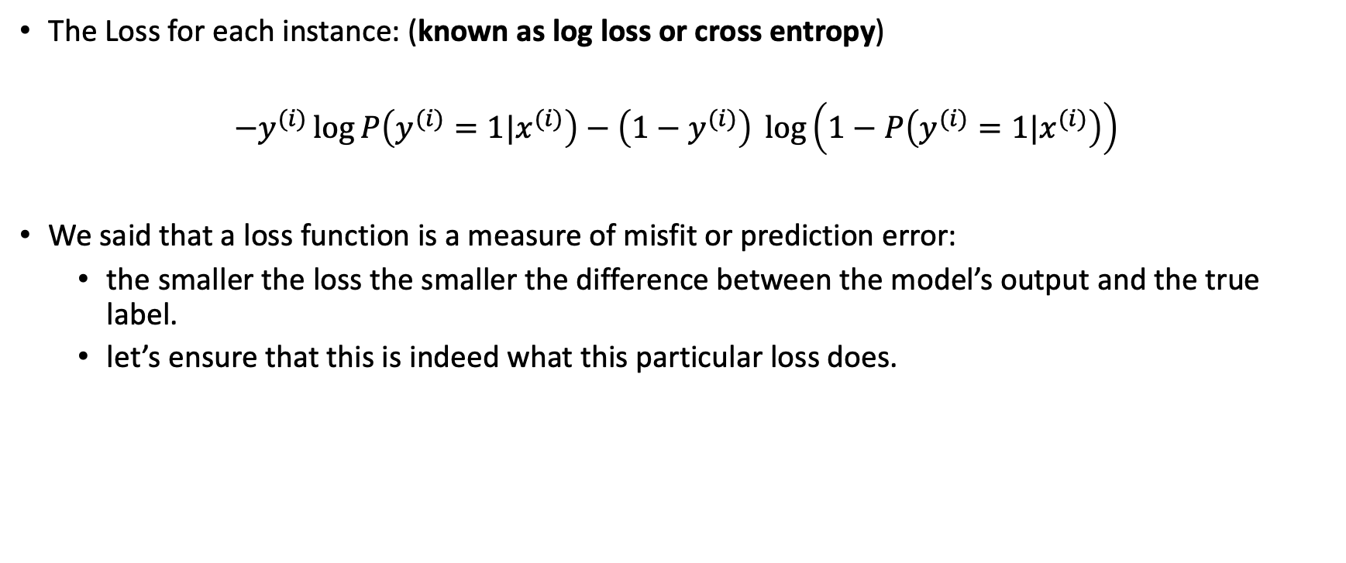
Log Loss or Cross Entropy
The Loss for each instance: (known as log loss or cross entropy)
$${−y}^{(i)}\log{P\left(y^{(i)}=1|x^{(i)}\right)−\left(1−y^{(i)}\right)} \log\left(1−P\left(y^{(i)}=1|x^{(i)}\right)\right)$$
We said that a loss function is a measure of misfit or prediction error:
the smaller the loss the smaller the difference between the model’s output and the true label.
let’s ensure that this is indeed what this particular loss does.

Slide 12

Log Loss or Cross Entropy
The Loss for each instance: (known as log loss or cross entropy)
$${−y}^{(i)}\log{P\left(y^{(i)}=1|x^{(i)}\right)−\left(1−y^{(i)}\right)} \log\left(1−P\left(y^{(i)}=1|x^{(i)}\right)\right)$$
If the true label is 1, then loss: $−\log{P\left(y^{(i)}=1|x^{(i)}\right)}$
The loss is minimized when the output of the model (probability of y=1) is close to 1.

Slide 13

Log Loss or Cross Entropy
The Loss for each instance: (known as log loss or cross entropy)
$${−y}^{(i)}\log{P\left(y^{(i)}=1|x^{(i)}\right)−\left(1−y^{(i)}\right)} \log\left(1−P\left(y^{(i)}=1|x^{(i)}\right)\right)$$
If the true label is 0, then loss: $−\log\left(1−P\left(y^{(i)}=1|x^{(i)}\right)\right)$
The loss is minimized when the output of the model (probability of y=1) is close to 0.

Slide 14

Fitting Logistic Regression
$$\min_{w,{ w}_{0}}{\sum_{i=1}^{n}{−y^{(i)}\log{P\left(y^{(i)}=1|x^{(i)}\right)−\left(1−y^{(i)}\right)}}\log\left(1−P\left(y^{(i)}=1|x^{(i)}\right)\right)}$$
There is a good news and a bad news!

Slide 15
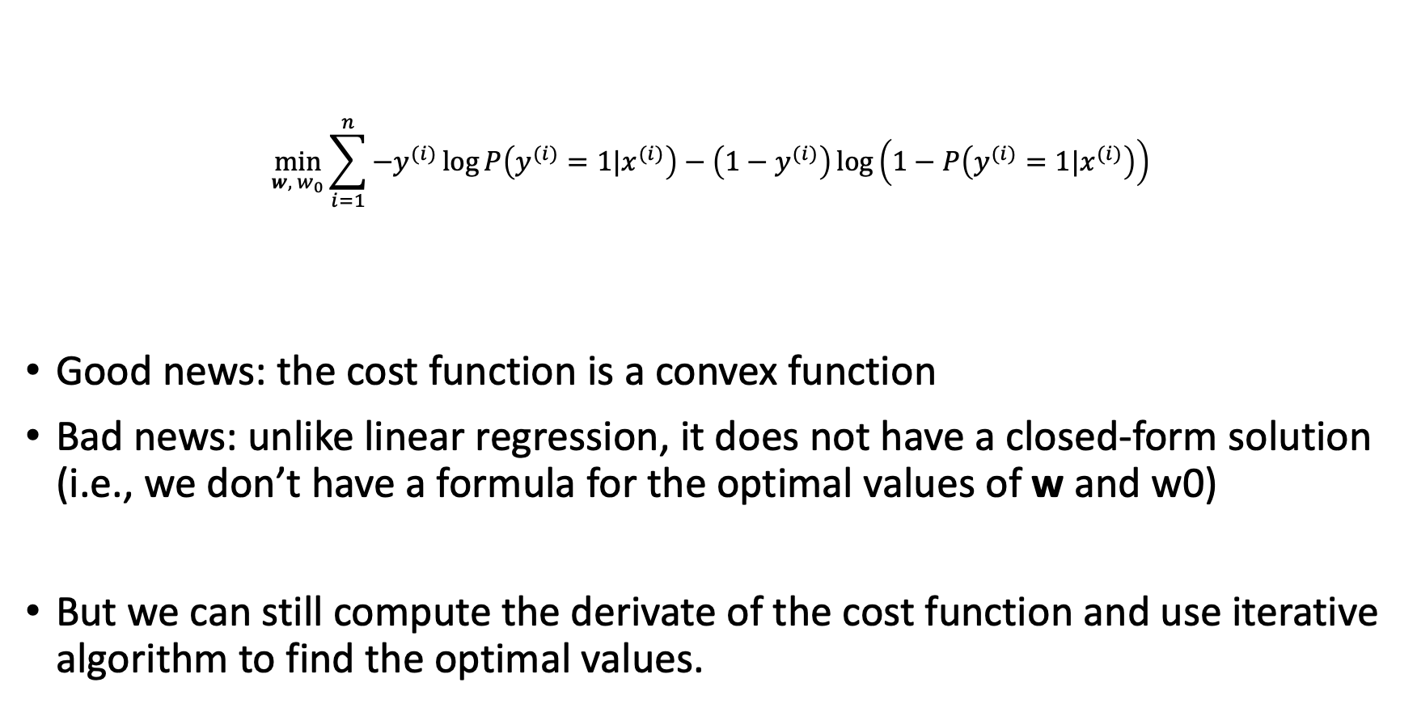
Fitting Logistic Regression
$$\min_{w,{ w}_{0}}{\sum_{i=1}^{n}{−y^{(i)}\log{P\left(y^{(i)}=1|x^{(i)}\right)−\left(1−y^{(i)}\right)}}\log\left(1−P\left(y^{(i)}=1|x^{(i)}\right)\right)}$$
Good news: the cost function is a convex function
Bad news: unlike linear regression, it does not have a closed-form solution (i.e., we don’t have a formula for the optimal values of w and w0)
But we can still compute the derivate of the cost function and use iterative algorithm to find the optimal values.

Slide 16
Fitting Logistic Regression
Note:
The cost function of logistic regression is convex.
To find the optimal parameters, it uses an iterative method:
Start with an initial guess
Update the guess until the minimizer is reached.
Source: https://towardsdatascience.com/animations-of-logistic-regression-with-python-31f8c9cb420

Slide 17
Question
Question: why did we not use an evaluation metric as our loss function? Evaluation metric vs loss function

Slide 18
Loss Function
You've evaluated predicted models but did a loss function ever come up?
Once the model is trained, we no longer need the loss function
The loss function is used during the training phase to find the model’s parameter.

Slide 19
How to solve optimization problems?

Slide 20
Training Phase
Training or fitting a model to the training data is a search problem, where we’re looking for the best parameters (search the parameter space).
We search the parameter space to find a point (combination of parameter values) which minimizes the cost function.

Slide 21
Several Approaches
Analytical Approach:
We’ve seen that with linear regression, the objective function is a convex function and it has closed form solution (by setting the derivative equal to zero)
Iterative (Numerical) Approach:
We’ve seen that with logistic function, the objective function is a convex function, but it does not have closed solution. This is why we use a numerical optimization problem (or when solving the derivative method may not be feasible).

Slide 22
Analytical & Iterative Approach
These approaches usually assume that the objective function is a smooth function: 1-continuous and 2-differentiable

Slide 23
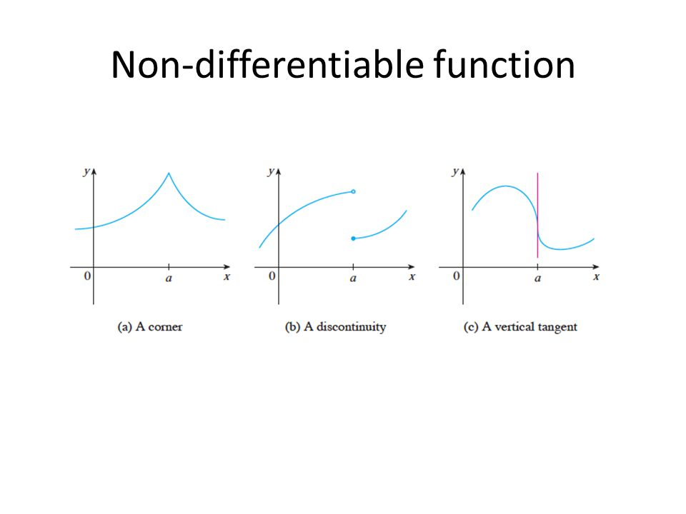
Smooth Functions
We use loss functions and models that are continuous and differentiable
Examples of equations that are not:
Accuracy – not smooth, a prediction is either right or wrong, leading to lots of discontinuities
Absolute values
We often modify functions to smooth them if we intend to use them with optimizations
Non-smooth Functions

Slide 24
Grid Search
Analytical and numerical methods make some assumptions about the cost functions.
Grid search (exhaustive search or brute force) assume nothing about the cost function.
Simple approach that evaluates the cost function over many possible values for the parameters.

Slide 25
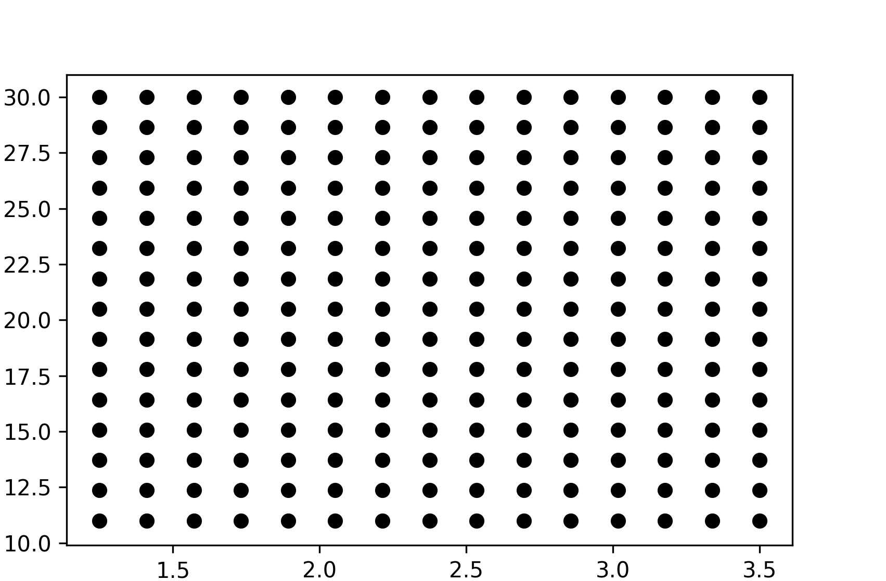


Grid Search
We want to do a grid search of parameter space
We define a grid of points
Evaluated the loss function at each point
Use the point that produced the lowest loss value as the parameters for the model
$$β_{1}$$
$$β_{0}$$

Slide 26
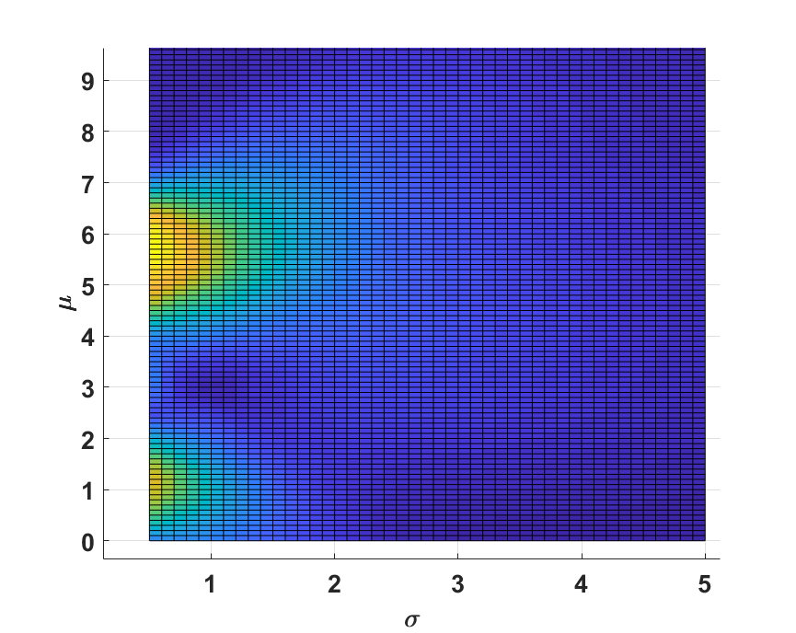
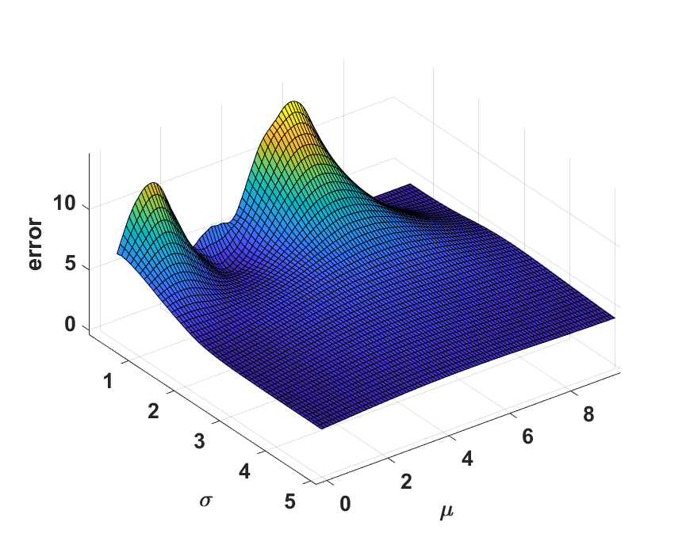
Grid Search
"Query" the loss function to get a prediction of error for each grid point
Search through this function space to find what model parameters lead to a minimal error value

Slide 27
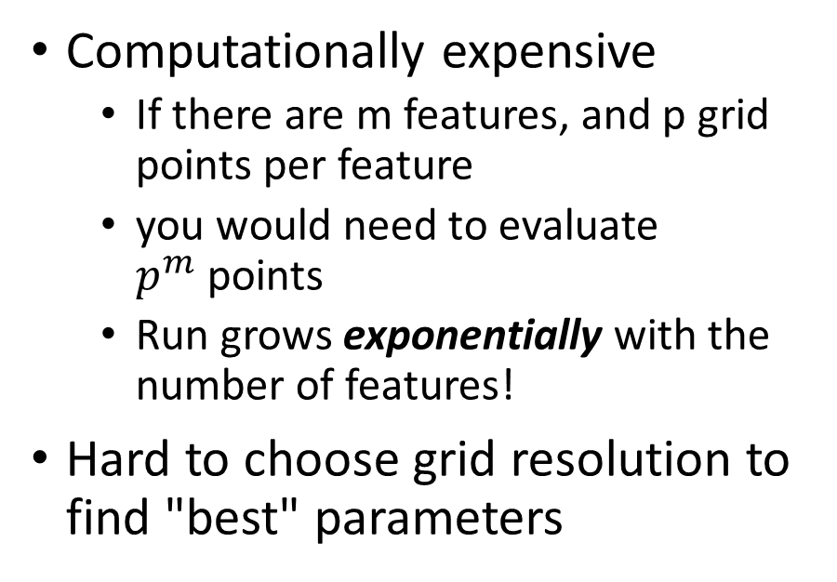
Grid Search
Advantages
Disadvantages
Easy to do
Does not require taking any derivatives
Does not assume any property on the cost functions (support non-smooth functions)
Computationally expensive
If there are m features, and p grid points per feature
you would need to evaluate $p^{m}$points
Run grows exponentially with the number of features!
Hard to choose grid resolution to find "best" parameters

Slide 28
Approaches for Optimizing Model Parameters
"Naïve" Grid Search
Divide the parameter space into a grid
Try the parameters represented at each grid cell
"Smart" Grid Search:
Simulated Annealing
Genetic Algorithms
Analytical Calculus Techniques
Take the first derivative
Find the parameters which make the derivative output 0
Numerical techniques
Use the derivative to perform a "smart" search of the parameter space

Slide 29
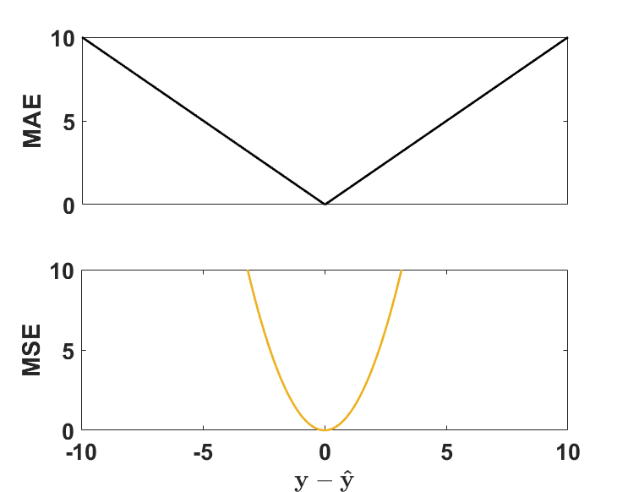

Error functions
Common forms
Mean Absolute error
$MAE= \frac{1}{n}\sum_{i=1}^{n}{\left|y−\hat{y}\right|}$
Mean-Squared Error
$MSE= \frac{1}{N}\sum_{i=1}^{N}{{(y−\hat{y})}^{2}}$

