Slide 1
Objective Functions – Loss & Cost Functions - I
CSC4601 Theory of Machine Learning

Slide 2
Overview
Data Pre-processing
Feature Engineering
Feature Scaling
Data Splitting into training and testing sets
Training
Use the training set to perform:
Model Fitting
Model selection: cross-validation, model tuning
Evaluation
Evaluation of final model on testing set
Prediction
Use the final model to predict the labels for new unlabeled data

Slide 3
What is model fitting?
What is given to us? (known)
What is not given to us? (unknown)
What is the goal of model fitting?

Slide 4
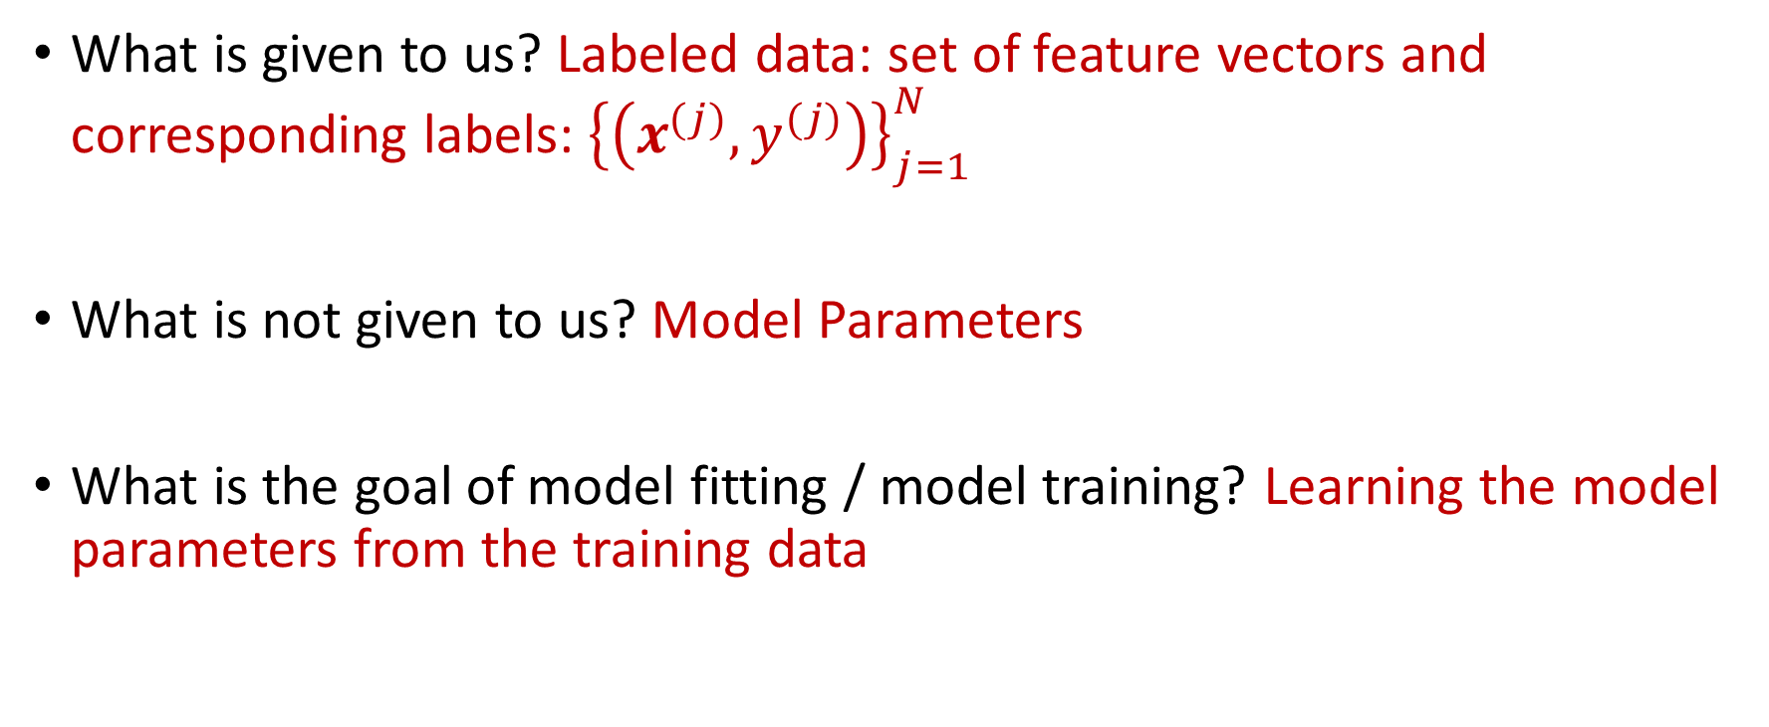
What is model fitting?
What is given to us? Labeled data: set of feature vectors and corresponding labels:${ \left\{\left(x^{(j)}, y^{(j)}\right)\right\}}_{j=1}^{N}$
What is not given to us? Model Parameters
What is the goal of model fitting / model training? Learning the model parameters from the training data

Slide 5
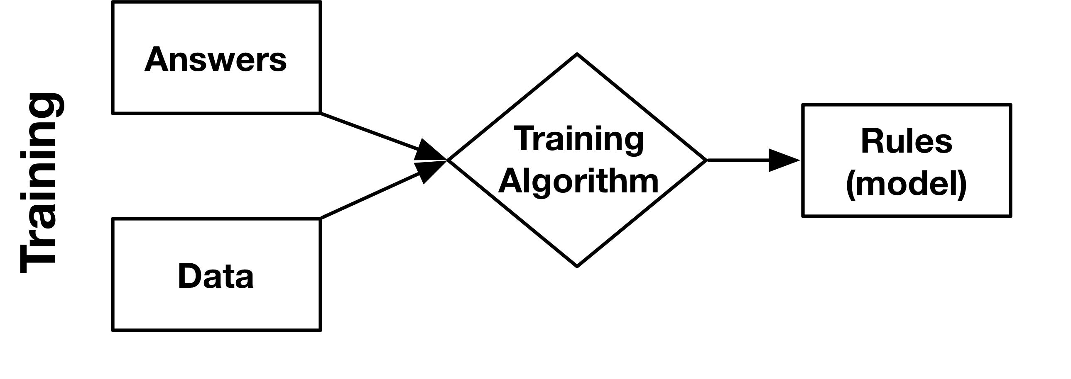
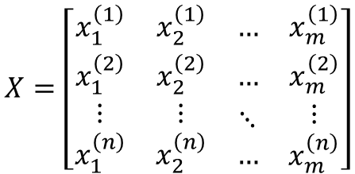
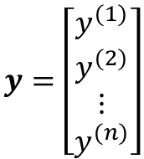
Training phase – Model fitting (Supervised Learning)
$$y=\left[\begin{aligned}y^{(1)} \\ \begin{aligned}y^{(2)} \\ \begin{aligned}⋮ \\ y^{(n)}\end{aligned}\end{aligned}\end{aligned}\right]$$
Label vector
Feature matrix that consists of training data
$$X=\left[\begin{matrix}x_{1}^{\left(1\right)} & x_{2}^{\left(1\right)} & … & x_{m}^{\left(1\right)} \\ x_{1}^{\left(2\right)} & x_{2}^{\left(2\right)} & … & x_{m}^{\left(2\right)} \\ \begin{aligned}⋮ \\ x_{1}^{\left(n\right)}\end{aligned} & \begin{aligned}⋮ \\ x_{2}^{\left(n\right)}\end{aligned} & \begin{aligned}⋱ \\ …\end{aligned} & \begin{aligned}⋮ \\ x_{m}^{\left(n\right)}\end{aligned}\end{matrix}\right]$$

Slide 6



Using Machine Learning Models
Future data with unknown label (Input)
Learned/Trained Model
$$f(.)$$
Predicted label (Output)
$$x=\left[\begin{aligned}x_{1} \\ \begin{aligned}x_{2} \\ \begin{aligned}⋮ \\ x_{m}\end{aligned}\end{aligned}\end{aligned}\right]$$
$$y=f(x)$$

Slide 7
Model Fitting
To fit a machine learning model in scikit-learn,
1. you instantiate the model
2. model.fit(X_train, y_train)
3. the model contains the learned model’s parameters
You can directly implement machine learning models without knowing what’s under the hood (implementation details):
However, understanding the implementation details helps you debug any issues, what to choose for the model’s hyperparameters, what models to try, ….

Slide 8
Overview
This sklearn fit method consists of the steps needed to learn the model’s parameters using the training data set: training algorithm.
We already know how:
KNN fits the data
Decision tree fits the data
For some other machine learning models (linear regression, logistic regression, SVM), the training algorithm consists of solving an optimization problem.
What do we mean by optimization problem?

Slide 9
Optimization Problem

Slide 10
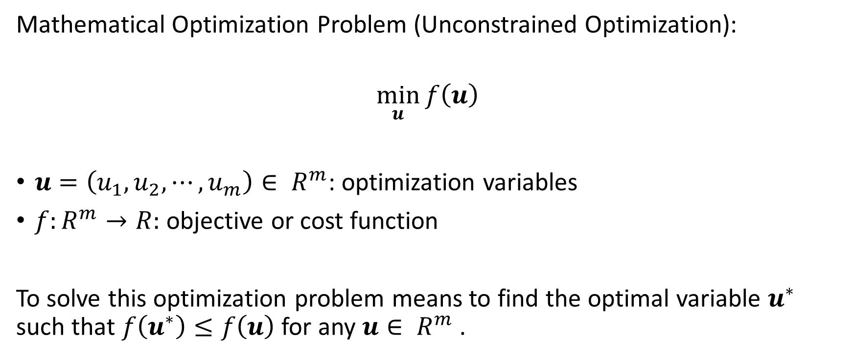
Optimization Problem
Mathematical Optimization Problem (Unconstrained Optimization):
$$\min_{u}{f\left(u\right) }$$
$u=\left(u_{1}, u_{2},⋯,u_{m}\right)∈ R^{m}$: optimization variables
$f:R^{m}→R:$objective or cost function
To solve this optimization problem means to find the optimal variable $u^{∗}$ such that $f\left(u^{∗}\right)≤f\left(u\right)$ for any $u∈ R^{m}$.

Slide 11
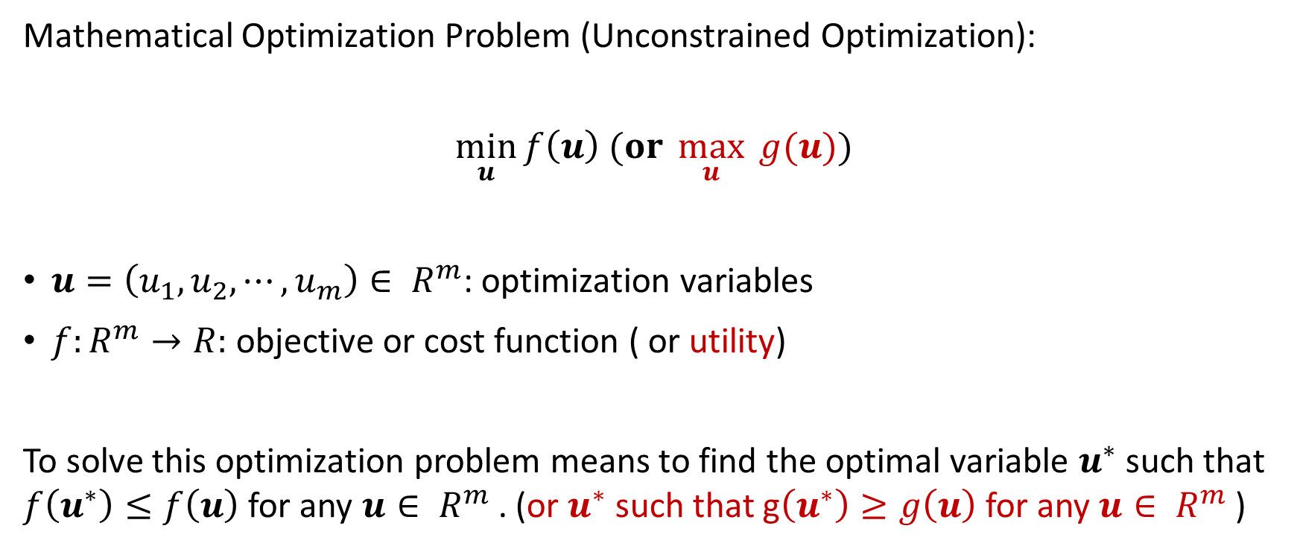
Optimization Problem
Mathematical Optimization Problem (Unconstrained Optimization):
$$\min_{u}{f\left(u\right) (or \max_{u}{ g(u)}})$$
$u=\left(u_{1}, u_{2},⋯,u_{m}\right)∈ R^{m}$: optimization variables
$f:R^{m}→R:$objective or cost function ( or utility)
To solve this optimization problem means to find the optimal variable $u^{∗}$ such that $f\left(u^{∗}\right)≤f\left(u\right)$ for any $u∈ R^{m}$. (or $u^{∗}$ such that g$\left(u^{∗}\right)≥g\left(u\right)$ for any $u∈ R^{m}$)

Slide 12
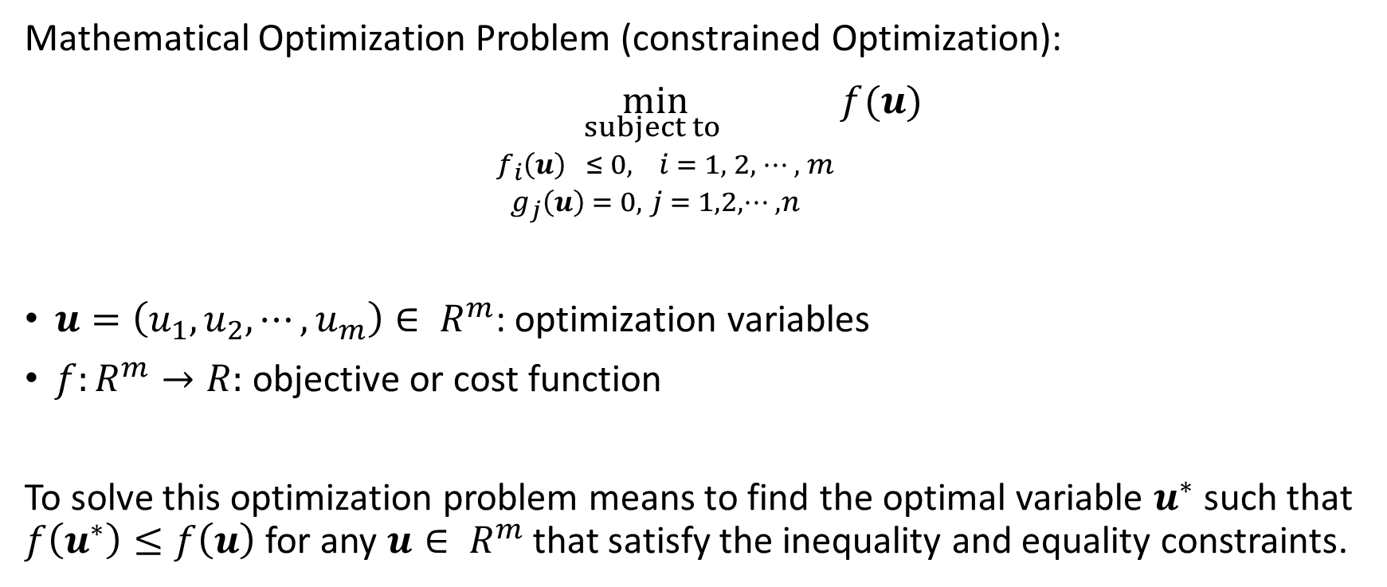
Optimization Problem
Mathematical Optimization Problem (constrained Optimization):
$$\min_{\begin{aligned}subject to \\ { f}_{i}\left(u\right) ≤ 0, i = 1, 2, ⋯, m \\ g_{j}\left(u\right) = 0, j = 1, 2, ⋯, n\end{aligned}}{f(u)}$$
$u=\left(u_{1}, u_{2},⋯,u_{m}\right)∈ R^{m}$: optimization variables
$f:R^{m}→R:$objective or cost function
To solve this optimization problem means to find the optimal variable $u^{∗}$ such that $f\left(u^{∗}\right)≤f\left(u\right)$ for any $u∈ R^{m}$that satisfy the inequality and equality constraints.

Slide 13
Example
An advertising company wants to find the best advertising strategy:
Goal: To figure out how many ads should be run in each media:
such as the total number of audience is maximized
while not exceeding the budget of $18,200 and at least 10% of the ads should occur in TV.
 | TV | Newspaper | Radio
Cost per ad ($) | 2000 | 600 | 300
Audience per ad | 100,000 | 40,000 | 18,000
Source: Link

Slide 14
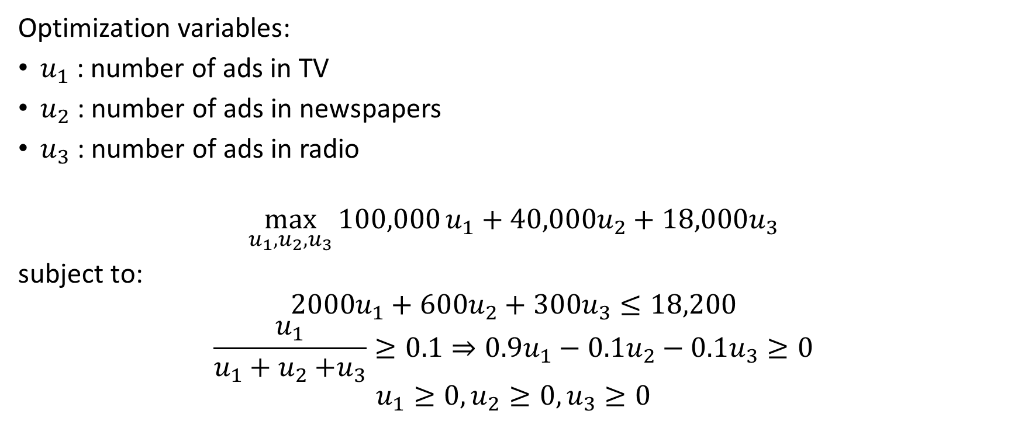
Example
Optimization variables:
$u_{1}$: number of ads in TV
$u_{2}$: number of ads in newspapers
$u_{3}$: number of ads in radio
$$\max_{u_{1}, u_{2},u_{3}}{100,000}u_{1}+40,000u_{2}+18,000u_{3}$$
subject to:
$$2000u_{1}+600u_{2}+300u_{3}≤18,200$$
$$\frac{u_{1}}{u_{1}{+ u}_{2}+u_{3}}≥0.1⇒0.9u_{1}−0.1u_{2}−0.1u_{3}≥0$$
$$u_{1}≥0,u_{2}≥0,u_{3}≥0$$

Slide 15
Optimization in ML

Slide 16
Where do we use optimization in machine learning?
Most ML training algorithms are based on optimization:
Linear regression
Logistic Regression
K-means
Support Vector Machines
Deep learning end-to-end
Etc…

Slide 17
Model fitting : Optimization problem
To find the parameters of linear regression and logistic regression, the problem is formulated as a minimization problem
What are the optimization variables?
What is the cost function?

Slide 18
Model fitting : Optimization problem
To find the parameters of linear regression and logistic regression, the problem is formulated as a minimization problem
What are the optimization variables? Parameters of the model
What is the cost function? Sum or average of loss functions

Slide 19
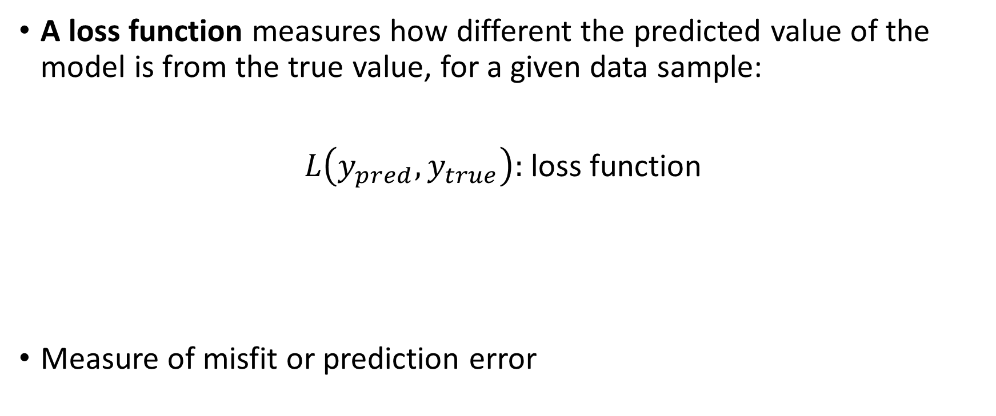
How is the fitting problem formulated as an optimization problem?
A loss function measures how different the predicted value of the model is from the true value, for a given data sample:
$L\left(y_{pred}, y_{true}\right):$loss function
Measure of misfit or prediction error
This is only for one instance in the training set.
Predicted output
of the model
True Label

Slide 20
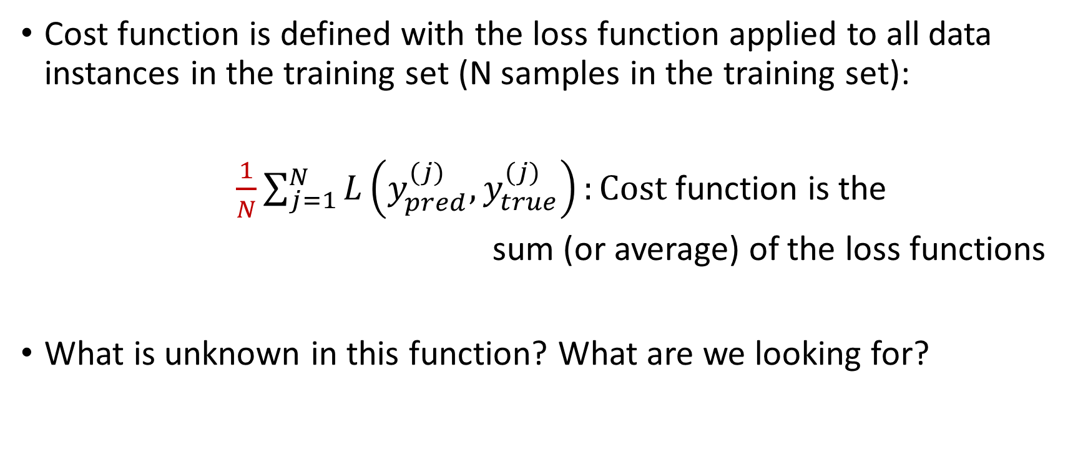
Cost or Objective Function for Data Fitting
Cost function is defined with the loss function applied to all data instances in the training set (N samples in the training set):
$\frac{1}{N}\sum_{j=1}^{N}{L\left(y_{pred}^{(j)}, y_{true}^{(j)}\right)}:Cost$ function is the
sum (or average) of the loss functions
What is unknown in this function? What are we looking for?

Slide 21

Cost or Objective Function for Data Fitting
We are looking to find the model’s parameters by minimizing this cost function:
$$\min_{\begin{aligned}model^{′}s \\ parameter\end{aligned}}{\sum_{j=1}^{N}{L\left(y_{pred}^{(j)}, y_{true}^{(j)}\right)}}$$

Slide 22
Linear Regression

Slide 23











Linear Regression
Weight each feature
Weighted sum of features
$$x_{1}$$
$$w_{1}$$
$$x_{2}$$
$$w_{2}$$
+
$${w_{1}x}_{1}+{w_{2}x}_{2 }+⋯+w_{m}x_{m}+w_{0}$$
$$\hat{y}=x^{T}w+w_{0}$$
$$w_{m}$$
$$x_{m}$$
$$w_{0}$$
$$1$$
where,
$x=\left[\begin{aligned}x_{1} \\ \begin{aligned}x_{2} \\ \begin{aligned}⋮ \\ x_{m}\end{aligned}\end{aligned}\end{aligned}\right]$ and $w=\left[\begin{aligned}w_{1} \\ \begin{aligned}w_{2} \\ \begin{aligned}⋮ \\ w_{m}\end{aligned}\end{aligned}\end{aligned}\right]$

Slide 24
Fitting a linear Regression
What is known for us? What is unknown and want to find?

Slide 25
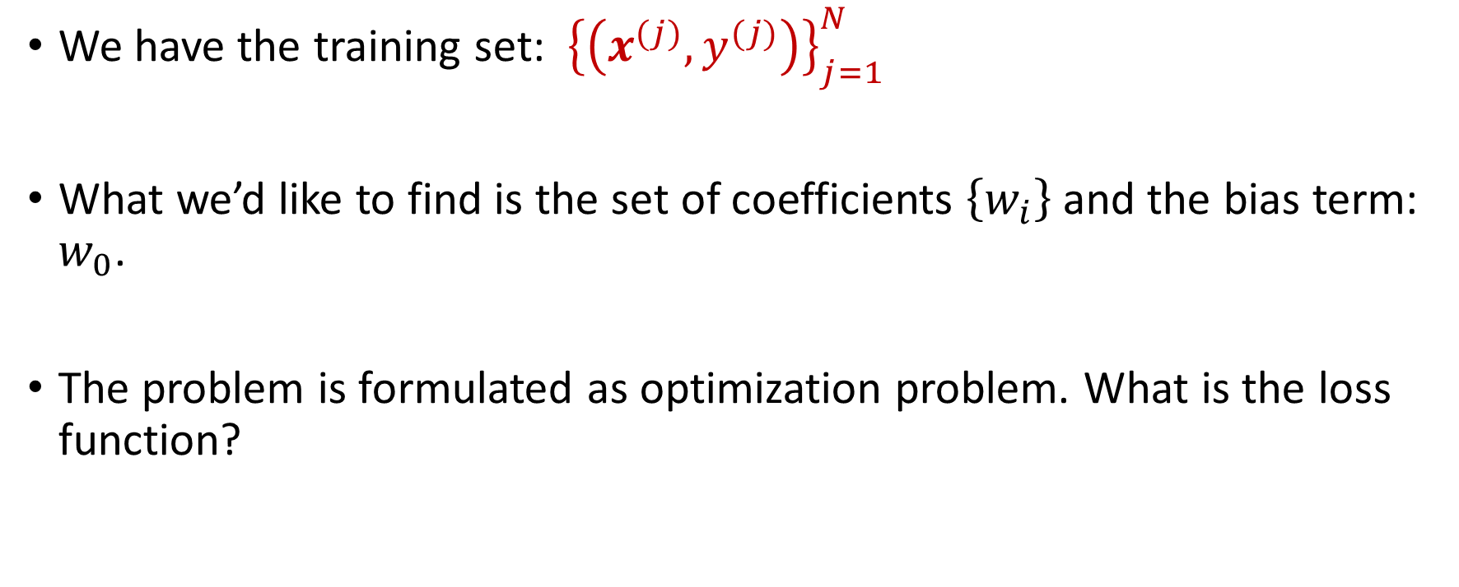
Fitting a linear Regression
We have the training set: ${ \left\{\left(x^{(j)}, y^{(j)}\right)\right\}}_{j=1}^{N}$
What we’d like to find is the set of coefficients $\left\{w_{i}\right\}$and the bias term: $w_{0}$.
The problem is formulated as optimization problem. What is the loss function?

Slide 26
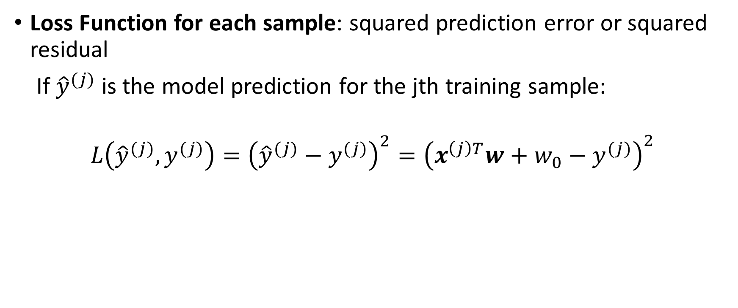
Fitting a linear regression model
Loss Function for each sample: squared prediction error or squared residual
If ${\hat{y}}^{(j)}$ is the model prediction for the jth training sample:
$$L\left({\hat{y}}^{(j)}, y^{(j)}\right)={\left({\hat{y}}^{(j)}−y^{(j)}\right)}^{2}={\left(x^{\left(j\right)T}w+w_{0}−y^{(j)}\right)}^{2}$$

Slide 27
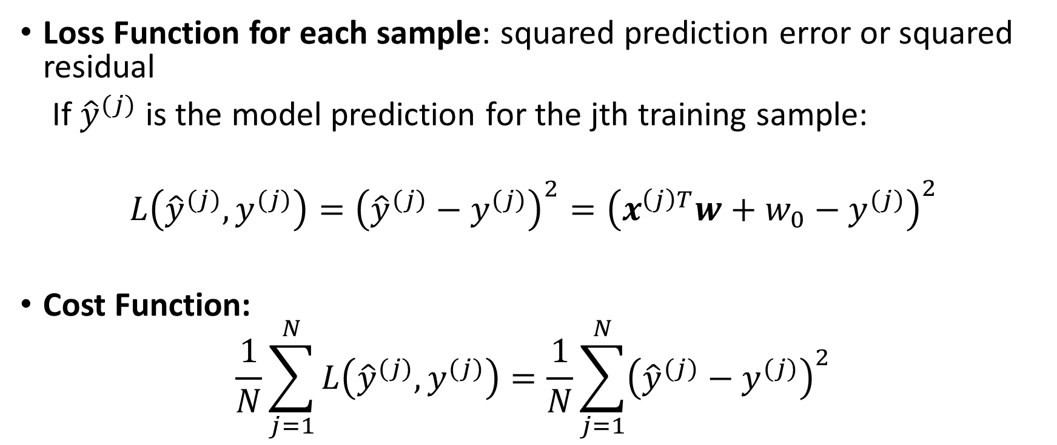
Fitting a linear regression model
Loss Function for each sample: squared prediction error or squared residual
If ${\hat{y}}^{(j)}$ is the model prediction for the jth training sample:
$$L\left({\hat{y}}^{(j)}, y^{(j)}\right)={\left({\hat{y}}^{(j)}−y^{(j)}\right)}^{2}={\left(x^{\left(j\right)T}w+w_{0}−y^{(j)}\right)}^{2}$$
Cost Function:
$$\frac{1}{N}\sum_{j=1}^{N}{L\left({\hat{y}}^{(j)}, y^{(j)}\right)}=\frac{1}{N}\sum_{j=1}^{N}{{\left({\hat{y}}^{(j)}−y^{(j)}\right)}^{2}}$$
Mean Square Error (MSE) or sum of squared residuals (SSR)

Slide 28
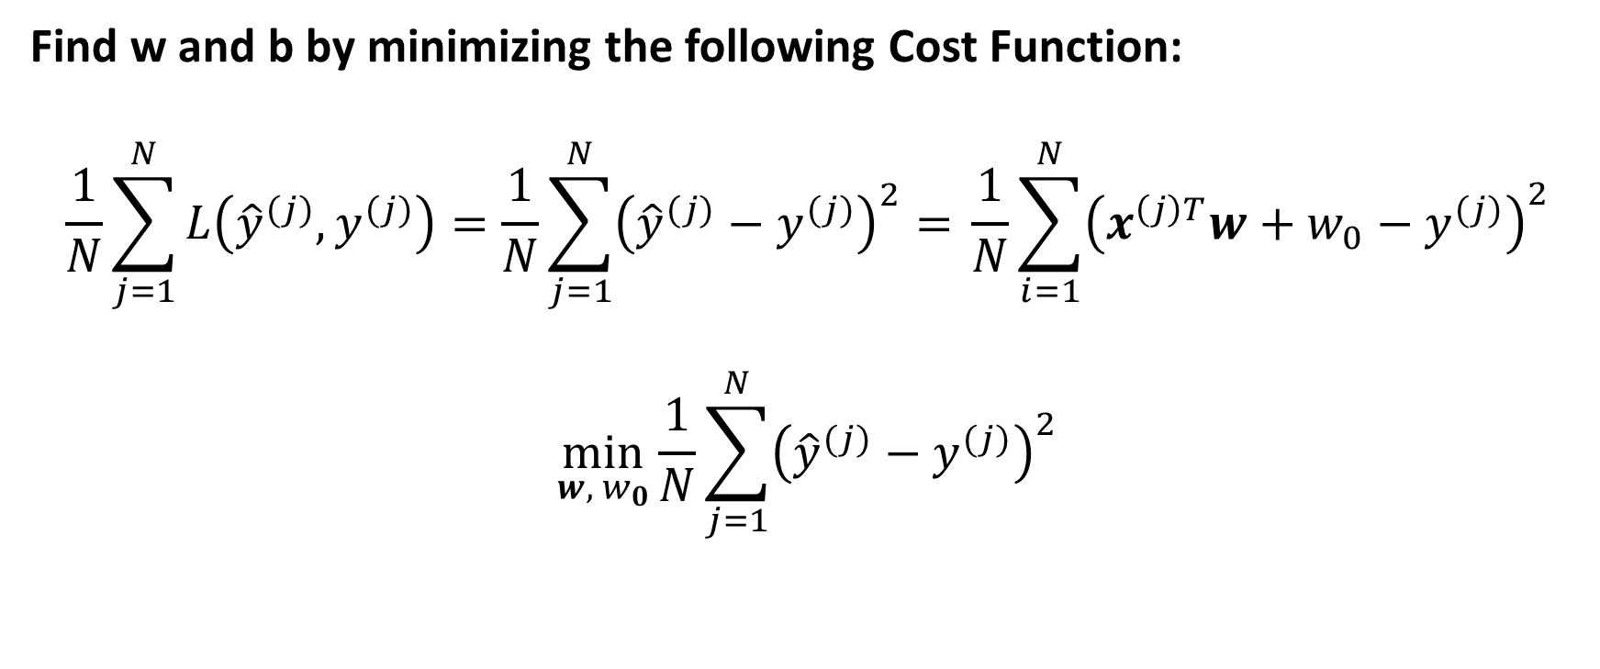
Fitting a linear regression model
Find w and b by minimizing the following Cost Function:
$$\frac{1}{N}\sum_{j=1}^{N}{L\left({\hat{y}}^{(j)}, y^{(j)}\right)}=\frac{1}{N}\sum_{j=1}^{N}{{\left({\hat{y}}^{(j)}−y^{(j)}\right)}^{2}= }\frac{1}{N}\sum_{i=1}^{N}{{\left(x^{\left(j\right)T}w+w_{0}−y^{(j)}\right)}^{2}}$$
$$\min_{w, w_{0}}{\frac{1}{N}\sum_{j=1}^{N}{{\left({\hat{y}}^{(j)}−y^{(j)}\right)}^{2}}}$$
This is also known as the least squares problem.

Slide 29
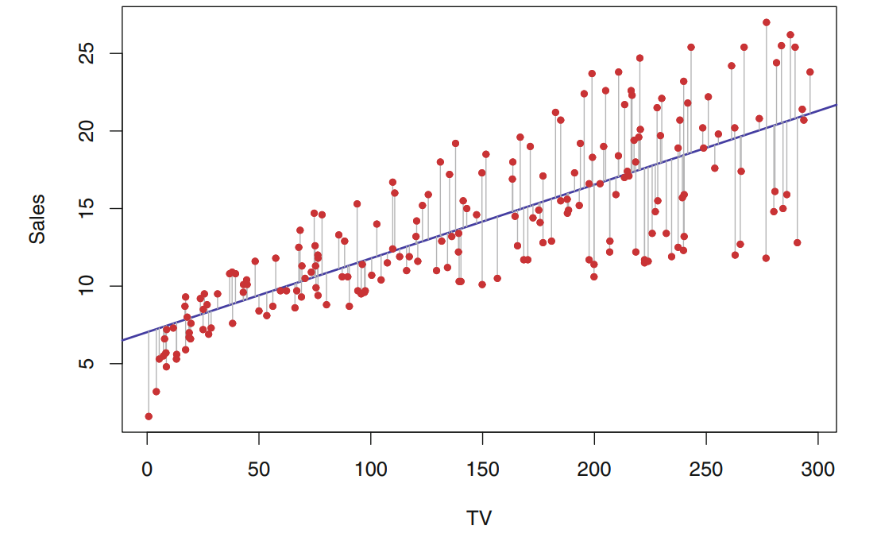
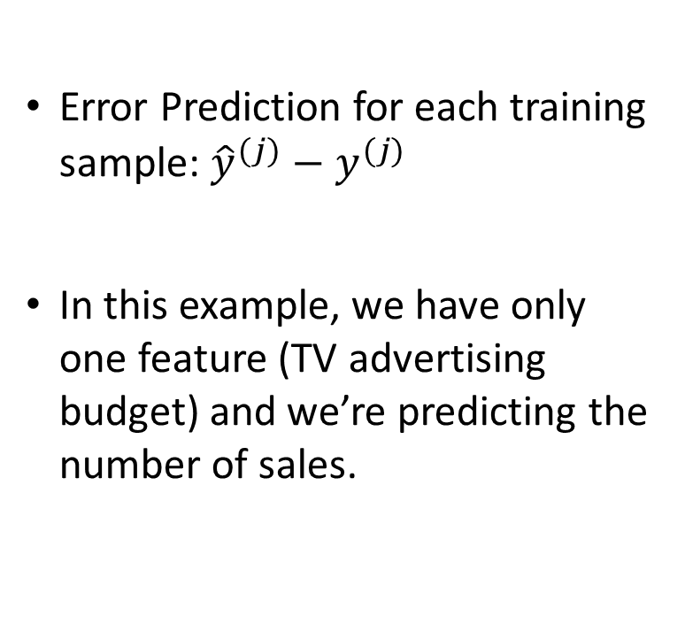
Visualizing the Error Prediction
Error Prediction for each training sample: ${\hat{y}}^{(j)}−y^{(j)}$
In this example, we have only one feature (TV advertising budget) and we’re predicting the number of sales.

Slide 30
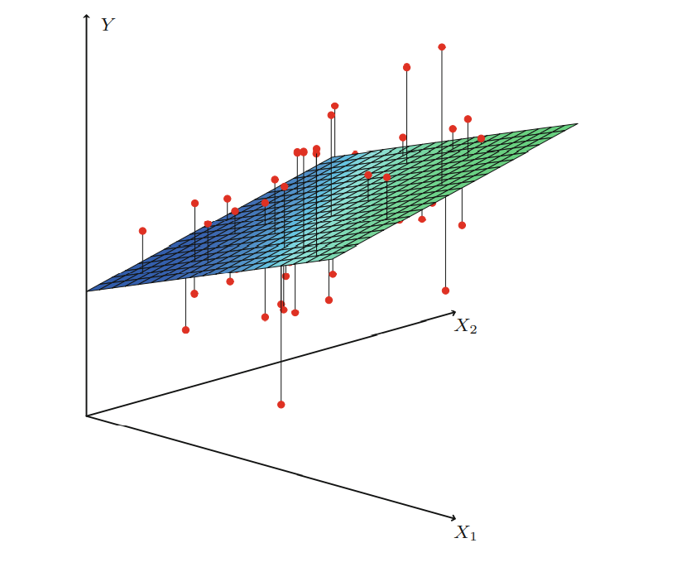
Visualizing the Error Prediction
In a three-dimensional figure, with two features and one response, the least squares regression line becomes a plane.
The plane is chosen to minimize the sum of the squared vertical distances between each observation (shown in red) and the plane.

Slide 31
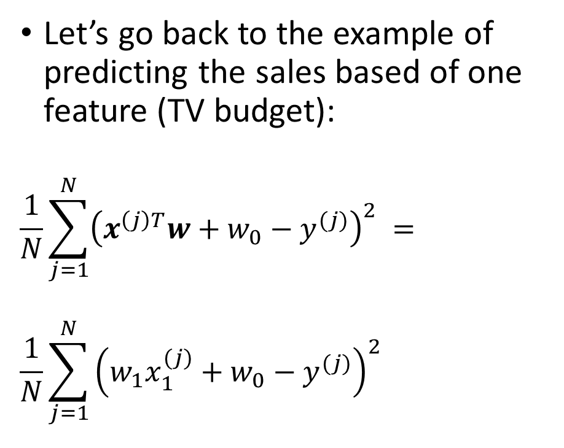
Visualizing the Cost function
Let’s go back to the example of predicting the sales based of one feature (TV budget):
$$\frac{1}{N}\sum_{j=1}^{N}{{\left(x^{\left(j\right)T}w+w_{0}−y^{(j)}\right)}^{2} }=$$
$$\frac{1}{N}\sum_{j=1}^{N}{{\left({w_{1}x}_{1}^{(j)}+w_{0}−y^{(j)}\right)}^{2} }$$

Slide 32
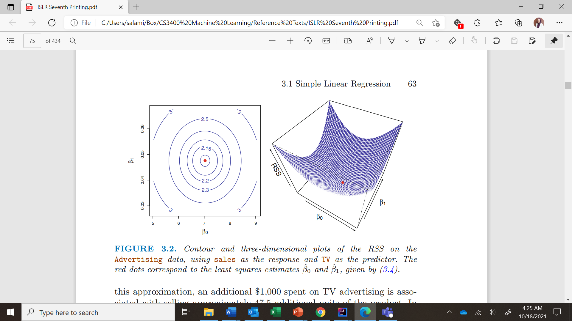
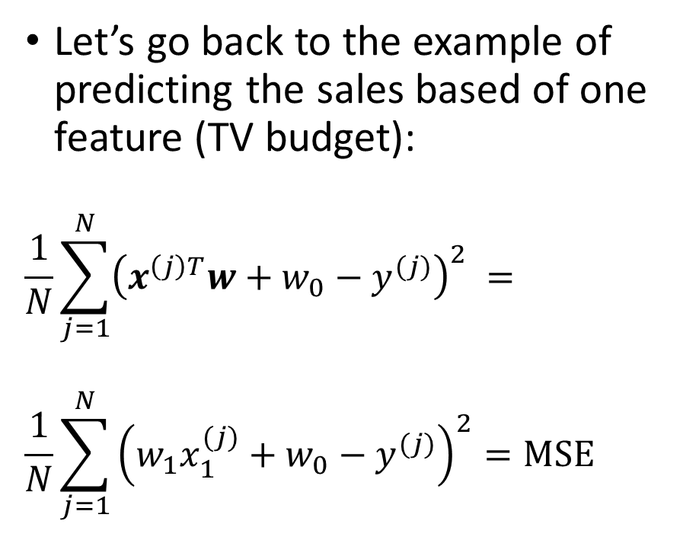


Visualizing the Cost function
Let’s go back to the example of predicting the sales based of one feature (TV budget):
$$\frac{1}{N}\sum_{j=1}^{N}{{\left(x^{\left(j\right)T}w+w_{0}−y^{(j)}\right)}^{2} }=$$
$$\frac{1}{N}\sum_{j=1}^{N}{{\left({w_{1}x}_{1}^{(j)}+w_{0}−y^{(j)}\right)}^{2}=MSE}$$
MSE
$$w_{1}$$
$$w_{0}$$

Slide 33


Visualizing the Cost function
$$w_{1}$$
MSE
$$w_{1}$$
$$w_{0}$$
b
$$w_{0}$$

Slide 34
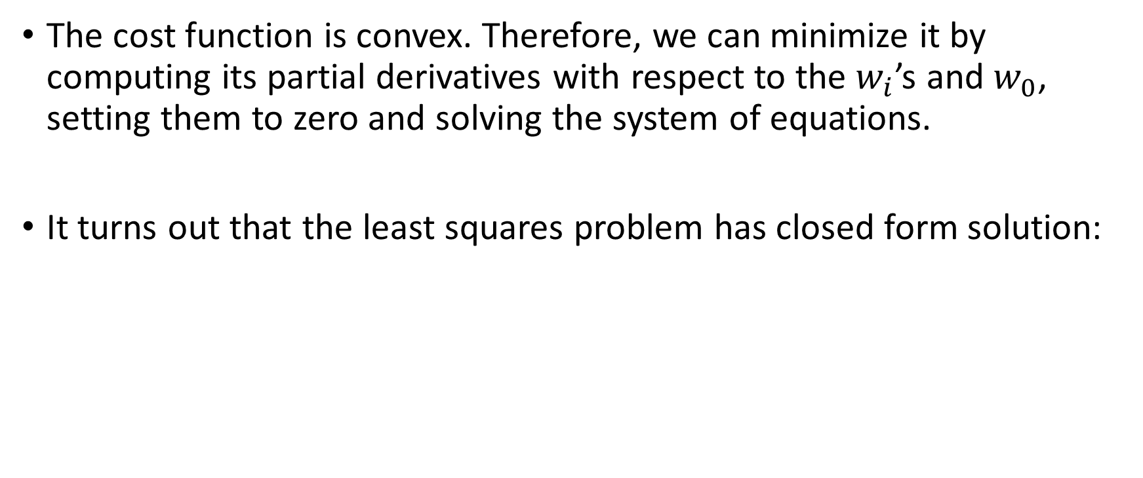
Solution to the Least-Squares Problems
The cost function is convex. Therefore, we can minimize it by computing its partial derivatives with respect to the $w_{i}$’s and $w_{0}$, setting them to zero and solving the system of equations.
It turns out that the least squares problem has closed form solution:

Slide 35


Solution to the Least-Squares Problems
It turns out that the least squares problem has closed form solution:
where X is:
$$\left[\begin{matrix}w_{0} \\ w_{1} \\ \begin{aligned}⋮ \\ w_{m}\end{aligned}\end{matrix}\right]={(X^{T}X)}^{−1}X^{T}y$$
$$X=\left[\begin{aligned}\begin{matrix}1 & { x}_{1}^{\left(1\right)} & { x}_{2}^{\left(1\right)} & … & x_{m}^{\left(1\right)} \\ 1 & x_{1}^{\left(2\right)} & x_{2}^{\left(2\right)} & … & x_{m}^{\left(2\right)} \\ 1 & ⋮ & ⋮ & ⋱ & ⋮ \\ 1 & x_{1}^{\left(n\right)} & x_{2}^{\left(n\right)} & … & x_{m}^{\left(n\right)}\end{matrix} \\ \end{aligned}\right]$$
Feature
Matrix
Label Vector

Slide 36


Solution to the Least-Squares Problems
It turns out that the least squares problem has closed form solution:
$$\underset{≜ w}{\underbrace{\left[\begin{matrix}w_{0} \\ w_{1} \\ \begin{aligned}⋮ \\ w_{m}\end{aligned}\end{matrix}\right]}}={(X^{T}X)}^{−1}X^{T}y$$
Note - Finding w that minimizes the MSE is equivalent to finding w such that:
$$X^{T}X w= X^{T}y$$
This form is known as the normal equations! And it is obtained from setting the partial derivatives to 0 (using vector notations).
If X has independent columns, then $X^{T}X$is non-singular.
Feature
Matrix
Label Vector

Slide 37
Solution to the Least-Squares Problems
It turns out that the least squares problem has closed form solution:
$$\left[\begin{matrix}w_{0} \\ w_{1} \\ \begin{aligned}⋮ \\ w_{m}\end{aligned}\end{matrix}\right]={(X^{T}X)}^{−1}X^{T}y$$
How is it implemented?
Matrix inversion is never computed explicitly because it is too costly to compute. Instead, we use tools from linear algebra (i.e., matrix decomposition such as SVD) to find the coefficients or weights. Ref1, Ref2, Ref3
Feature
Matrix
Label Vector

Slide 38
Solution to the Least-Squares Problems
It turns out that the least squares problem has closed form solution:
$$\left[\begin{matrix}w_{0} \\ w_{1} \\ \begin{aligned}⋮ \\ w_{m}\end{aligned}\end{matrix}\right]={(X^{T}X)}^{−1}X^{T}y$$
How is it implemented?
Approach 2: When the number of features is high, we can use iterative methods.
Feature
Matrix
Label Vector

